Slide 1
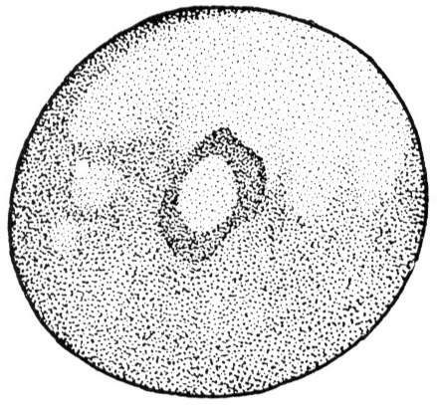
The Role of Desmoplakin During Epidermal Development
Author: Morgan Van Driest
Mentor: Dr. Amanda Dickinson
Notes:
Good morning, I am interested in the role of Desmoplakin During Epidermal development

Slide 2
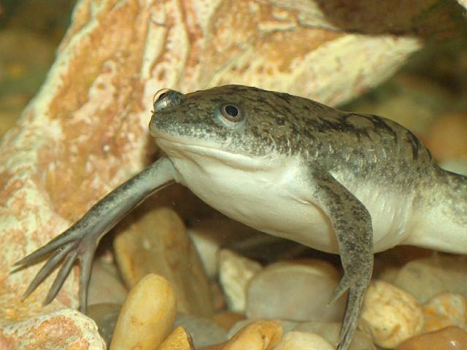
Experimental Goal
To determine how dysfunctional desmoplakin affects the developing epidermis, specifically in the organism Xenopus laevis.
Xenopus laevis (African clawed frog)
Notes:
I hope to investigate how the dysfunction of Desmoplakin affects the developing epidermis, specifically in the organism Xenopus laevis (also known as the African Clawed frog). Hopefully this will make more sense in a bit.

Slide 3
Project Overview
Background and Significance
Experiment
Expected Outcome
Discussion
Notes:
So why is what I hope to investigate important? What is my experiment? What do I expect to happen? Let’s talk about it.

Slide 4
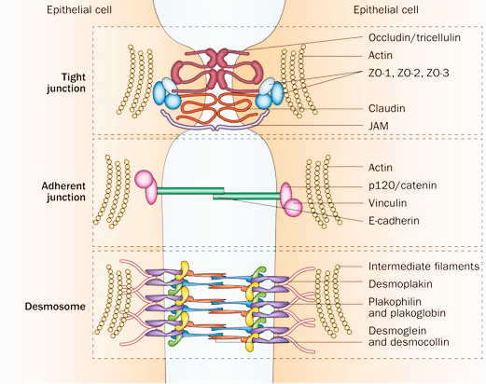
Introduction: What is a desmosome?
A type of cell junction
Involved in maintaining cell adhesion
Loss of function results in disease
Image by: http://www.nature.com/nrgastro/journal/v10/n2/fig_tab/nrgastro.2012.221_F1.html
Notes:
The desmosome is one of three cell junctions found in the skin. These three junctions (reference picture, tight junctions, adherin junctions and the desmosome) work together to maintain cell adhesion, specifically in the epithelial cells of the epidermis. The desmosome contains the structural proteins Desmoplakin, plakophilin, plakoglobin, desmoglein and desmocollin. This investigation focuses on desmoplakin in particular, I will go into further detail shortly. However, loss of function of the desmosome and its structural components often leads to disease.

Slide 5
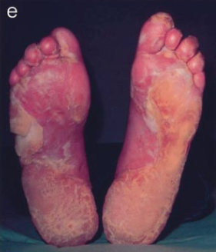
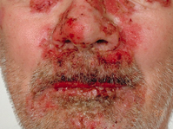
Significance: Skin Diseases associated with the desmosome
Causes: Failure in cell adhesion
Molecular defect: dysfunctional desmosomes
Palmoplantar keratoderma
Pemphigus vulgaris
Image by: Whittock et al (2002)
Image by: http://www.dermnetnz.org/immune/pemphigus-vulgaris.html
Notes:
Some of the associated diseases that have been related to failure of desmosome function include palmoplantar keratoderma (left), skin fragility such as blistering or skin lesions, and pemphigus vulgaris (right) Pemphigus vulgaris and palmoplantar keteroderma have specifically been linked to the malfunction of the desmoplakin protein that is in the desmosome. Many desmosome related diseases have been characterized, however, not much has been investigated regarding how loss of function of the desmosome and its protein components affects the embryo and the developing epidermis.

Slide 6
Experimental Hypothesis
Hypothesis: Desmoplakin is necessary for epidermal development
Image by: http://www.nature.com/nrgastro/journal/v10/n2/fig_tab/nrgastro.2012.221_F1.html
Notes:
I hypothesis that desmoplakin is necessary for epidermal development. I believe that without it functioning properly the epithelial cells that make up the epidermis will not properly differentiate.

Slide 7
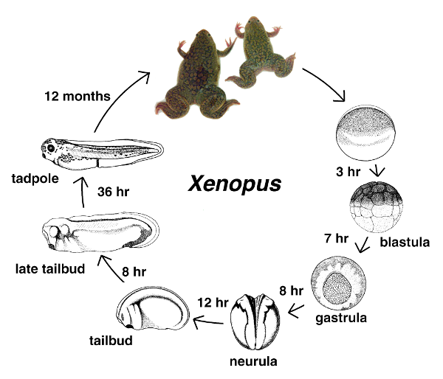
Why choose Xenopus?
Free living embryos
Development can be monitored at all stages
Epidermis is similar to the epidermis of mammalian embryos
Image by: Xenbase.org
Notes:
For my experiment, I chose to use the model organism Xenopus laevis (African clawed frog) for many reasons. The embryos of this organism are free living, meaning they are able to be grown outside of the mother. This is beneficial because the development of the embryos can be monitored every second if desired, as opposed to other organisms such as rats that are grown within the mother and are not as easily monitored during development. Also, the developing epidermis of the frog is very similar to the epidermis of mammalian embryos, therefore this study can be used to further enhance what we know about the desmosome in humans as well.

Slide 8
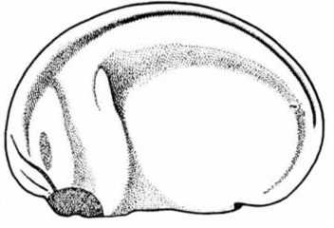
Experimental Design
Plakin
Rod
In vitro transcription
mRNA
Plakin
Rod
Microinject into embryo
Mutant construct
Look at epidermal cell types using EM
Embryo makes mutant protein
Formation of epidermis
Images by: Xenbase.org
Notes:
For my experiment I will be taking a mutant desmoplakin gene (the top references what its usual protein domains are and the bottom is the mutant construct that I will be using), the construct is missing this important tail domain (point). The mutant construct is not something that I will be making, instead it will be purchased and used as a biological tool. After the mutant construct has been obtained, I will allow for in vitro transcription for the purpose of making mRNA, this mRNA will then be injected into the embryo at the one cell stage. As the embryo develops it will being to make the mutant protein, the epidermis will form, and then I will be able to observe the result of this using electron microscopy.

Slide 9
Transmission Electron Microscopy
Electrons transmitted through specimen
Interactions of electrons within the specimen forms image
Two part fixation process
1. Glutaraldehyde
2. Osmium tetroxide
Plastic embedding
1. Dehydration of sample using ethanol
2. Embedded in epoxy resin
Notes:
The use of transmission electron microscopy is very beneficial in this investigation. It is able to provide us with a very detailed image of the developing epidermis. The microscope uses a beam of electrons and transmits them through the specimen. These electrons then interact with the specimen to form the image. There is a two part fixation process that must be done in order to get an image of the specimen. First the sample is fixed in glutaraldehyde, its purpose is to kill the cells of the specimen and crosslink its proteins. The second part is the use of osmium tetroxide, it acts as a staining agent and helps to provide contrast in the image. The sample is then dehydrated using a serious of ethanol washes and embedded in an epoxy resin. It is then sliced into thin sections, nanometers thick, and visualized under the microscope.

Slide 10
Visualization of Normal Cell Differentiation
Proper cell differentiation
Two cell types:
1. Secretory
2. Multiciliated
Goblet Cell
Desmosome
Multiciliated Cell
Characterization of normal cell differentiation in Xenopus laevis
Image by Navaneetha Krishnan Bharathan & Dickinson Lab, unpublished
Notes:
Typically under the electron microscopy we would expect to see two defining types of cell differentiation in the normal Xenopus epidermis, one being a goblet or secretory cell and the other being a multiciliated cell. The goblet cell provides secretions, such as mucus for the purpose of bacterial resistance. The ciliated cells create fluidity around the embryo and also serves as protection.

Slide 11
Experimental Expectations
Cell differentiation will not occur
Who am I??
Loss of function of desmosomes may cause failure in cell communication
Notes:
However, I don’t expect to see this when looking at the cells that have a loss of function of desmoplakin, ultimately affecting the desmosome. I think this may be the case because cell communication is very important during differentiation and without the desmosomes there may be a gap in the relay of information between cells, ultimately affecting their communication and specific differentiation signals.
As an alternative to this however, the cells may be able to properly differentiate due to not needing proper desmosome function during the early stages of development. It is possible that the desmosome could be more important during the later adult stages.

Slide 12
Discussion of Possible Results
Understanding cell differentiation may lead to understanding diseases associated with the desmosome
Useful for developing treatment and prevention
Notes:
From this, we hope that by understanding cell differentiation, we can begin to understand the diseases associated with lack of desmosome function. Ultimately this could leads us to developing prevention and treatment options for the diseases such a pemphigus vulgaris and palmoplantar kerotderma that I previously mentioned.

Slide 13
Questions?
Notes:
Thank you

