Slide 1
Vaginal TM7 and the absorption of amino acids
Patricia Turpin

Slide 2
Bacterial Vaginosis
Lindau, S., (2008), Vaginal Self-Swab Specimen Collection in a Home-Based Survey of Older Women: Methods and Applications. Journal of Gerontology, 106-118.
Gram stained vaginal smear with Bacterial Vaginosis
Datcu, R., (2014), Characterization of the vaginal microflora in health and disease, Danish Medical Journal.

Slide 3
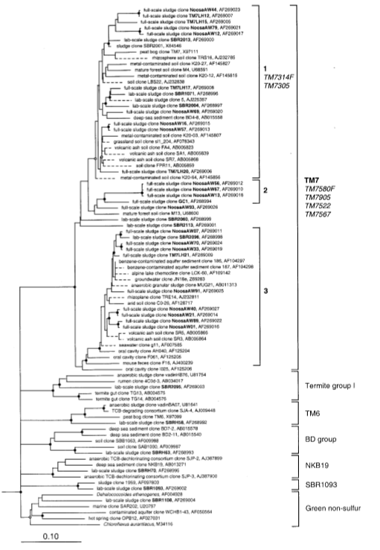
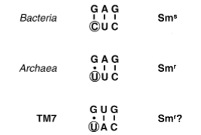

TM7
Hugenholtz, P., et al, (2000) Investigation of Candidate Division TM7, a Recently Recognized
Major Lineage of the Domain Bacteria with No Known Pure-Culture Representatives.
Applied and Environmental Microbiology, 67, 411-419.
May not be able to synthesize amino acids.

Slide 4
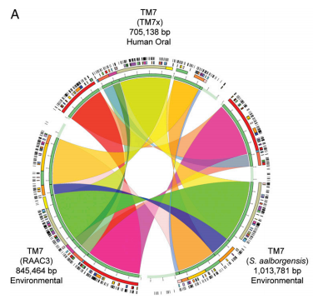
Oral TM7
Actinomyces odontolyticus
He, X., et al (2015) Cultivation of a human-associated TM7 phylotype reveals a reduced genome and epibiotic parasitic lifestyle. PNAS, 112, 244-249.

Slide 5
Question
The purpose of this experiment is to determine if Vaginal TM7 absorbs amino acids from the environment or from the host.

Slide 6
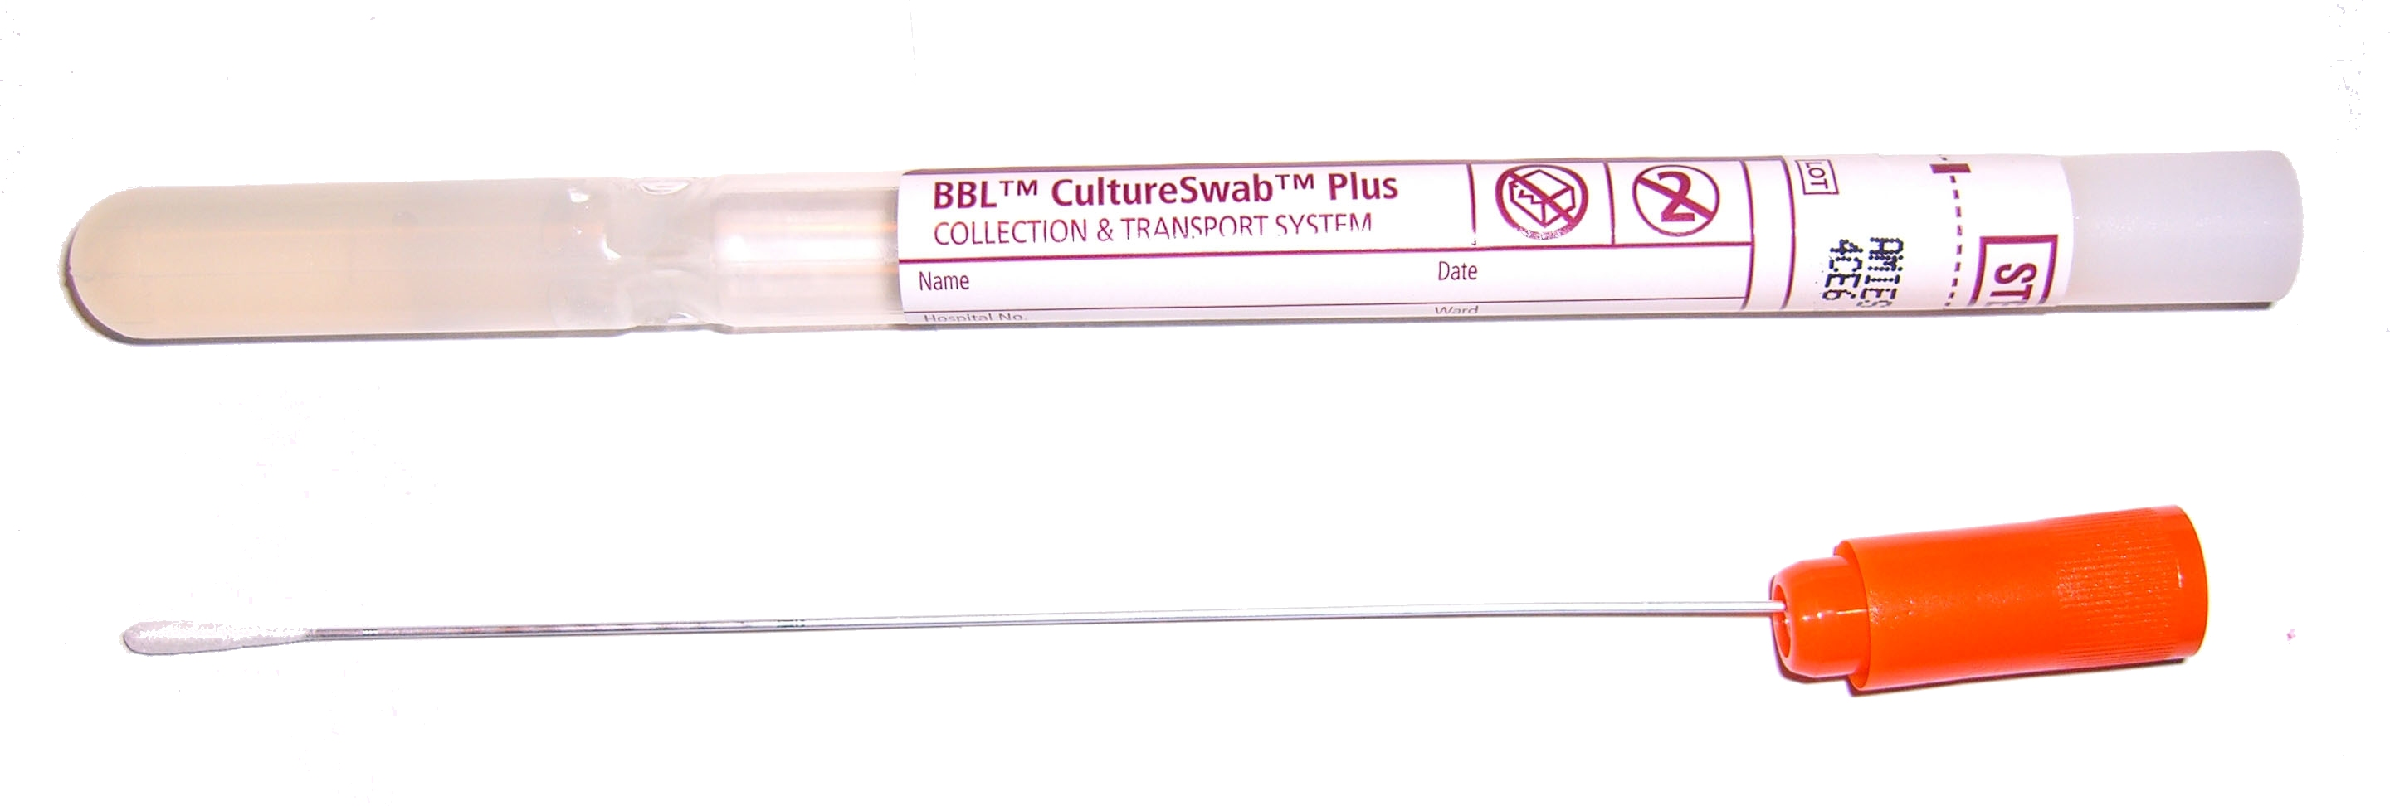

Sample Collection and Correlation
Actual vs. Expected
Higher the ratio, higher probability to be host.

Slide 7
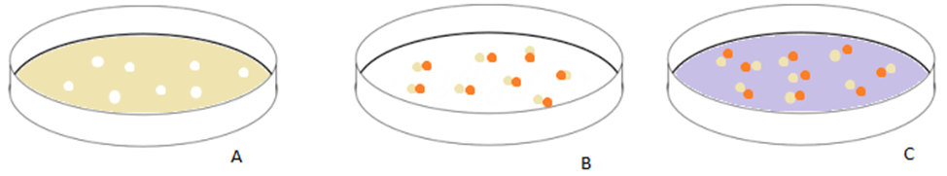
Growing samples
Host cell, determined in step 1, grown in a solution of 14C labeled amino acids.
14C labeled host cells with TM7 attached in a natural solution.
TM7 attached to host cells in a solution of 15N amino acids.

Slide 8
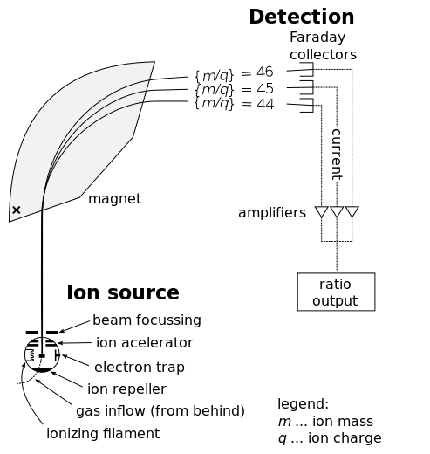
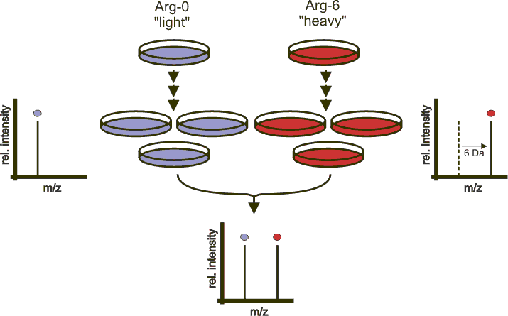
Testing

Slide 9
Questions or comments

