Slide 1
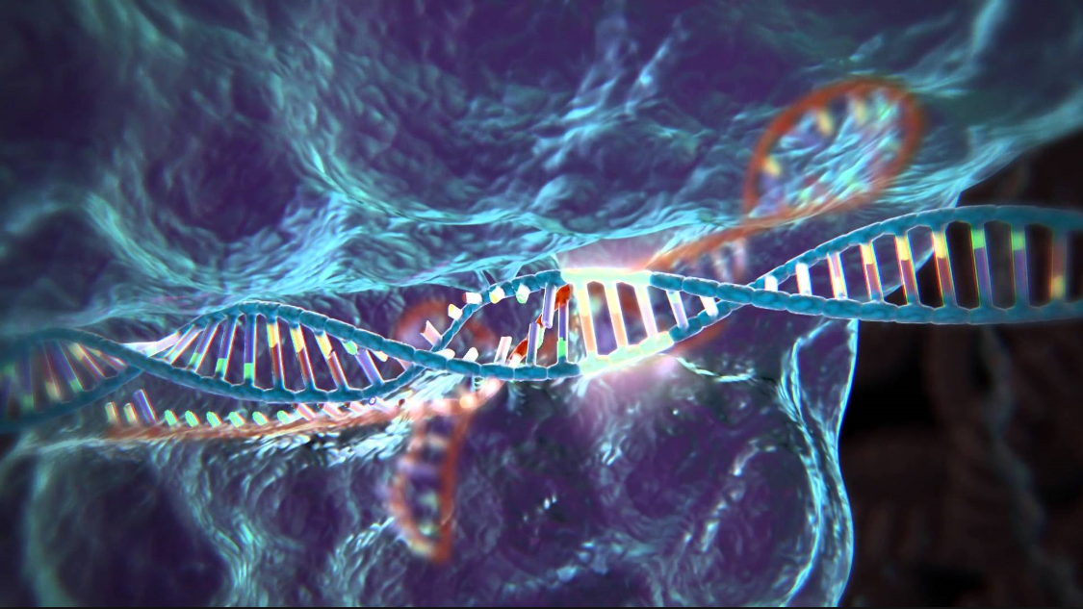
CRISPR/Cas9 as a tool for creation of p53 knock-outs in human glioma cells:
a research proposal by gus thomas

Slide 2
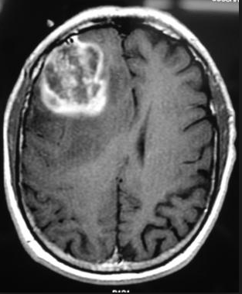
Overview and Introduction:
Glioblastoma Multiforme (GBM):
Aggressive brain cancer
Very poor prognosis
Often includes mutated/defective p53 gene

Slide 3
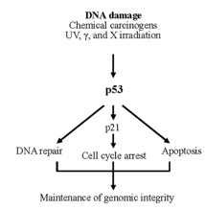
Overview and Introduction:
p53 Gene:
Protein product first step in a cascade of intracellular interactions
Mutant p53 promotes angiogenesis
p21 gene and associated protein prevents tumors

Slide 4
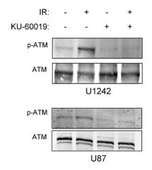
Biddlestone-Thorpe et al. (2013)
Human glioma cell - mp53 versus wtp53:
Gene regulating p53 repair (ATM) inhibited
Use of a kinase inhibitor on ATM
mp53 dominant to wtp53 – is mp53 responsible for sensitivity to radiosensitization?

Slide 5
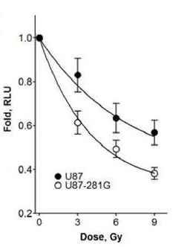
Biddlestone-Thorpe et al. (2013) + Objective

Slide 6
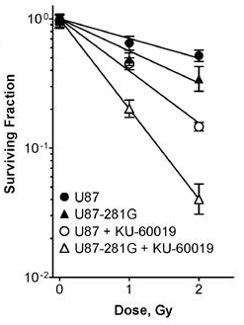
Objective:
Create knockout (KO) glioma cells
Confirm differences in ATM inhibitor radiosensitivity
Impact:
1/3 GBM →mp53
Healthy brain = wtp53
Confirm if mp53 increases sensitivity to radiosensitization

Slide 7
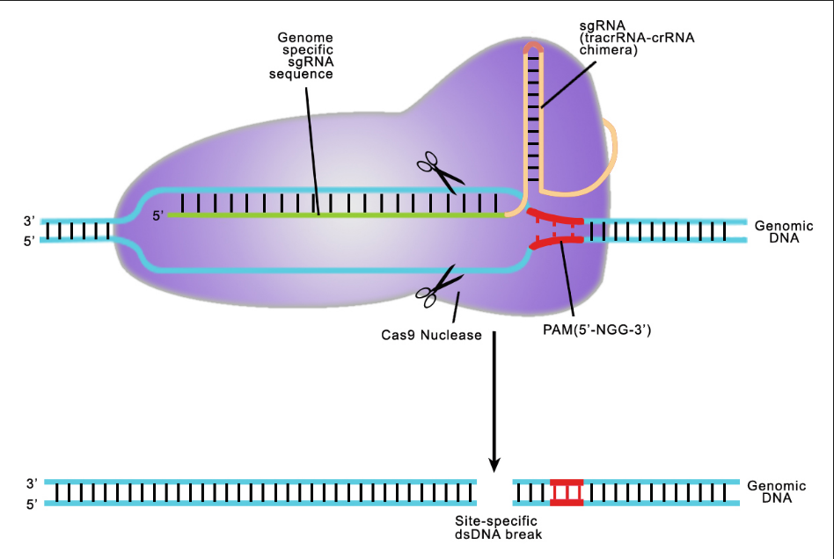
Overview of CRISPR/Cas9
gRNA + Cas9 protein = endonuclease with high specificity
Target determined by gRNA oligonucleotide sequence (20 bp)
Delivery of endonuclease to nucleus of target cell → DNA complement is excised → NHEJ → KO cell line created
Risks:
Off-target effects and/or failure

Slide 8
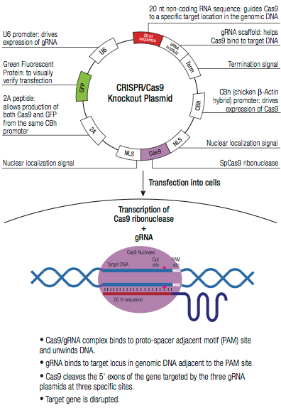
I will instead be using an empty gRNA cloning vector and a Cas9 expression plasmid whose products will be transcribed in vivo.

Slide 9
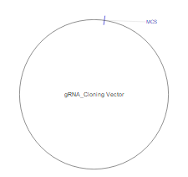
Cas9 Expression Plasmid + gRNA Cloning Plasmid:
Empty gRNA Cloning Vector:
Human-OptimizedCas9 Expression Plasmid:

Slide 10
Experiment: Vector Transfection Process
Lipofection transfection:
1): Cells dissociated & plated
2): Lipofectectamine + growth medium added
3): Varying amounts of plasmids added

Slide 11
Experiment: Determination of Off-Target Effects:
All cell lines incubated
VD PCR – amplifies p53
5’ – CCCATCTACAGTCCCCCTTG – 3’ (Primer Sequence)
Products cloned into vector system
Sequenced by T7 primer

Slide 12
Experiment: Determination of Off-Target Effects:
Western Blot + Radiosensitization
Repeat procedure from Thorpe experiment
Bradford Assay
SDS-PAGE
Different electrophoretic mobility reveals phenotypic off-target effects

Slide 13
Expected Results:
Hoping for >1 case with full knockout, few off-target effects
Radiosensitization sensitivity increased alongside mp53
Induce a specific p53 mutation in preparation for radiotherapy?

Slide 14
References:
Articles:
L. Biddlestone-Thorpe, M. Sajjad, E. Rosenberg, J.M. Beckta, N.C.K. Valerie, M. Tokarz, B.R. Adams, A.F. Wagner, A. Khalil, D. Gilfor, S.E. Golding, S. Deb, D.G. Temesi, A. Lau, M.J. O’Connor, K.S. Choe, L.F. Parada, S.K. Lim, N.D. Mukhopadhyay, and K. Valerie. ATM Kinase Inhibition Preferentially Sensitizes p53-Mutant Glioma to Ionizing Radiation. 2013. Clinical Cancer Research. 19(12): 3189-3200.
Zhen, S., Ling, H., Takahasi, Y., Narita, S., Yun-Hui, L., and Yan, L. 2014. In Vitro and in Vivo Growth Suppression of Human Papillomavirus 16-Positive Cervical Cancer Cells by CRISPR/Cas9. Biochemical and Biophysical Research Communications. 450(4): 1422-1426.
Golding S.E., E. Rosenberg, N., Valerie, I. Hussaini, M. Frigerio, X.F. Cockcroft, et al. 2009. Improved ATM kinase inhibitor KU-60019 radiosensitizes glioma cells, compromises insulin, AKT and ERK prosurvival signaling, and inhibits migration and invasion. Mol Cancer Therapy. 8:2894–902.
Doench, J.G., Hartentian, E., Graham, D.B., Tothova, Z., Hegde, M., Smith, I., Sullender, M., Ebert, B.L., Xavier, R.J., and Root, D.E. 2014. Rational Design of Highly Active gRNAs for CRISPR-Cas9-Mediated Gene Inactivation. 2014. Nature Biotechnology. 32(12): 1262-1267.
Drost, J., R.H.V. Jaarsveld, B. Ponsioen, C. Zimberlin, R.B. Boxtel, A. Buijs, M. Sachs, R.M. Overmeer, G.J. Offerhaus, H. Begthel, J. Korving, M.V.D. Wetering, G. Schwank, M. Logtenberg, E. Cuppin, H.J. Snippert, J.P. Medema, G.J.P.L. Kops, and J. Clevers. 2015. Sequential cancer mutations in cultured human intestinal stem cells. Nature. 521(7550): 43-47.

Slide 15
References:
Other Images:
https://www.google.com/search?q=crispr+cas9&source=lnms&tbm=isch&sa=X&ved=0ahUKEwj0jqu9o8HMAhXFVz4KHeD2DLYQ_AUICSgD&biw=1920&bih=1003#imgrc=czdWDDU_aEl5TM%3A
http://emedicine.medscape.com/article/1156220-overview
CRISPR/Cas9 Guide: addgene – the nonprofit plasmid repository. (https://www.addgene.org/crispr/guide/; Accessed April 2016).
https://www.google.com/search?q=CRISPR+p53+KO&espv=2&source=lnms&tbm=isch&sa=X&ved=0ahUKEwi6rMvEi9XMAhUKXR4KHWWZCwEQ_AUICCgC&biw=1920&bih=1017#imgrc=_
L. Biddlestone-Thorpe, M. Sajjad, E. Rosenberg, J.M. Beckta, N.C.K. Valerie, M. Tokarz, B.R. Adams, A.F. Wagner, A. Khalil, D. Gilfor, S.E. Golding, S. Deb, D.G. Temesi, A. Lau, M.J. O’Connor, K.S. Choe, L.F. Parada, S.K. Lim, N.D. Mukhopadhyay, and K. Valerie. ATM Kinase Inhibition Preferentially Sensitizes p53-Mutant Glioma to Ionizing Radiation. 2013. Clinical Cancer Research. 19(12): 3189-3200.

