Slide 1
Measurement of the expression of the ALOX15 gene in wounds undergoing negative pressure wound therapy
Nate Stearrett

Slide 2
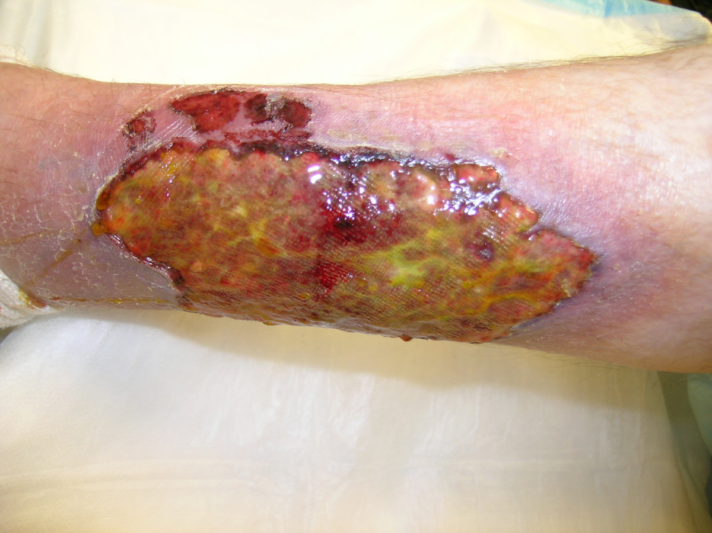
Chronic Wounds
Effect 6.5 million people in the US
Cost over $25 billion annually to treat
Increasing as diabetes and obesity increase
Many are stuck in inflammation

Slide 3
Problems With Inflammation
Excessive neutrophil build up
Neutrophils can prolong inflammation by releasing inflammatory cytokines
Can damage surrounding tissue by releasing oxidative products

Slide 4
Lipoxin Role in Resolution
Polymorphonuclear leukocytes
Inflammation
How to stop?

Slide 5
Lipoxin Role in Resolution
Polymorphonuclear leukocytes
Arachidonic acid (C_{20:4} fatty acid)
Inflammation

Slide 6
Lipoxin Role in Resolution
Polymorphonuclear leukocytes
Arachidonic acid (C_{20:4} fatty acid)
15-Lipoxygenase
Inflammation

Slide 7
Lipoxin Role in Resolution
Polymorphonuclear leukocytes
Arachidonic acid (C_{20:4} fatty acid)
15-Lipoxygenase
Inflammation
Lipoxin

Slide 8
Lipoxin Role in Resolution
Polymorphonuclear leukocytes
Arachidonic acid (C_{20:4} fatty acid)
15-Lipoxygenase
apoptosis
Inflammation
Lipoxin

Slide 9
Lipoxin Role in Resolution
Polymorphonuclear leukocytes
Arachidonic acid (C_{20:4} fatty acid)
15-Lipoxygenase
apoptosis
Inflammation
Lipoxin

Slide 10
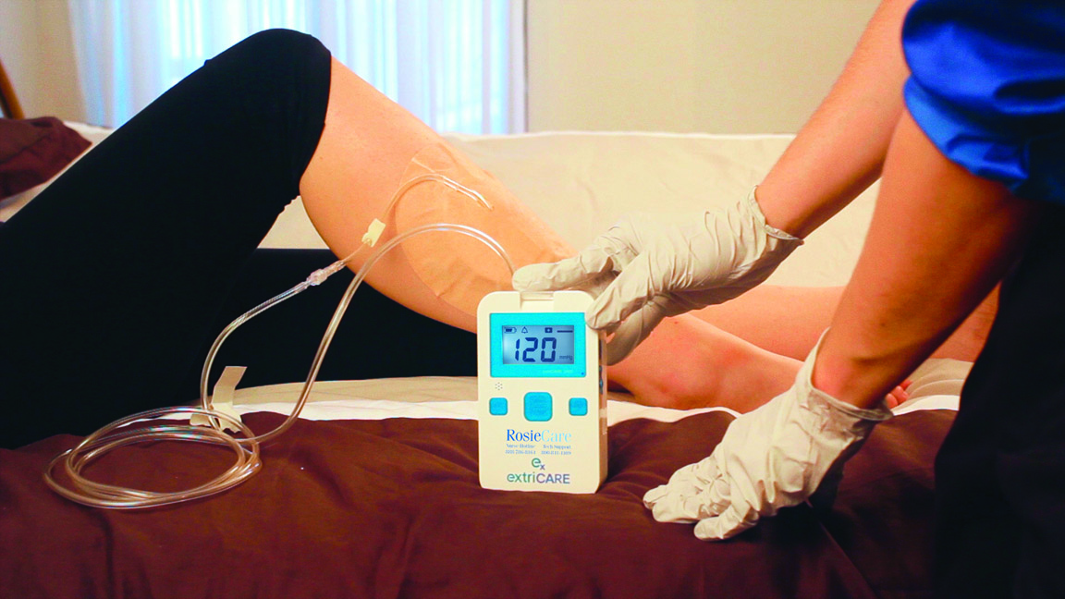
Negative Pressure Wound Therapy
Increases incidence of wound closure and reduces time needed for wound to close
Reduces bacterial load
Sucks away excess wound fluids
Molecular mechanism?

Slide 11
NPWT Effect on Gene Expression
Downregulates expression of MMPs
Upregulates expression of a variety of genes helpful to wound healing

Slide 12
Hypothesis
The purpose of this experiment is to discover whether NPWT effects the gene expression of ALOX15, whose protein product controls biosynthesis of the lipoxins directly involved in wound resolution.

Slide 13
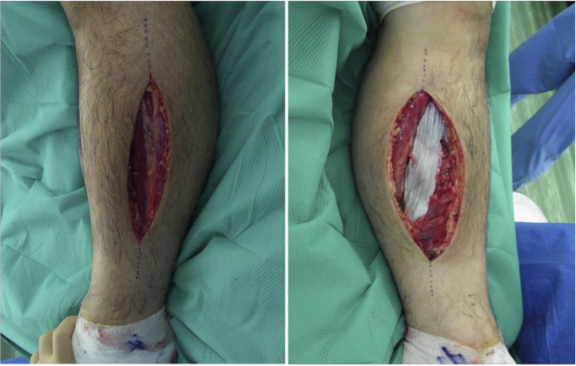
Sampling

Slide 14
qPCR
Reverse transcribe mRNA to cDNA
Amplify cDNA exponentially with dsDNA indicator
Compare starting transcript amounts by comparing how many cycles it takes for fluorescence to reach certain point

Slide 15
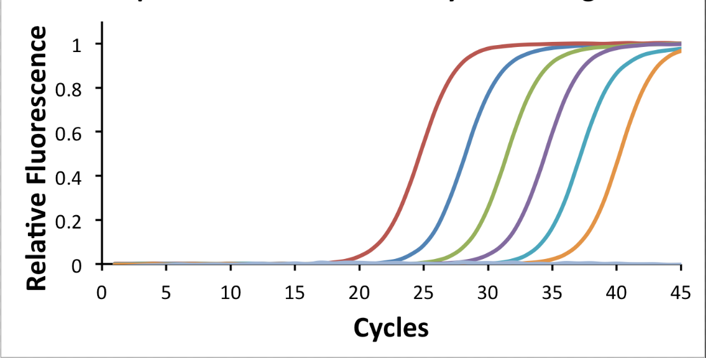
Quantifying Gene Expression

Slide 16
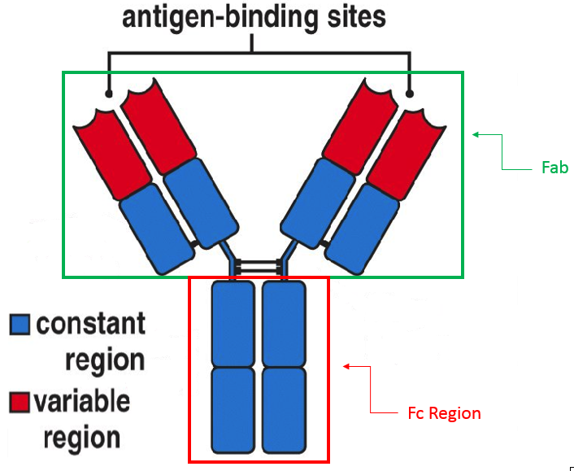
Antibody Structure
Fab regions bind antigen
Fc region is constant for whole class of antibodies within species

Slide 17
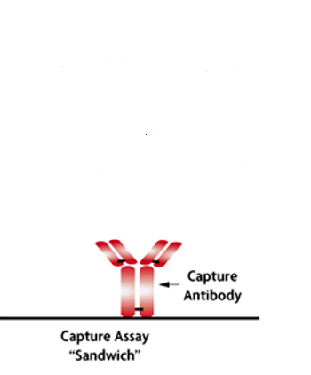
qPCR Amplifies Transcripts
15-LO

Slide 18
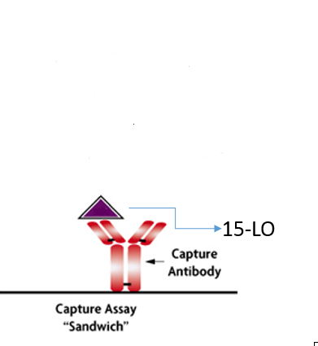
qPCR Amplifies Transcripts
15-LO

Slide 19
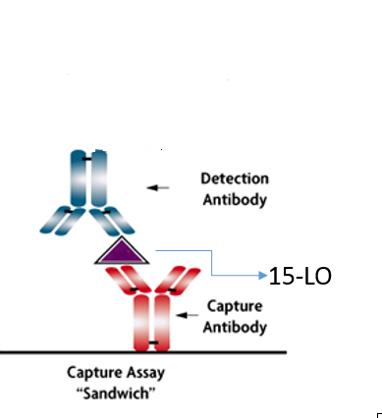
qPCR Amplifies Transcripts
15-LO

Slide 20
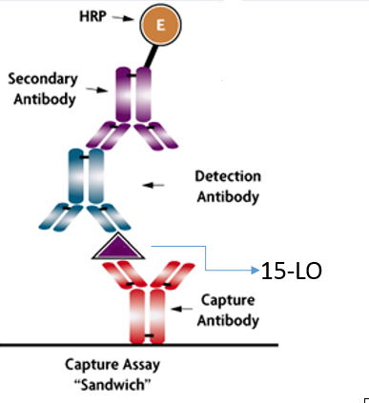
qPCR Amplifies Transcripts
15-LO

Slide 21
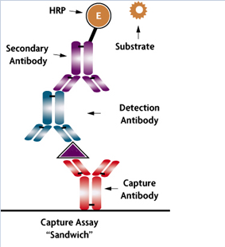
qPCR Amplifies Transcripts
15-LO

Slide 22
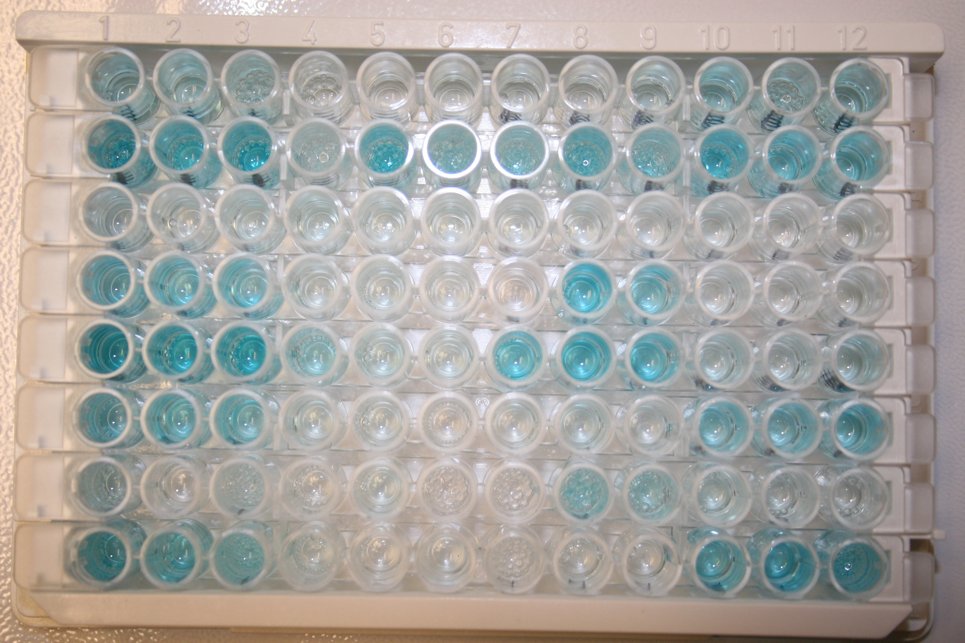
Color Change Indicates Presence

Slide 23
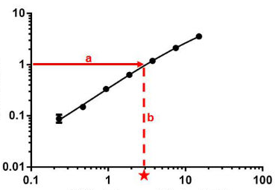
Quantifying Protein Levels
Obtain OD via spectrophotometry
Cross reference with chart to find out concentration
Optical Density (450nm)
Concentration (ng/mL)

Slide 24
Expected Results
If NPT does effect gene expression of ALOX15, there should be elevated mRNA transcript and protein levels observed.

Slide 25
Why We Care
The results will further explain why NPWT works on a molecular level, allowing us to better apply it.
Could supplement NPWT with aspirin to further enhance lipoxin biosynthesis

Slide 26
References
http://wjes.biomedcentral.com/articles/10.1186/1749-7922-2-10
Hsu, C. (2013). Negative pressure accelerated monolayer keratinocyte healing involves Cdc42 mediated cell podia formation. Journal of Dermatological Science, 70(3), 196-203.
Zenke, Inokuchi, Okada, Ooae, Matsui, & Sakai. (2014). Useful technique using negative pressure wound therapy on postoperative lower leg open wounds with compartment syndrome. Injury Extra, 45(9), 83-87.
http://www.mypols.de/qpcr-probe-2x-master-mix/
http://www.onegoodthingbyjillee.com/2016/03/home-remedies-to-heal-scars-naturally.html
http://www.bio-rad.com/en-us/product/cell-lysis-rt-qpcr-kits
http://vetsci.co.uk/2011/01/07/diagnostic-tests-used-for-viruses/
http://www.abcam.com/protocols/calculating-and-evaluating-elisa-data
Gilroy, D., Lawrence, T., Perretti, M., & Rossi, A. (2004). Inflammatory Resolution: New Opportunities for Drug Discovery.Nature Reviews: Drug Discovery, 3(5), 401-416.

