Slide 1
Measuring the Effect of Silencing the APP gene and Stimulating the CaMKII Pathway on Synaptic Plasticity in Alzheimer’s Disease
Harshita Nangunuri

Slide 2
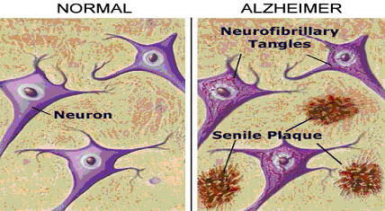
Alzheimer’s Disease
Hallmark Symptoms
Senile Plaques (SPs)
B-amyloid peptide
Neurofibrillary Tangles (NFTs)
Tau protein
http://www.spice-of-life.com/columns/thesis/Figure%2011%20-%20Neuronfibrillary.jpg

Slide 3
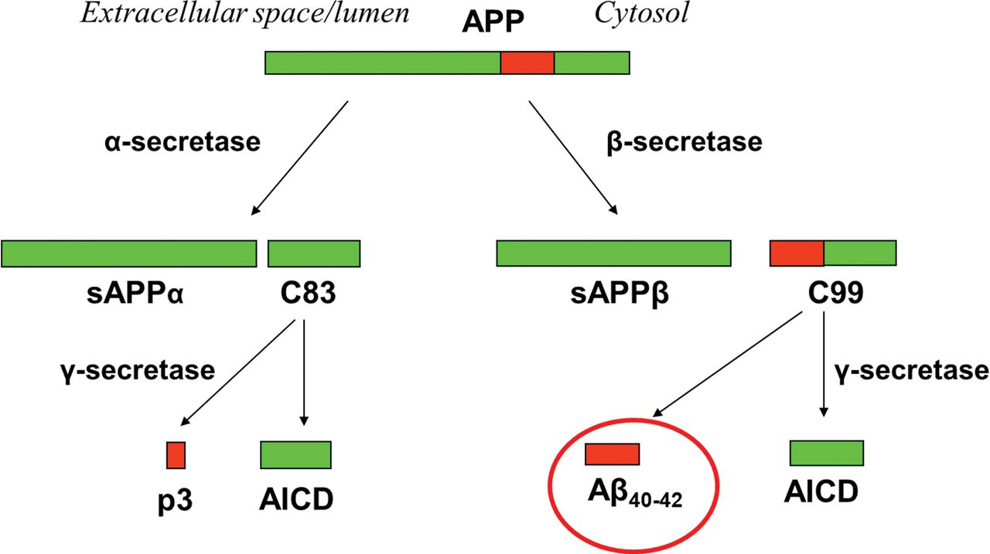
APP Gene
Amyloid precursor protein
B-amyloid peptide
Affects synaptic plasticity
Forms senile plaques (SPs) in AD patients

Slide 4
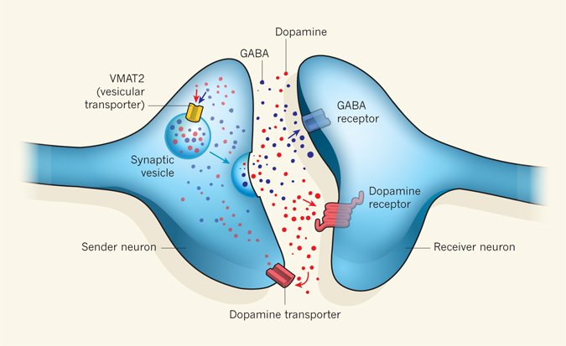
Previous Research
Problems with APP Gene Knockout

Slide 5
Central Question
The purpose of this experiment is to determine a method in which the ability of presynaptic neurons to secrete presynaptic vesicles containing neurotransmitters is not compromised when the APP gene is knocked out.

Slide 6
Method 1:
Increase intracellular Ca+
Method 2:
Lower threshold for vesicle release

Slide 7
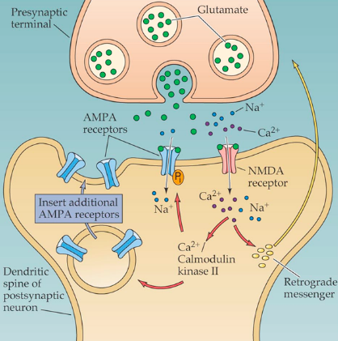
CaMKII Pathway
https://qph.is.quoracdn.net/main-qimg-12969c313f9ce29abe65a2f8241279a2?convert_to_webp=true
Notes:
One method to overcome this problem is by increasing the amount of intracellular Calcium in these cells
Ca+ increases the ability of presynaptic cells to release vesicles
Norepinephrine + a-adrenergic receptor

Slide 8
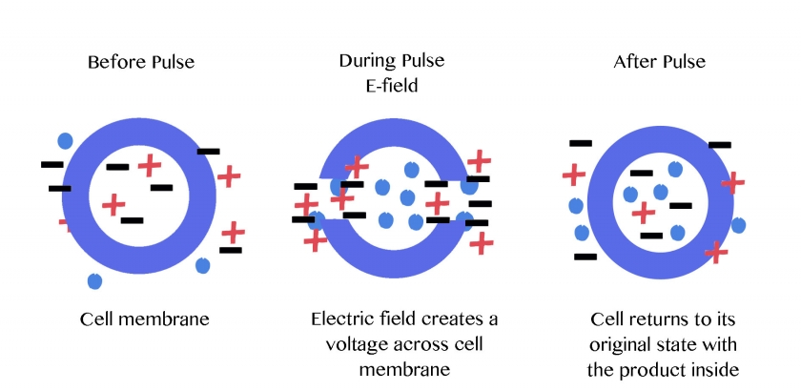
Experiment
Normal hippocampal cell
Trituration
Seibenhener et al. (2012)
Electroporation
Morgan et al. (1995)

Slide 9
Experiment
3 Groups
siRNA
Control group
(APP Gene Active, No NMDA Present)
Positive Control
(APP Gene Silenced, Incubated with NMDA )
Negative Control
(APP Gene Silenced, No NMDA Present)

Slide 10
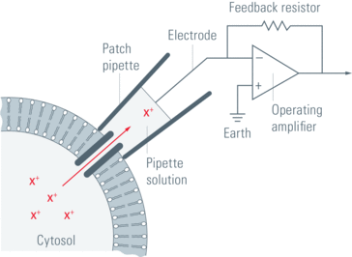
Experiment
Patch Clamp

Slide 11
Discussion
Ideal Results
Silent APP Gene
Improved synaptic activity

Slide 12
References
Liang et al. (2010). Neuronal gene expression in non-demented individuals with intermediate Alzheimer’s Disease neuropathology. Neurobiological Aging:549-566. (http://www.ncbi.nlm.nih.gov/pubmed/18572275)
Latest Alzheimer's Facts and Figures. (2016). Retrieved May 07, 2016, from http://www.alz.org/facts/
Perez M, Cuadros R, Benitez M, Jimenez J (2004). Interaction of Alzheimer’s disease amyloid β peptide fragment 25–35 with tau protein, and with a tau peptide containing the microtubule binding domain. Journal of Alzheimer’s Disease 6:461-467. (http://content.iospress.com/download/journal-of-alzheimers-disease/jad00350?id=journal-of-alzheimers-disease%2Fjad00350)
Mandal, A. (2014, October 20). What are Tau Proteins? Retrieved May 07, 2016, from http://www.news-medical.net/life-sciences/What-are-Tau-Proteins.aspx
APP. (2016, April 26). Retrieved April 30, 2016, from https://ghr.nlm.nih.gov/gene/APP
Williams, J. T. (2012, October 11). Neuroscience: Promiscuous vesicles. Retrieved May 07, 2016, from http://www.nature.com/nature/journal/v490/n7419/fig_tab/490178a_F1.html
Laßek et al. (2014). Amyloid precursor protein knockout diminishes synaptic vesicle proteins at the presynaptic active zone in mouse brain. Current Alzheimer Research 10:971-980. (http://www.ncbi.nlm.nih.gov/pubmed/25387333)
Simons, T. J. (1988). Calcium and neuronal function. Neurosurgical Review, 11(3):119-129. (http://link.springer.com/article/10.1007/BF01794675)
Strack S, Choi S, Lovinger D, Colbran R (1997). Translocation of Autophosphorylated Calcium/Calmodulin-dependent Protein Kinase II to the Postsynaptic Density. The Journal of Biological Chemistry 272(21):13467-13470. (http://www.jbc.org/content/272/21/13467.full.pdf+html)
Seibenhener, M. L., & Wooten, M. W. (2012). Isolation and Culture of Hippocampal Neurons from Prenatal Mice. Journal of Visualized Experiments : JoVE 65:3634. (http://www.ncbi.nlm.nih.gov/pmc/articles/PMC3476399/)
Veitinger, S. (2011, November 09). The Patch-Clamp Technique. Retrieved May 07, 2016, from http://www.leica-microsystems.com/science-lab/the-patch-clamp-technique/
Zito K and Scheuss V (2009). NMDA Receptor Function and Physiological Modulation. Encyclopedia of Neuroscience:1157-1164. (http://brain.phgy.queensu.ca/pare/assets/Neurobiology2.pdf)
Purves, D., & Williams, S. M. (2001). Neuroscience. 2nd edition. Sinauer Associates. Retrieved April 30, 2016, from http://www.ncbi.nlm.nih.gov/books/NBK10802/
Morgan, W. F., & Day, J. P. (1995). The Introduction of Proteins into Mammalian Cells by Electroporation. Methods of Molecular Biology, 48:63-71 (http://link.springer.com/protocol/10.1385/0-89603-304-X:63)
Light Microscope vs Electron Microscope. (n.d.). Retrieved May 01, 2016, from http://www.ivyroses.com/Biology/Techniques/light-microscope-vs-electron-microscope.php

Slide 13
Questions?

