Slide 1
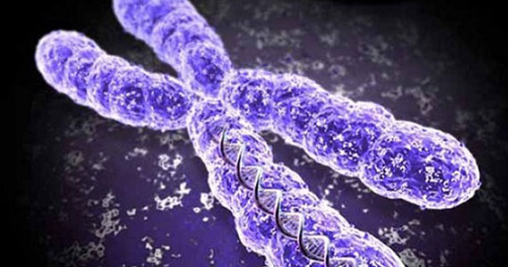
BPTF role in PI3K-AKT pathway in breast cancer
Michael Livingston

Slide 2
40,000 people per year

Slide 3
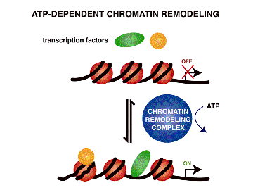
What is Cancer?
Normal cells acquiring tumor promoting traits
uncontrolled cell growth
avoiding detection by the immune system
overriding DNA damage checkpoints
Dysregulated Gene Expression
Nucleosome Remodeling complexes
ATP-dependent

Slide 4
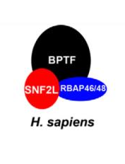
Nucleosome Remodeling Factor (NURF)
Largest subunit: Bromodomain PHD finger transcription factor (BPTF)
Functional role in tumor progression is incompletely understood
Notes:
Part of the ISWI family

Slide 5
PI3K-AKT Pathway
Regulates many normal cellular processes
proliferation, survival, and growth.
Processes that are critical for tumor growth

Slide 6
Experiment Overview
CRISPR/Cas9 knockout BPTF gene
Overexpress BPTF
Transfect cell lines
Western Blot
Will knockout of BPTF decrease expression of proteins related to PI3K-AKT pathway in breast cancer cell lines?

Slide 7
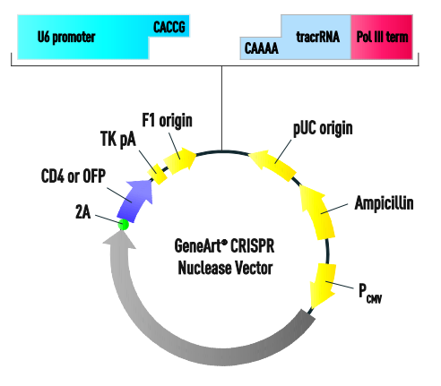
CRISPR/Cas9
Target sequence:
“AGAGGAGGACATGGTCTCCGAGG”
Used to knockout BPTF gene

Slide 8
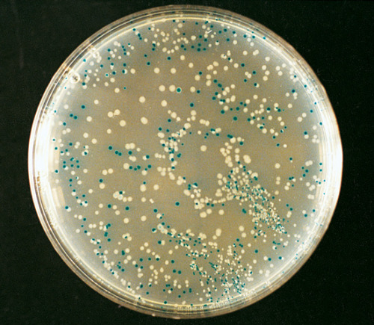
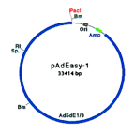
Generate recombinant adenoviruses via Co-transfection
Screen E.coli
-Recombinants are white
-Non-recombinants are blue
Co-Electroporate vectors into E.coli
Adenoviral backbone vector

Slide 9
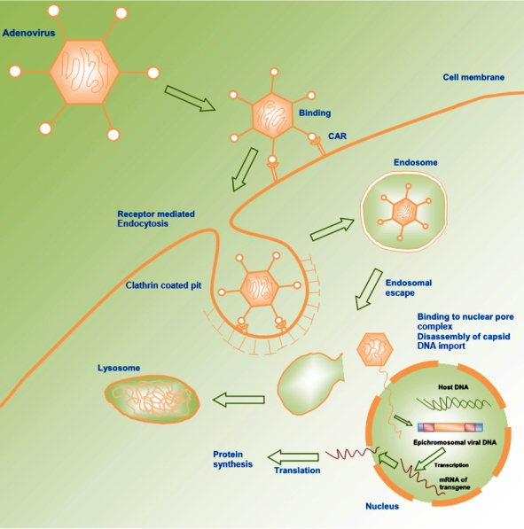
Transfect Cell Lines

Slide 10
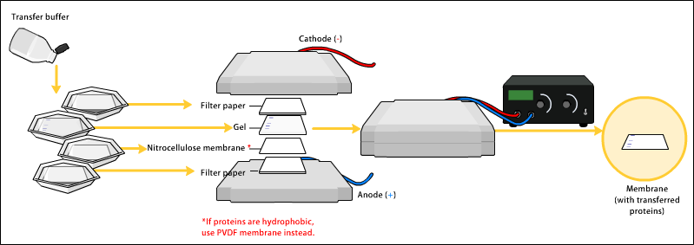
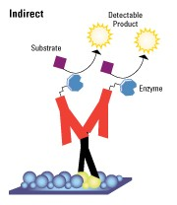
Western Blot
Secondary
Detection

Slide 11
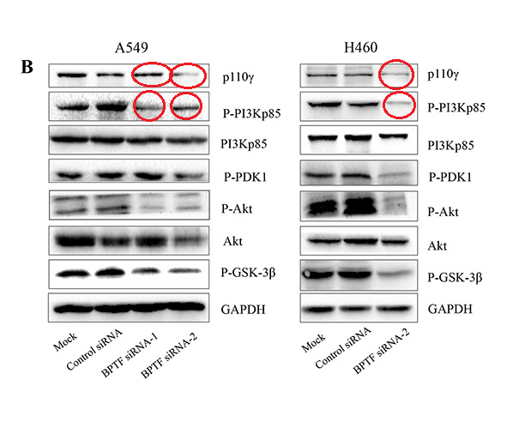
Previous Study’s Results
Dai et al (2015) examined the effects of BPTF on lung cancer cell lines
Reported that BPTF regulates PI3K-AKT signaling pathway in lung cancer (Fig).
Will knockout of BPTF decrease expression of proteins related to PI3K-AKT pathway in breast cancer cell lines?

Slide 12
Questions or Comments

Slide 13
References
Tessa G. Montague; Jose M. Cruz; James A. Gagnon; George M. Church; Eivind Valen. (2014). CHOPCHOP: a CRISPR/Cas9 and TALEN web tool for genome editing. Nucleic Acids Res. 42. W401-W407
"GeneArt CRISPR Products and Services." Thermo Fisher Scientific. N.p., n.d. Web. 30 Apr. 2016.
Luo, Ji, Brendan D. Manning, and Lewis C. Cantley. "Targeting the PI3K-Akt pathway in human cancer: rationale and promise." Cancer cell 4.4 (2003): 257-262.
Vos, Pieter, et al. "AFLP: a new technique for DNA fingerprinting." Nucleic acids research 23.21 (1995): 4407-4414.
Liu, B., Yip, R. K., & Zhou, Z. (2012). Chromatin Remodeling, DNA Damage Repair and Aging. Current Genomics, 13(7), 533–547. http://doi.org/10.2174/138920212803251373
Raab, J. R., Resnick, S., & Magnuson, T. (2015). Genome-Wide Transcriptional Regulation Mediated by Biochemically Distinct SWI/SNF Complexes. PLoS Genet, 11(12), e1005748.
-Kim, K. H., Kim, W., Howard, T. P., Vazquez, F., Tsherniak, A., Wu, J. N., ... & Orkin, S. H. (2015). SWI/SNF-mutant cancers depend on catalytic and non-catalytic activity of EZH2. Nature medicine, 21(12), 1491-1496.
https://upload.wikimedia.org/wikipedia/commons/3/3d/Gene_therapy.jpg

