Slide 1
Impact of raft association of NF155 on the inflammatory response of microglial cells

Slide 2
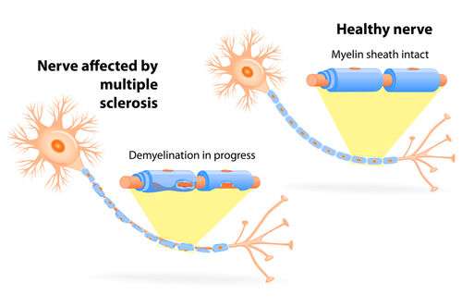
Multiple Sclerosis
Bionews Texas

Slide 3
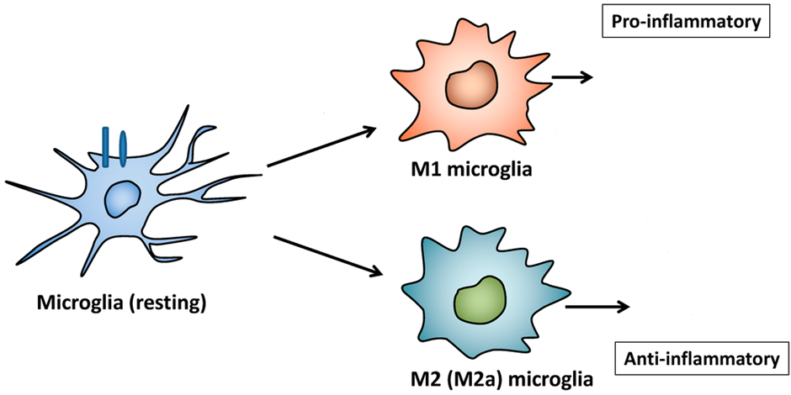
Microglial activation
Cytokine Release
Cytokine Release

Slide 4
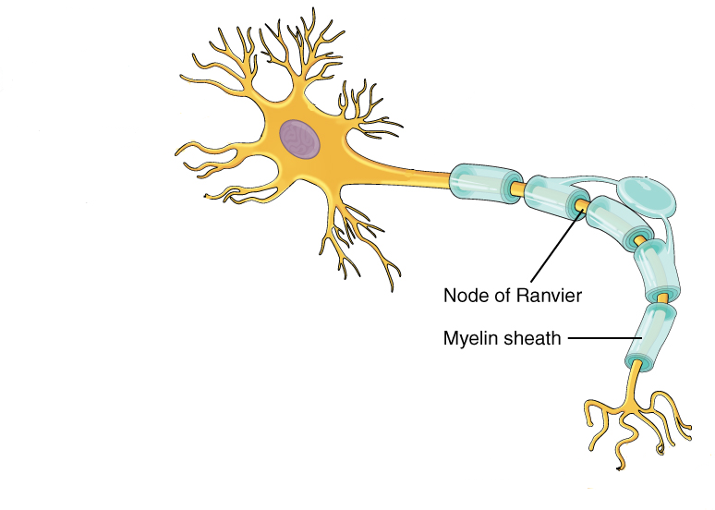
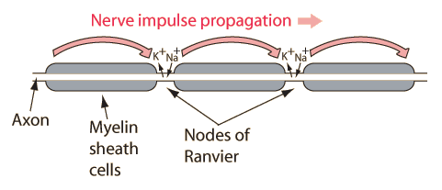
Myelin Improves Conduction
Hyperphysics.phy
Boundless.com

Slide 5
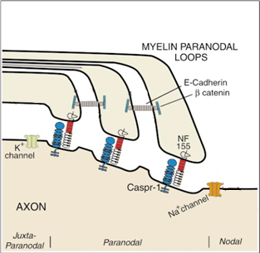
Myelin Paranodes
Paranode
Adapted from Trapp et al

Slide 6
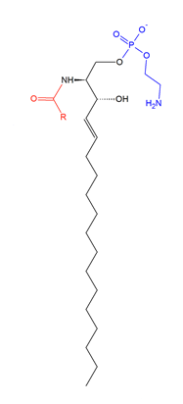
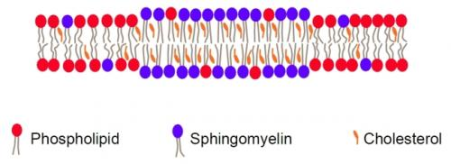
Lipid Rafts – Rich in Sphingolipids and Cholesterol
Acyl group
LIPID RAFT
A Sphingomyelin
Wikipedia

Slide 7
NF155 Raft association in MS
Maier et al 2007
non-MS

Slide 8
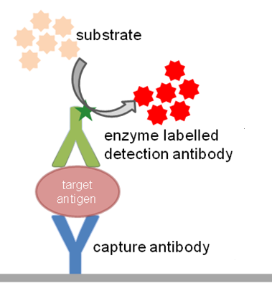
Experimental Overview
Myelin Isolation
Liposome Synthesis
Cell Culturing
ELISArray
Cell Proliferation Assay
Immunocytochemistry
BitesizedImmunology

Slide 9
Myelin Isolation with sucrose density gradient and fractioning
Adapted from knowledgeclass.blogspot.com

Slide 10
Liposome Synthesis
Adapted from Patil & Jadhav

Slide 11
Liposome Treatments
Control Protein non-raft liposomes
Control Protein raft liposomes
NF155 non-raft liposomes
NF155 raft liposomes

Slide 12
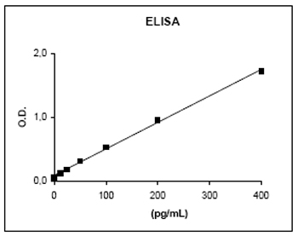
ELISA – quantifying cytokine release
Optical Density
Antigen Concentration
Leinco
Elisa-antibody.com

Slide 13
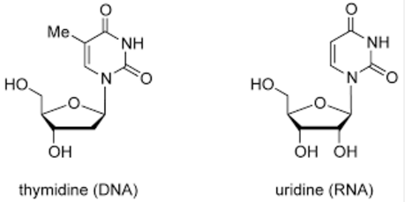
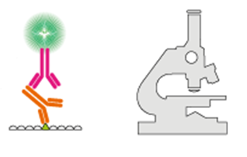
Cell proliferation Assay
Br
Enzyme Labelled 2° Antibody
Detection Antibody
Thymidine Bromodeoxyuridine
Bromodeoxyuridine
Adapted from atdbio

Slide 14
Measuring morphological Change
Enzyme Labelled 2° Antibody
ACTIVATION
Detection Antibody
IBA1
Adapted from Proteinatlas

Slide 15
Results
CYTOKINE RELEASE
CELL PROLIFERATION
AMOEBOID MORPHOLOGY

