Slide 1
“War is politics…” Carl von Clausewitz (1780-1831)
War in History

Slide 2
Why War?
Resources
Territory
Land
Access to the sea
Ethnicity
Religion
Ideology

Slide 3
Major War
Event | From | To | Low | High
Warring States Era, China | BC 475 | BC 221 | 10 m | 10 m
An Shi Rebellion, China | 756 | 763 | 36 m | 36 m
Mongol Conquests, Europe, Asia | 1207 | 1279 | 30 m | 60 m
Thirty Years War | 1618 | 1648 | 3 m | 11.5 m
Napoleonic Wars | 1804 | 1815 | 3.5 m | 16 m
Taiping Rebellion, China | 1851 | 1864 | 20 m | 50 m
US Civil War | 1861 | 1865 | 618,000 | 970,000
Russian Civil War | 1917 | 1921 | 5m | 9 m
WW I (high includes Spanish Flu) | 1914 | 1918 | 15 m | 66 m

Slide 4
More Major War
Chinese Civil War | 1945 | 1949 | 1.3 m | 6. 1 m
WW II | 1939 | 1945 | 60 m | 72 m
Viet Nam War | 1945 | 1975 | 2.5 m | 5 m
Korean War | 1950 | 1953 | 2.5 m | 3.5 m
Nigerian Civil War | 1967 | 1970 | 1 m | 1 m
Afghan Civil War | 1979 | Present | 1.5 m | 2.0 m
Iran-Iraq War | 1980 | 1988 | 1.0 m | 1.0 m
Congo Civil War | 1994 | 1997 | 800,000 | 800,000
Second Congo War | 1998 | 2003 | 3.8m | 13.8
Notes:
4

Slide 5
Causes of War and Peace
Human Nature
Balance of power
Power Transition/Long Cycle
Nuclear Revolution
Interdependence

Slide 6
1. Human Nature?
Thomas Hobbes 1588-1679
Conflict
Jean-Jacques Rousseau 1712-1788
Cooperation

Slide 7
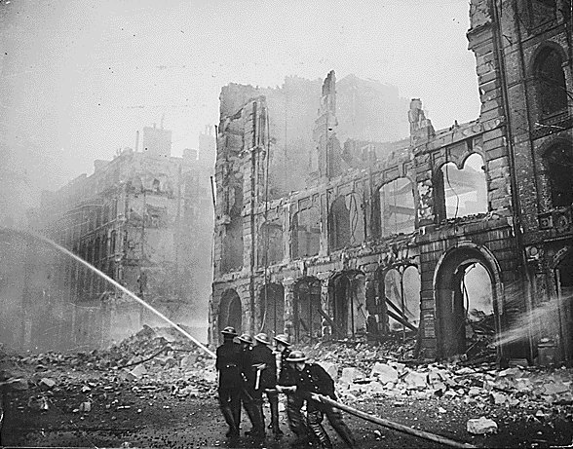
London 1940

Slide 8
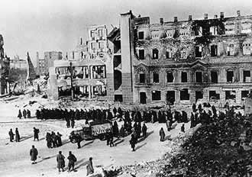
Stalingrad 1943

Slide 9
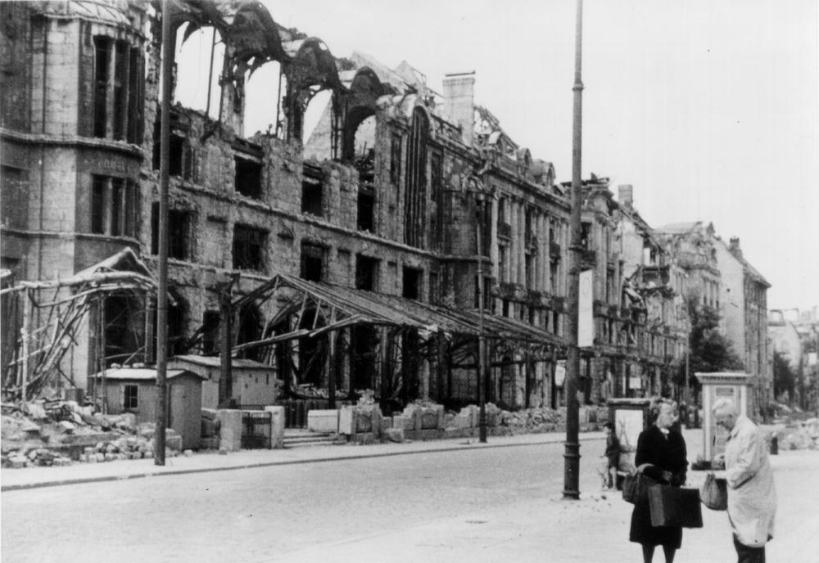
Berlin 1945

Slide 10
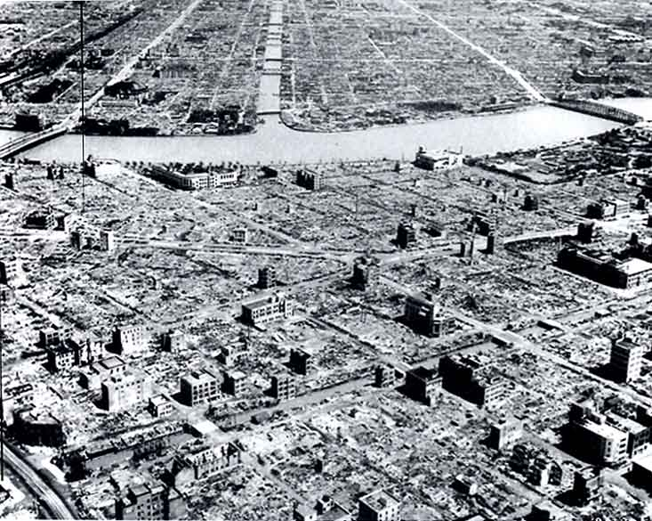
Tokyo 1945

Slide 11
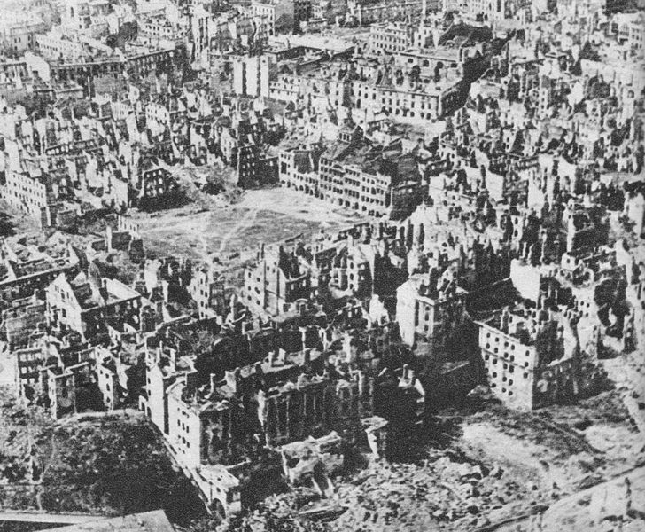
Warsaw 1945

Slide 12
Bergen-Belsen Concentration Camp (sign placed there after British liberation of the camp)

Slide 13
Hiroshima

Slide 14
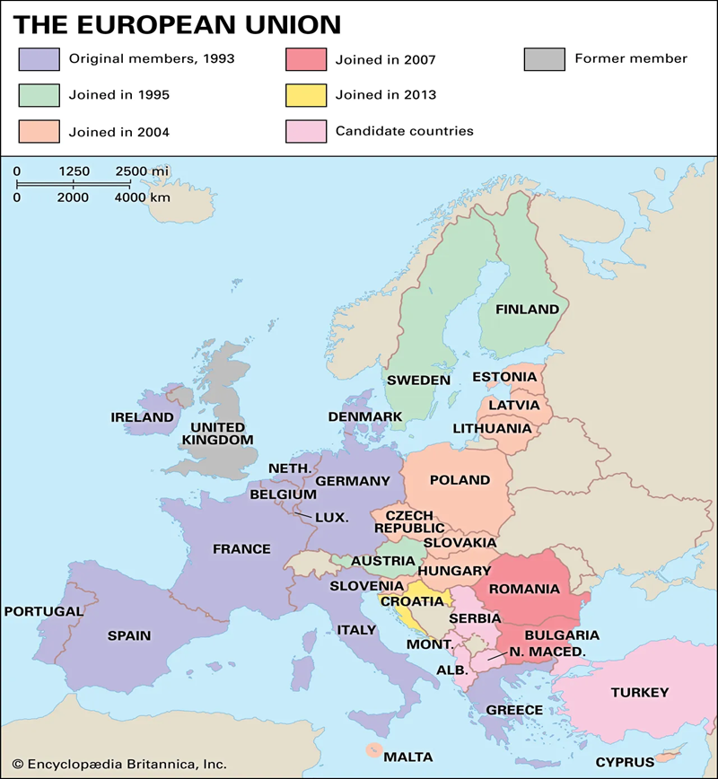
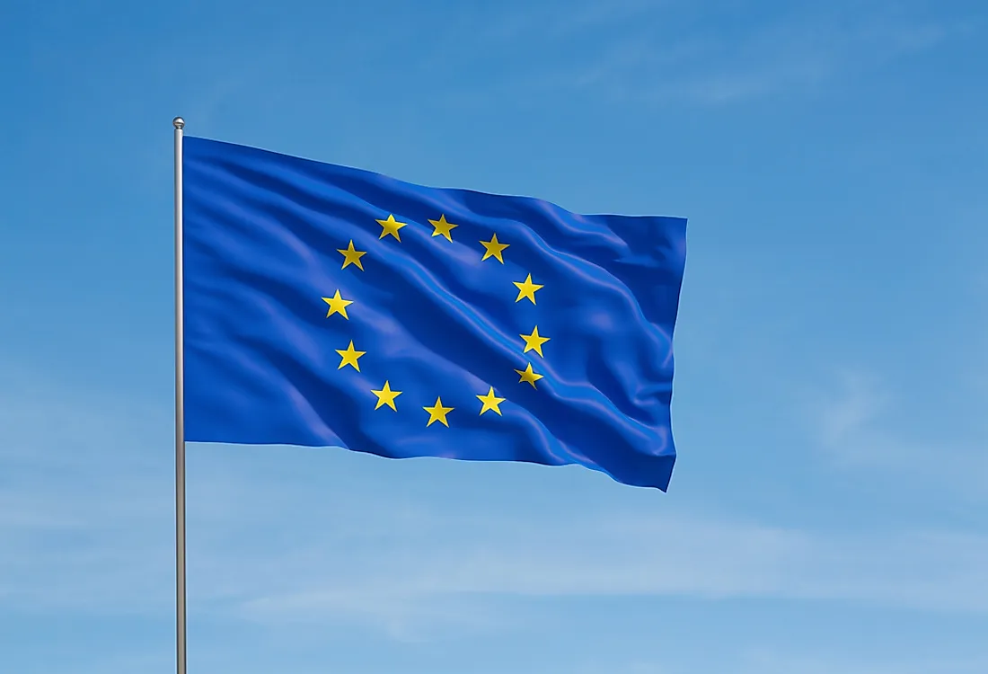
European Union
European Parliament
European Council
European Commission
Common Currency: Euro
European Central Bank
Court of Justice of EU

Slide 15
2. Balance of Power Concert of Europe 1815-1914
England
Russia Prussia/Germany
France Austria Hungary

Slide 16
Bipolarity The Cold War Balance of Power
Israel Syria/Egypt/PLO
Ethiopia Somalia
Taiwan China
S. Korea N. Korea
S. Viet Nam N. Viet Nam
W. Berlin E. Berlin
W. Germany E. Germany
Britain/France/Japan Poland/Czech
US USSR

Slide 17
Bipolarity After the Cold War Version One
India Russia
US China

Slide 18
Bipolarity After the Cold War Version Two
India
US China

Slide 19
China and East Asia
The Choice?
Balancing
Bandwagoning

Slide 20
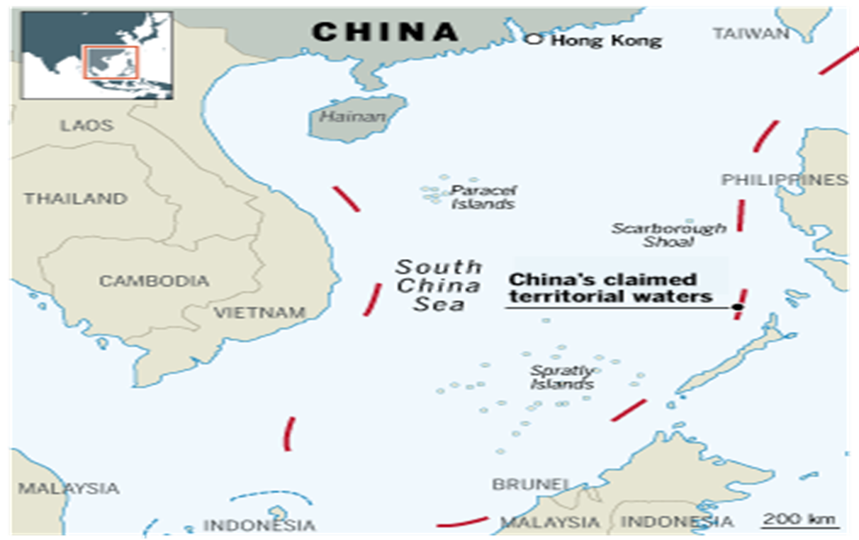
China’s Claims in the South China Sea
The “Nine-Dash Line”

Slide 21
3. Long Cycle Theory (Power Transition)
Hegemonic War
Winner becomes Hegemon
Hegemon rules system
Hegemon weakens
Challenger Rises
Notes:
21

Slide 22
Long Cycle Four: 1792-1914
Hegemonic England
Power
Dominance Decline
War WW I begins
1792-1815 1850 1914
Napoleonic Wars decline begins
Time
Notes:
22

Slide 23
Long Cycle Five: 1914-?
Hegemonic US
Power
Dominance Decline
War U.S. US v. China?
1914-1945 1973 decline 20??
begins
Time
Source for Cycles: George Modelski, Long Cycles in World Politics, Seattle, University of Washington Press, 1987.
Notes:
23

Slide 24
US Decline?
1970s?

Slide 25
US Economic Decline?

Slide 26
US Economic Decline?

Slide 27
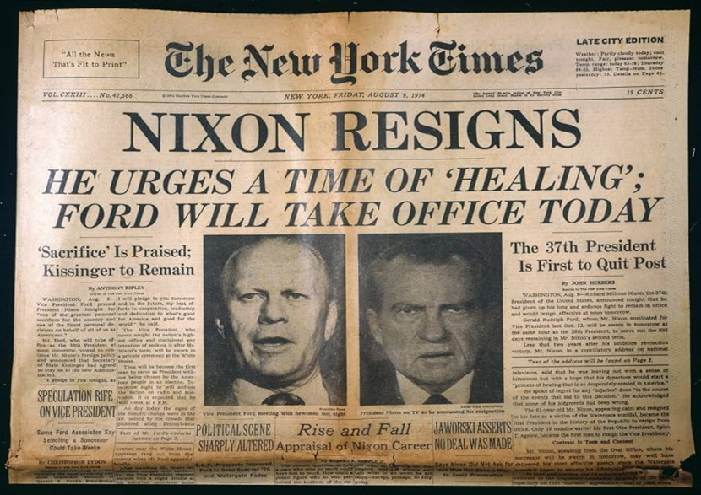
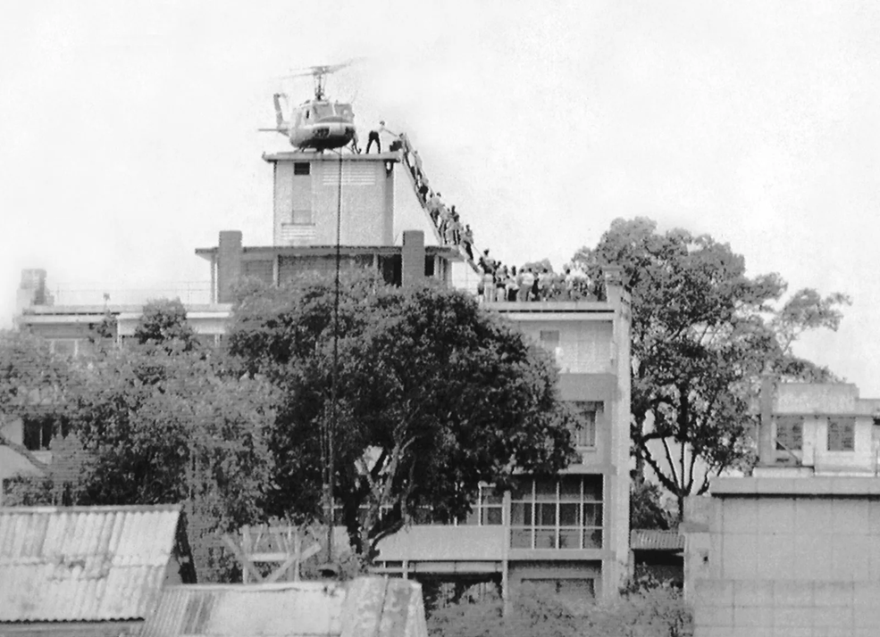
US Political and Foreign Policy Weakness?
President Nixon Resigns
8/9/1974
US Fails in Vietnam Evacuation
Saigon, 4/30/1975

Slide 28
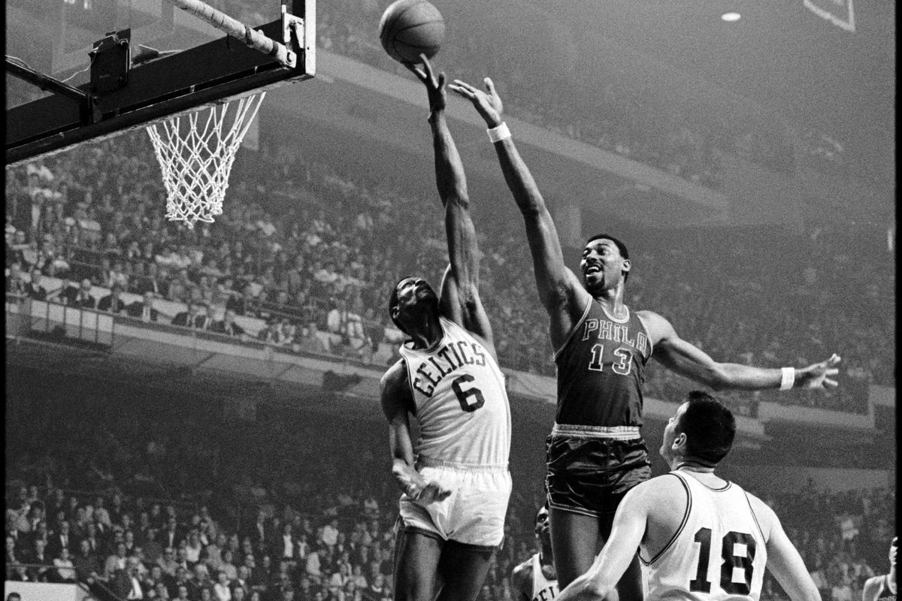
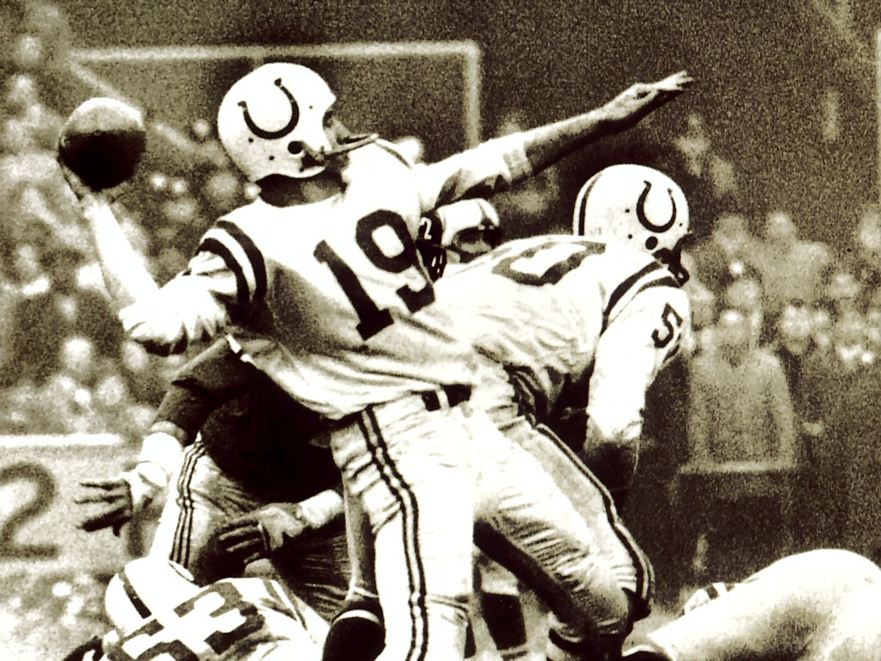
Legends Leave
Bill Russell Retires 1969
Wilt Chamberlain Retires 1973
Johnny Unitas Retires 1973

Slide 29
Super Bowl XI Raiders 32 Vikings 14 January 9, 1977

Slide 30
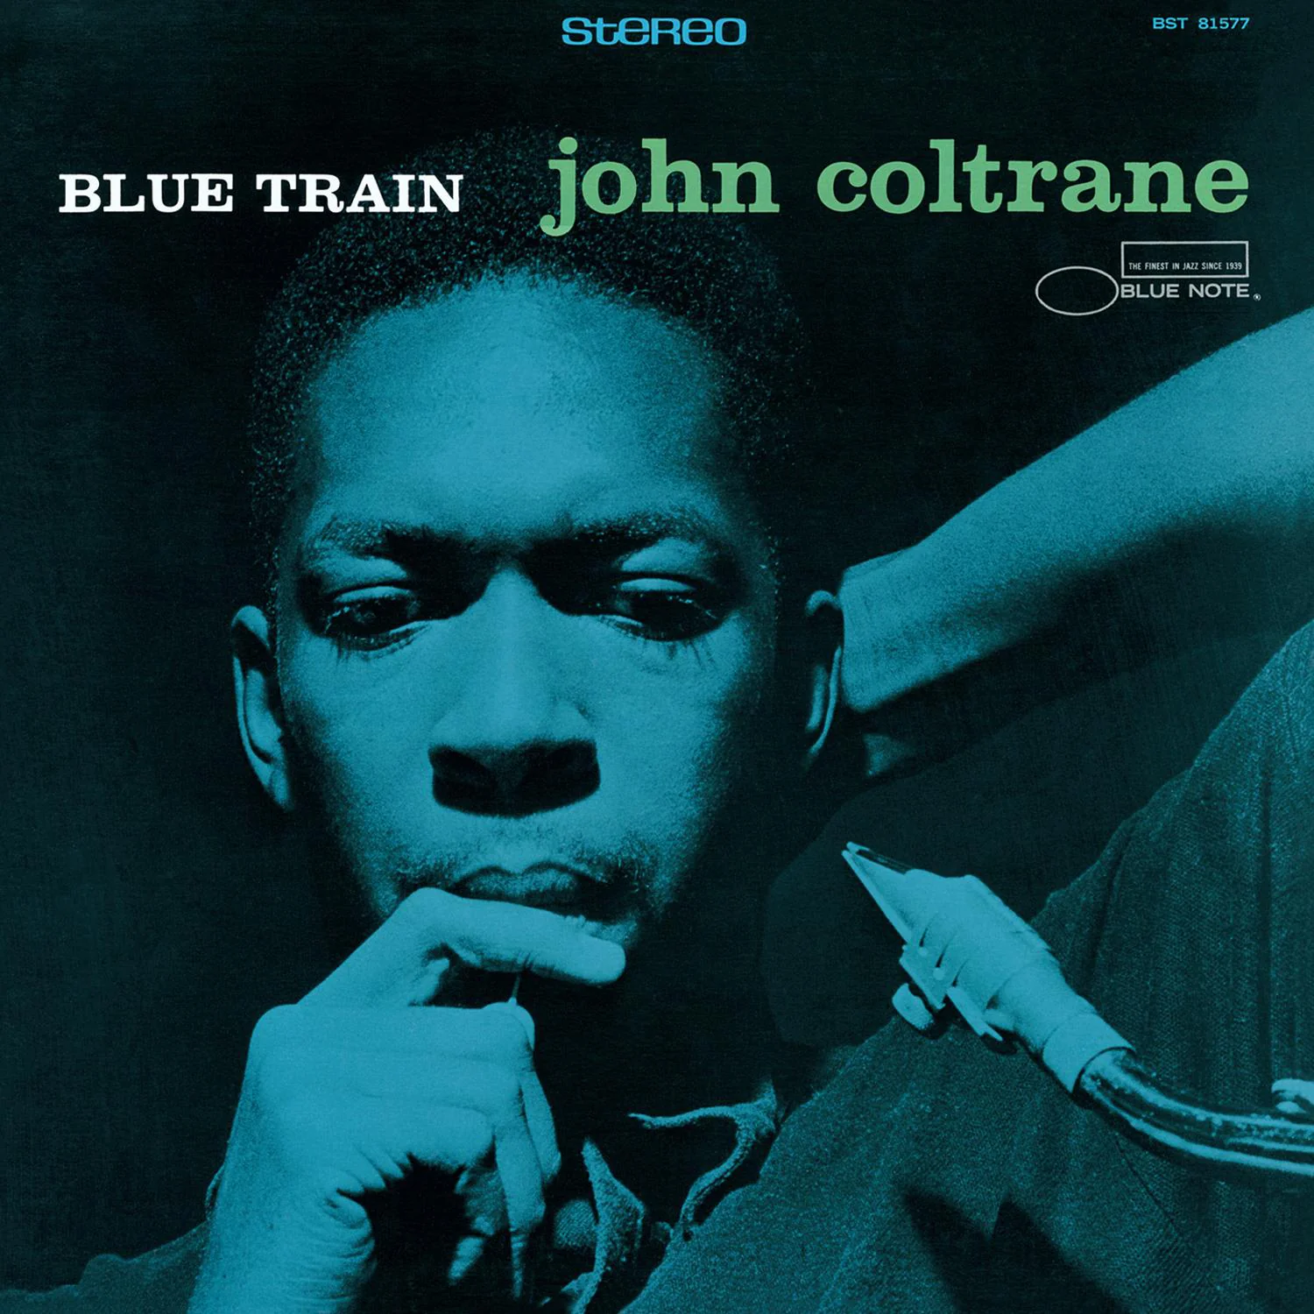
Cultural Decline
Disco!!! Blue Note Records
Label Discontinued 1979
Revived 1985

Slide 31
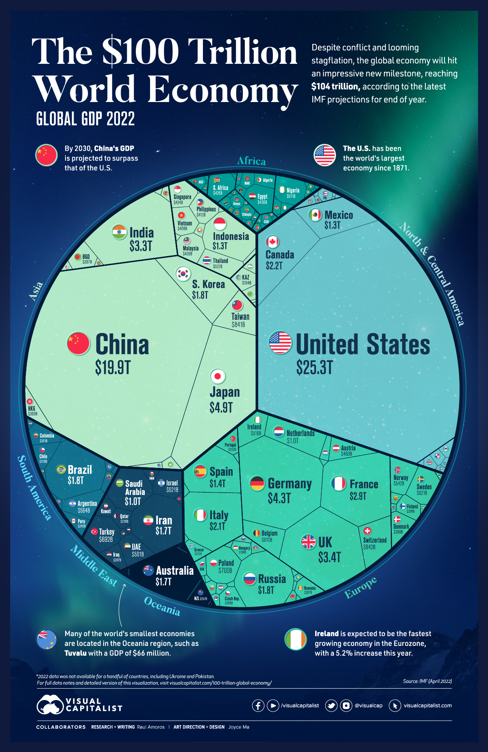
But US Recovered…
Soviet Union Collapsed 1989-1991
US Economy Still Booming
https://www.visualcapitalist.com/100-trillion-global-economy/

Slide 32
This is fun…

Slide 33
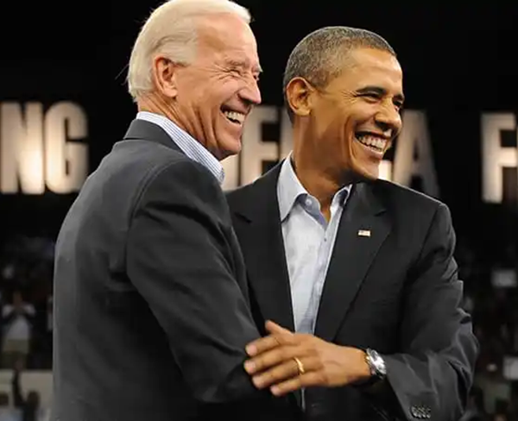
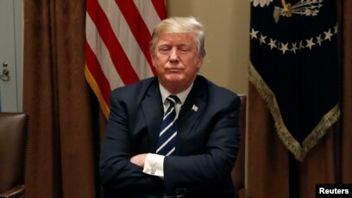
But does US want global leadership?
YES
NO
“Rules-based international order”
“In fact, I would encourage them (Russia) to do whatever the hell they want.” (to nations that don’t meet the 2% defense spending quota)

Slide 34
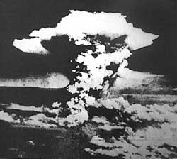
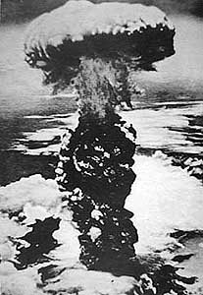
4. Nuclear Revolution
Hiroshima Nagasaki

Slide 35
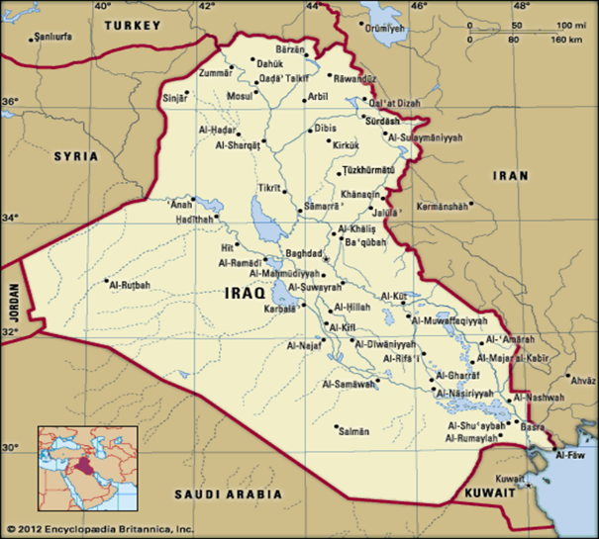
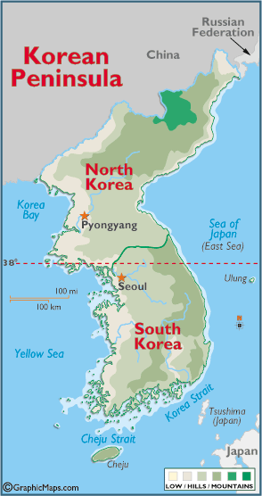
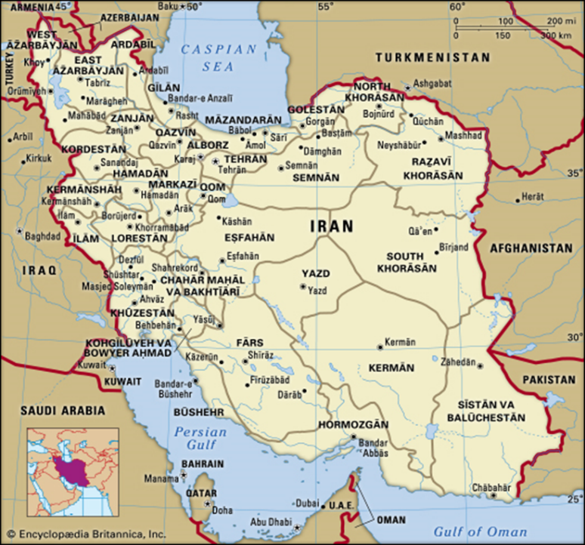
Deterrence = Peace
Can every nation be deterred?
Iraq North Korea
Iran

Slide 36
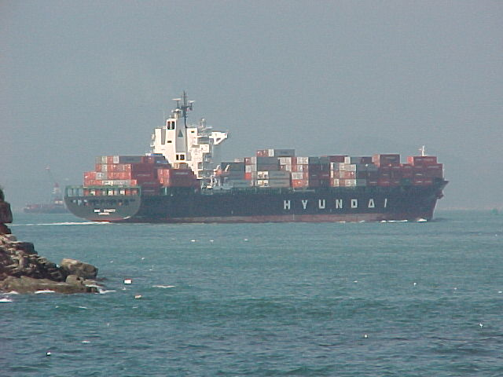
5. Interdependence World Peace?

Slide 37
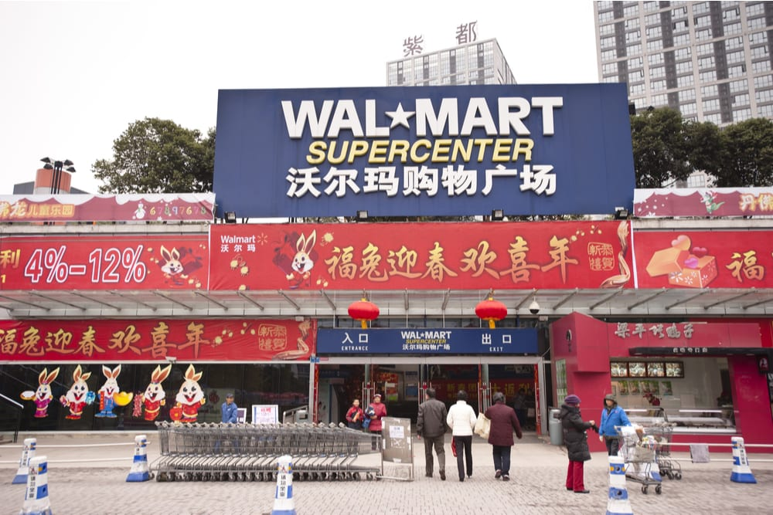
World Peace?

Slide 38
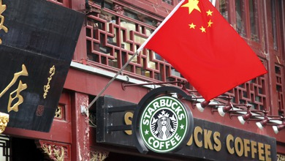
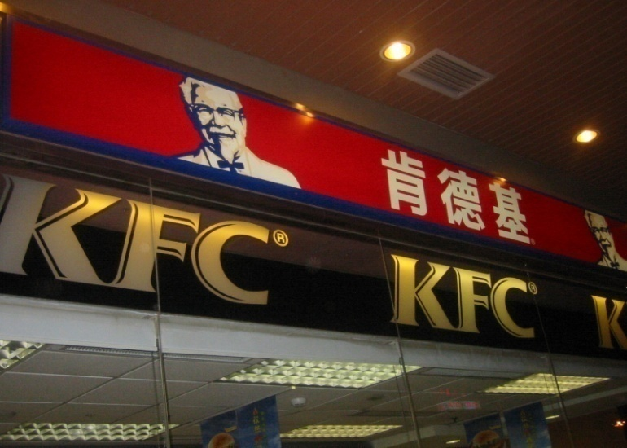
Welcome to China

Slide 39
Welcome to the US

Slide 40
World Trade Growth

