Slide 1
The Weather Underground
Strategies, Targets, and Methods of Operation
HSEP 301
By :Iain Hill
12/5/2023

Slide 2
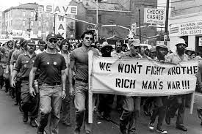
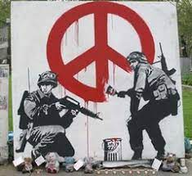
Methods of Operation
Vietnam War Protest
Protesting and public rallies
“Unruly” or “rebellious” at first
Secretive meetings
Appeal to youth
Peaceful protest deemed ineffective
Moved to violence
Anti war graffiti

Slide 3
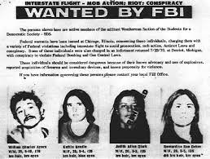
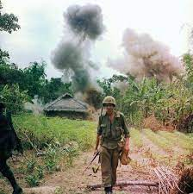
Strategy
Wanted Weathermen after protest
Violent in nature
Radical left wing ideologies
“Oppressive establishment” vs “The people”
Resist Vietnam War
Bombings, Robberies
Create fear within American Society
US Soldier in Vietnam

Slide 4
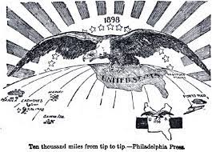
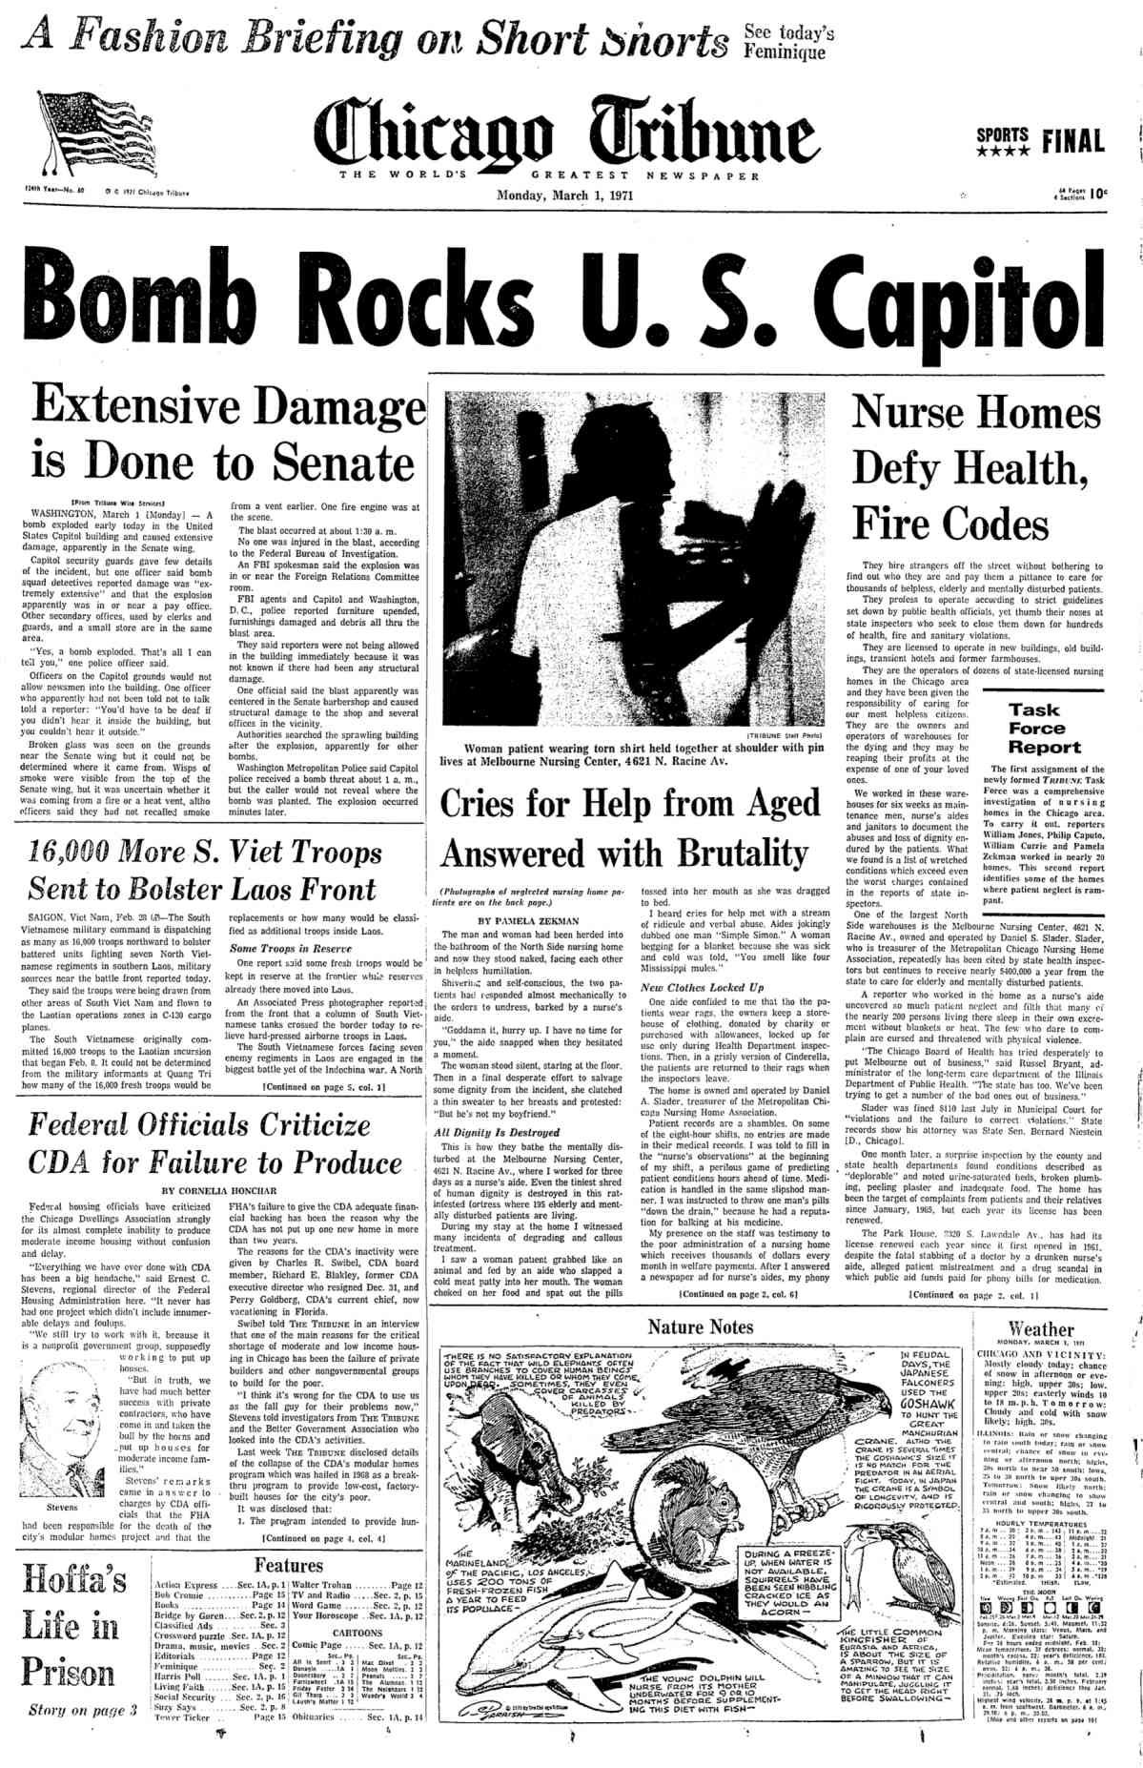
Targets
Newspaper headline after Weathermen bombing on Capital Building
Diagram representing early US imperialism
Symbols of US Imperialism
Buildings of Authority
Symbols of Vietnam Effort
High-profile officials
Heart of Democracy
No civilians targeted
Precautions taken to ensure specific targeting

Slide 5
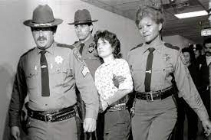
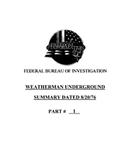
Conclusion
Weatherman Katherine Boudin being arrested
Methods/Strategies representative of Ideology
Gained large media coverage
Societal shifts in thinking weakened movement
Increased law enforcement pressure
Movement died out after Vietnam War
Goals Unreached-
No Revolutionary change
No government overthrow
FBI investigation summary on the Underground

