Slide 1
The Weather Underground Origins, Objectives, and Doctrines
By: Emily Williams

Slide 2
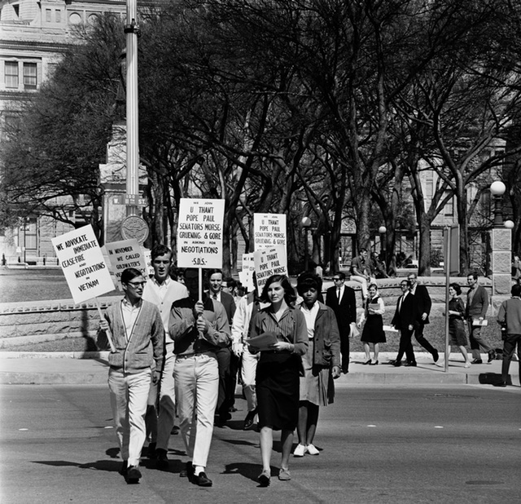
Origins
The Weather Underground (Weathermen before they went underground) was a New Left group that came about around 1968 in the United States. They sprung up out of a need for social justice and to end the war in Vietnam.
They were able to organize into the Weathermen because the founding members were all Students for a Democratic Society (SDS) members on the Anne Arbor campus of the University of Michigan. They officially became the Weathermen at an SDS convention in 1969. The founding members being Bill Ayers, Bernardine Dhorn, Karen Ashley, John Jacobs, Jeff Jones, Gerry Long, Howie Machtinger, Jim Mellen, Terry Robbins, and Steve Tappis.
** They got their name from the Bob Dylan song Subterranean Homesick Blues in the line "you don't need to be a weatherman to know which way the wind blows."

Slide 3
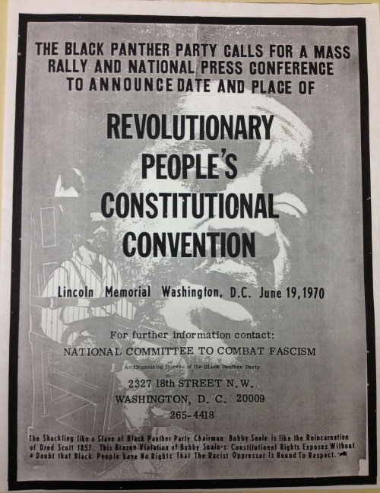
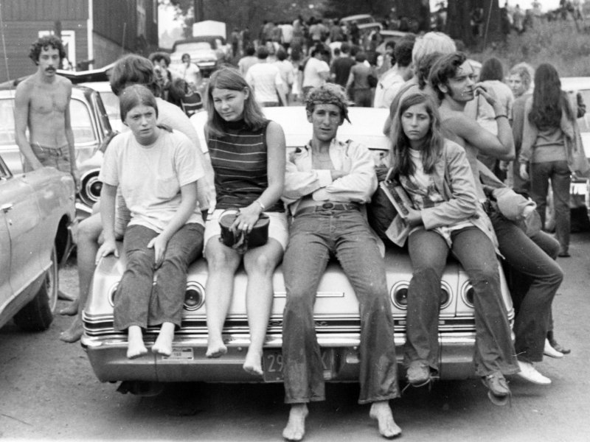
Objectives
Pre 1970 the Weather Underground had a few main objectives. They wanted to create a revolutionary white fighting force to fill the absence of white support in the black liberation movement. The Black Panther party was to be their vanguard.
They also wanted to create a revolutionary youth movement. Their goal was to organize efforts towards high schools, community colleges, and trade schools. They wanted a broad range of youth to join their cause, not just university students.
Post-1970, the Weathermen slightly abandoned their previous goals and focused their energy towards underground, guerilla warfare to address their concerns of the U.S. government. They concluded that traditional political protest will not end war and that planned offensive attacks were neccesary to do so. Ultimatley, their new goal was to overthrow the government and replace it with some form of socialism.

Slide 4
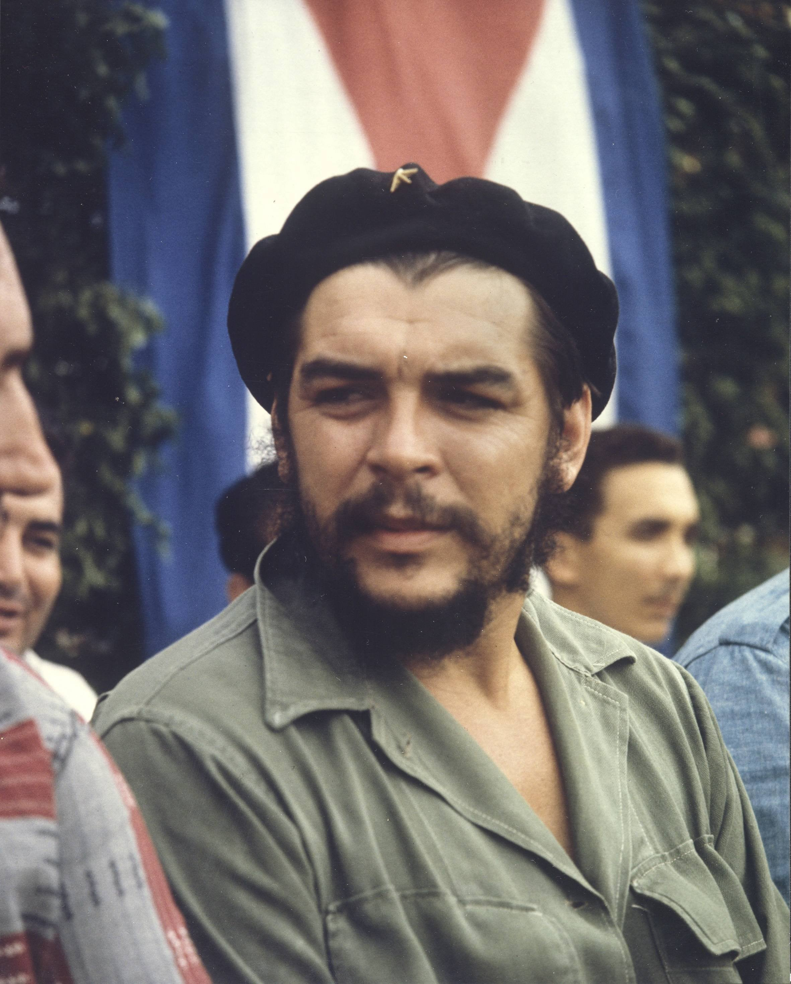
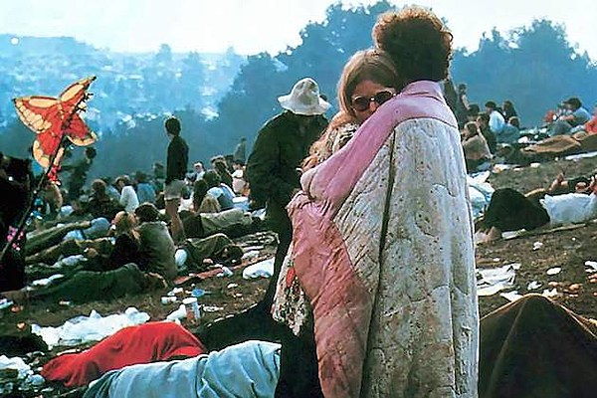
Doctrines
The Weather Undergrounds core beliefs were
Anti-capitalist: late-stage capitalism creates alienating expectations and requirements. Pro-socialist
Anti-imperialist: U.S invasion of Vietnam was an imperialist tactic
Black nationalism, Feminism, Marxism
Pro lgbtq2+
Rejection of traditional family values, social order, and gender rules
They gained inspiration from Latin America in the 1960's and leaders of the time being Che Guevara and Fidel Castro. Revolution in the Revolution by Régis Debray was a book. many members had on hand.
Additional confidence and inspiration from Woodstock. In that attendees created a fully sustainable and operational socialist like society for three days.

Slide 5
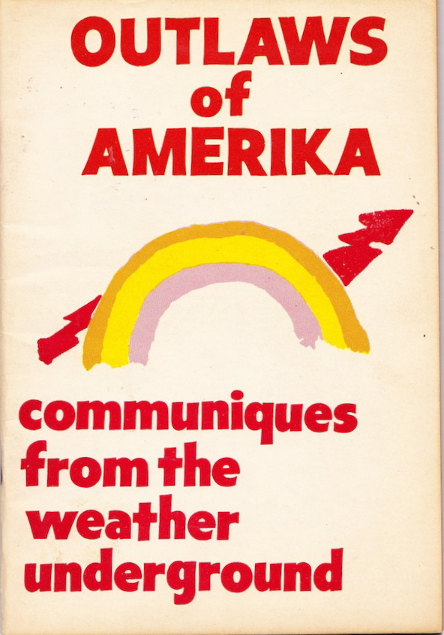
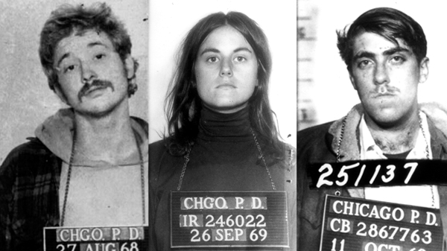
Conclusion
The Weather Underground remains to be the most notable group to come out of the New Left. What started as a student activism organization for social issues such as civil and political rights, lgbtq+ rights, feminism, and drug policy reforms ended as an underground, guerilla, domestic terrorist organization. They began to disenegrate after the U.S. and Vietnam reached a peace accord in 1973 and was defunct by 1977.

