Slide 1
Notes:
The Weather Underground Organization, commonly known as the Weather Underground, was a radical left-wing organization in the United States during the 1970s. It was not a militia in the traditional sense, but rather an underground revolutionary group that emerged from the anti-Vietnam War movement.
The Weather Underground was a faction of the Students for a Democratic Society (SDS) and advocated for the overthrow of the U.S. government. The group engaged in protests, acts of civil disobedience, and, notably, acts of domestic terrorism, including bombings. Their targets were often government buildings, banks, and symbols of what they perceived as American imperialism.
The Weather Underground's activities were controversial and drew attention during a tumultuous period in U.S. history, marked by social and political unrest. The organization disbanded in the early 1980s, and some former members turned themselves in or went through legal processes. It's important to note that discussions about the Weather Underground often involve historical context and are not reflective of any current organization or movement.

Slide 2
Notes:
who are the key leaders? Is it a committee or a person?
Bernardine Dohrn: A central figure in the organization, Dohrn was a leader and spokesperson for the Weather Underground. She played a significant role in shaping the group's ideology.
Bill Ayers: Another prominent member, Ayers was involved in the leadership of the Weather Underground. He co-authored the organization's manifesto, "Prairie Fire," and was involved in planning some of the group's actions.
Mark Rudd: Rudd was a leader within the Students for a Democratic Society (SDS), and when the SDS split, he became involved with the Weather Underground. He played a role in organizing protests and actions.

Slide 3
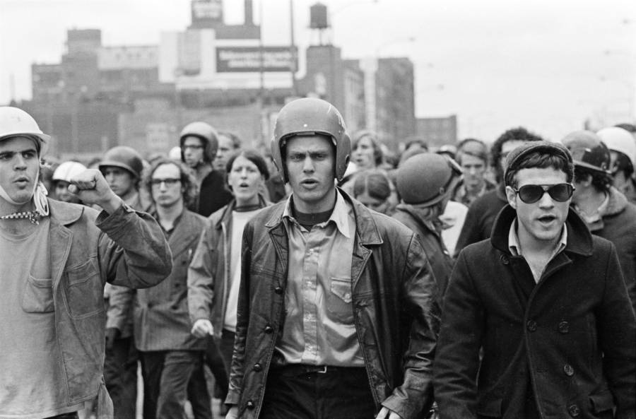
Notes:
What is the leadership structure? Hierarchical? Network? Leaderless? Committees? Different wings for different functions? Decision making by command or consensus?
Decentralization: The organization did not have a single central leader or a formal hierarchy. Decision-making was often decentralized, and different factions or individuals were involved in planning and executing actions independently.
Collective Decision-Making: While there were influential figures within the organization, major decisions were often made collectively. The Weather Underground emphasized participatory democracy and sought to avoid a traditional hierarchical structure.
Operational Cells: The Weather Underground operated in small, autonomous cells, each responsible for its own actions. This structure was designed to enhance security and minimize the impact of arrests on the overall organization.
Ideological Unity: Despite its decentralized structure, there was a degree of ideological unity among members. The organization shared a common vision of opposing what it perceived as American imperialism and engaged in actions to protest against the Vietnam War and other social and political issues.
Underground Activities: The organization operated clandestinely, and its members went underground to avoid law enforcement. This further contributed to the decentralized nature of the organization.
Networked Leadership: While there were influential individuals like Bernardine Dohrn, Bill Ayers, and Mark Rudd, the leadership was more networked than strictly hierarchical. Different members had varying degrees of influence, and decisions were often made through consensus or collective discussions.

Slide 4
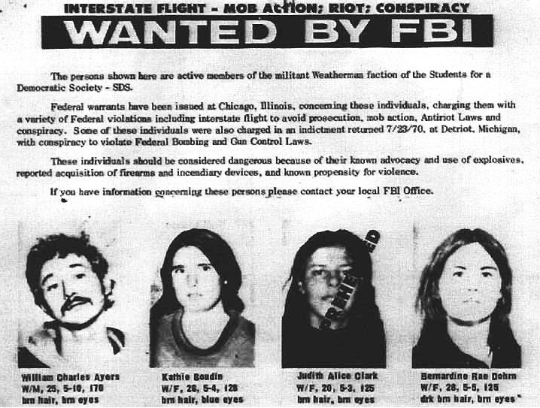
Is the leadership stable? Have there been factions, leadership disputes? Has leadership been changed or eliminated? If so, what happened?
Notes:
Split from the SDS: The Weather Underground emerged from a factional split within the Students for a Democratic Society (SDS). The split reflected ideological differences regarding the approach to activism and political change. The Weather Underground represented a more radical and militant wing of the SDS.
Shifts in Strategy: Over time, there were internal debates and shifts in strategy within the Weather Underground. Some members advocated for more confrontational and violent tactics, while others questioned the effectiveness of such methods.
Internal Disputes: The organization faced internal disputes over its direction, with differing opinions on the role of violence and the level of militancy. These disputes led to tensions among members.
Changes in Leadership Influence: Influential figures within the organization, such as Bernardine Dohrn and Bill Ayers, played significant roles in shaping the group's ideology. However, the influence and leadership roles of individuals could change over time.
Legal Pressures: The legal pressures and the need to operate clandestinely led to challenges in maintaining a stable leadership structure. Some members faced legal consequences, and the organization had to adapt to ongoing law enforcement efforts.
Decline and Disbandment: By the early 1980s, the Weather Underground had largely disbanded. Some members turned themselves in, while others continued their lives in different capacities. The organization's decline was influenced by a combination of internal conflicts, legal pressures, and changing political dynamics.

Slide 5
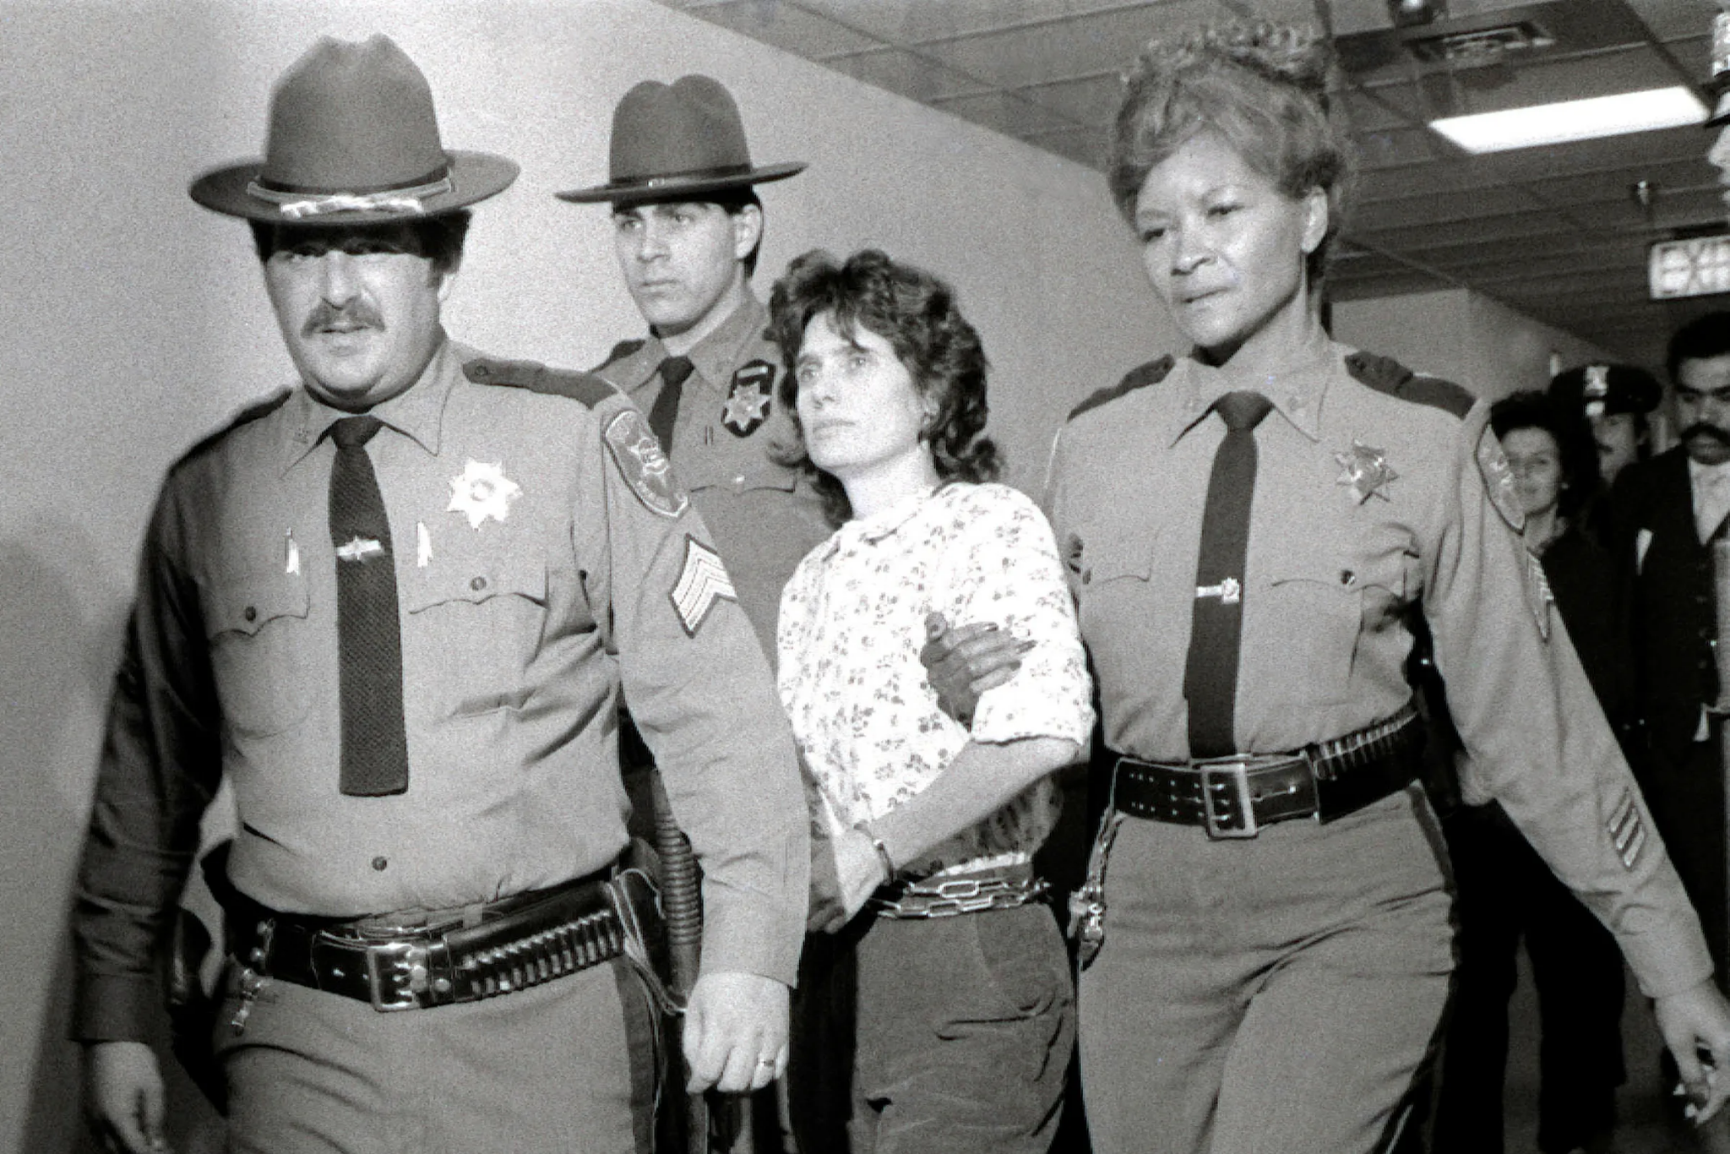
Notes:
Conclusions: Is the leadership weak or strong? How dependent was the organization on its leadership? Can this leadership survive?
Decentralization: The Weather Underground embraced decentralization and operated in small, autonomous cells. This approach aimed to minimize the impact of leadership losses and arrests on the overall organization. The lack of a single, centralized leadership structure made it more resilient to the removal of specific leaders.
Collective Decision-Making: Major decisions were often made collectively, emphasizing a participatory democracy model. This approach reduced dependence on individual leaders and encouraged a shared commitment to the organization's goals.
Ideological Unity: Despite internal disagreements, there was a certain level of ideological unity among members. The organization's shared vision of opposing perceived American imperialism and promoting radical change contributed to its resilience.
Survival and Disbandment: The organization faced significant challenges, including legal pressures, internal disputes, and changing political dynamics. Ultimately, it disbanded in the early 1980s. However, some former members continued their lives in different capacities, and the organization, in its various forms, left a lasting impact on countercultural and activist movements.

