Slide 1
US-China Relations
New Cold War?

Slide 2
Theories of Great Power Relations
Western IR
Chinese IR?

Slide 3
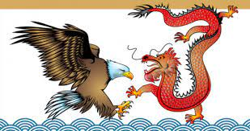
Key Issue
Rise and Fall of Great Powers
Hegemony

Slide 4
Western Ideas on Great Powers and Leadership
Neorealism
Power Transition
Long Cycle
Hegemonic Stability Theory
Neoclassical Realism

Slide 5
1. Neo-Realism
Anarchy Rivalry
Self Help Security
Dilemma
States Seek
Power

Slide 6
Peace or War?
Peace = balance of power
War = imbalance of power
Taiwan China
S. Korea N. Korea
S. Viet Nam N. Viet Nam
W. Germany E. Germany
Britain/France/Japan Poland/Czech
Nuclear weapons Nuclear weapons
US USSR

Slide 7
Balancing or Bandwagoning?
S. Korea
Viet Nam
Japan
Malaysia
Indonesia
Philippines
India
Pakistan
Russia
US China

Slide 8
2. Power Transition
Hegemonic Realism
Long Cycle Theory
Hegemonic Stability Theory
Peace = Imbalance of power
War = Balance of power

Slide 9
Long Cycle Theory
Hegemonic War
Winner becomes Hegemon
Hegemon
Rules
Hegemon weakens
Challenger Rises
Notes:
9

Slide 10
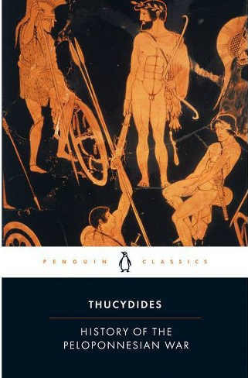
“Thucydides Trap”
Thucydides 460—400 BCE?
History of The
Peloponnesian War
(431-404 BCE)
“What made war
inevitable was the
growth of Athenian power
and the fear which this
caused in Sparta.”
Book One, section 23

Slide 11
Hegemonic Stability Theory
Hegemonic War
Winner becomes hegemon; makes rules for international system
Hegemon weakens;
system weakens
Rise of challenger to hegemon and system
Hegemon Rules System

Slide 12
Values, Ideas, The System?
Liberal Democracy
vs.
Authoritarian State Capitalism
“Rules-based International Order”
Biden-Modi
Blinken Statement March 2021

Slide 13
3. Neo-classical Realism
Anarchy Choice of Action
Self Help Perception of
Threat
States Ideology, Domestic Politics, Culture

Slide 14
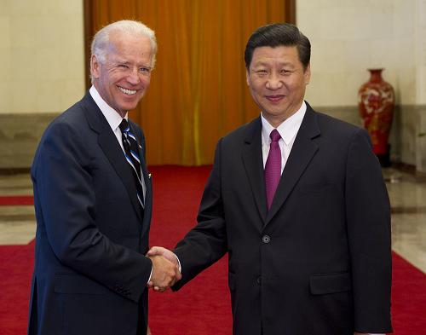
US and China?
Interdependence?
Liberal-Democracy vs. Authoritarian State Capitalism?
Nationalism as a tool for regime legitimacy?
Strategic Choices?
Leadership?

Slide 15
Chinese Ideas on Great Powers and Leadership
Realism isn’t Western
Order-Chaos Cycle and Leadership Change
Hegemony and Stability in Confucianism
Strategy: Humane Authority vs. Hegemony/Tyranny

Slide 16
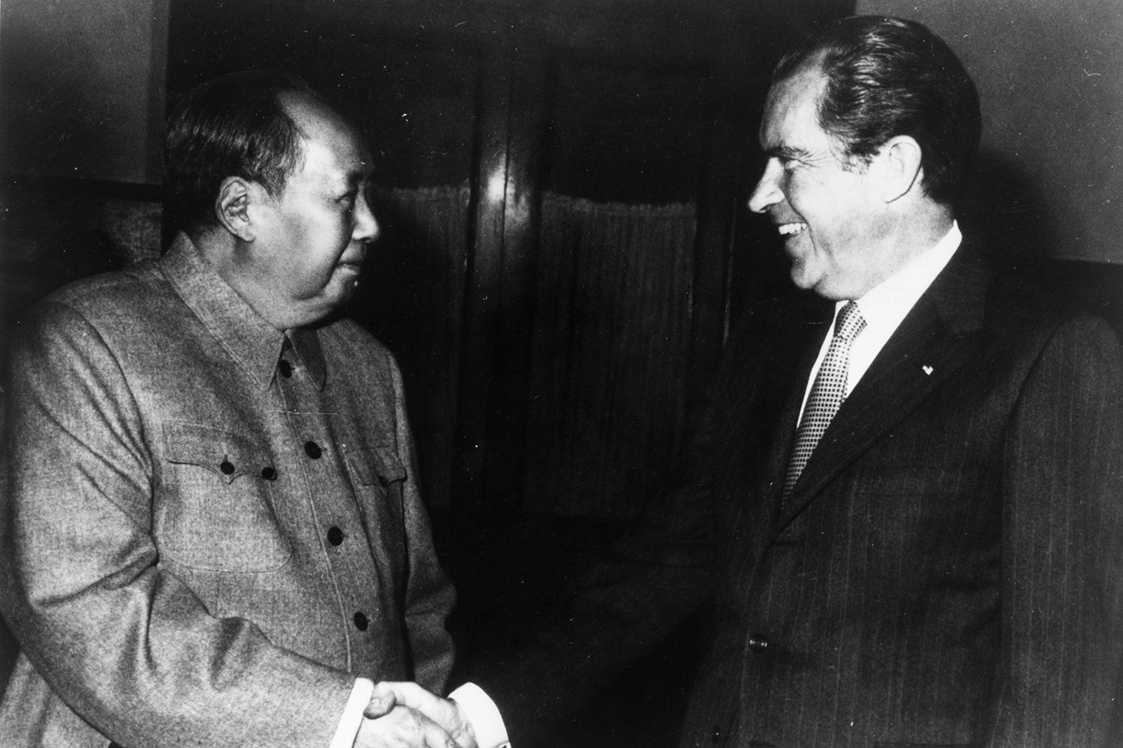
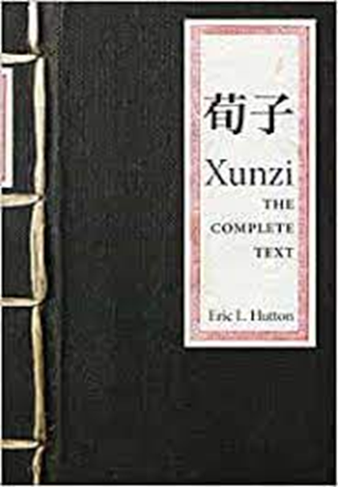
1. Realism and Balance of Power
Xunzi
310-238? BCE
Mao Zedong and Nixon 1972

Slide 17
2. Order-Chaos Cycle
Chaos
(decentralization
and war)
Order
(centralization)
Order
(centralization)
Chaos
(decentralization
and war)

Slide 18
Chinese Dynasties
Three Sovereigns and Five Emperors 2852-2205 (Pre-Dynasty)
Xia 2205-1766 BCE
Shang 1766-1122 BCE
Zhou 1122-221 BCE
Spring and Autumn Period 770-476
Warring States Period 475-221
Qin 221-206 BCE
Han 206 BCE-220 AD
Three Kingdoms 220-280
Western Jin 265-316
Eastern Jin 317-439
Southern and Northern 386-589
Sui 589-618
Tang 618-906
Five Dynasties and Ten Kingdoms 907-960
Song 960-1279
Yuan (Mongol) 1279-1368
Ming 1368-1644
Qing (Manchu) 1644-1911

Slide 19
Why do Dynasties Rise and Fall?
Quality of Challenges
Leadership War
Collapse
Strategy Stability
of Dynasty

Slide 20
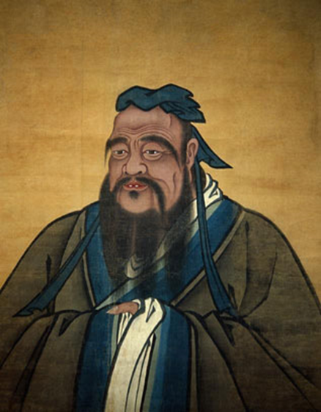
3. Hegemony and Stability in Confucianism
Kong Fu Zi (Confucius) 551-479 BCE
Mengzi (Mencius ) 372-298 BCE
Xunzi (310-238?)
Harmony
Hierarchy
Humane Authority
Leader earns Legitimacy

Slide 21
Confucian Spin on Hegemonic Stability Theory
War for Leadership
Winner becomes leader; makes rules for the international system
Rules deviate from Humane Authority; leader loses legitimacy
Rise of challenger to the leader; new rules challenge old system
Rules based on Humane Authority; earn legitimacy

Slide 22
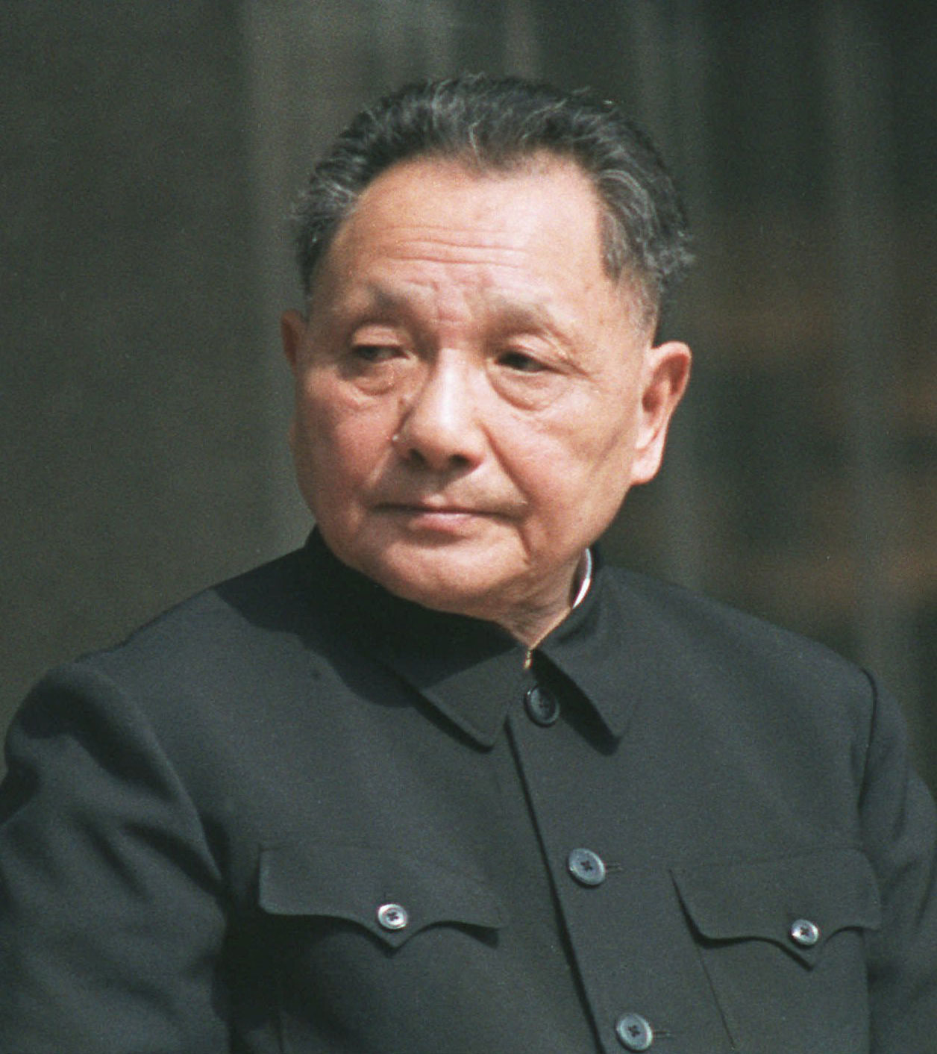
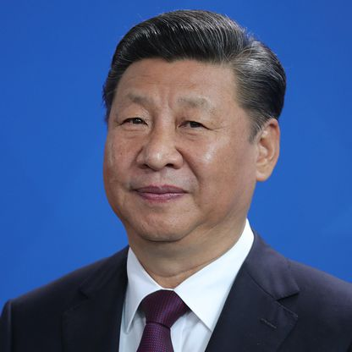
Hegemony vs. Legitimacy
Hegemony: leadership through power
Humane Authority: leadership through legitimacy
US liberalism post-WWII
US after Iraq
Deng (1978-97) vs. Xi Jinping (2012--)

Slide 23
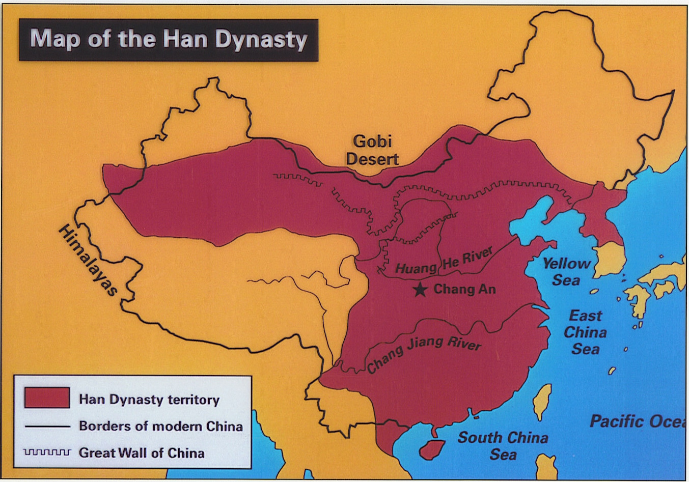
Tribute System
Han Dynasty 206 BCE –221 BCE

Slide 24
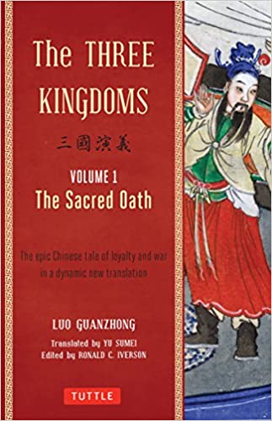
4. Strategy
First Paragraph
The Three Kingdoms
Luo Guanzhong, 1315-1400
“Domains under heaven,
after a long period of
division, tends to unite;
after a long period of
union, tends to divide.
This has been so
since antiquity…”
Notes:
“Domains under heaven, after a long period of division, tends to unite; after a long period of union, tends to divide. This has been so since antiquity. When the rule of the Zhou Dynasty weakened, seven contending kingdoms sprang up, warring one with another until the kingdom of Qin prevailed and possessed the empire. But when Qin's destiny had been fulfilled, arose two opposing kingdoms, Chu and Han, to fight for the mastery. And Han was the victor.”

Slide 25
Strategy Determines Outcomes (Not Deterministic)
Sage King Interstate
(humane authority) Order
Or…
Hegemon
Tyrant
Strategy
(Strategic Choice)

Slide 26
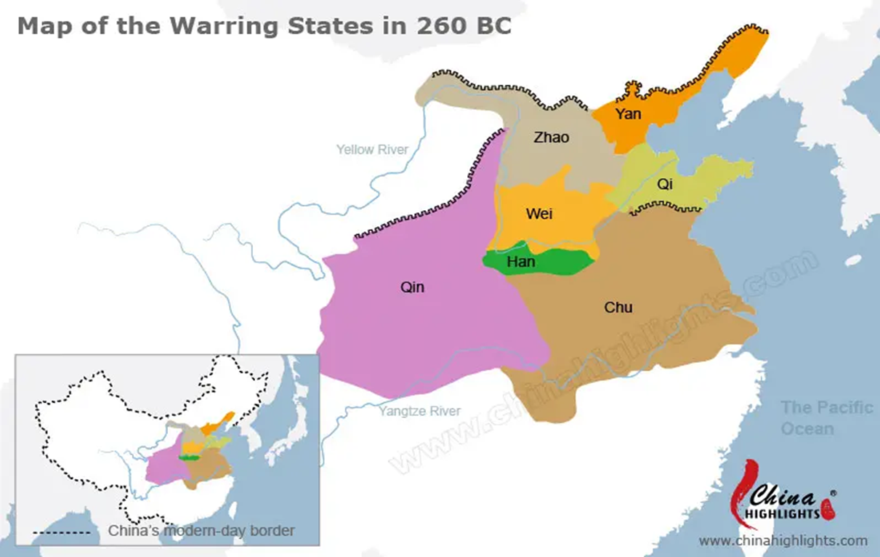
Warring States Period 475-221 BCE
Qin Empire 221-206 BCE

Slide 27
Qin Empire 221-206 BCE

Slide 28
One Interpretation: Rome Fell; China Didn’t
Rome at its Peak Han at its peak
27 BCE-476 AD 206 BCE-221 AD
(Successor until 1453) Successor until 1911)

