Slide 1
4. Trump: Russia as Friend President Vladimir Putin

Slide 2
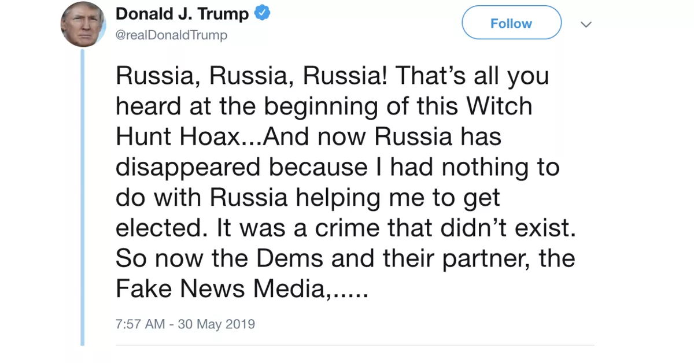
Russia and Trump Friendship

Slide 3
Russia and States of the Former Soviet Union

Slide 4
Russian Presidents
Boris Yeltsin
1991-1999
Vladimir Putin
1999-2008, 2012--

Slide 5
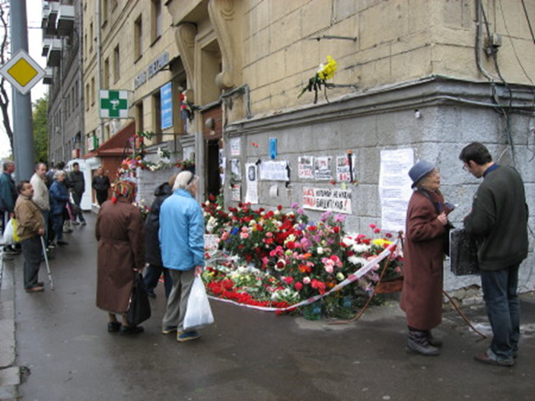
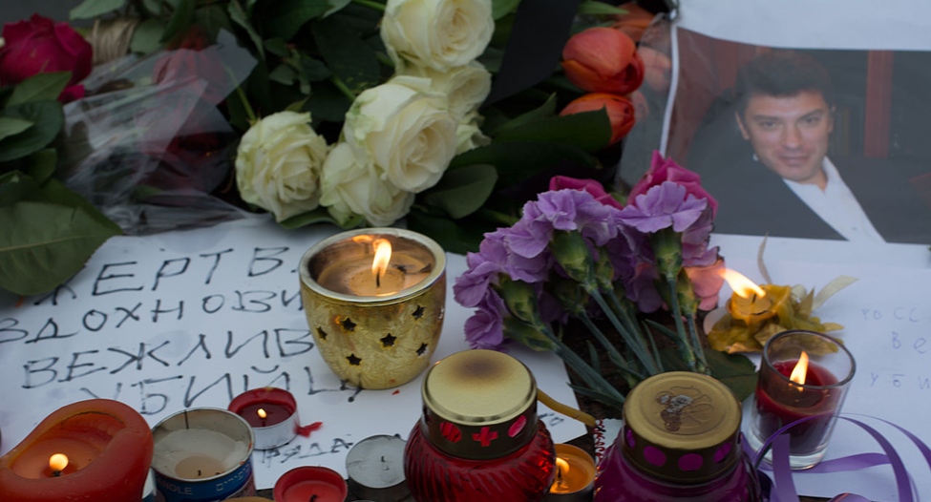
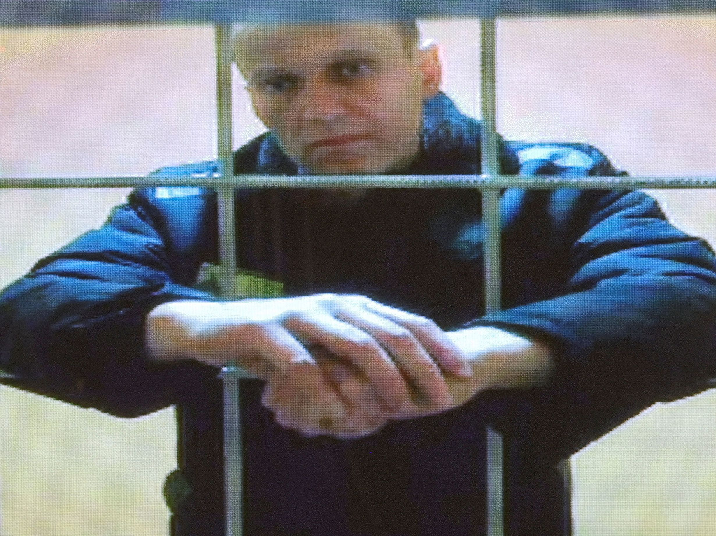
Putin’s Rule at Home
Anna Politkovskaya, Boris Nemstov,
October 2006 Feb. 2015
Alexei Navalny
In prison since January 2021
Murdered in Prison 2/16/2024

Slide 6
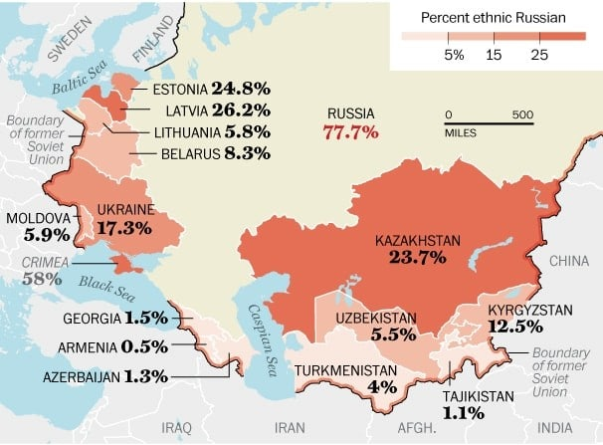
Putin Foreign Policy
Return to Great Power Status
Reclaim Sphere of Influence
Near Abroad
Weaken NATO
Undermine
Liberal Democracy

Slide 7
NATO Expansion

Slide 8
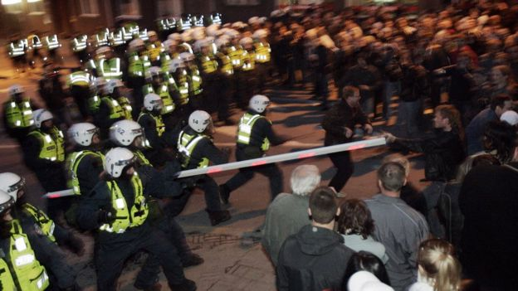
Hybrid Warfare
Mixture of Cyberattacks
Information Warfare
Media/social Media Disinformation Campaigns
Paramilitary Operations
Estonia 2007

Slide 9
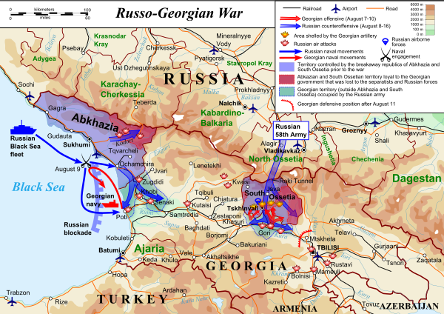
Russia vs. Georgia 2008
Abkhazia and South Ossetia

Slide 10
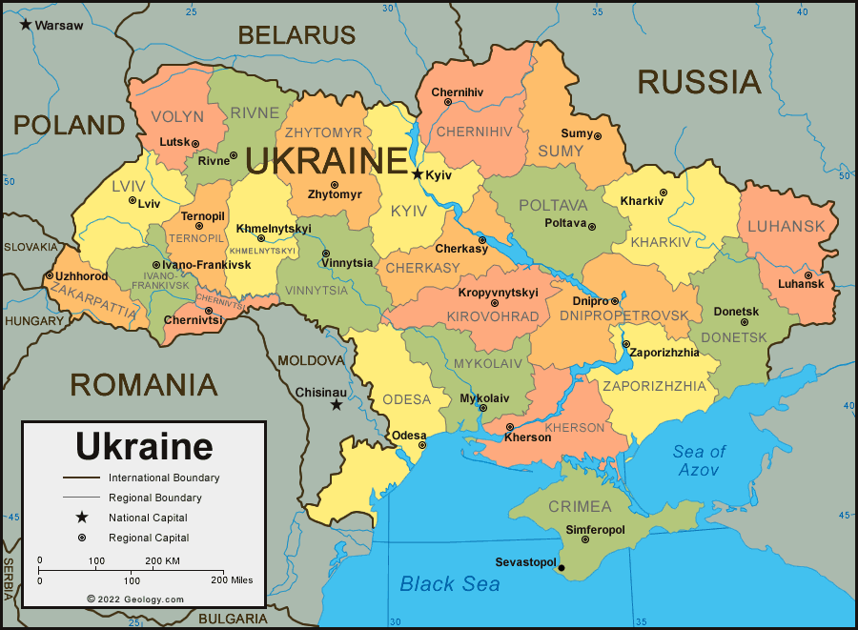
Independent Ukraine
Budapest Agreement December 1994

Slide 11
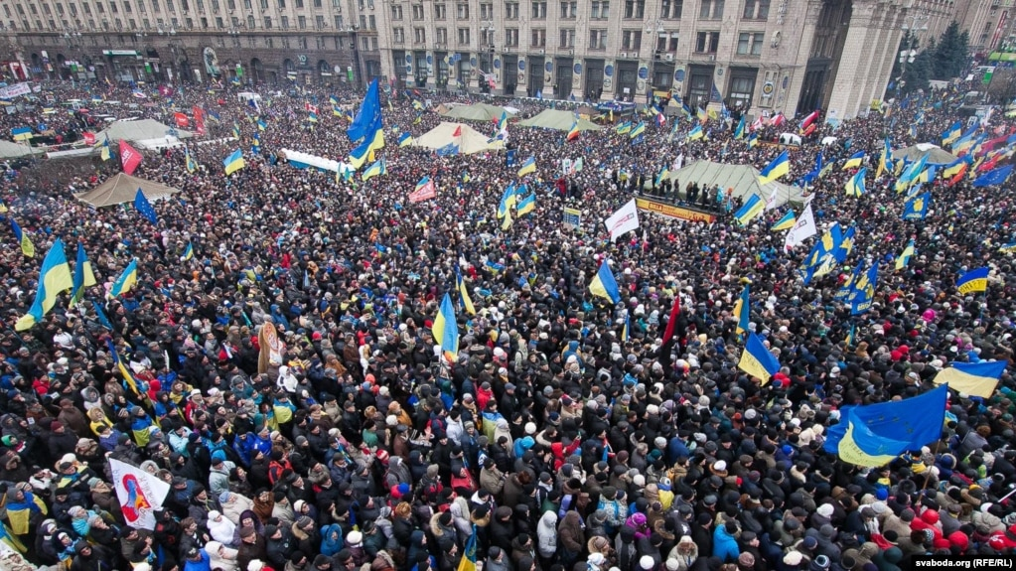
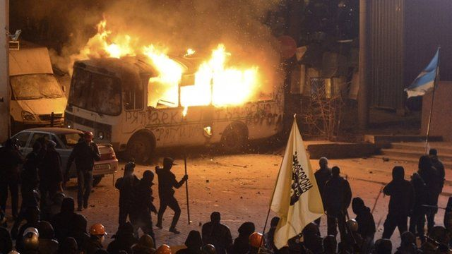
Ukraine Crisis November 2013--2014
Protests in Kyiv Jan-Feb 2014

Slide 12
Russian Response 2014
“Little Green Men”
Russia’s Sphere of Influence

Slide 13
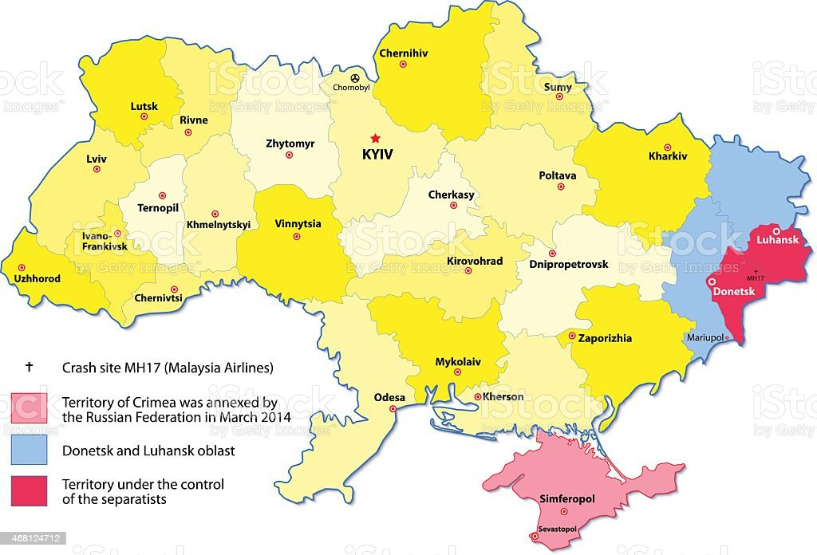
Ukraine After 2014
Minsk Protocol 2014

Slide 14
February 2022: Invasion

Slide 15
Why Invade?
Ukraine/Kyiv as heart of old Russia
Russian return to Great Power Status
(“Putin the Great”)
NATO expansion and Russian traditional insecurity
Not enough NATO expansion
Few punishments after 2014
US commitment to Europe/NATO uncertain

Slide 16
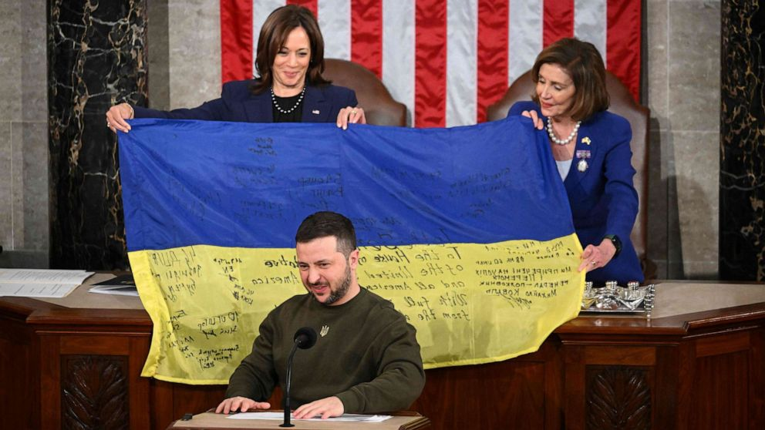
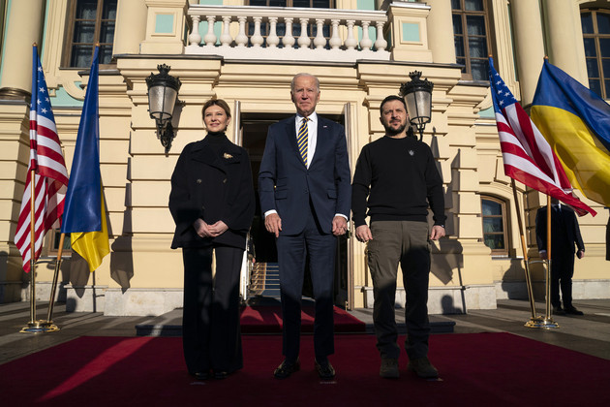
US Response
President Zelensky addresses US Congress 12/2022
Biden in Ukraine February 2023

Slide 17
Big Picture I
European Response
German increases in defense spending
NATO Supplies to Ukraine
Finland in NATO; Sweden wants in
Asian Response
Supplies to Ukraine
Japan doubles defense
spending

Slide 18
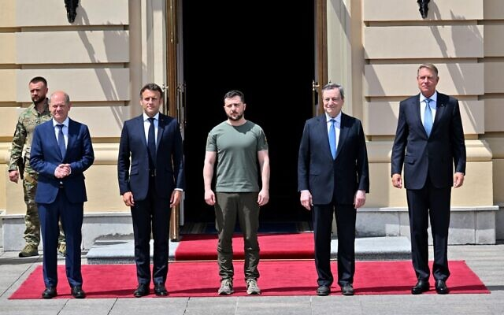
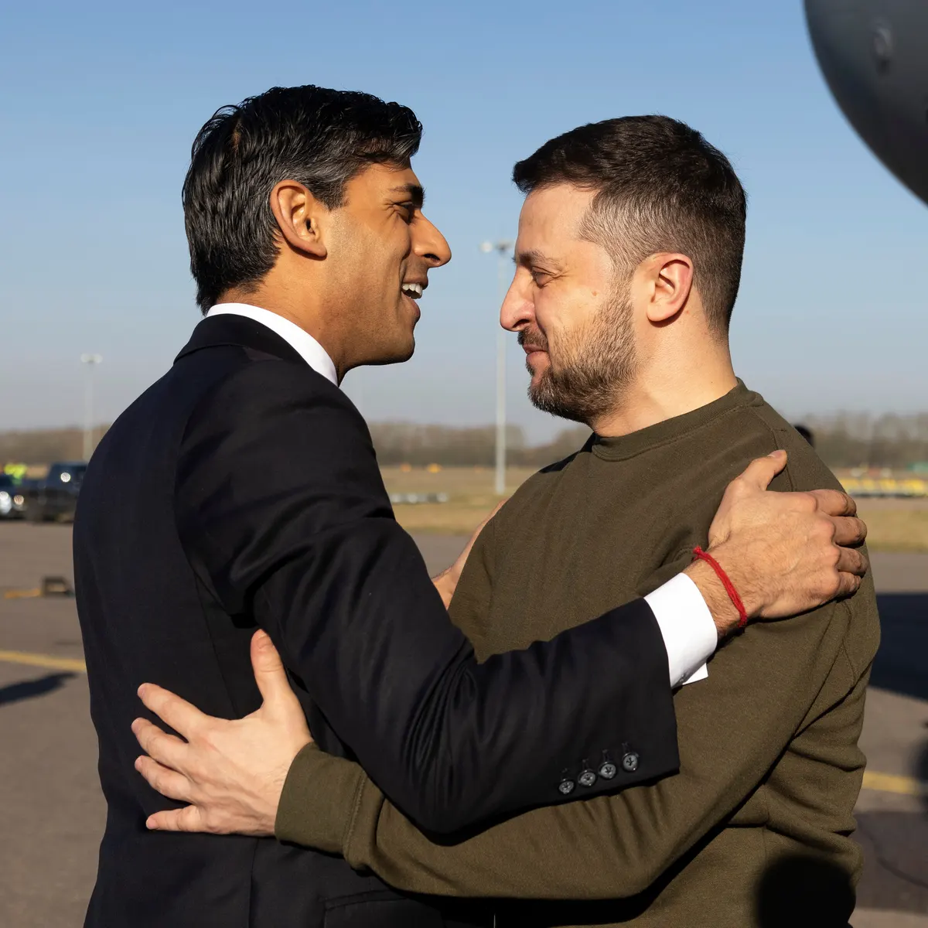
Why Is Ukraine So Important?
Left to right: Zelensky with German Chancellor Olaf Scholz, French PM Emmanuel Macron, then Italian PM Mario Draghi, Romanian President Klaus Iohannis, 2022; Zelensky with British PM Rishi Sunak, 2023;

Slide 19
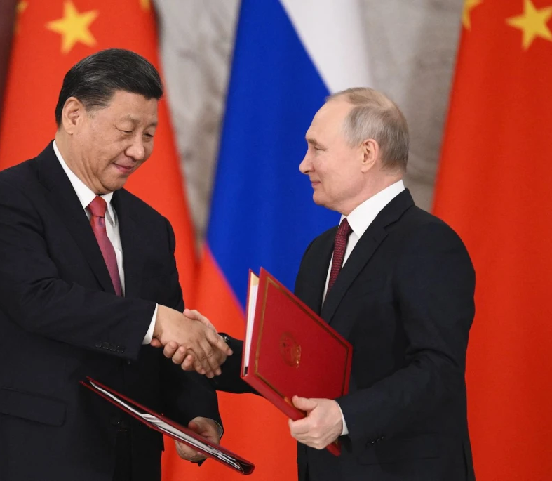
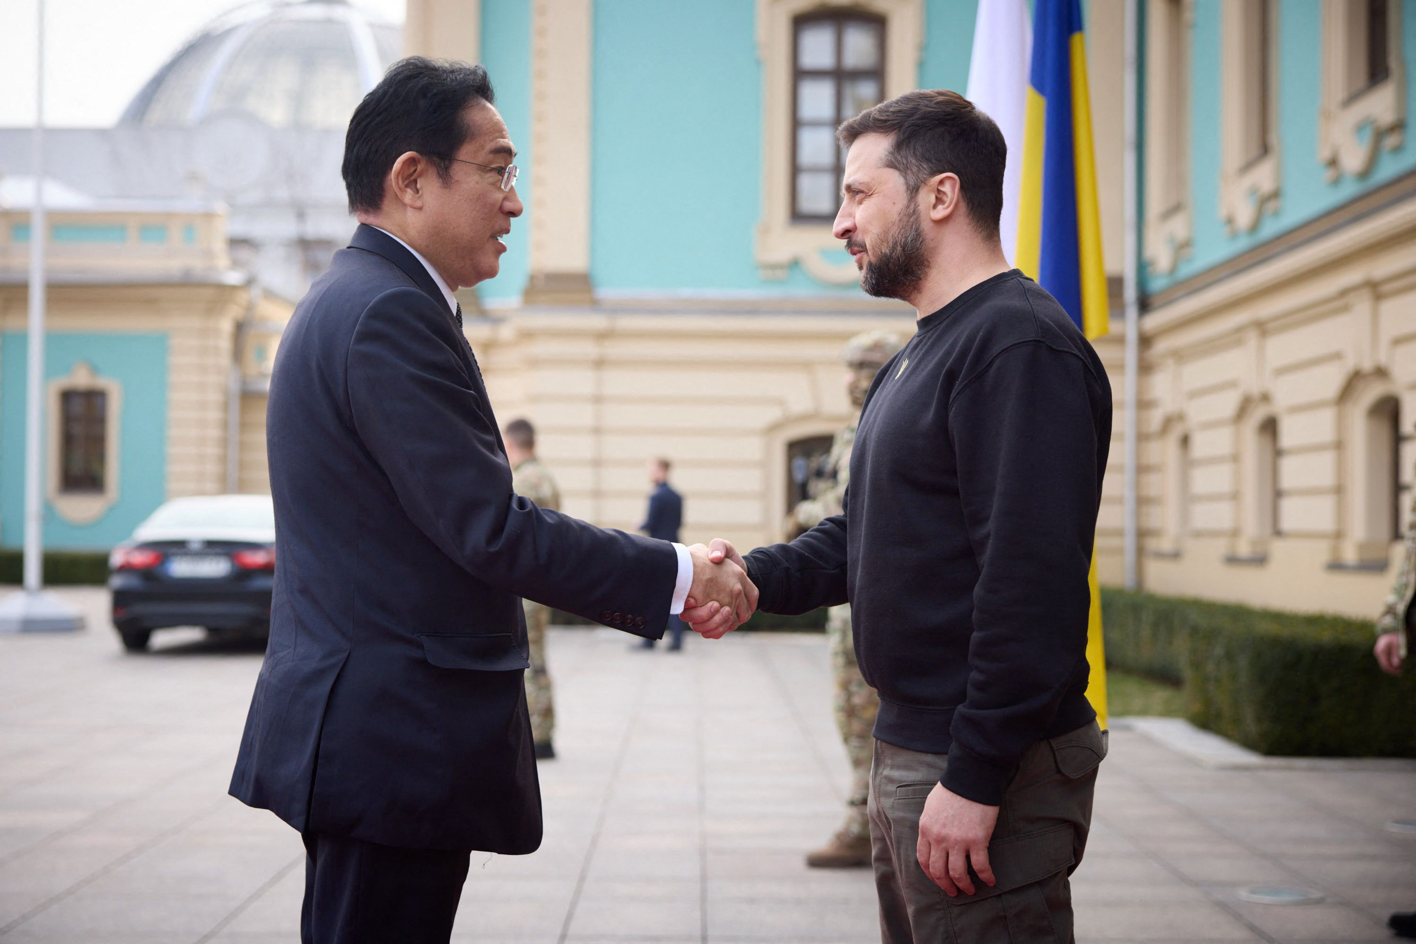
Why is Ukraine So Important?
March 21, 2023
Moscow Kyiv
Xi and Putin Japanese PM Kishida and Pres. Zelensky

Slide 20
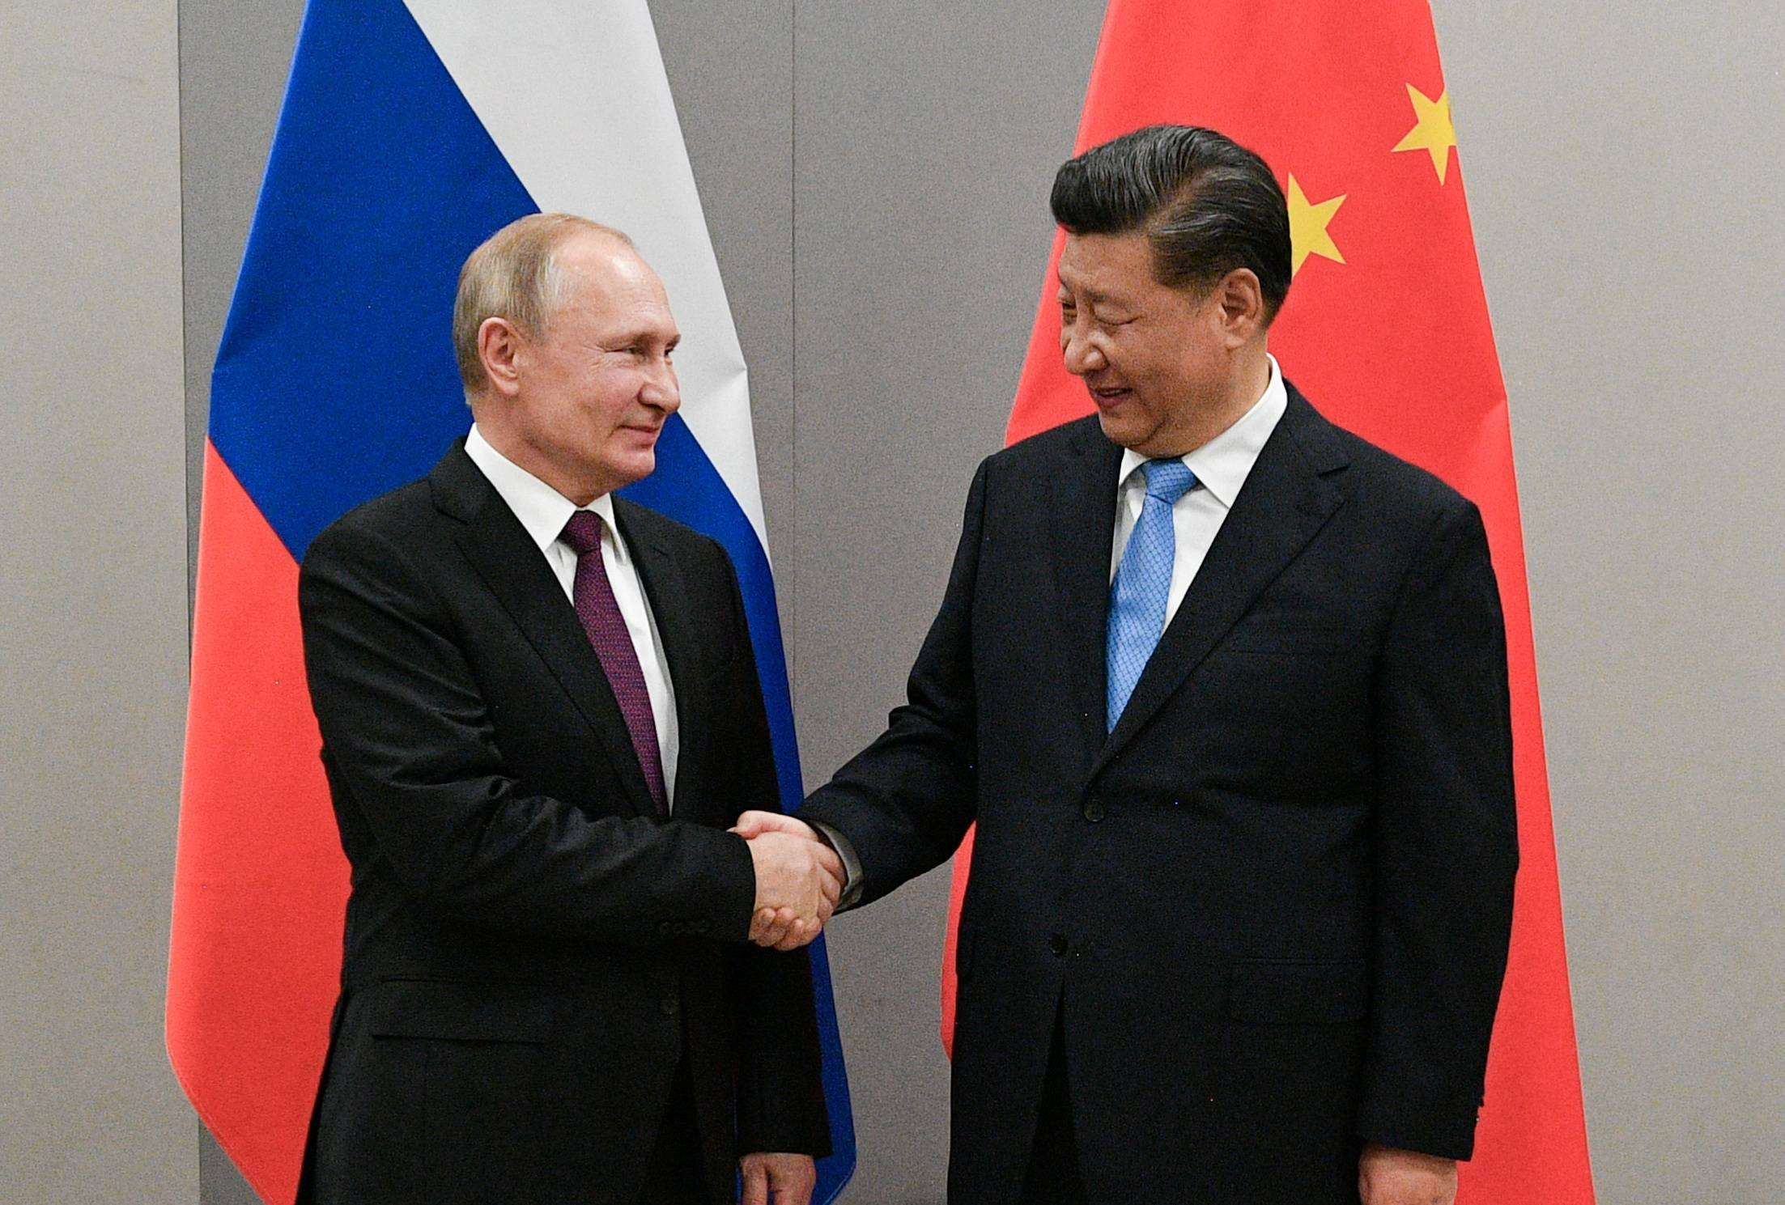
Big Picture II
Joint Statement of the Russian Federation and the People’s Republic of China on the International Relations Entering a New Era and the Global Sustainable Development, February 4, 2022 (Translation by US Air Force, Air University)
Putin and Xi
February 2022

Slide 21
Highlights of Joint Statement
Multipolarity
Redistribution of power in the world
Cultural Diversity and civilizational diversity of nations
Democracy is culturally defined
Non-interference in internal affairs of nation
All states must accept “diversity of their civilizational, cultural, and historical backgrounds…”
“Certain states” cause “instability” by acting unilaterally
“Certain states” impose their standards on others, and try to change other countries political systems

Slide 22
More Highlights of Joint Statement
Alliances are divisive (NATO expansion is bad)
Oppose “certain states” attempts to gain military superiority and “ideologized cold war approaches”
Russia-China friendships has no limits
Russia believes in one China and Taiwan is part of China
Calls for “new kind of relationships between world powers on the basis of mutual respect, peaceful coexistence, and mutually beneficial cooperation.”

Slide 23
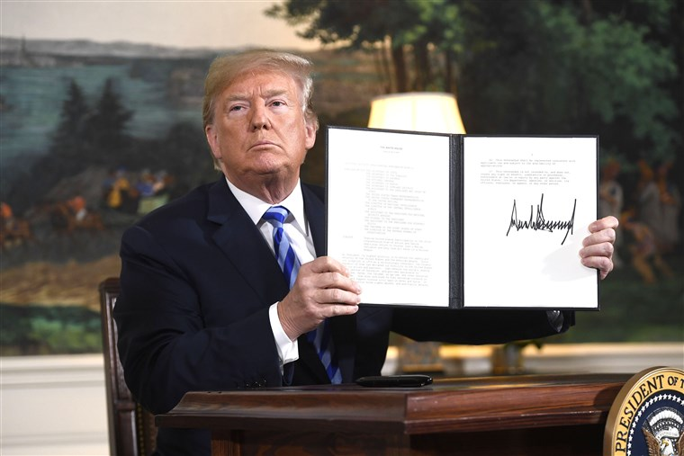
7. Proliferation: Iran
Obama JCPOA
Trump: withdrawal from deal (5/18)
Biden: No return JCPOA

Slide 24
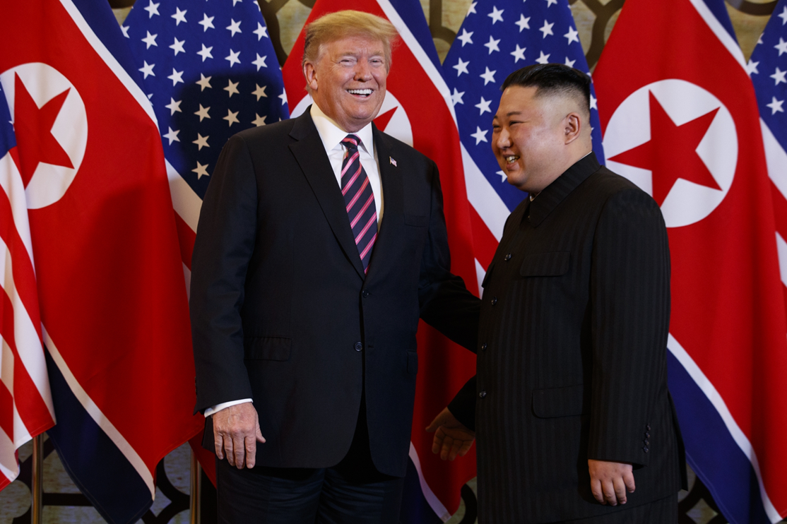
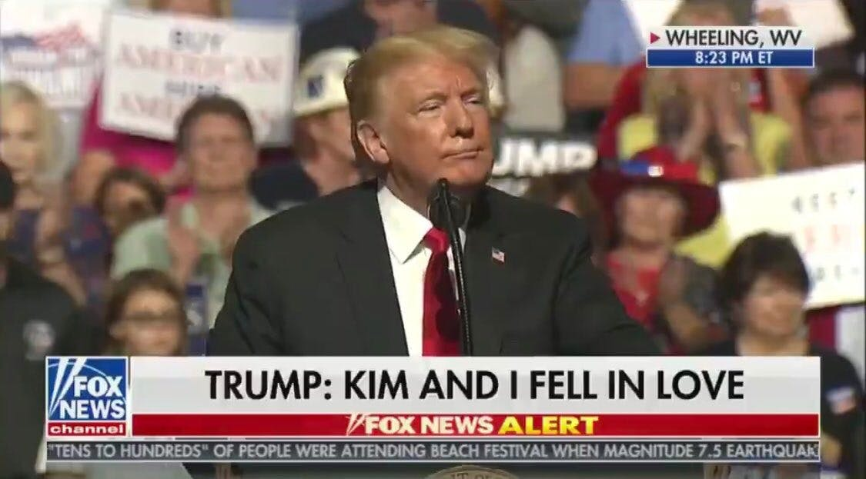
Proliferation: N. Korea
Summits: June 2018; February 2019

Slide 25
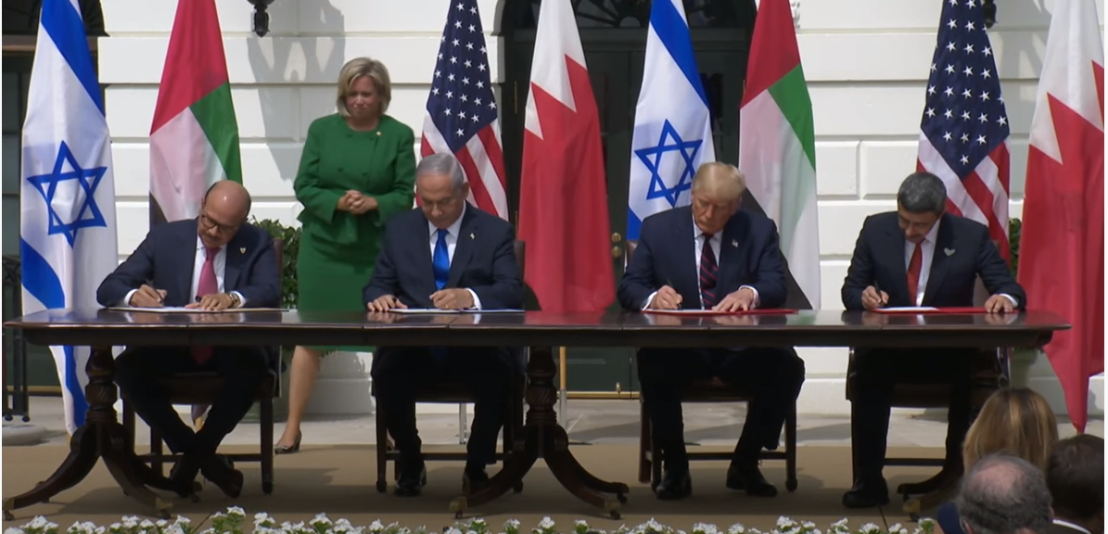
Abraham Accords Declaration 2020
Bahrain-Israel
Israel-Morocco
Israel-UAE
Sudan Declaration
White House Abraham Accords Signing Ceremony with President Donald Trump, Israeli Prime Minister Benjamin Netanyahu, UAE’s Foreign Minister Abdullah bin Zayed bin Sultan Al Nahyan and Bahrain Foreign Minister Abdullatif bin Rashid Al Zayani

Slide 26
Dilemma of Bilateral Deals: Strategic Coherence? (Reference)
Tariffs on China and asking China to restrain North Korea
Asking to Japan and S. Korea to help with North Korean threat while putting tariffs on their products
Withdrawing from JCPOA with Iran, but withdrawing from Kurdish areas, strengthening Iran, abandoning Kurdish allies; assistance to Saudi Arabia against Iran in Yemen
Economic pressure on all US allies, but asking for assistance in countering rise of China
Russia?

