Slide 1
Donald Trump

Slide 2
The Fact Problem
Fact Check.Org From the Annenberg Center at the University of Pennsylvania
PolitiFact.com From several newspapers
The Fact Checker From the Washington Post
Snopes.com (fact checking and debunking urban legends and internet hoaxes that are often about politics)

Slide 3
Trump Doctrine?

Slide 4
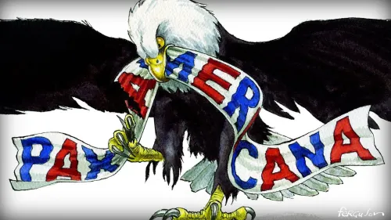
Trump Doctrine?
Nationalism, not internationalism
Bilateral Deals
What’s in it for the US?

Slide 5
Elements of Trump Foreign Policy
Rejection of Rules-Based International Order led by US
Rejection of US commitments to international institutions
Rejection of long-term commitments or restraint on US actions
Alliances are Obsolete
Free Trade has hurt the US
Transactional :Bilateral Deals with allies, rivals, and threats with no long term implications

Slide 6
Tradition vs. Trump
Tradition/Obama/Biden
Trump
Global US Leadership
Free Trade/Economic Order
China: security threat; economic opportunity
Alliances
Russia as rival
Counterterrorism
Proliferation
Iran: Deal
N. Korea: sanction
America First
Protection of US economy first
China as economic threat
Reject alliances
Russia as a friend
Counterterrorism
Proliferation
Iran: sanction
N. Korea: Deal

Slide 7
1. Tradition: US Leadership

Slide 8
Trump: America First

Slide 9
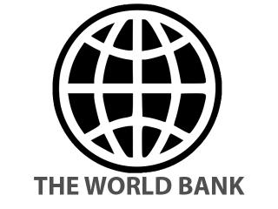
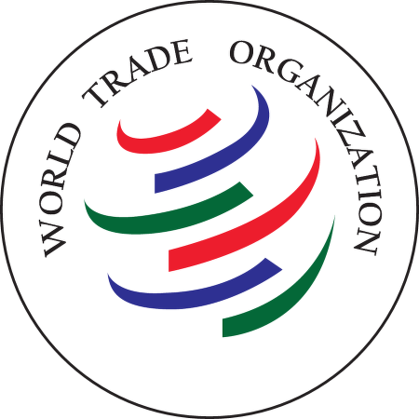
2. Tradition: Free Trade/Economic Order

Slide 10
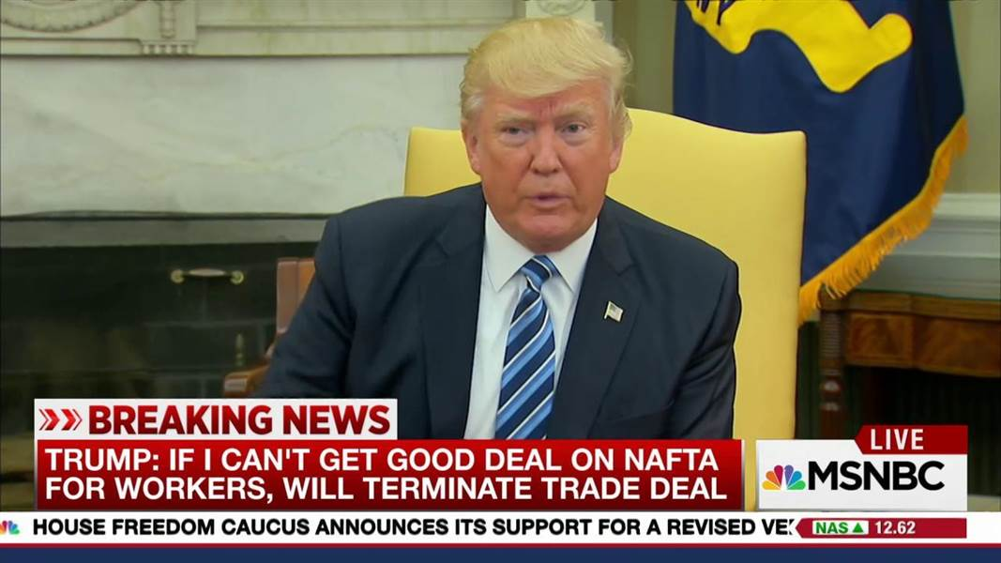
Trump: Protection Economic Nationalism
NAFTA
TPP

Slide 11
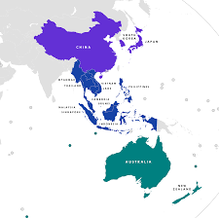
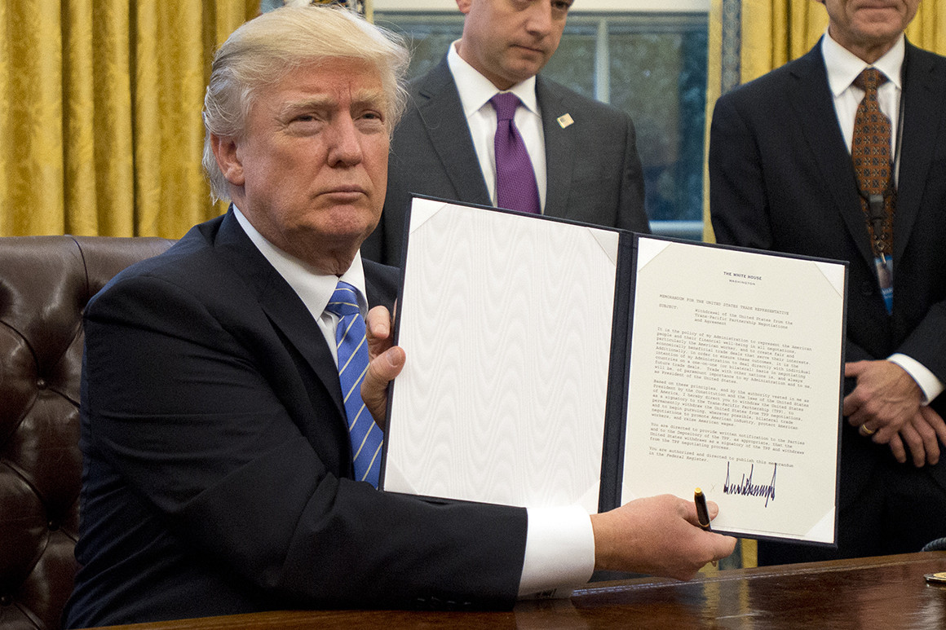
Trump Trade Policy
Trump Policy
After TPP
Deals without the US
Trump withdraws from TPP, January 2017
USMCA: US Mexico Canada Agreement 2018 (renegotiated NAFTA)
US-China Agreement 2019
CPTPP 2017
RCEP 2020

Slide 12
Trump Tariffs on China

Slide 13
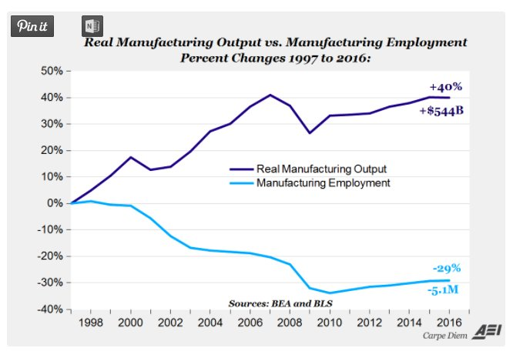
Decline in US Manufacturing
Manufacturing Employment in the US
But…output…

Slide 14
Technology, not Trade Causes Loss of Most Jobs?

Slide 15
But Biden…
Has not lifted the tariffs on China imposed by Trump
New Trade Policy:
Jake Sullivan speech April 27, 2023
“America’s industrial base had been hollowed out”
“modern American industrial strategy”
“targeted public investments”
“fairer, more durable global economic order”
“The People’s Republic of China continued to subsidize at a massive scale…”
“The project of the 2020s and the 2030s is different from the project of the 1990s.”
“competing with China on multiple dimensions…Managing competition responsibly ultimately takes two willing parties”

Slide 16
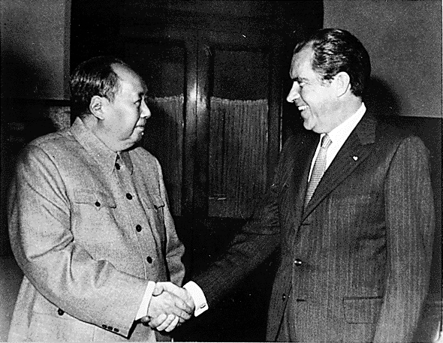
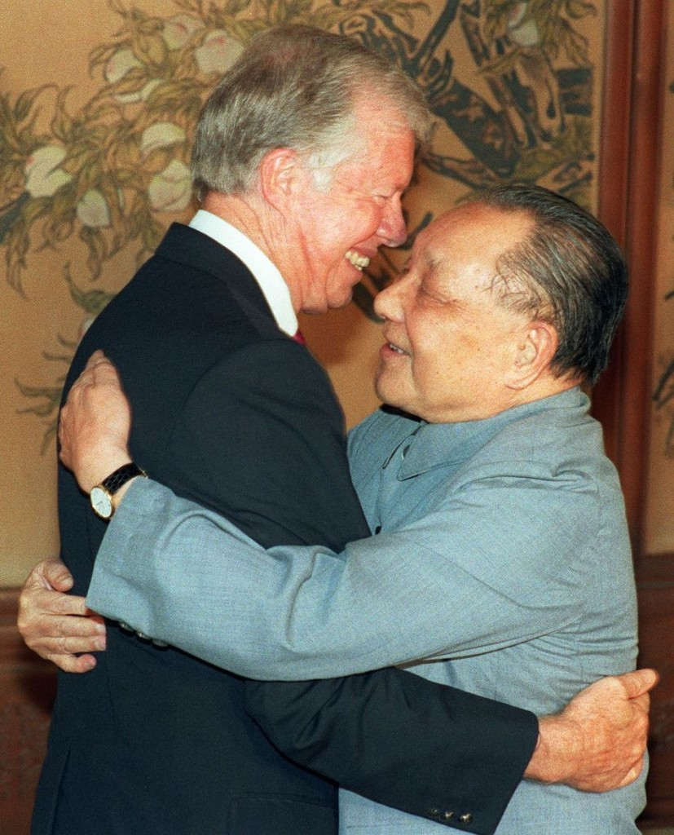
3. Tradition: China as Security Threat and Economic Opportunity

Slide 17
Trump: China as Economic Threat

Slide 18
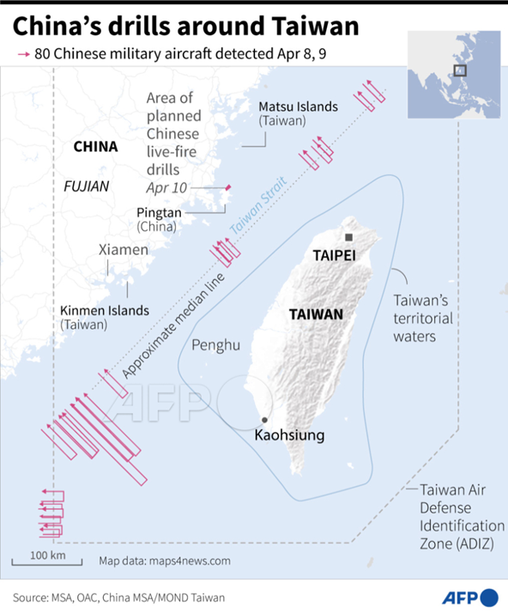
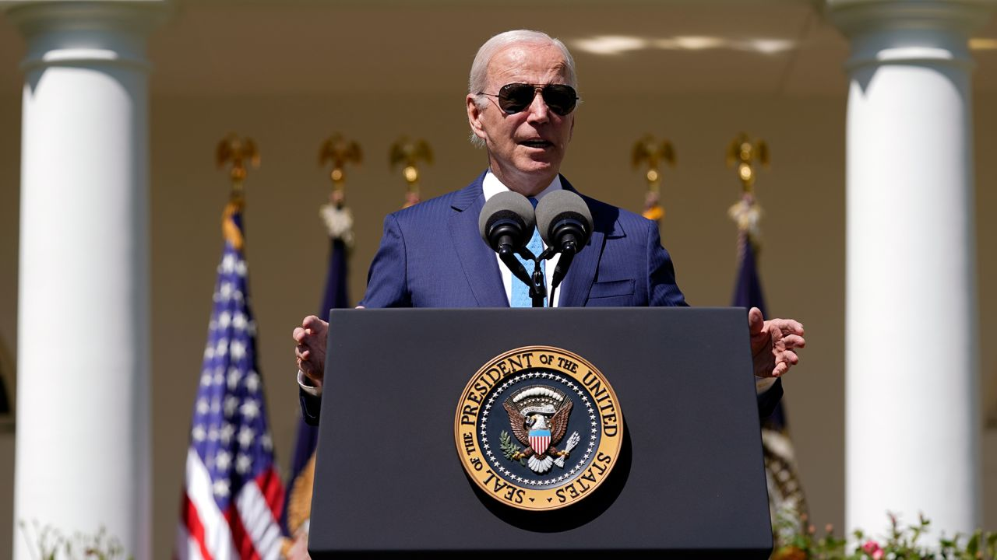
Biden: China as a Great Power Rival
October 2022 National Security Strategy
September 2022:“Biden tells 60 Minutes U.S. troops would defend Taiwan”
May 2022: South China Morning Post

Slide 19
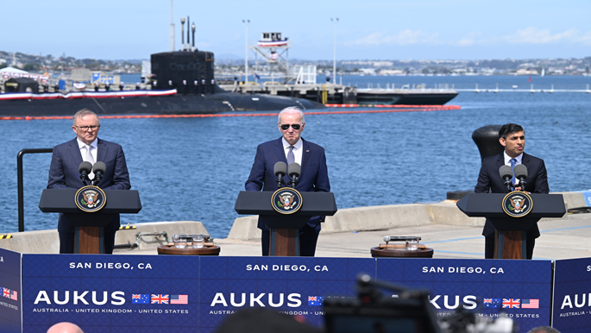
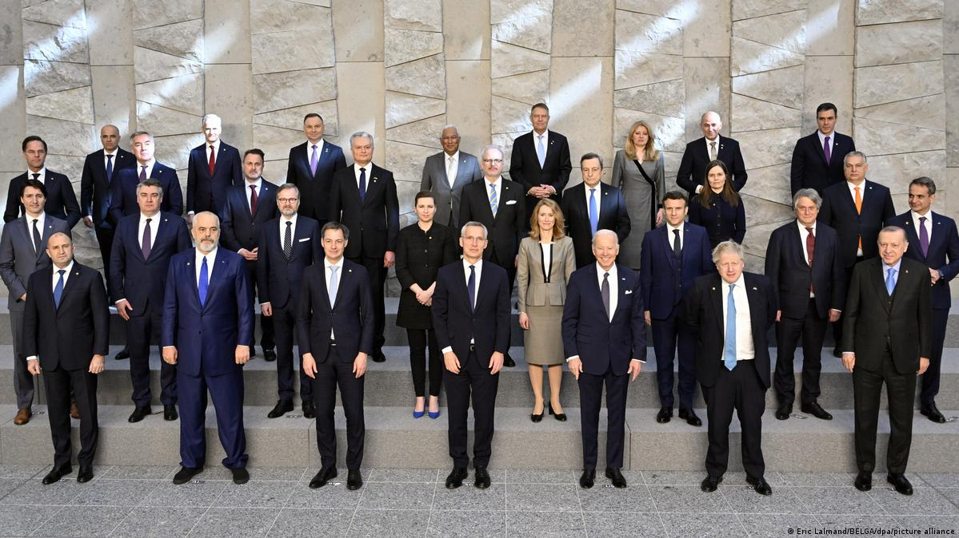
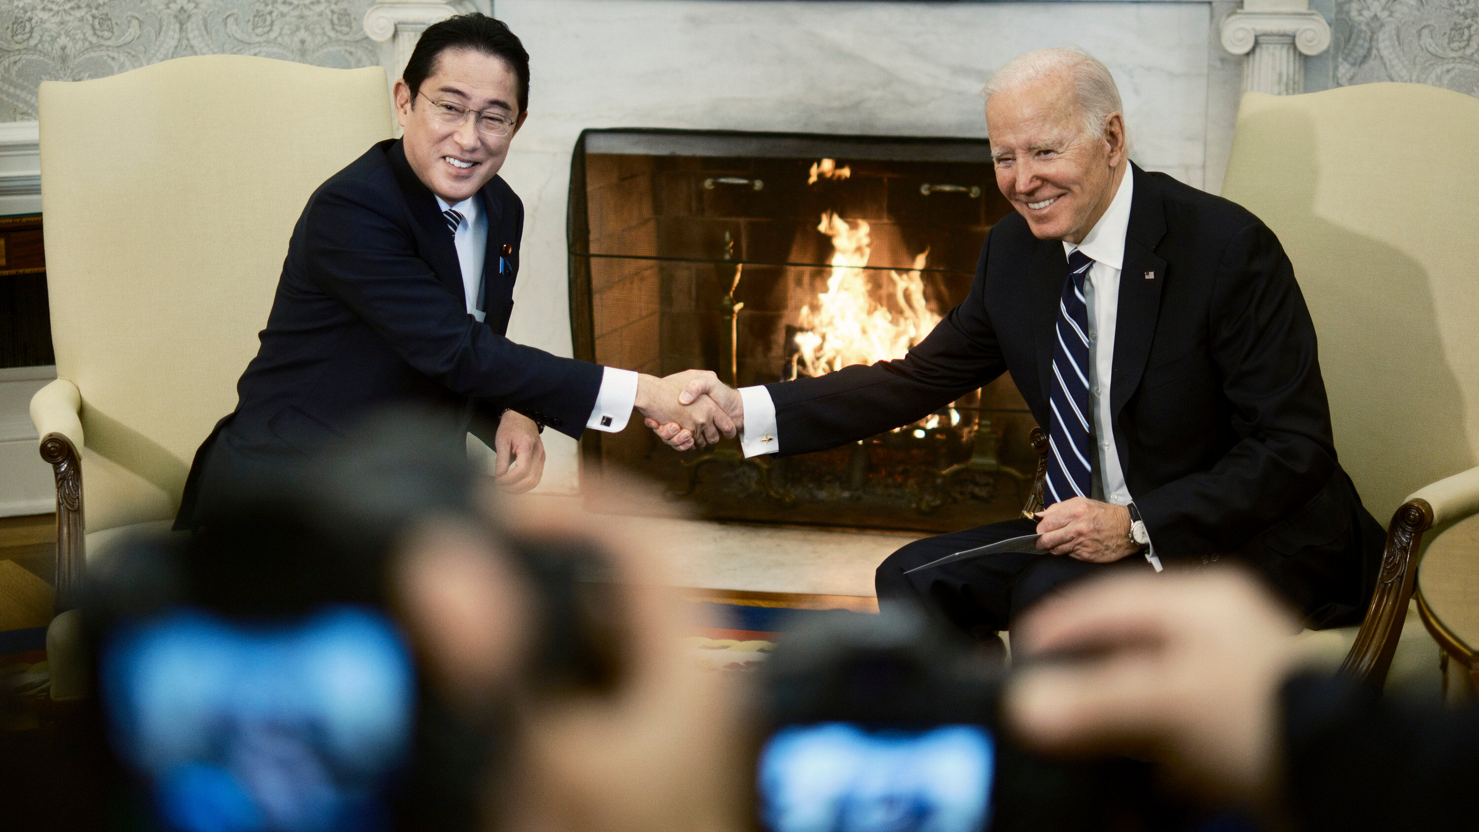
4. Tradition: Alliances

Slide 20
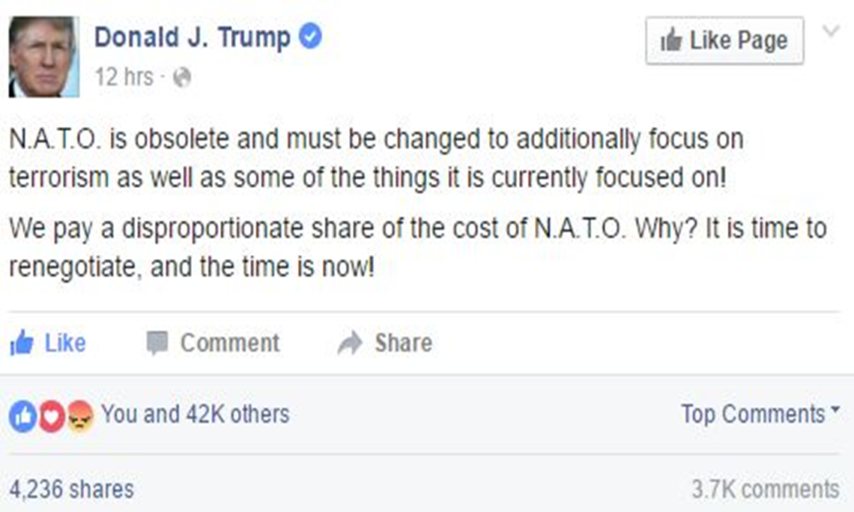
Trump: Skeptical about Alliances
US wants to be paid for defending allies

Slide 21
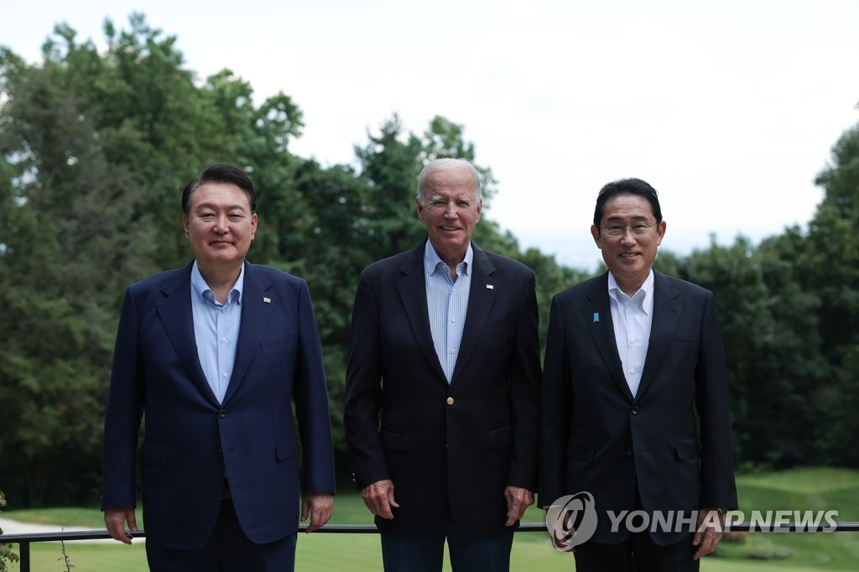
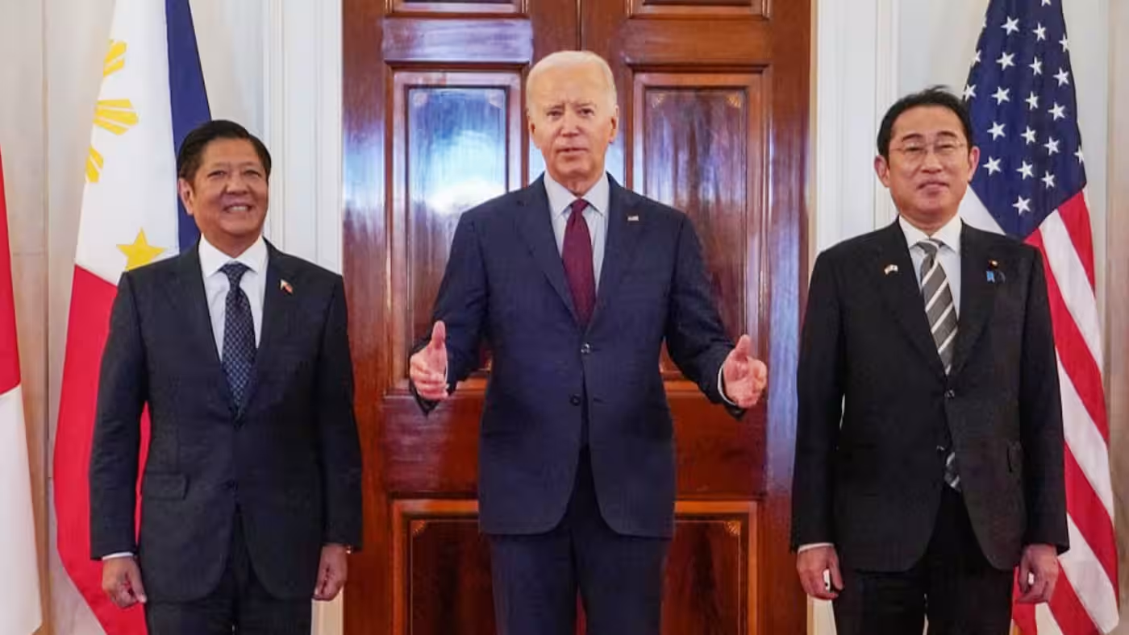
Biden: Strengthen and Expand Alliances
Sweden and Finland added to NATO, 2023/24
S. Korea, US, Japan Summit Philippines, US, Japan Summit
August 2023 April 2024
Yoon, Biden, Kishida Marcos, Biden, Kishida

Slide 22
4. Tradition: Russia as Rival

Slide 23
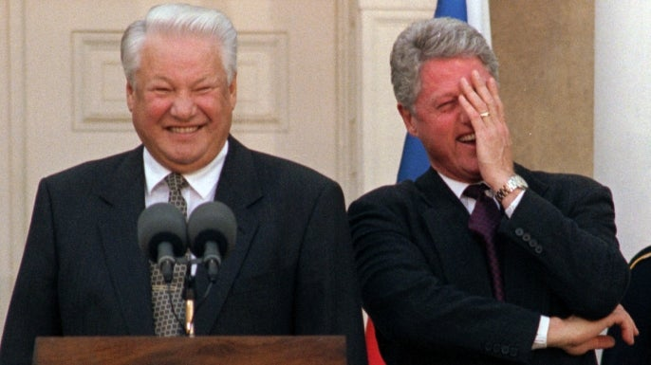
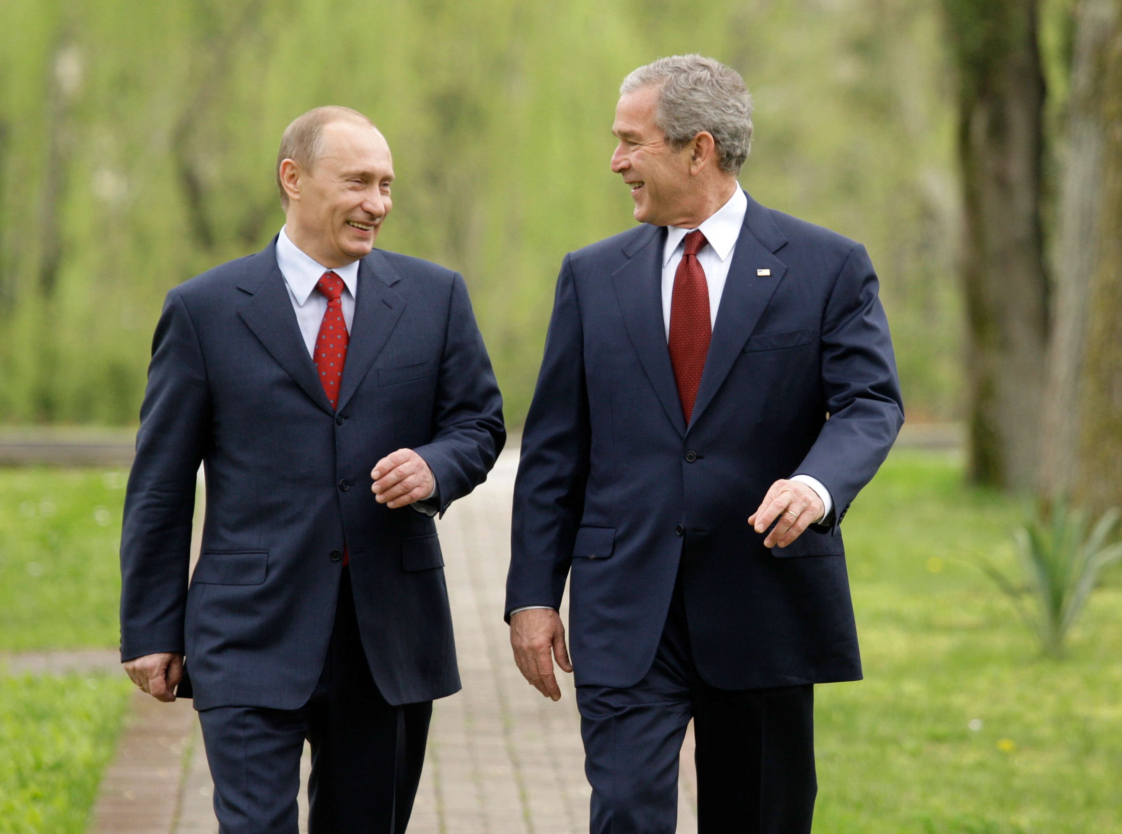
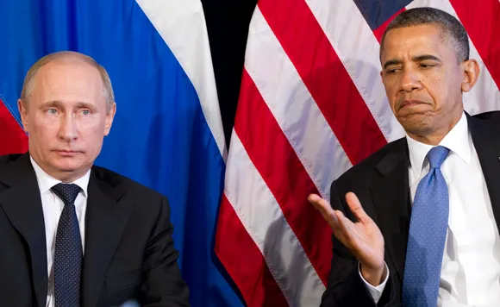
Post-Cold War Russia as a Friend?
Yeltsin-Clinton Putin-GW Bush
Putin-Obama

