Slide 1
Impeachment of Donald Trump 2019-2020

Slide 2
House of Representatives
US Constitution
Article I, Section 2, Clause 5: ”The House of Representatives shall chuse their Speaker and other Officers; and shall have the sole Power of Impeachment.”

Slide 3
US Senate
US Constitution
Article 1, Section 3, Clause 6: “The Senate shall have the sole Power to try all Impeachments. When sitting for that Purpose, they shall be on Oath or Affirmation. When the President of the United States is tried, the Chief Justice shall preside: And no Person shall be convicted without the Concurrence of two thirds of the Members present.”
Article 1, Section 3, Clause 7: “Judgment in Cases of impeachment shall not extend further than to removal from Office, and disqualification to hold and enjoy any Office of honor, Trust or Profit under the United States: but the Party convicted shall nevertheless be liable and subject to Indictment, Trial, Judgment and Punishment, according to Law.”

Slide 4
Standard for Impeachment and Removal
US Constitution
Article 2, Section 4: “The President, Vice President and all civil Officers of the United States, shall be removed from Office on Impeachment for, and Conviction of, Treason, Bribery, or other high Crimes and Misdemeanors.”

Slide 5
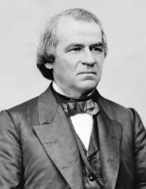
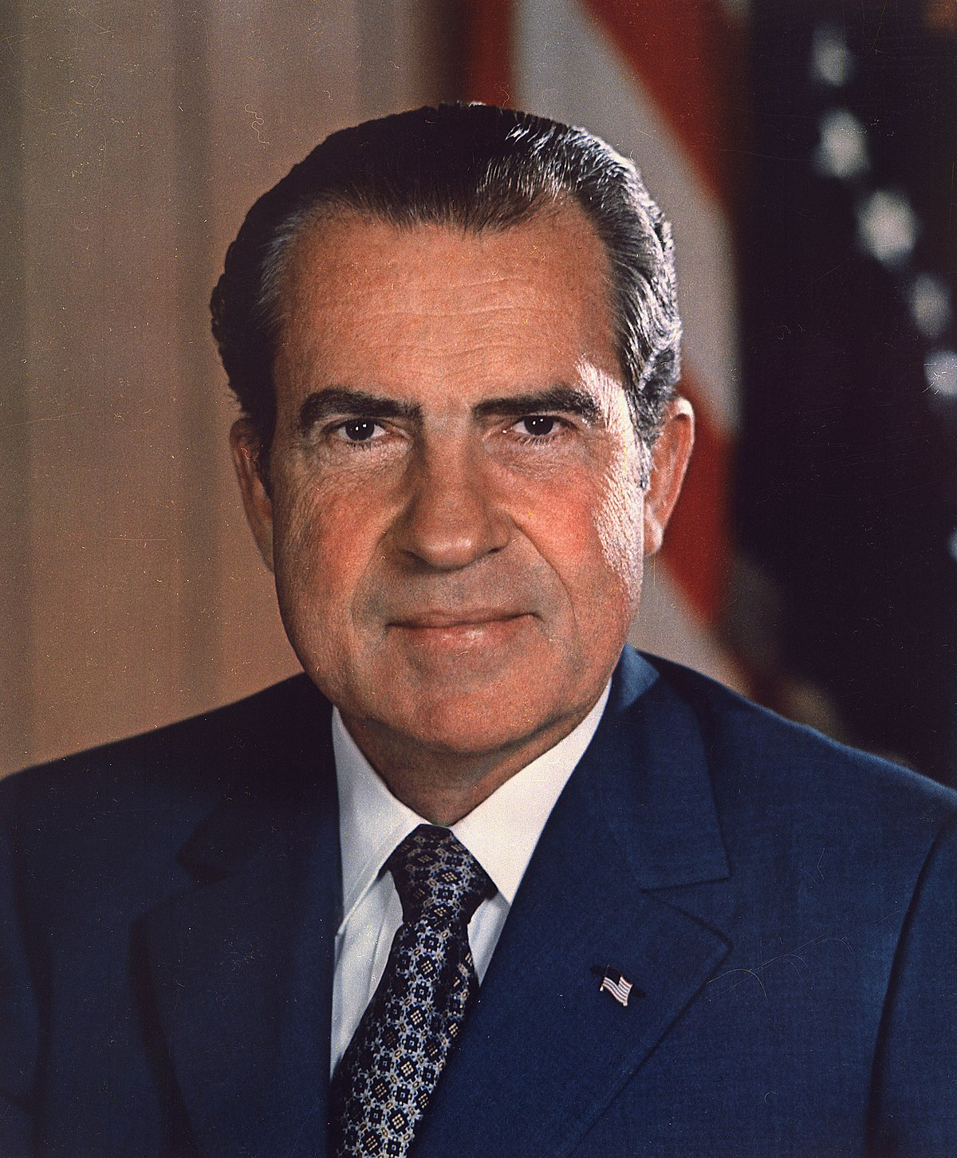
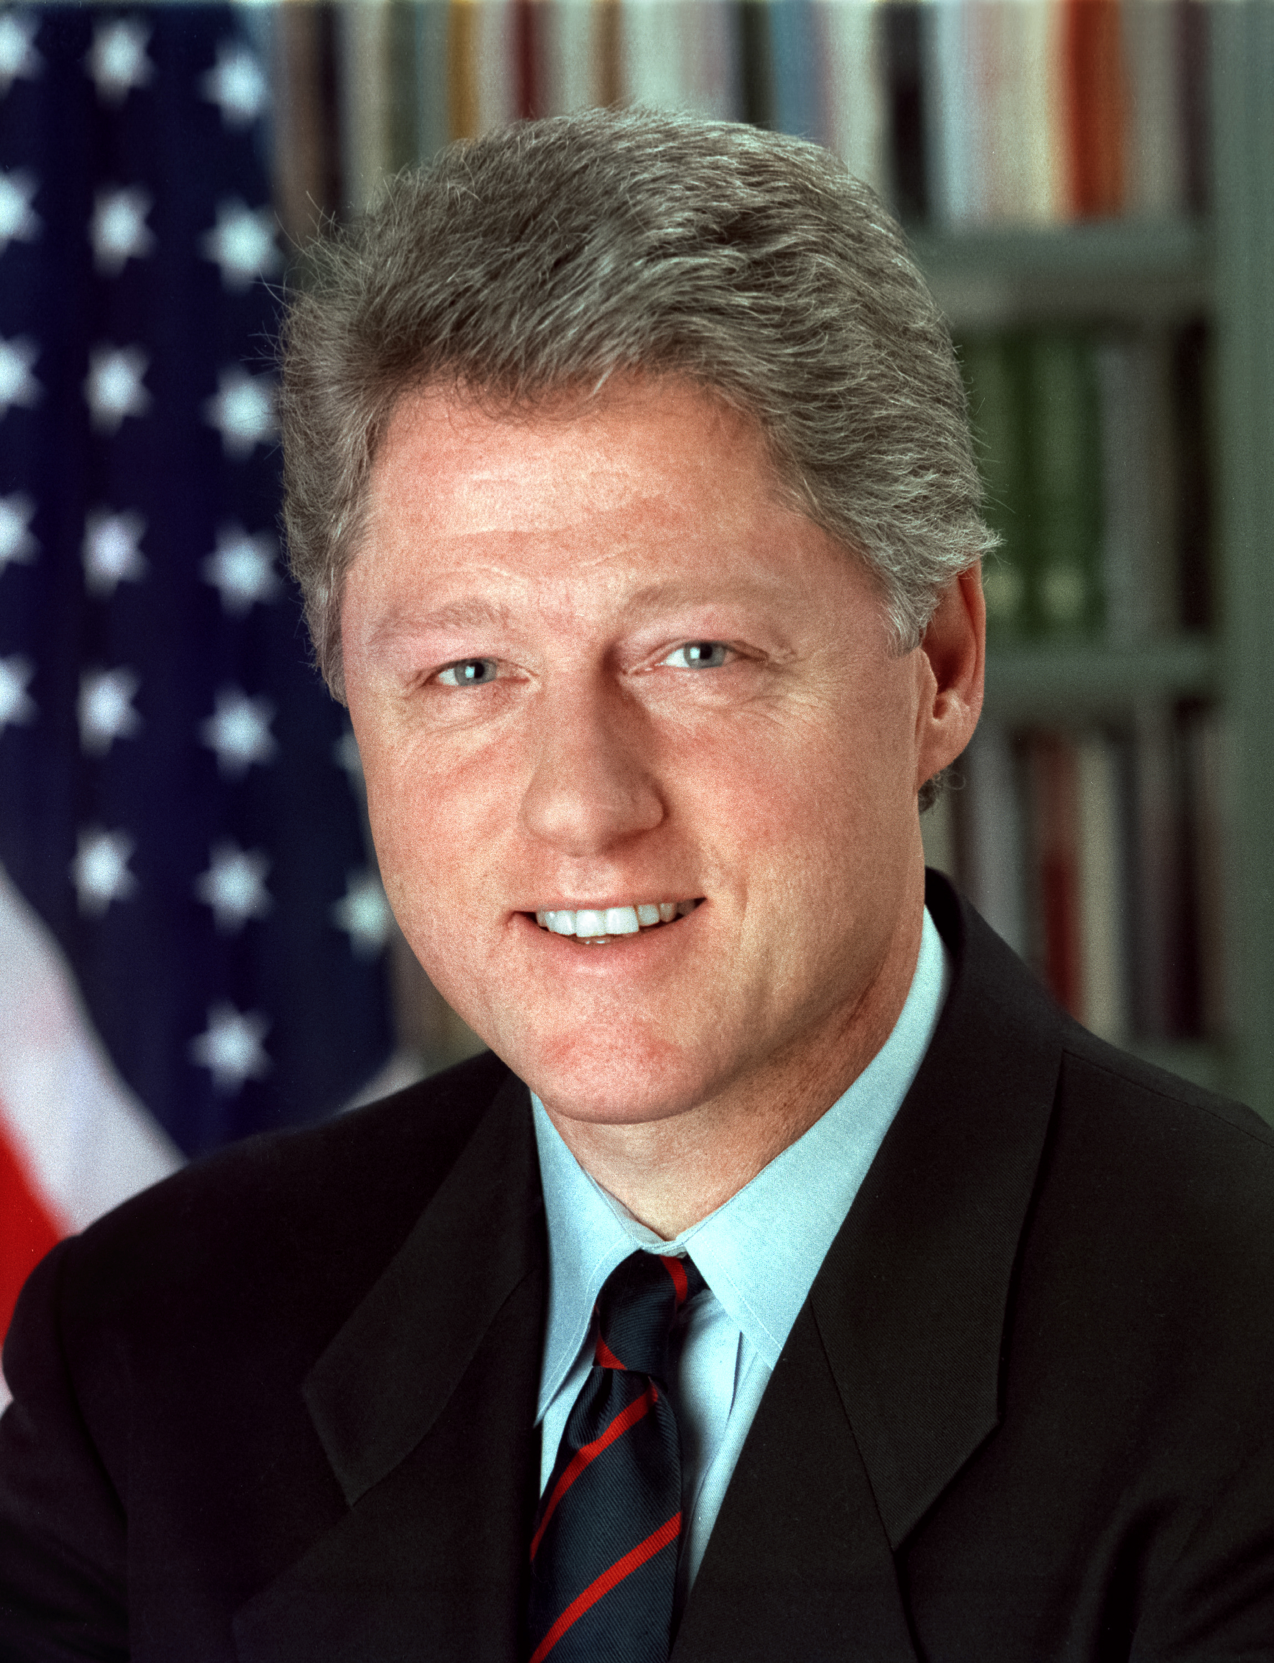
The Past
Andrew Johnson Richard Nixon Bill Clinton
Impeached, Impeachment Impeached,
but not removed proceedings underway. but not removed
1868 Resigned 8/9/1974 1998/99

Slide 6
Ukraine and Russian Aggression, 2014

Slide 7
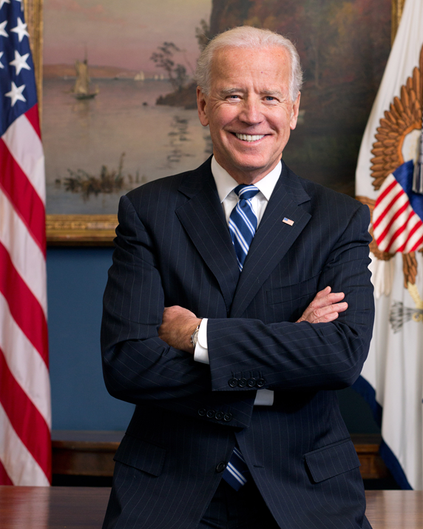
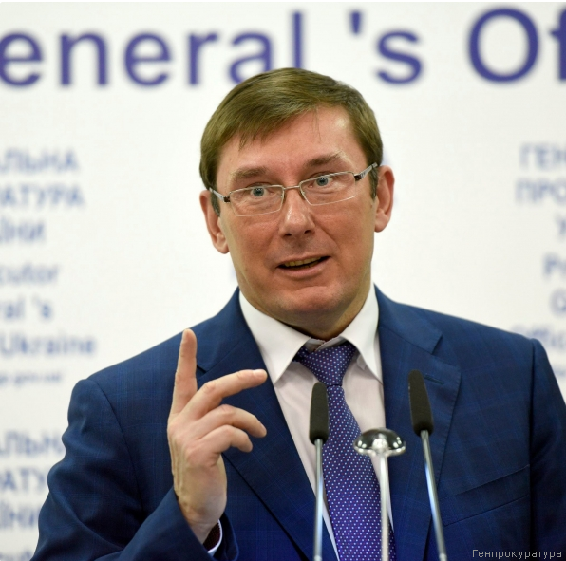
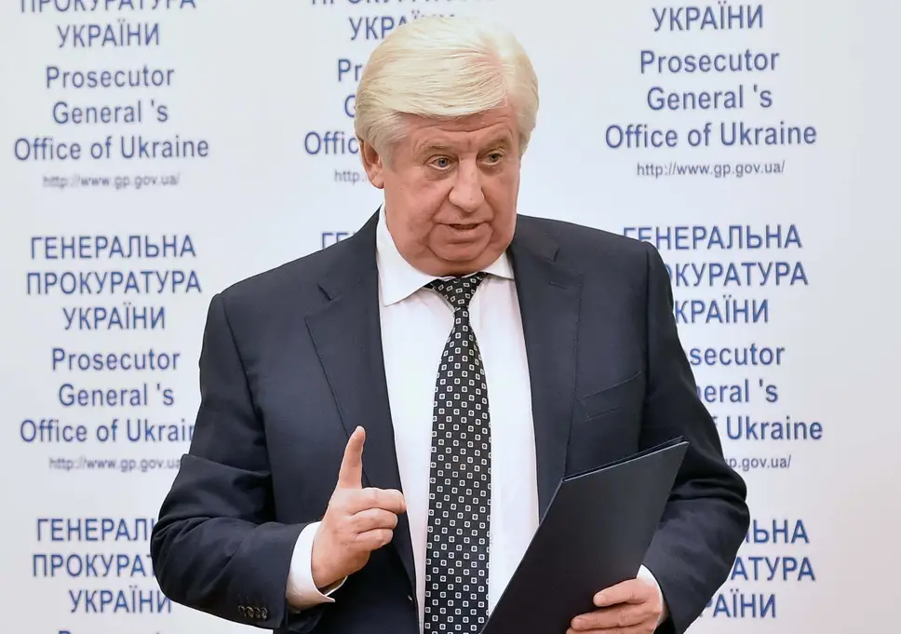
Allegations against VP Joe Biden Russian Disinformation Campaign
Viktor Shokin VP Joe Biden Yuri Lutsenko
Ukraine Chief Prosecutor Shokin Successor

Slide 8
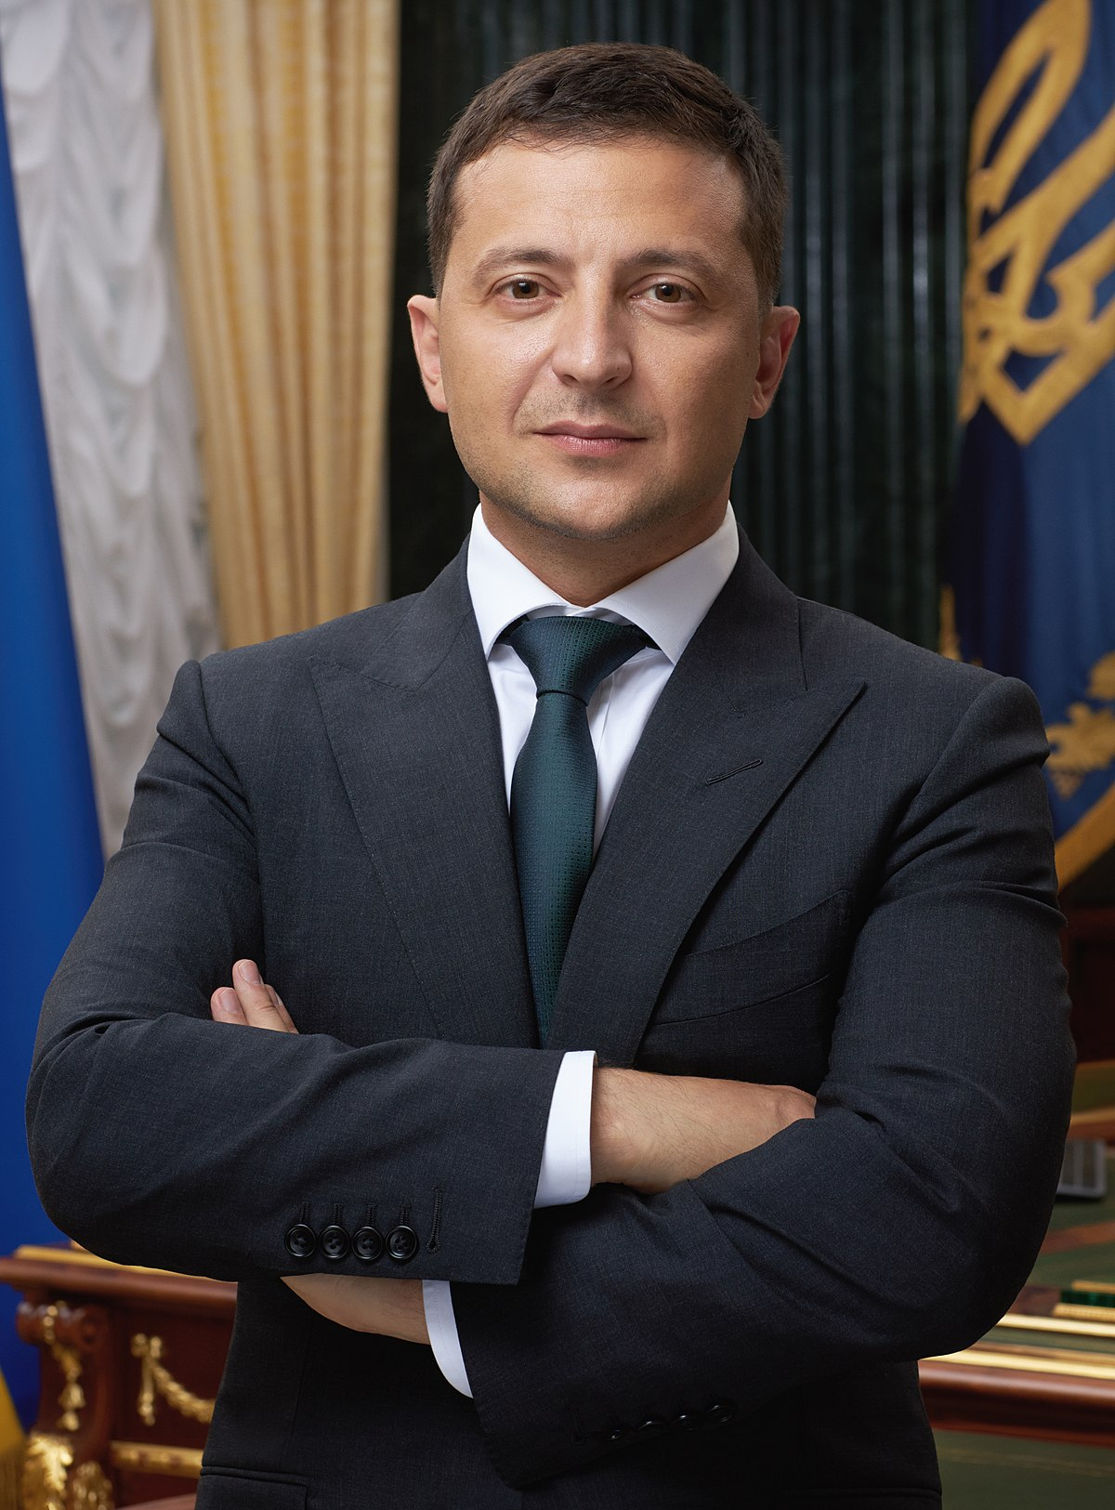
Trump and Ukraine
$391 million in US Aid to Ukraine
July 25, 2019 Phone Call
The Whistleblower Report
White House Transcript
Pres. Volodimir Zelensky
“…I would like you to do us a favor though… The other thing, There's a lot of talk about Biden's son,. that Biden stopped the prosecution and a lot of people want to find out about that so whatever you can do with the Attorney General would be great. Biden went around bragging that he stopped the prosecution so if you ·can look into it ... It sounds horrible to me.” (pages 3-4)

Slide 9
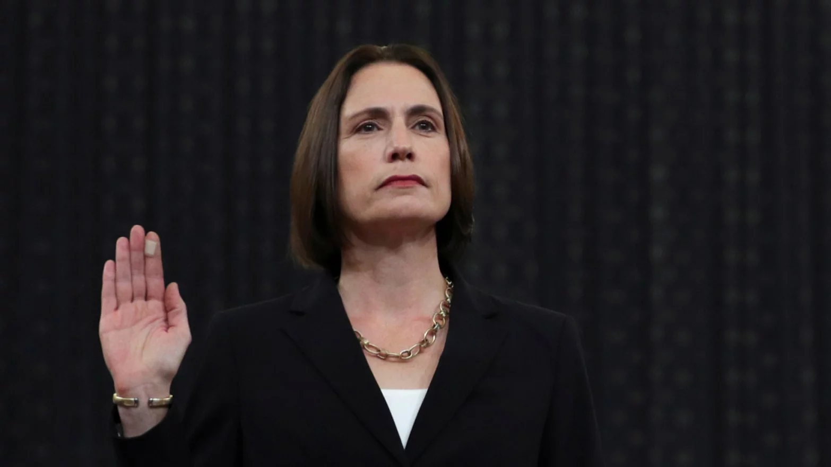
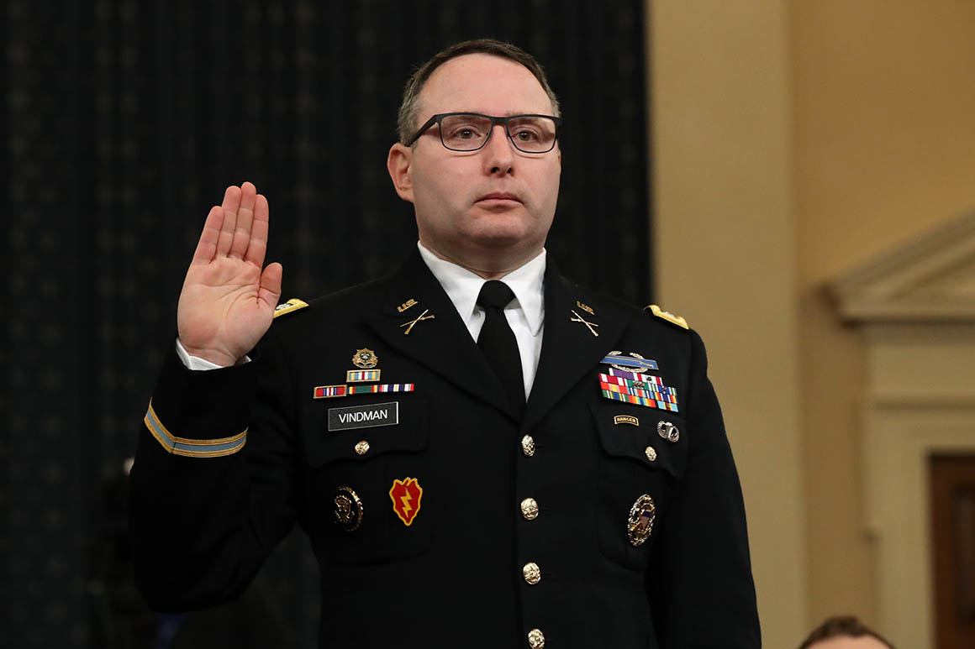
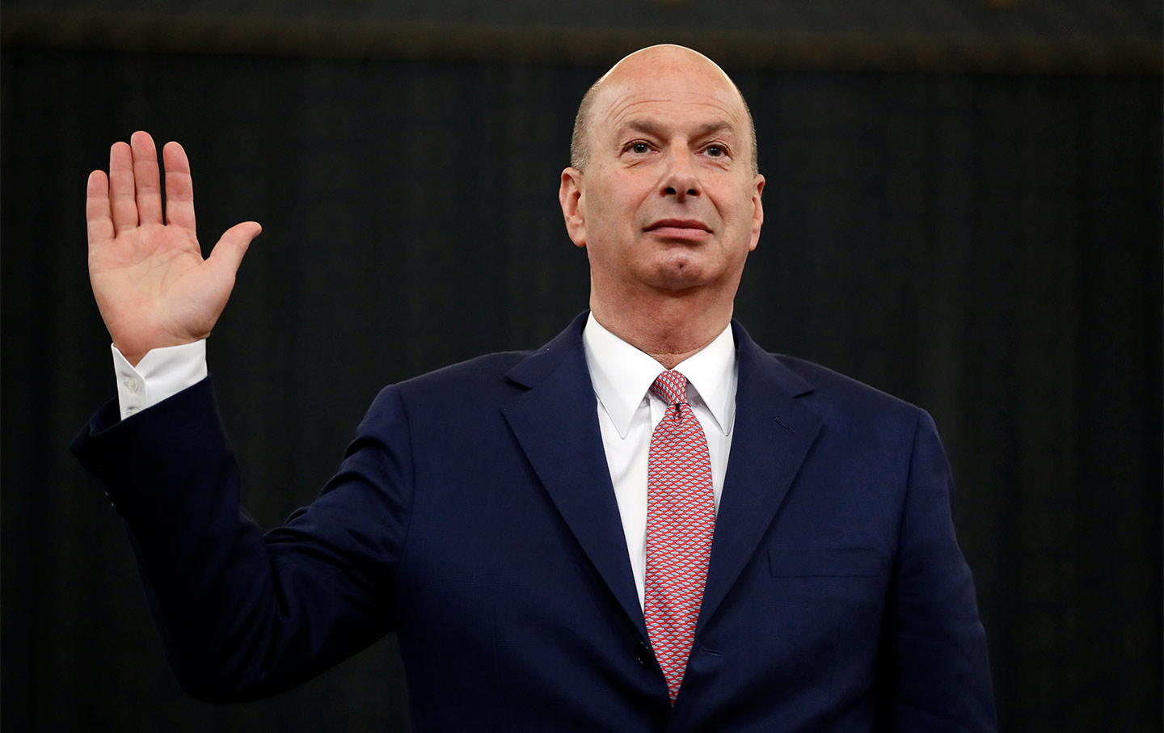
House Intelligence Committee
Hearings October –November 2019
Committee Report December 2019
Fiona Hill Lt. Col. Alexander Vindman Ambassador
NSC Staff NSC Staff Gordon Sondland

Slide 10
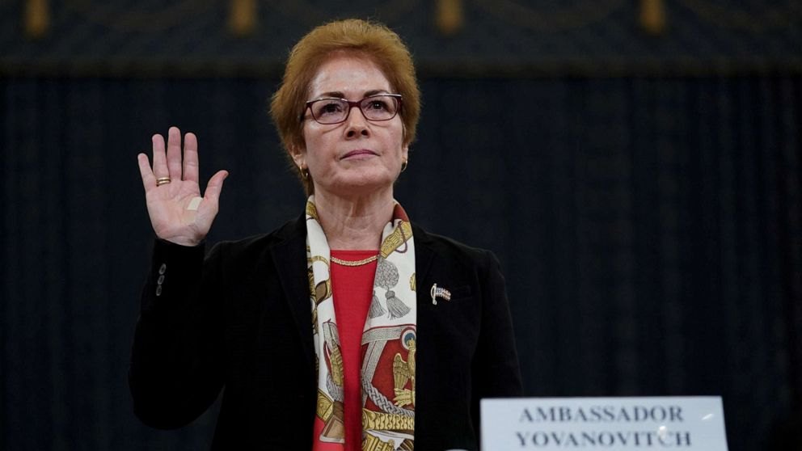
House Intelligence Committee
Ambassador Marie Yovanovitch
Former US Ambassador to Ukraine

Slide 11
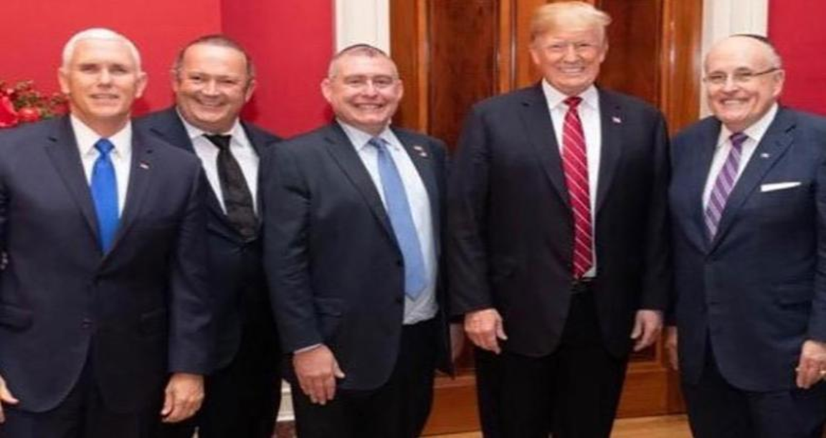
Rudolph Giuliani
VP Pence, Igor Fruman, Lev Parnas, Pres. Trump, Mayor Giuliani
(Fruman and Parnas indicted for campaign finance violations)

Slide 12
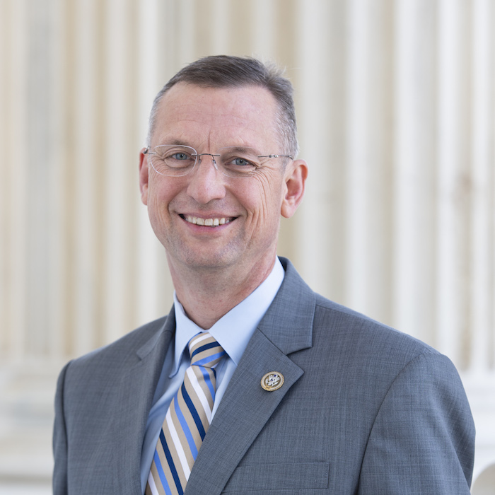
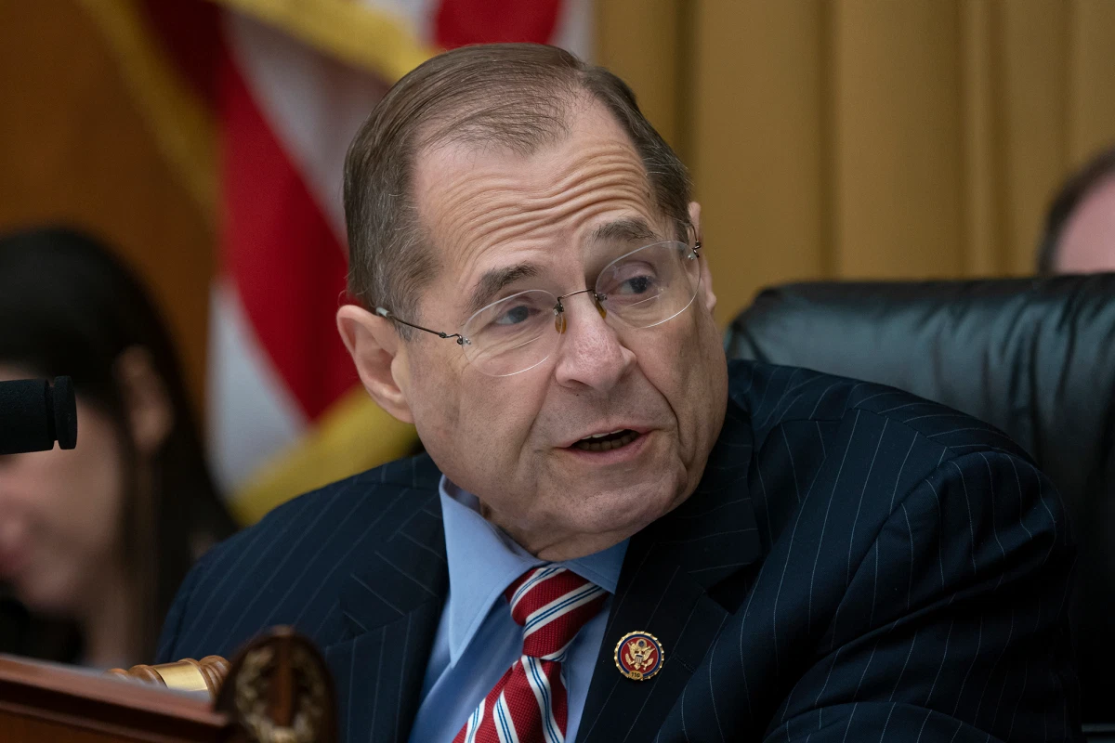
House Judiciary Committee
Hearings
Impeachment Report, December 13, 2019
Chair Jerold Nadler (D-NY) Ranking Member Doug Collins (R-GA)

Slide 13
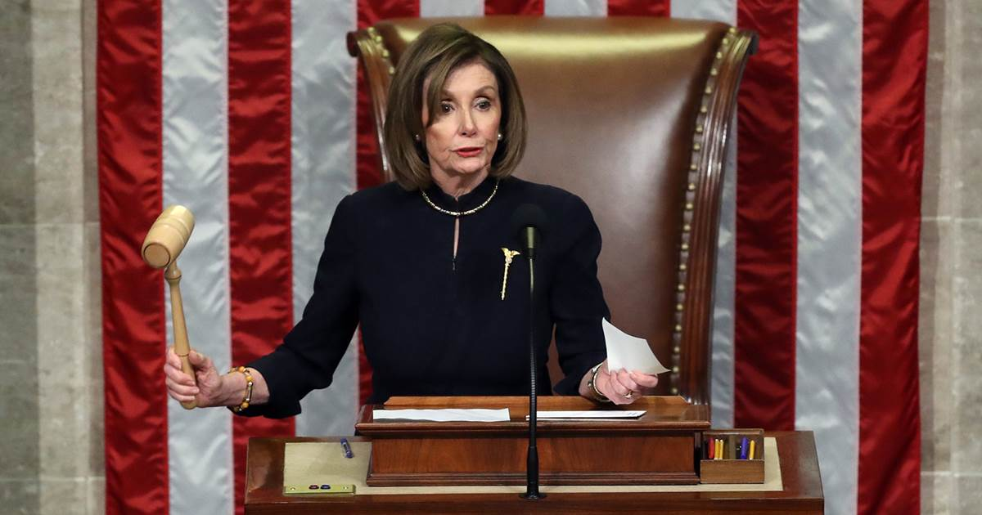
Trump Impeached December 18, 2019
Articles of Impeachment against President Donald Trump
December 10, 2019
Vote on Article One: Abuse of Power (230-197)
December 18, 2019
Vote on Article Two:
Obstruction of Congress (229-198)
December 18, 2019

Slide 14
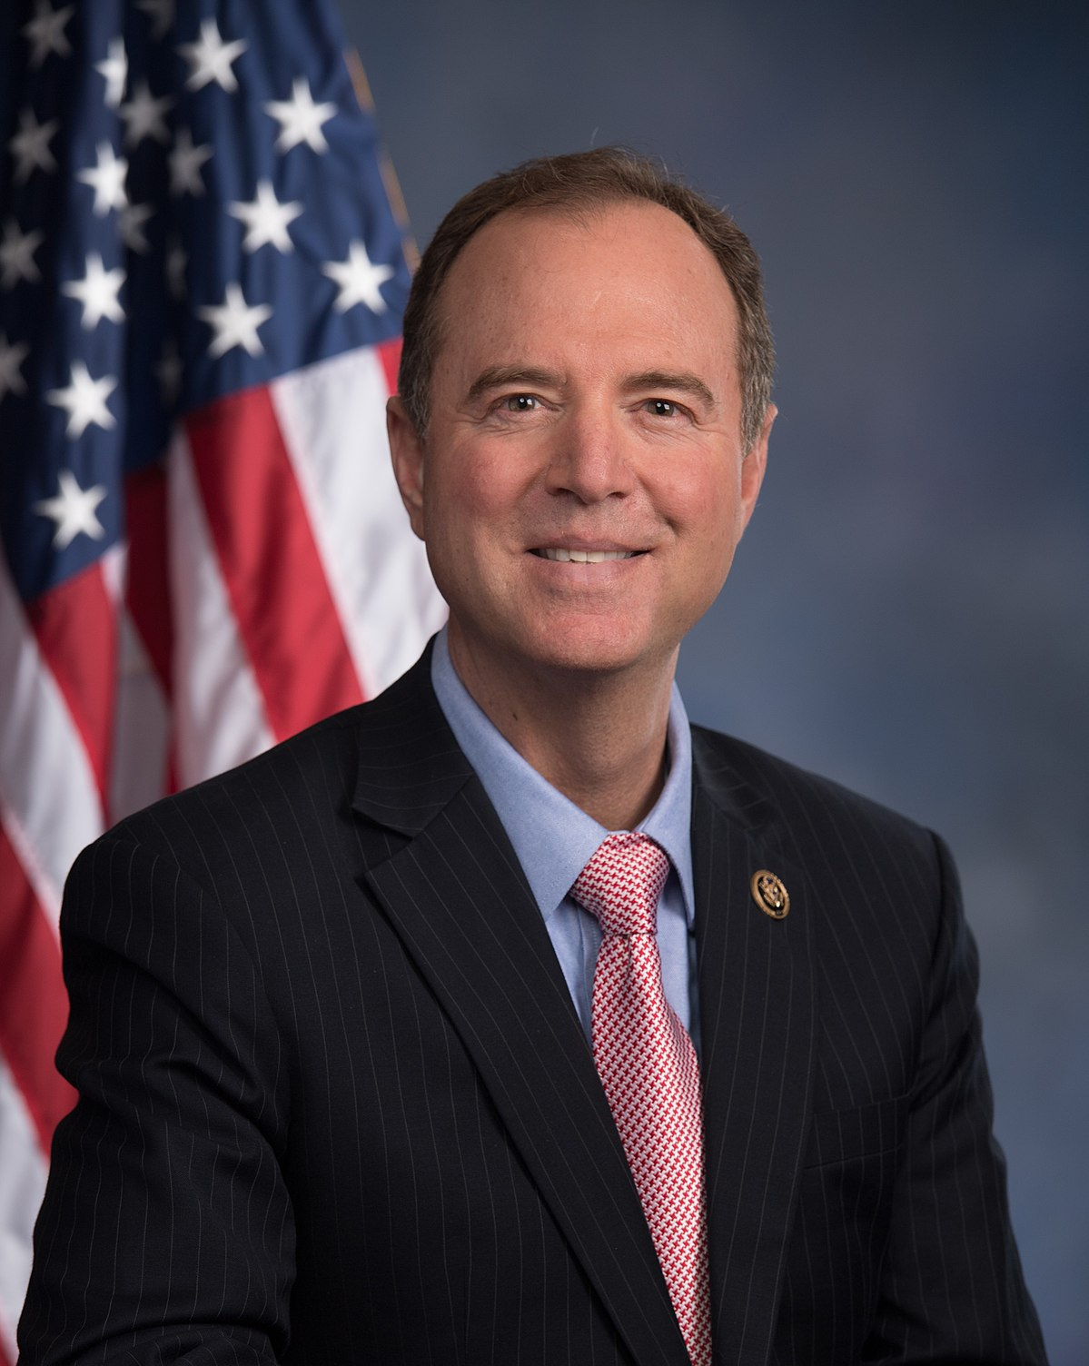
House Vote to Send Articles of Impeachment to Senate: January 15, 2020
House Impeachment Managers
Adam Schiff, D-CA
Jerold Nadler, D-NY
Hakeem Jeffries, D-NY
Val Demings, D-FL
Zoe Lofgren, D-CA
Jason Crow, D-CO
Sylvia Garcia, D-TX Rep. Schiff
Intel Committee Chair

Slide 15
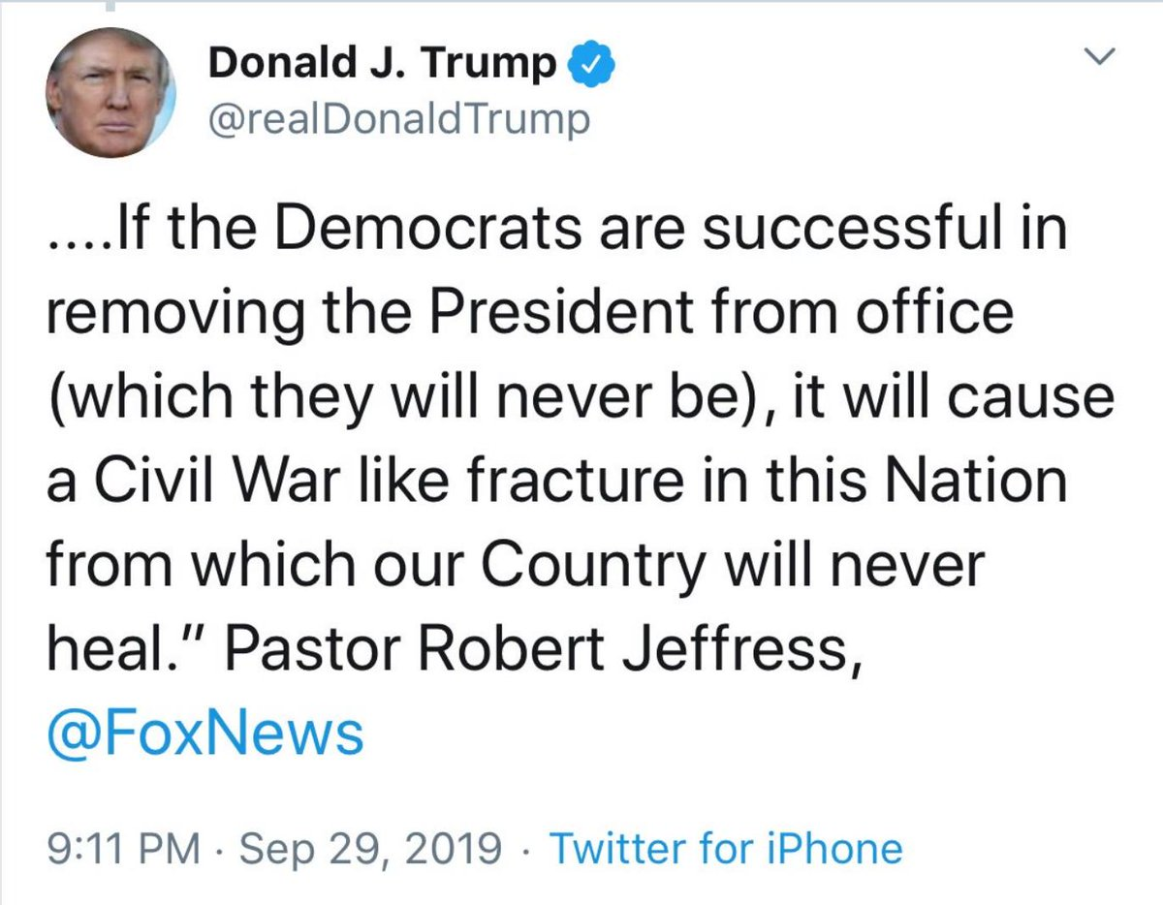
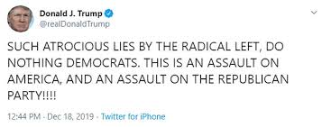
Trump Response
Refusal to allow witness testimony
Refusal to turn over documents

Slide 16
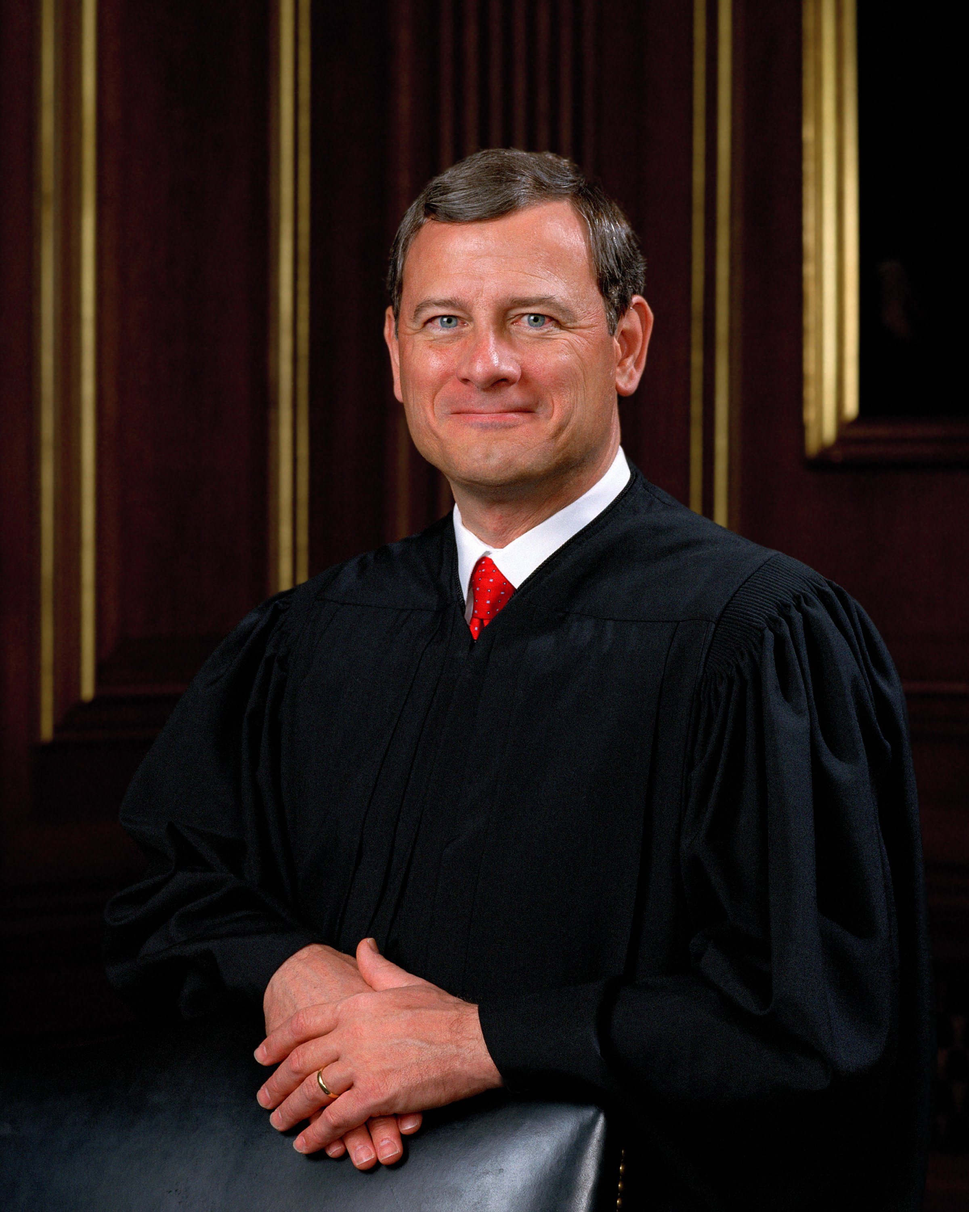
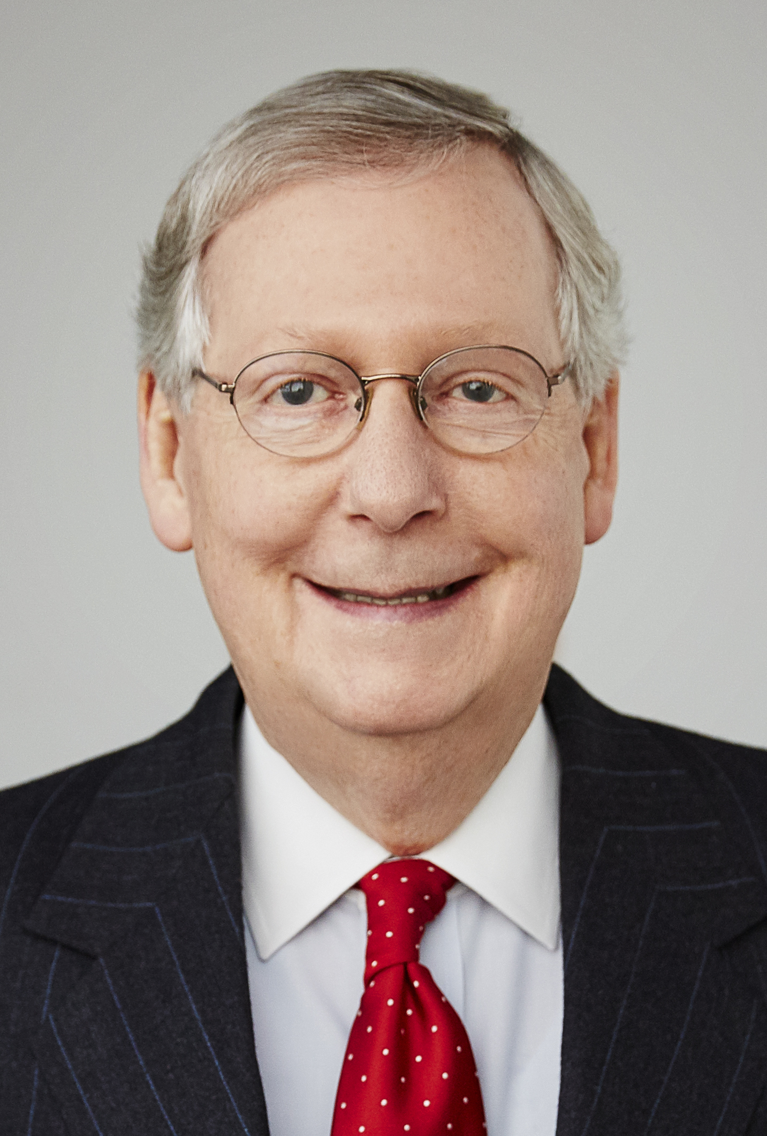
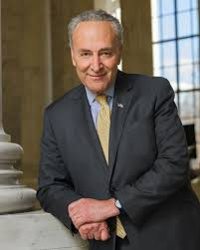
To the Senate
Majority Leader Minority Leader
Mitch McConnell Chief Justice Chuck Schumer
(R-KY) John Roberts (D-NY)

Slide 17
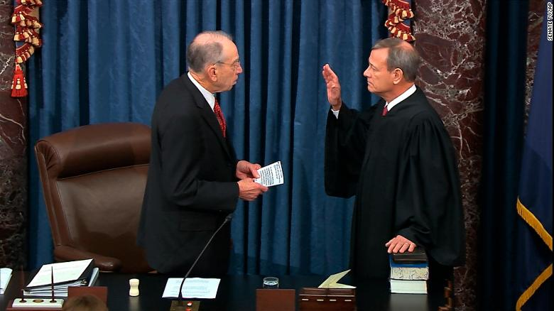
Starting Arguments
House Impeachment Trial Memorandum
Trump White House Trial Memorandum
President Trump’s Response
January 16, 2020
Senator Charles Grassley (R-IA)
Swearing in Chief Justice John Roberts

