Slide 1
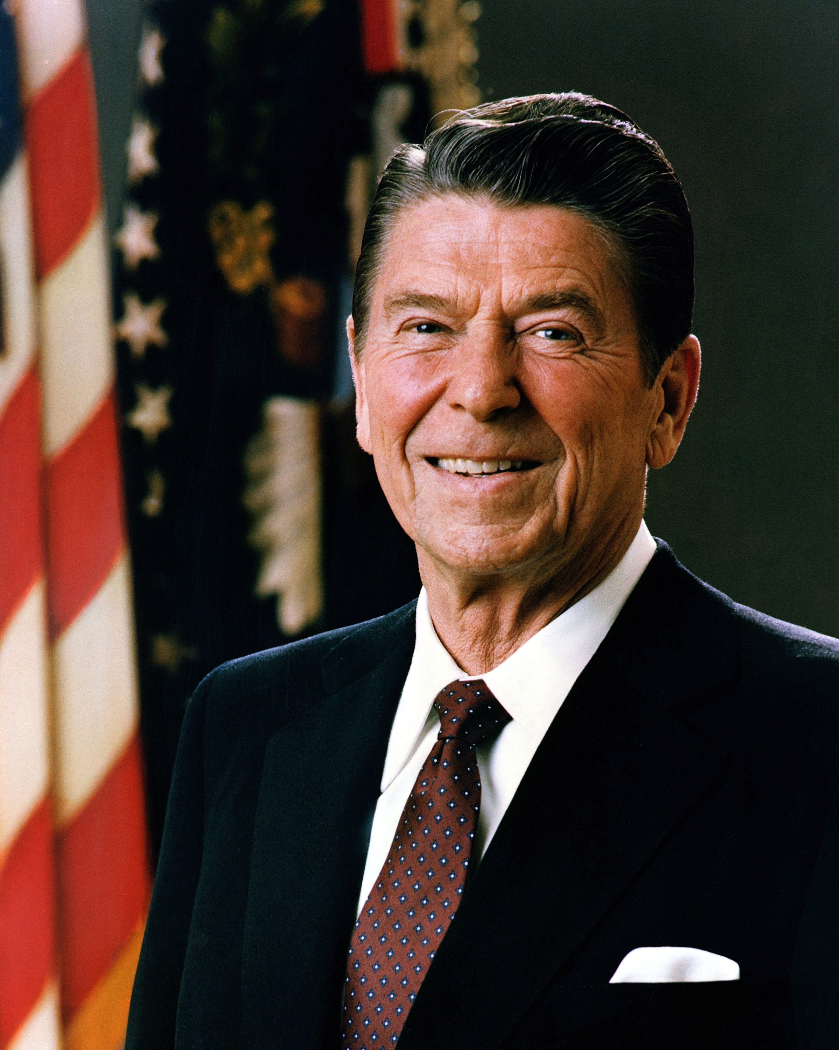
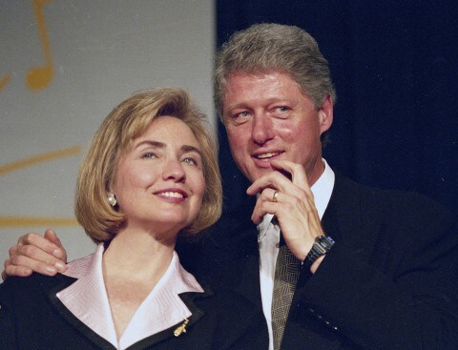
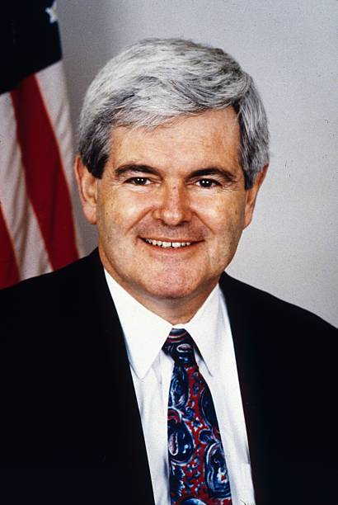
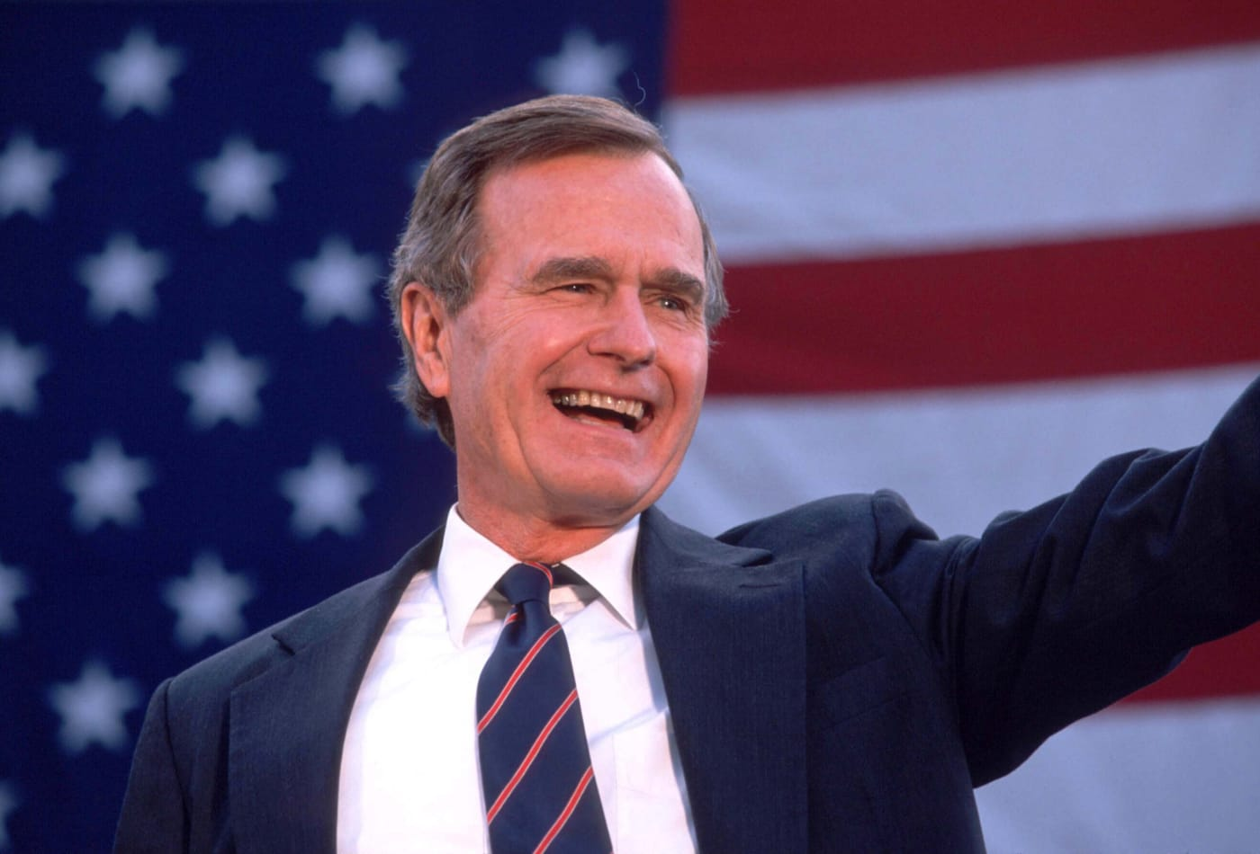
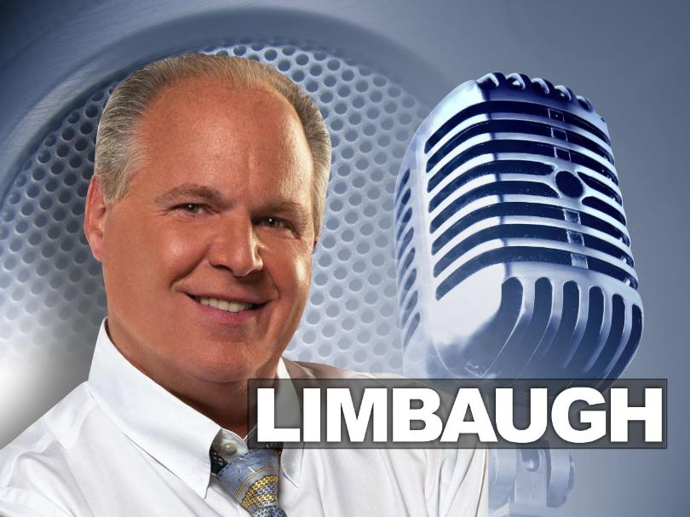
The Battle for Party Philosophy 1980s/1990s

Slide 2
The Political Context
Reagan Realignment
Reagan Success
Democratic defeat 1984: 525-13 EV
Change in belief:
  Government is the problem

Slide 3
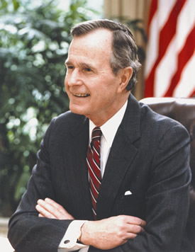
George H. W. Bush (41)
Ultimate Insider
(reference)
US House of Representatives (1967-71)
Senate Candidate 1970
US Ambassador to the UN
Head, US Liaison Mission to China
Republic Party Chairman
Director of Central Intelligence

Slide 4
Republican Party Battle Lines
conservative
Small “c”
Smaller government
Some government role
Cut taxes
Economic focus
Might be pro-choice
Conservative
Movement Conservative
Gov’t is the problem
Huge tax cuts
Social conservative
  Anti-Abortion
  Gun rights
  Evolution/Creationism
  Anti-Gay rights
  Prayer in school

Slide 5
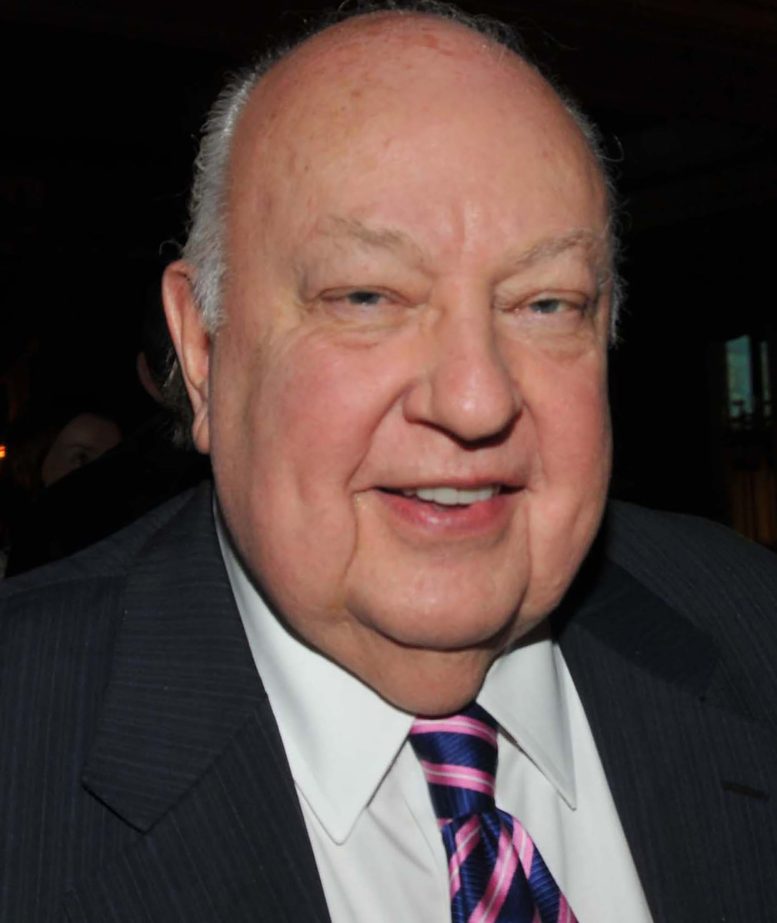
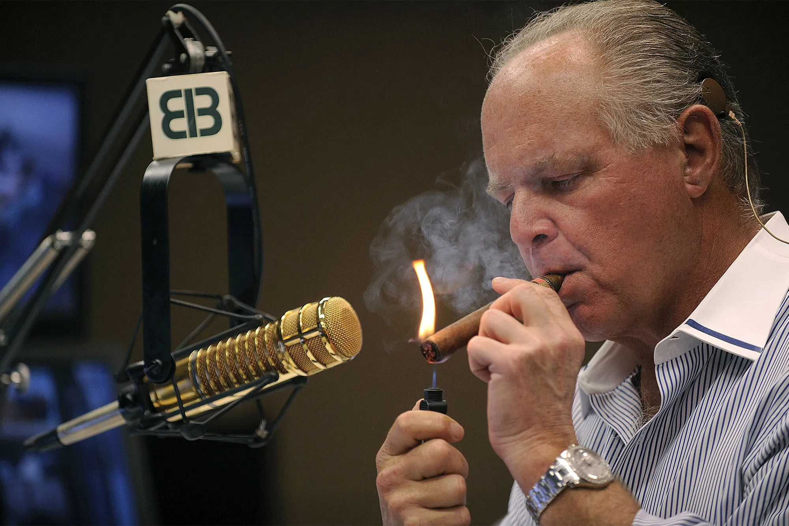

The Real Deciders
Rush Limbaugh Fox News
Syndicated since 8/1988 On air 10/96
        Roger Ailes

Slide 6
Media Defines the Party
Limbaugh
Fox News
Republican
Voters
Republican
Politicians

Slide 7
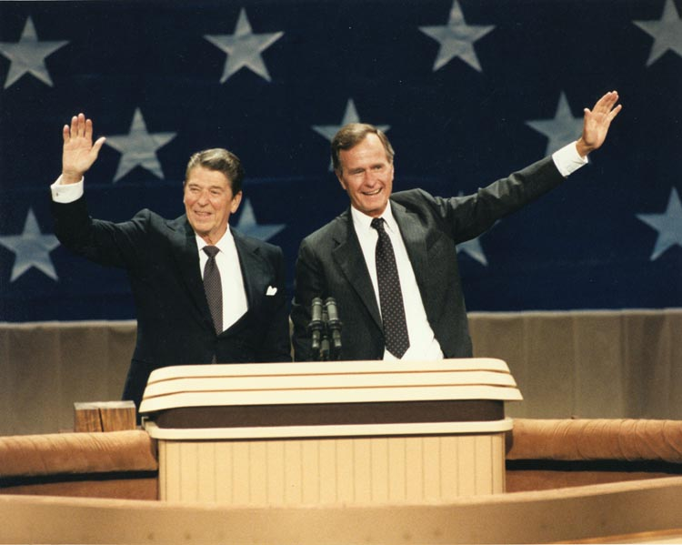
Party Loyalty: 1980

Slide 8
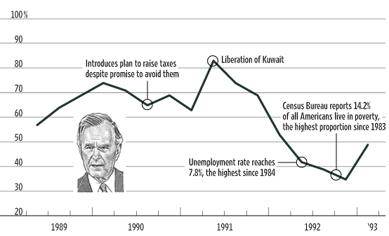
Bush 41 Approval

Slide 9

Movement Triumphs
Capital “C” Conservatives win
Ronald Reagan’s Party
  or Limbaugh’s
  or Fox’s

Slide 10
Democratic Party Changes
1960s-1980s
Loss of South
Reagan shifts the electorate to right
Deficit
Tax Revolts
Perceived failure of Great Society
Rejection of Reaganomics
Crushing loss in 1984
Notes:
10

Slide 11
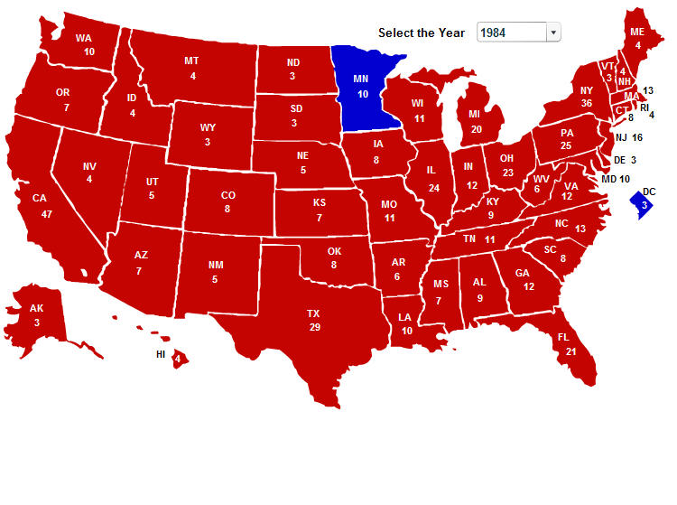
Democrats Hit Bottom

Slide 12
Democratic Debate
Traditional Liberals
Centrist “New Democrats”
New Deal/Great Society
pro-labor
maybe protectionist
socially liberal
activist government
Democratic Leadership Council
pro-business
free trade
socially liberal
limited, but important, government role

Slide 13
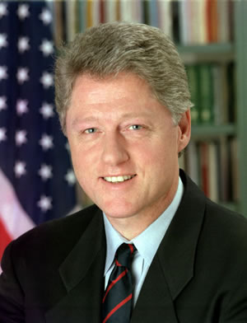
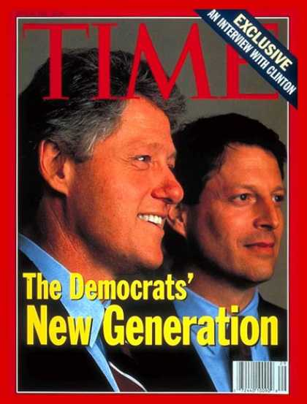
Bill Clinton
Notes:
13

Slide 14
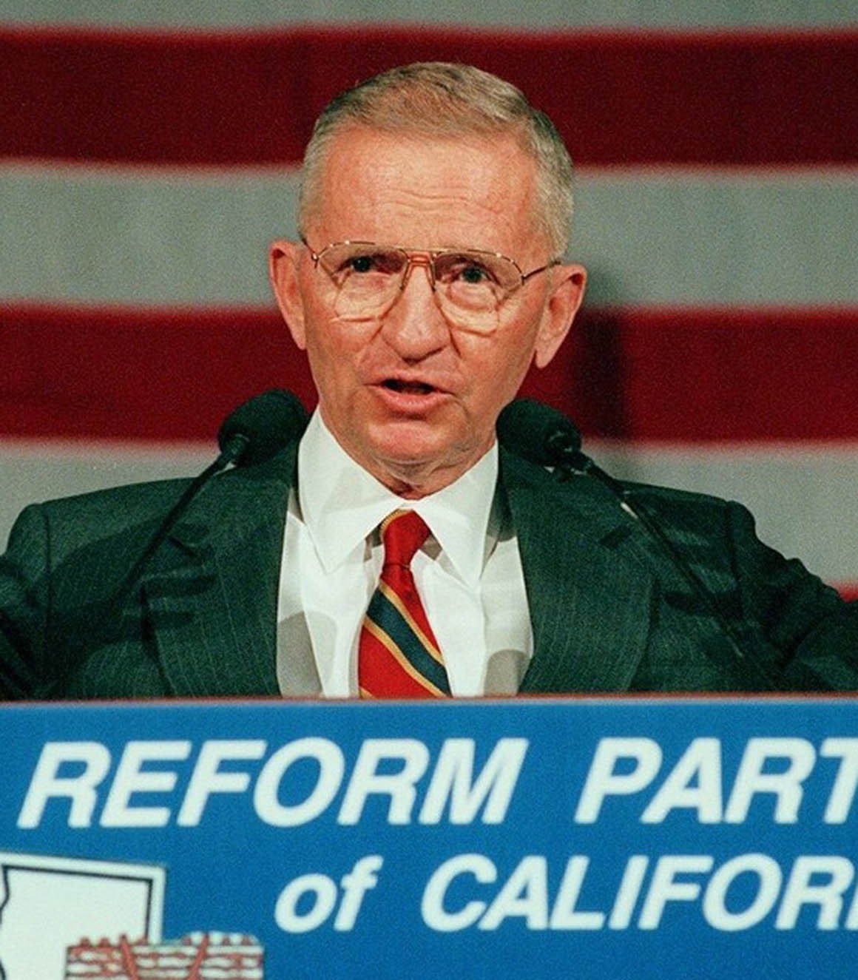
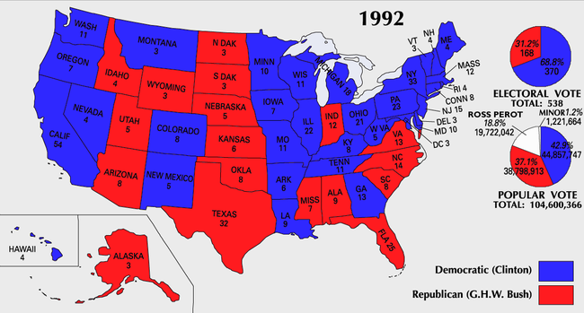
1992
Clinton 43%
Bush 37%
Perot 19%
Notes:
14

Slide 15
Was Clinton a New Democrat? The Argument
Republican view
Old Democrat
Paleoliberal
Tax and spend liberal
Big Government
Democrat view
New Democrat
Notes:
15

Slide 16
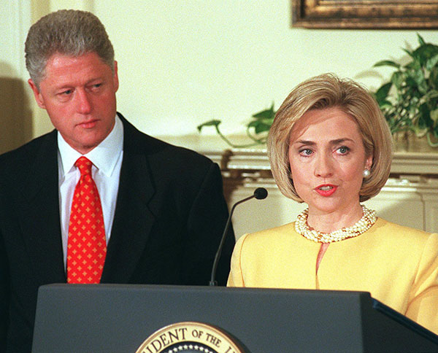
Was Clinton a New Democrat?
Gays in the military
Health Care
Notes:
16

Slide 17
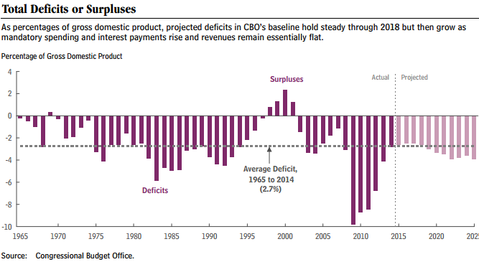
Was Clinton a New Democrat?
Budget
“Triangulation” and Welfare Reform
  1996 SOTU: “The era of big government is over”

Slide 18
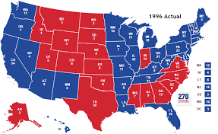
1996 Election
Clinton 379 EV 49.23%
Dole 159 EV 40.72%

Slide 19
Was Clinton a New Democrat?
Trade
Economic World Order Building
  NAFTA: North American Free Trade Agreement
  APEC: Asia-Pacific Economic Cooperation
  WTO: World Trade Organization
Modernizing the Economy
  Modernizing the Workforce
  Clinton NH Speech: February 1992
Notes:
19

Slide 20
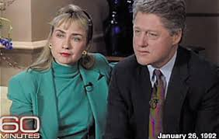
The Trust Issue
1992 Campaign
The Draft
Drug Use
Gennifer Flowers
The Interview
Notes:
20

Slide 21
1990s Gingrich GoPac Memo
“Language: A Key Mechanism of Control.”
“Language is listed as a key mechanism of control used by a majority party…Apply these to the opponent, their record, proposals and their party.”
“decay… failure (fail)… collapse(ing)… deeper… crisis…
destructive… destroy… sick… pathetic… lie… liberal…
they/them… unionized bureaucracy… betray… shallow…
traitors… sensationalists…endanger… coercion… hypocrisy
… radical… threaten… devour… waste… corruption…
incompetent… permissive attitudes… destructive… impose…
self-serving… greed…anti-(issue): flag, family, child, jobs…
pessimistic… excuses… intolerant…stagnation… welfare… corrupt… selfish… insensitive… status quo… mandate(s)… taxes… spend(ing)… shame… disgrace… punish (poor…)… bizarre… cynicism… cheat… steal… abuse of power… machine… bosses… obsolete… criminal rights… red tape… patronage”
Gingrich on Clintons: “Counterculture McGoverniks”

Slide 22


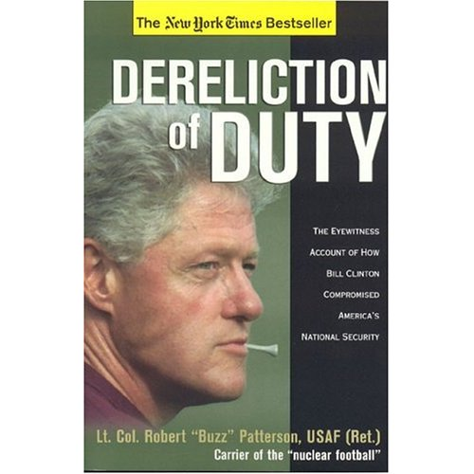

Clinton Haters
American Spectator
Regnery Publications
Notes:
22

Slide 23
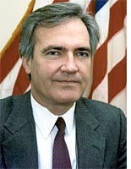
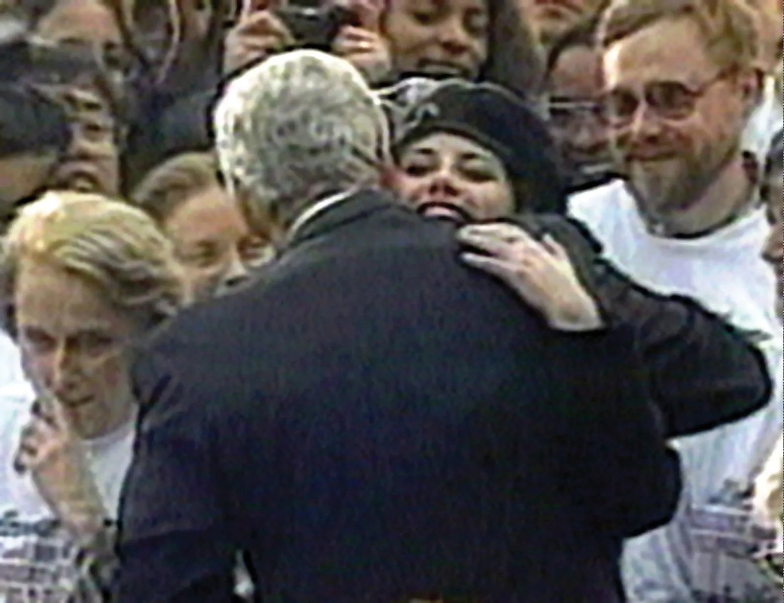
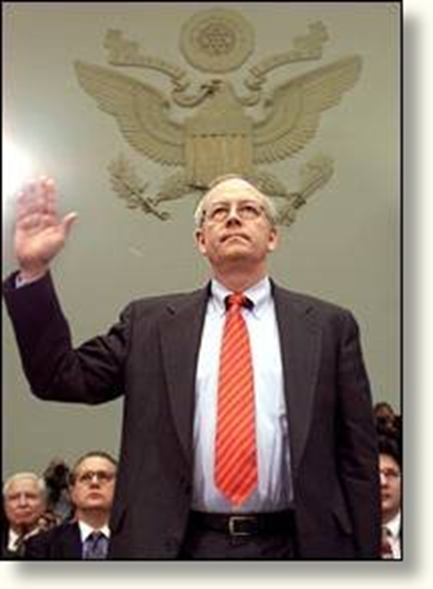
“Lewinsky Gate”
Comparison to other scandals
Whitewater Estates
Ken Starr’s Report 9/9/98
Vince Foster Monica Lewinsky Ken Starr

Slide 24
Clinton and Lewinsky Scandal
(reference)
March 8, 1992: Whitewater story in New York Times
July 1993: Vince Foster Commits Suicide
January 1994: Clinton asks DoJ to appoint special prosecutor
November 1995: Clinton begins affair with Monica Lewisky
January 1998: Attorney General Reno gives Ken Starr permission to investigate Clinton-Lewinsky relationship
September 1998: Starr Report to Congress
December 1998: Impeachment proceedings Begin
January 1999: Clinton acquitted

Slide 25
Whitewater-Lewinsky Chronology I
(for reference only)
Whitewater Vince Foster
Estates story suicide
(NY Times) (July 93)
investigation; Atty Gen Robert Fiske (1994)
files disappear Reno mid-1994 Kenneth Starr appoints Strategy: find Independent anyone who Clinton
Counsel told about finances
American Spectator David Brock Paula goes public; Paula’s lawyers
“Arkansas project” Story about sues President Clinton enemies
“Paula”
Clinton Arkansas Rivals

Slide 26
Whitewater-Lewinsky Chronology II
(for reference only)
Nov. 1995 Affair ends
Clinton begins 1997
Affair with
Lewinsky
Jan 1998 August 1998 Starr report
Jones’ lawyers Clinton testifies Sept 1998
get a tip; Starr’s Grand Jury;
ask about Lewinsky denies affair
Jan 1997
USSC rules; Reno gives Starr Starr gets tapes Impeachment
Legal to sue a approval to of Lewinsky-Tripp proceedings
President investigate conversations begin
Clinton-Lewinsky Dec. 1998
Jan 1998
Clinton and Lewinsky Senate
deposed in civil trial; acquits
deny affair 1/99

Slide 27
Articles of Impeachment
Judiciary Committee Report
Roll Call Votes (reference)
Article One: Perjury before Grand Jury
  Passed Judiciary Comm. 12/12/98: 21-16
  Passed full House 12/19/98: 320-204
  Rejected by Senate 2/12/99: 45-55
Article Two: Perjury in Civil Suit
  Passed by Judiciary Comm. 12/12/98: 20-17
  Rejected by House 12/19/98: 205-229

Slide 28
More Articles of Impeachment
(reference)
Article Three: Obstruction of Justice
  Passed Judiciary Comm. 12/12/98: 21-16
  Passed House 12/19/98: 221-212
  Rejected by Senate 2/12/99: 50-50
Article Four: Perjury in Questions to Judiciary Committee
  Passed Judiciary Comm. 12/12/98: 21-16
  Rejected by House 12/19/98: 148-285

Slide 29
