Slide 1
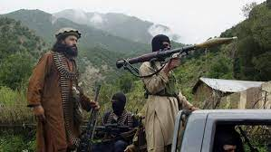
Overview of the Presentation
Tehreek-e-Taliban (TTP)
The organization is resilient
Lawlessness in tribal regions of Afghanistan and Pakistan
Drug trafficking
Source of revenue for Taliban
Counterbalance against foreign influence

Slide 2
TTP is Here to Stay
Stabilizing tribal territories
Local support for the TTP
Terrorist groups pay more than blue collar jobs
The Taliban benefits from having local affiliates

Slide 3
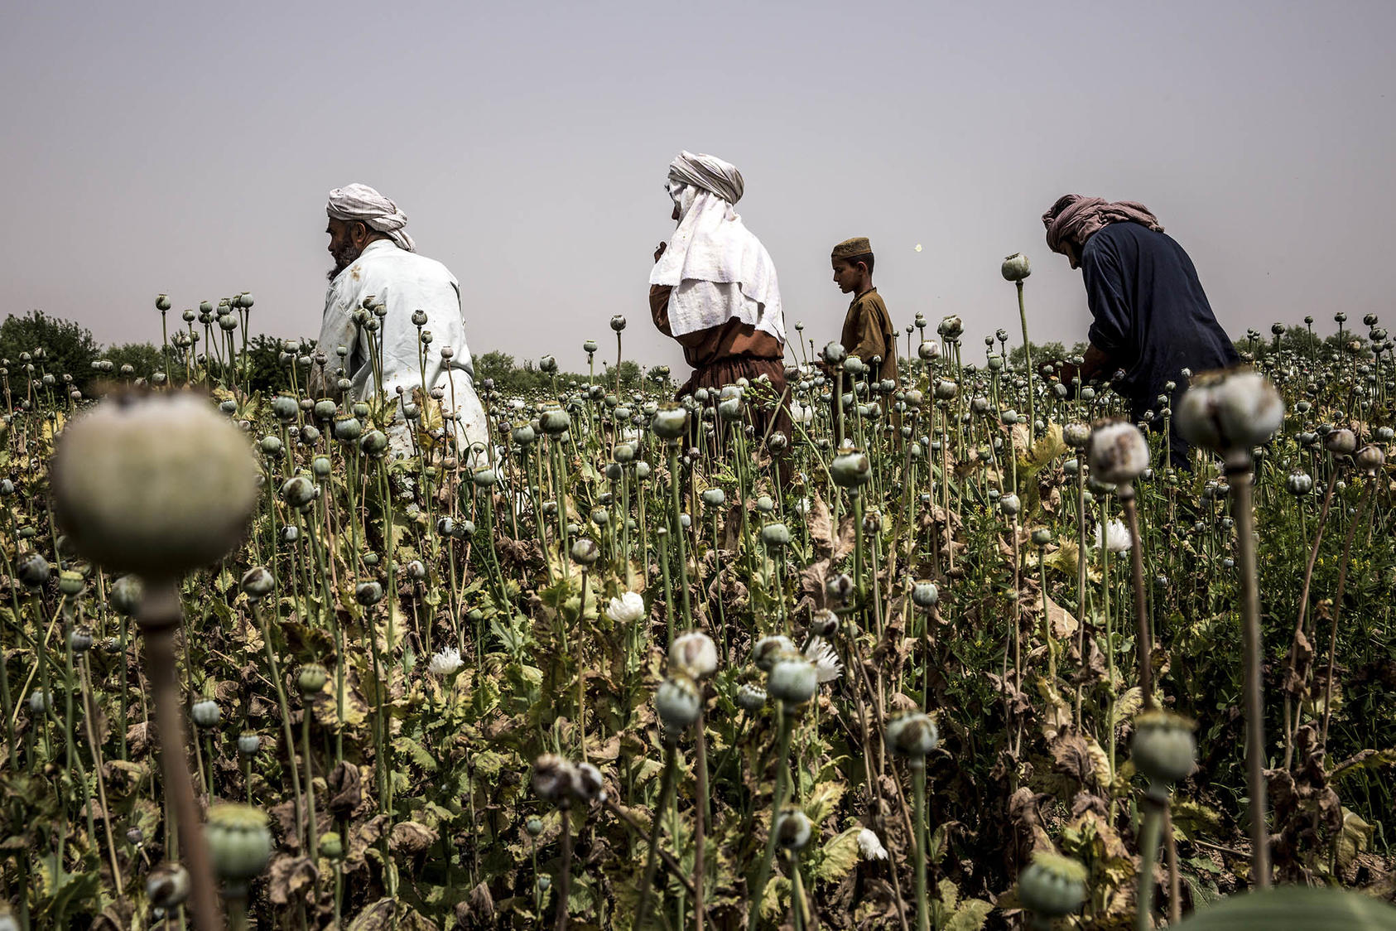
TTP and Taliban Benefit from Drug Trafficking
The Afghan economy has collapsed
Drug trafficking props up the Taliban
There is great demand for drugs in the Middle East and Asia
The US will not lift sanctions anytime soon

Slide 4
Counterterrorism Operations Failed
The US invasion of Afghanistan did not stabilize the country
The Taliban exploited America’s presence in the country
Drone strikes and targeted killings will not help
Afghans generally reject American influence

Slide 5
Taliban Prefers TTP Over American Influence
The Taliban can live with rival or allied terrorists, not the US
Taliban claims that it is fighting groups like al-Qaeda and ISIS
TTP is a grassroots movement with local support
The Taliban will not try to create more ethnic discord
The Taliban knows that it cannot police the entire country

