Slide 1
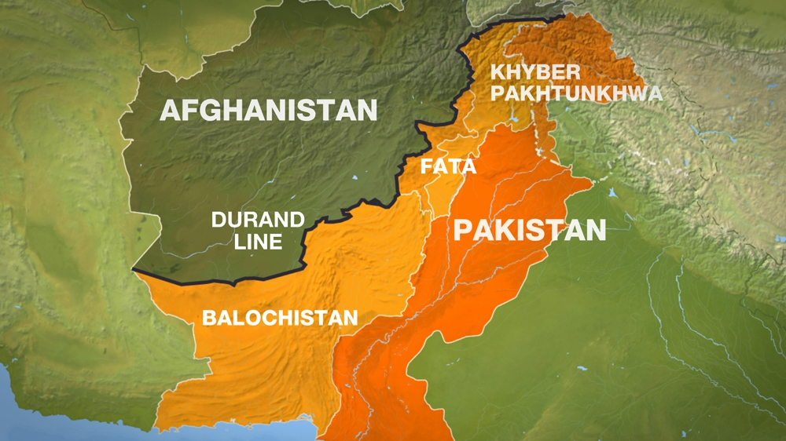
The Strategy of Tehrik-e-Taliban (TTP)
“There is no god but Muhammad, His Messenger Taliban movement in Pakistan”
Map of the Afghan/Pakistani Border and FATA
By Lauren Prattis
Notes:
There is no god but Muhammad, His Messenger
Taliban movement in Pakistan

Slide 2
TTP Strategy includes…
1. Violence
- TTPs relationship to the Pakistani government
2. Bombings and Suicide Attacks
3. Victory

Slide 3
Training and tactics
1. Training Facility
2. Training in Combat
3. Training in Bomb-making

Slide 4
Targets
1. National Security Threat
2. Classification of Targets:
- Soft Targets
- Hard Targets

Slide 5
Notable attacks
1. Personal Targets
- Prime Minister Benazir Bhutto
2. Physical Targets
- Peshawar School (2014)
- Peshawar Mosque Attack (2023)

