Slide 1
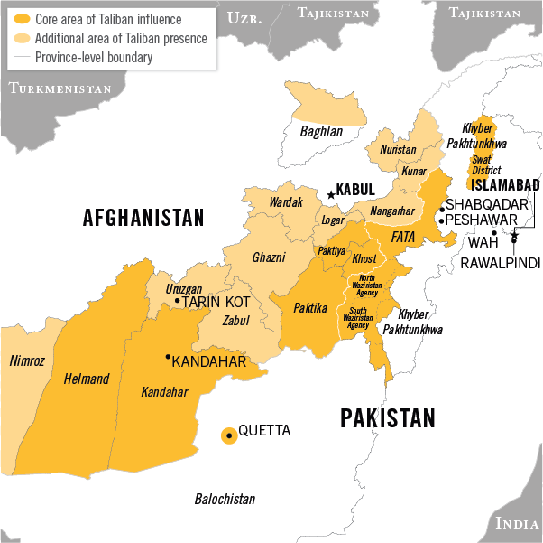
Leadership:
The Tehrik-e-Taliban
Kiya Lawler

Slide 2
Leadership
Previous Leadership and structure
Leadership changes and structure
The TTP Leadership Today

Slide 3
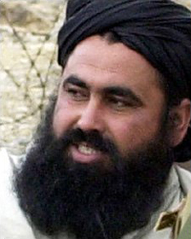
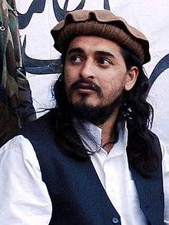
Previous Leadership
Baitullah Mehsud (2007-2009)
Hakimullah Mehsud (2009-2013)
Maulana Fazlullah (2013-2018)
Centralized structure
infighting and faction splits
power up top
rapid decline

Slide 4
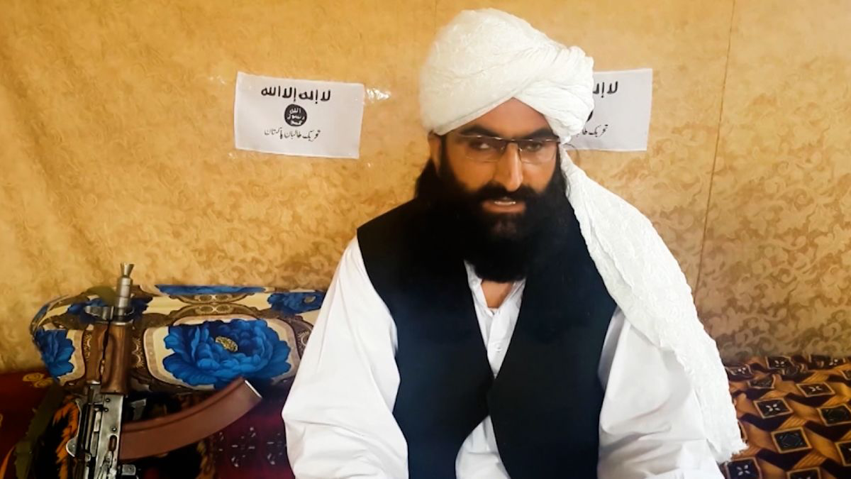
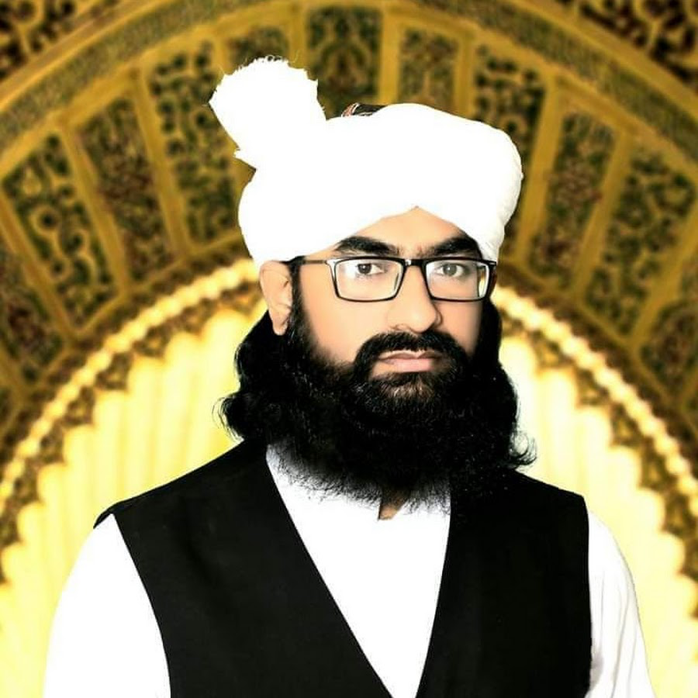
Changes in Leadership
Mufti Noor Wali Mehsud 2018 - present
Strict centralized -> open institutionalized
many factions/ministries
information and broadcasting, political affairs, defense
spread of power
Qari Amjad
New leadership council

Slide 5
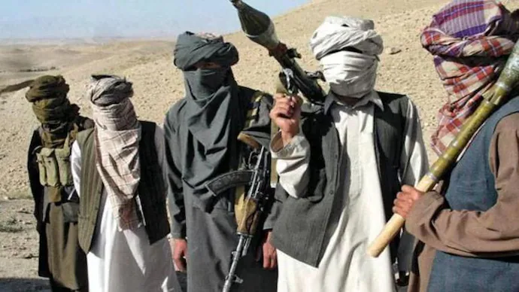
The TTP Leadership Today
Noor Wali’s impact
fixed splinter factions
Reduced civilian casualties and civilian targeted attacks
Uniting document
Clear roles guidelines
Strength and resiliency
Members of the TTP 2021
1
2

