Slide 1
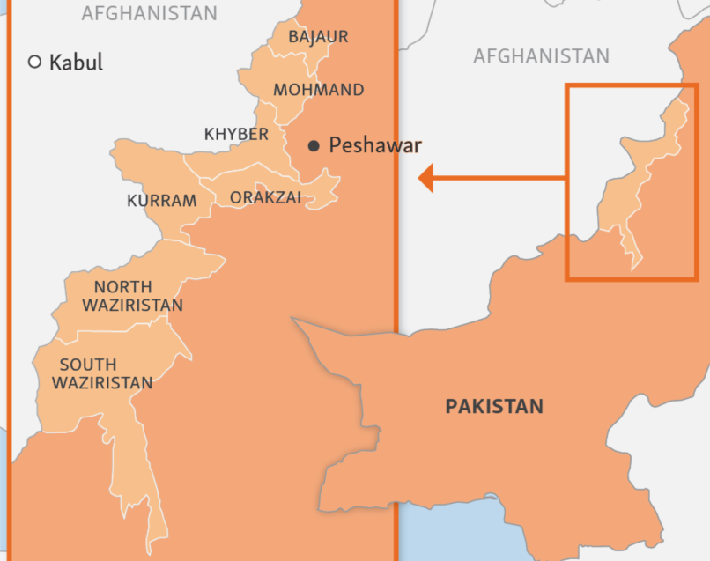
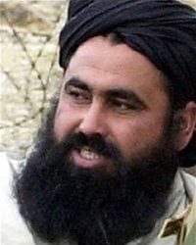
Counter Terrorism Against Tehrik-e-Taliban
Dean Putnam
Right: Baitullah
Mehsud

Slide 2
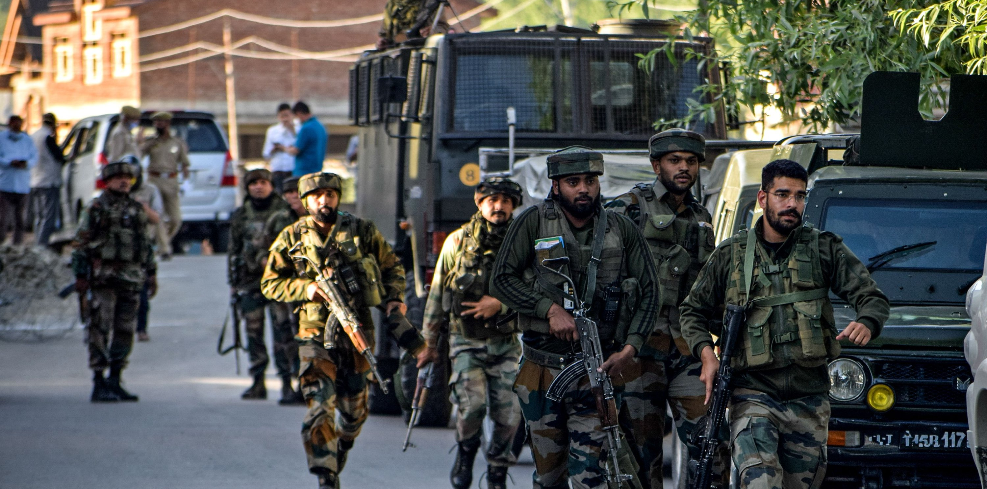
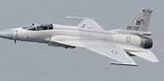
Offensive Strategy
24 operations from 2002 to 2017
Use of air power and artillery
Checkpoints
Destruction of TTP supply lines and headquarters

Slide 3
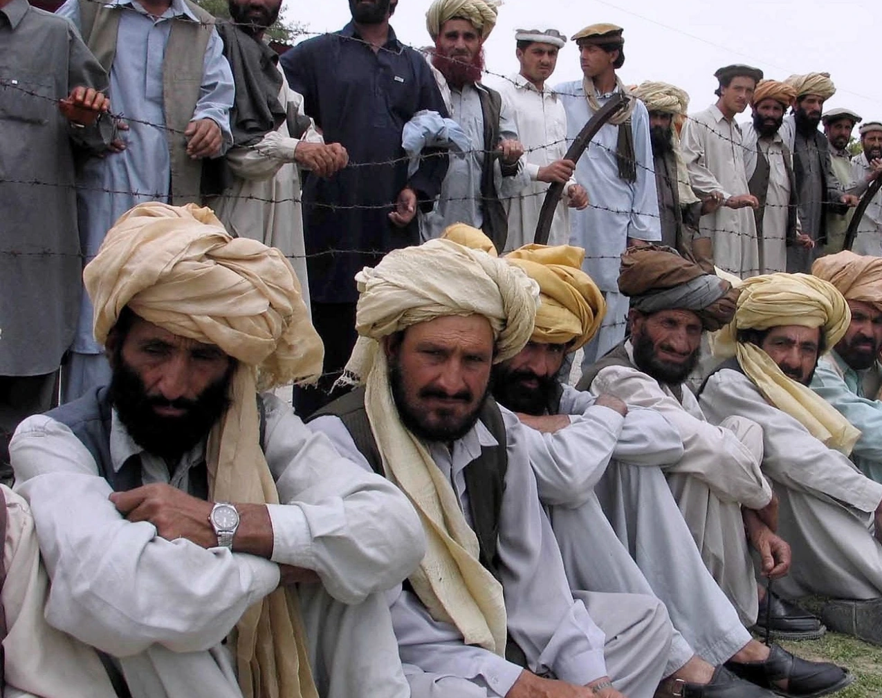
Non-Combat Counter Terror Operations
Returnee support projects
School reforms and the importance of the madrassas
Forming a narrative
Lack of infrastructure

Slide 4
Pakistani Foreign Relations
Afghani resentment
Trying to keep Indian influence at bay
Pakistan’s finger pointing at Afghan nationals

Slide 5
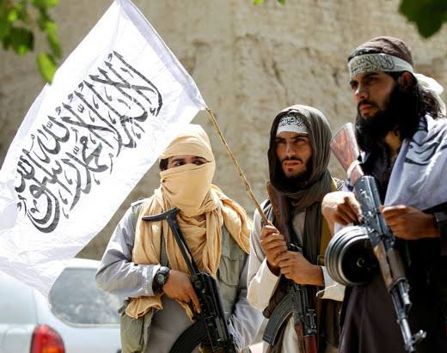
Conclusion
Aggressive campaigns but civilian casualties
Necessity of better relations with neighbors
Destruction of enemy supply lines is important

