Slide 1
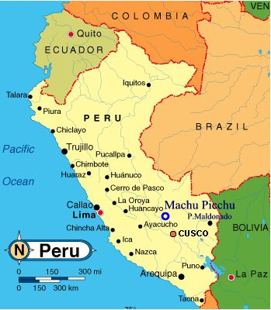
Support and Recruitment of Shining Path Peru

Slide 2
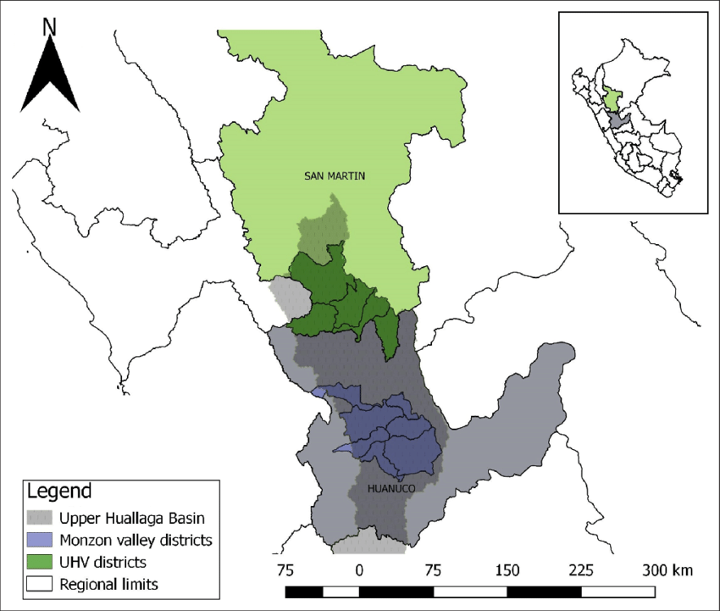
Funding
Cocaine
$20 - $100 million annually
Supporters
Toll booth

Slide 3
Allies
Supporters
Peasants and working middle class
Drug Lords

Slide 4
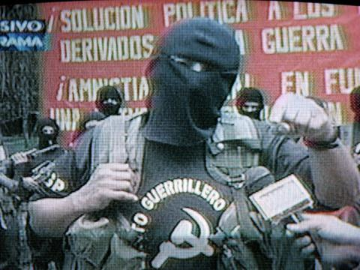
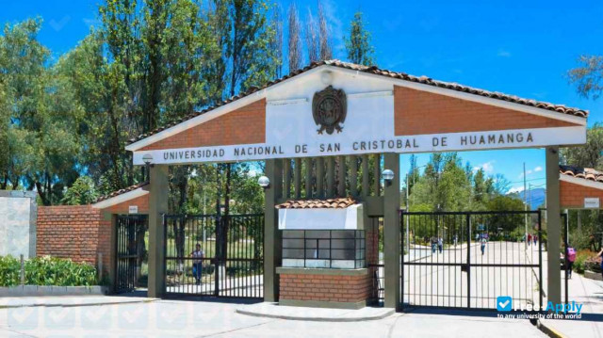
Recruitment
Marxist Classics
Women and Younger people
Escuela Populares (Popular schools)

Slide 5
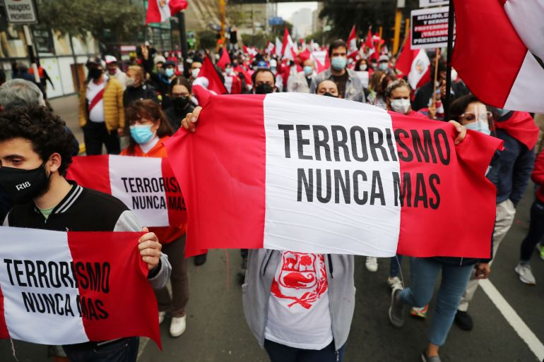
Shining Path
Leaderless
Continuing drug work
Failed to overthrow government

