Slide 1
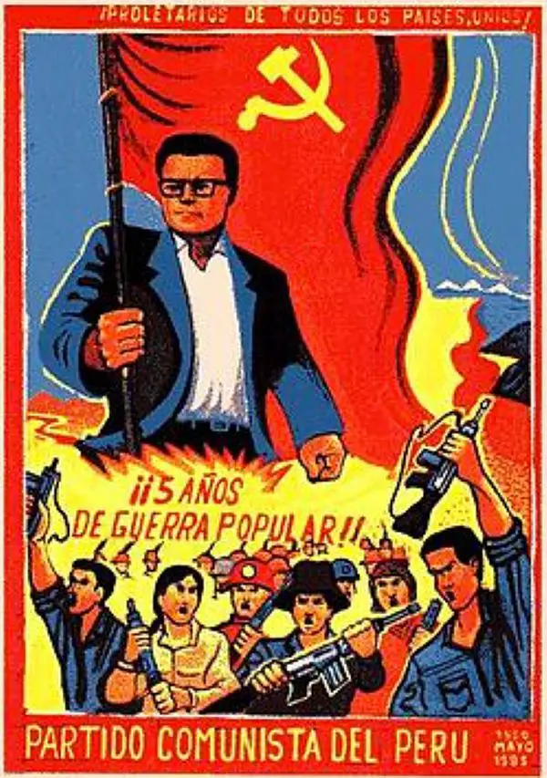
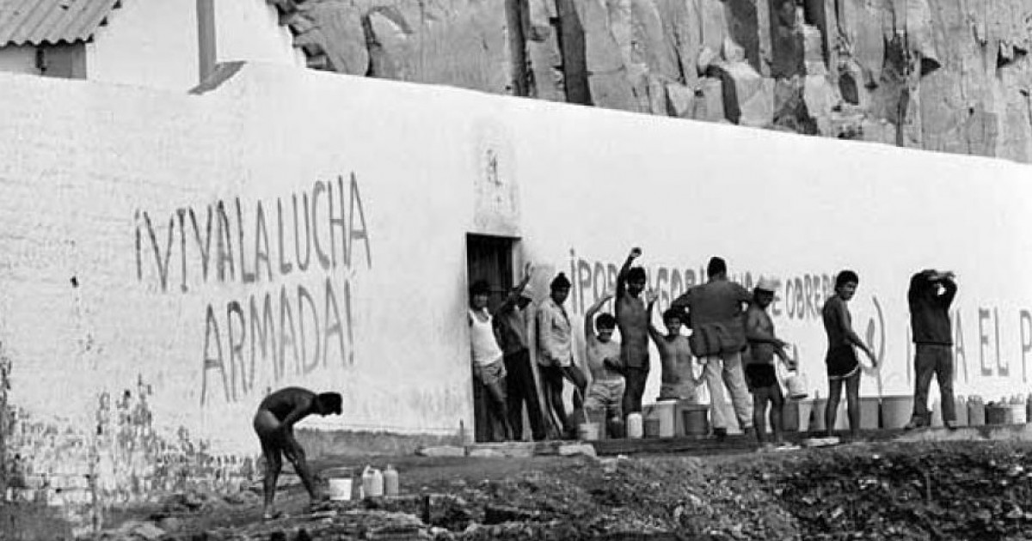
Strategy, Tactics, and Targets: The Shining Path
Notes:
Who? what? where? when? why?
Topic: shining path’s strategy
What issue? The issue id like to address is whether the shining path’s strategy has been successful or not.
Overall, there are a wide range of strategies, tactics, and targets for this group. The main strategy utilized by this group is violence against the government and civilians of Peru. Ultimately, these strikes should culminate into the formation of the people’s republic of new democracy, after the overthrowing of the previous government. The violent strategies employed by this group worked remarkably well for the chaotic state that Peru was in during the 1980s up towards the early 1990s, though after Alberto Fujimori gained office, renewed counterterrorism efforts and US security assistance led to the arrest of the group’s leader, and the fracturing of the Shining Path into smaller militant communist groups, respectively. therefore, this group’s strategy is ineffective in its current state and will most likely never see resurgence to the levels seen during the shining path’s peak.

Slide 2
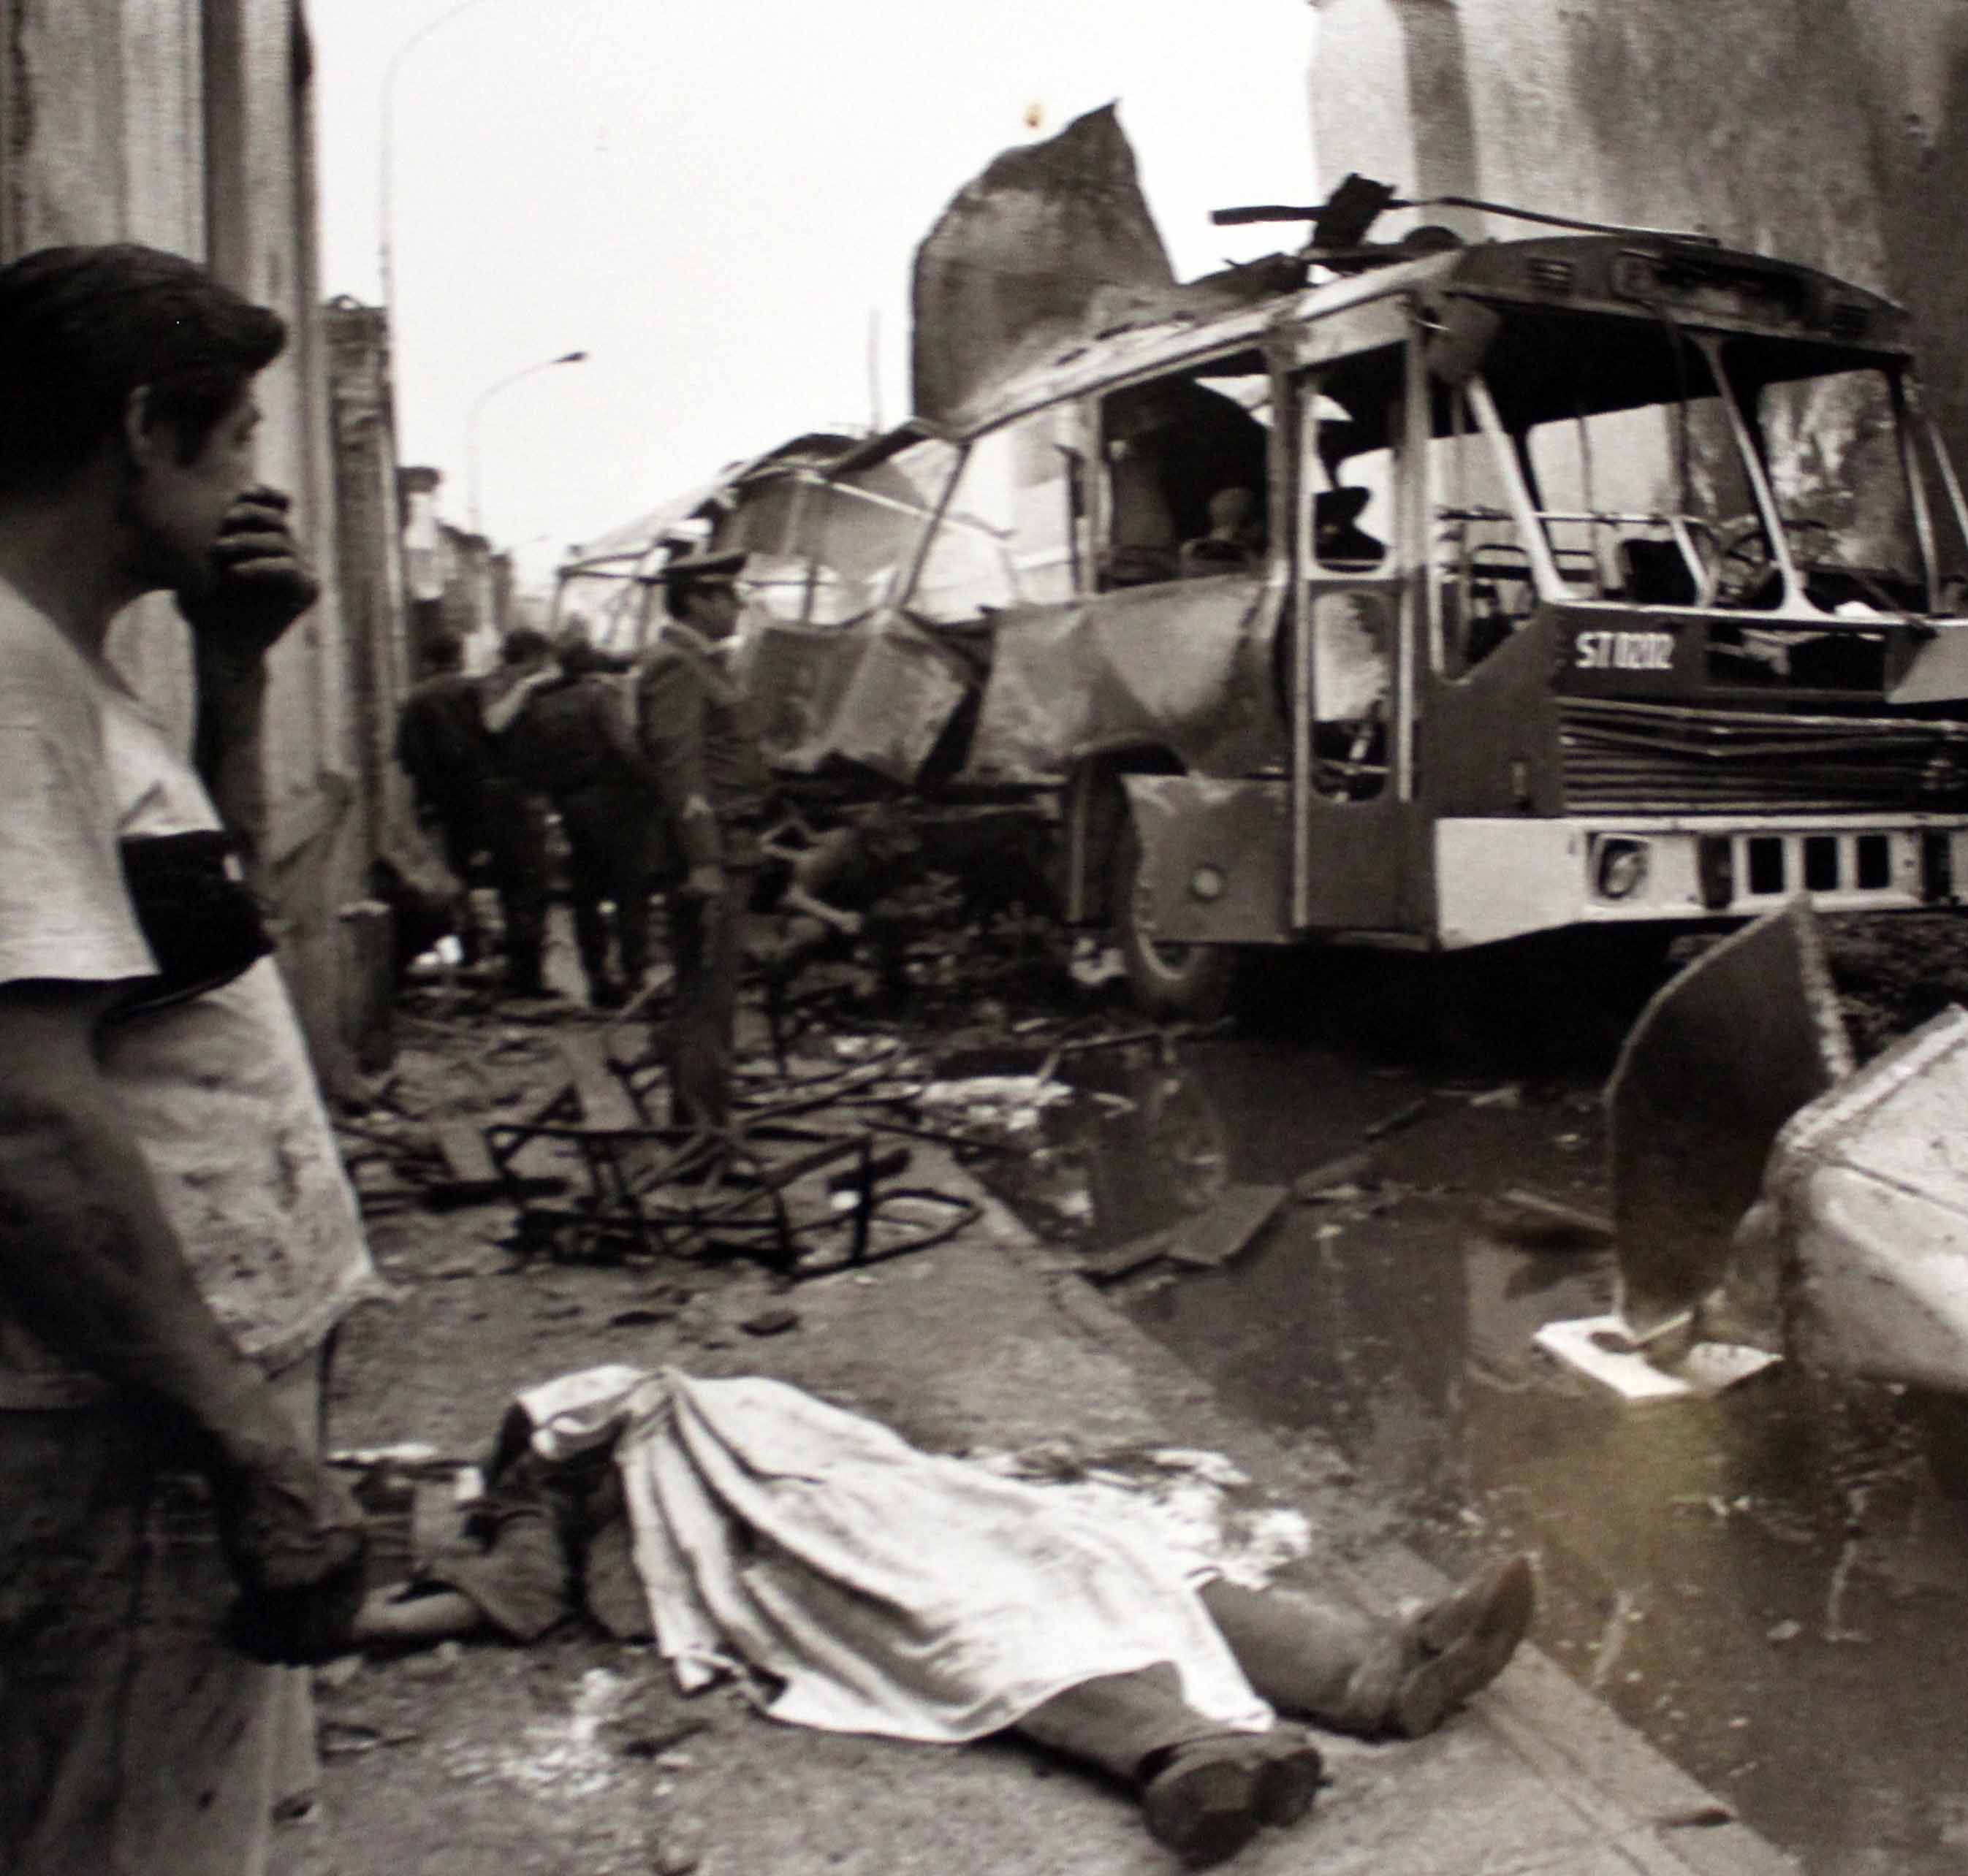
Strategy
Violent struggle
People’s War
Pensamiento Gonzalo
Notes:
The shining path implemented a strategy of terrorist violence. This group was deeply rooted in ideological thought, notably Maoist principles of a people’s war and guerilla struggle. The ideology coined “pensamiento Gonzalo” directly influenced the strategy enacted by the group. All people who did not share the shining path’s ideology were considered adversaries. The “physical elimination” of all opponents to the group was encouraged among members, hence the high incidence of violent terrorist attacks conducted by this group. The Shining Path’s end goal for their strategy is the violent removal of the Peruvian government in exchange for a maoist peasant-ran government.

Slide 3
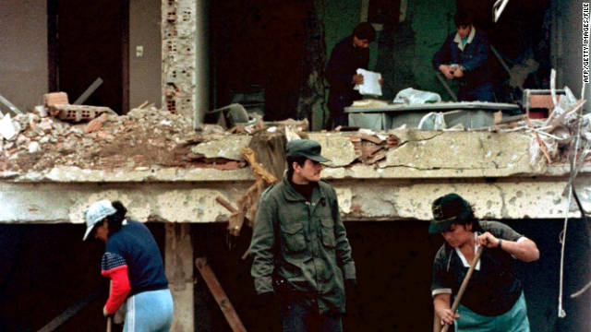
Tactics
No negotiation
Reprisals
Assassinations
Bombings
Notes:
Some tactics used by this group were bombings, typically against symbols of capitalism and government control, like police stations or banks. Assassinations and reprisals against civilian populations were also common during this group’s peak in the mid to late 1980s, with the most notable massacre being conducted against civilians in Lucanamarca in 1983 for a suspected killing of a high-ranking shining path member by ronderos (peasant militia). Due to the inherent belief that all adversaries of the ideology must be eliminated, negotiation is practically impossible with this group. Car bombs were some of the most common methods used in the shining path’s attacks on large population centers like Lima. A prominent example would be the Tarata bombing which killed and injured upwards of 275 people at a bank.

Slide 4
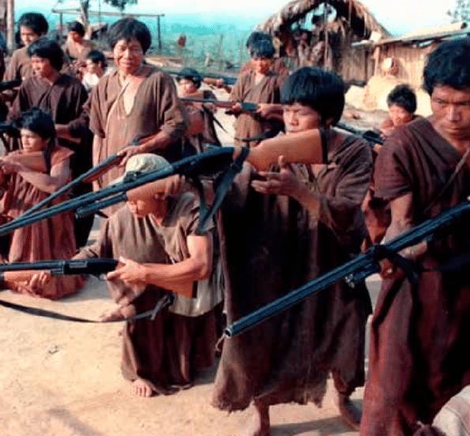
Targets
Campesinos
Peruvian government
All ideological dissidents
Notes:
The targets of this group were typically anyone adversarial to the group’s ideology as well as any government affiliates. Campesinos (peasant farmers) were typically at most risk of violent attacks. This is shown with the formation of Ronderos, which were peasant militias tasked with protecting their villages. These Ronderos notably killed a high-ranking shining path member which caused a reprisal from the group, massacring 69 campesinos in Lucanamarca. Though, really anyone who was not sympathetic to the group, or its ideology was a valid target in the shining path’s eyes.

Slide 5
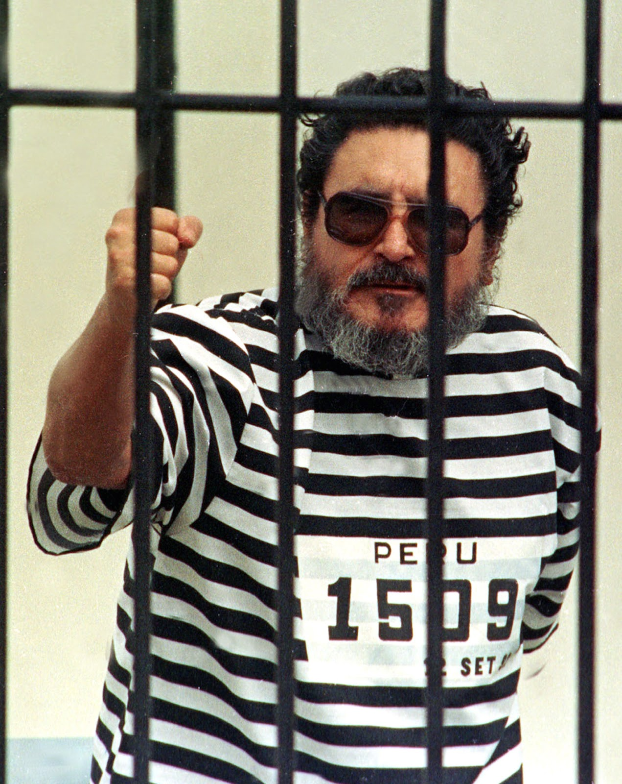
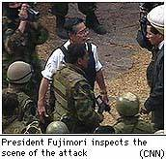
The Shining Path
Abimael Guzman “Chairman Gonzalo”
Government Response
Fujimori Presidency (1990)
Imprisonment SL of leader (1992)
Notes:
Answering the question: has the strategy worked?
The strategy of the shining path, while effective to start, did not adapt to renewed counterterrorism efforts conducted under the Fujimori presidency and thus rapidly declined into a negligible threat to the Peruvian government. The killing blow for this group was the imprisonment of its founder and leader, Abimael Guzman, which then saw the shining path split into smaller militant communist groups. In 2000, the Peruvian government declared victory against the Shining Path, which largely had been reduced to various drug trafficking organizations and smaller communist militant groups who periodically conduct smaller-scale attacks against the population of Peru. However, without any unity among the groups, it is highly unlikely that any one group could hold the same amount of power that the shining path once did.

