Slide 1
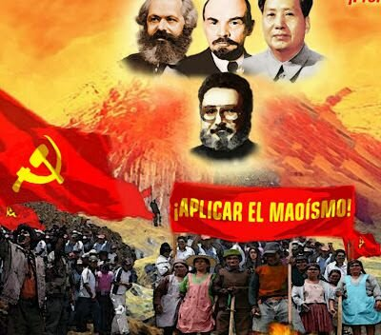


Origins, Doctrine, Objectives of Sendero Luminoso (SL)
Notes:
The topic I will be discussing is the Origins, Doctrine and Objective of Sendero Luminoso, which I will be referring to as the SL. SL was a terrorist organization was founded by Abimael Guzman in 1969 in Ayacucho Peru. The SL collapsed in 1992 with the capture of Guzman, but not before claiming the lives of over 61,000 during the war with the Peruvian government. Although the group accumulated a large following, it ultimately failed to meet its objectives.

Slide 2
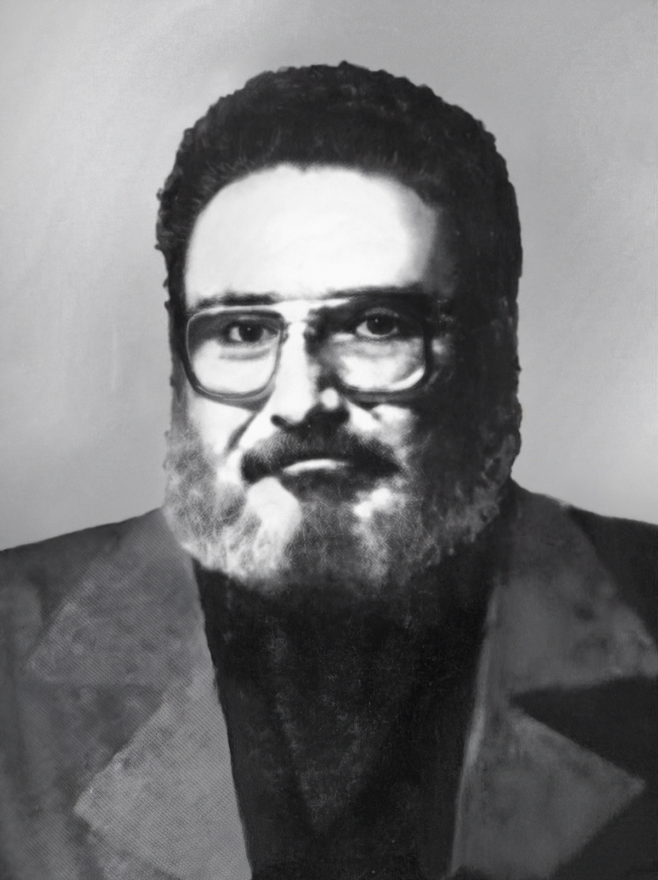
Origins – Creation of SL
Abimael Guzman
Founder Abimael Guzman, former philosophy professor
Created in response to negligence towards peasant populations
Began as part of the Ejercito de Liberacion Nacional (ELN) Huamanga command in 1962
ELN Huamanga command breaks off from national organization over disputes of utilizing guerilla fronts on Peruvian highlands
Notes:
First, I will be explaining the origins of SL. It’s founder, Abimael Guzman, was a philosophy professor at the National University of San Cristobal of Huamanga. He founded this group along with other members of the university in response to the negligence from the Peruvian government towards the peasant population, which was underserved. The group began as part of the Ejercito de Liberacion Nacional also known as the ELN Huamanga command in 1962. The ELN Huamanga command was part of a larger national organization, which it eventually broke off from as a result of disputes over the utilization of guerrilla fronts on Peruvian highlands.

Slide 3
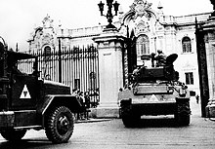
Origins
1968: General Juan Velasco launched a coup d’etat and army mutiny, drives President Fernando Belaunde Terry out
  Initiates left-leaning agrarian reforms
  Takes 6 years to act upon reforms
  Fights with General Bermudez over power
Peasant population performs demonstrations against government
1969, SL organizes formally, experiences strong support from peasant populations
Notes:
Later, in 1968, a military general Juan Velasco launchesd a coup detai and army mutiny against the administration of President Fernando Belaunde Terry, and successfully ousted him. Velasco went on to initiate a series of left-leaning agrarian reforms to pull the sinking Peruvian economy out of debt. However, he took six years to act upon these reforms, to which 15,000 peasants responded with a demonstration to call for a speed up of action. General Morales Bermudez then stepped in and began to overturn many of Velasco’s enactments, further infuriating peasant populations. As a result, Guzman and the SL, which formally organized in 1969, were met with strong peasant support given the often-pro-wealthy leaders of the Peruvian government, and lack of commitment to support the peasant populations.

Slide 4
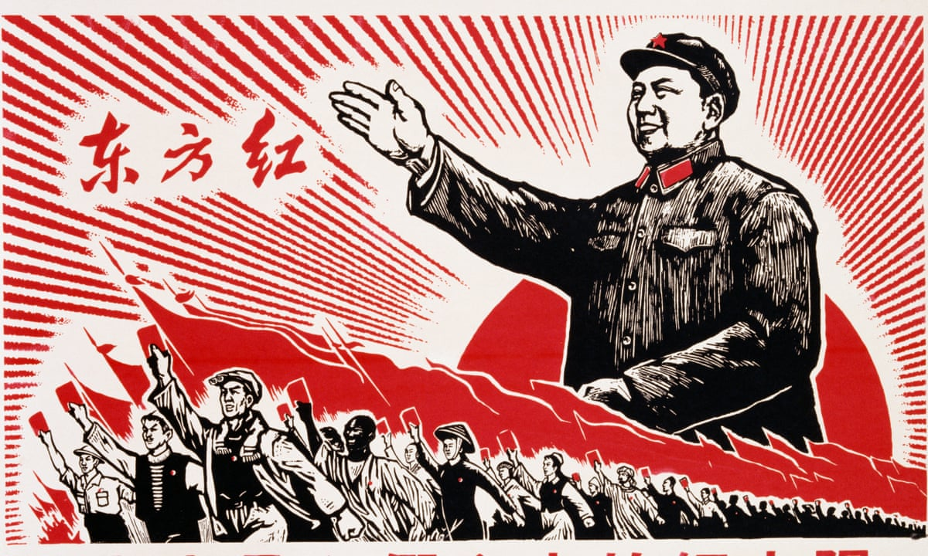
Doctrine
Did not believe in publicity
Guzman and others closely studied Maoism in his travels to China
Believed he was the fourth sword of communism, after Carl Marx, Vladimir Lenin, and Mao Zedong
Notes:
Next, I will be discussing the doctrine of the SL. Unlike many other terrorist organizations, SL did not often indulge in publicity and often did not take direct responsibility for certain attacks. The doctrines of the SL originate from Maoist principles and theories, of which Guzman closely studied along with other leaders such as Antonio Diaz Martinez and Catalina Adrianzen in their travel to China. Guzman strongly believed he was the fourth sword of communism, after Carl Marx, Vladimir Lenin, and Mao Zedong. SL believed in a doctrine most similar to that of the Maoist in the People’s War, and the utilization of guerrilla war tactics as a necessity to meet their objectives and instill fear within the wealthier population.

Slide 5
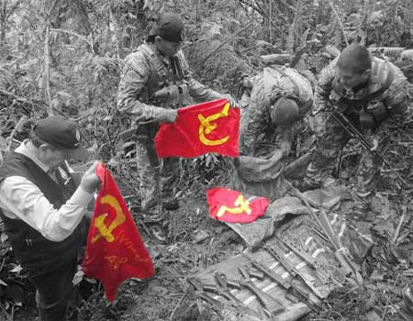
Objectives
Guerilla style tactics
Overthrow Peruvian government and replace with a communist regime
Objectives were not met
Sendero Luminoso
Notes:
Finally, the main objective of the SL was to overthrow their view of an outdated Peruvian government system. Guzman strongly believed communism was the means for peasant liberation and sought to replace the government with a radical Maoist-Marxist regime.
These objectives were never met as a result of the capture of Abimael Guzman.

