Slide 1
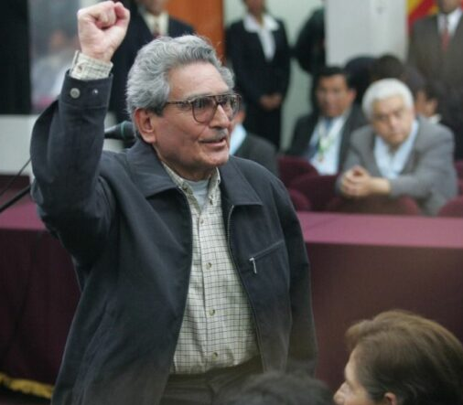
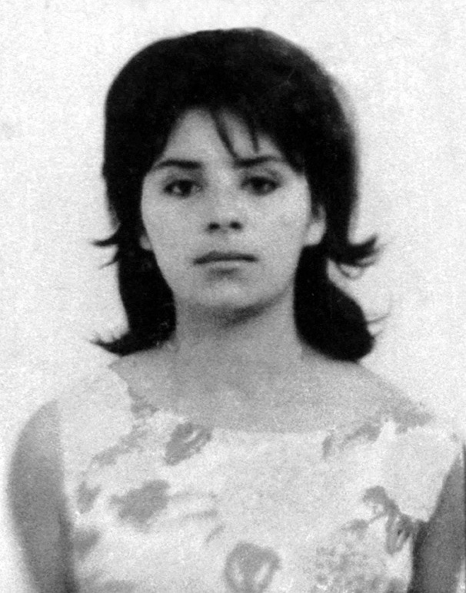
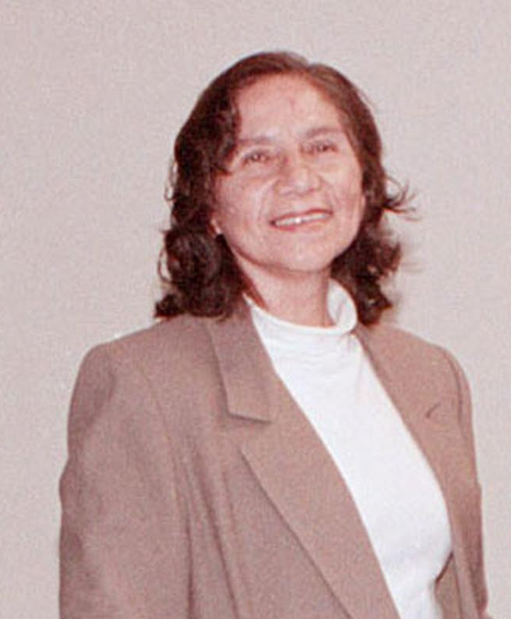
Abimael Guzman Augusta La Torre Elena Iparraguirre

Slide 2
Abimael Guzman
The Central Committee
Coordinator
Secretaries

Slide 3
Annihilation Detachment
Assault Group
Containment Detachment
Razing Detachment

Slide 4
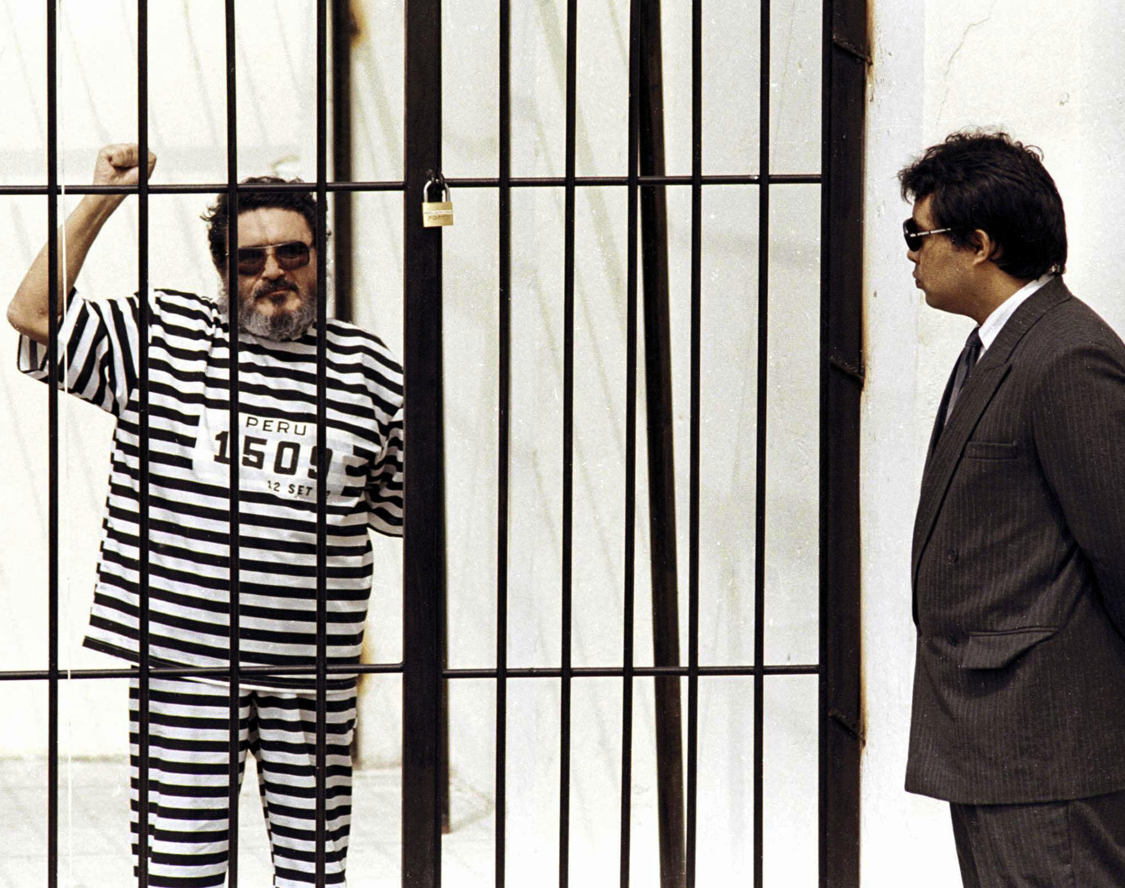
Abimael Guzman's arrest

Slide 5
Oscar Ramirez and the downfall of the Shining Path

