Slide 1

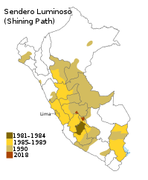
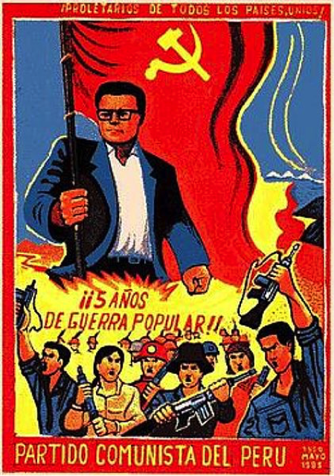
Counterterrorism:
Shining Path

Slide 2
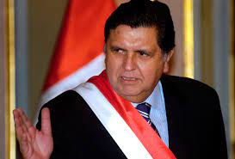
Alan Garcia
Three component Policy
  Military
  Economic
  Political

Slide 3
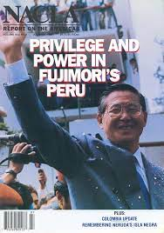
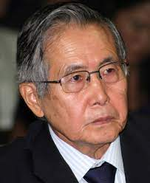
Repentance Law
(Ley de Arrepntimiento)
False Accusations
Police Ignorance
International Outcry

Slide 4
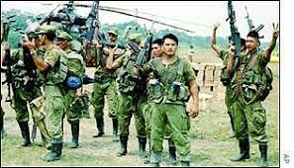
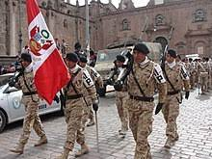
Military Action
Creation of Death Squads
Two Major Massacres
Military Involvement
Anti-Guerilla Police Unit

Slide 5
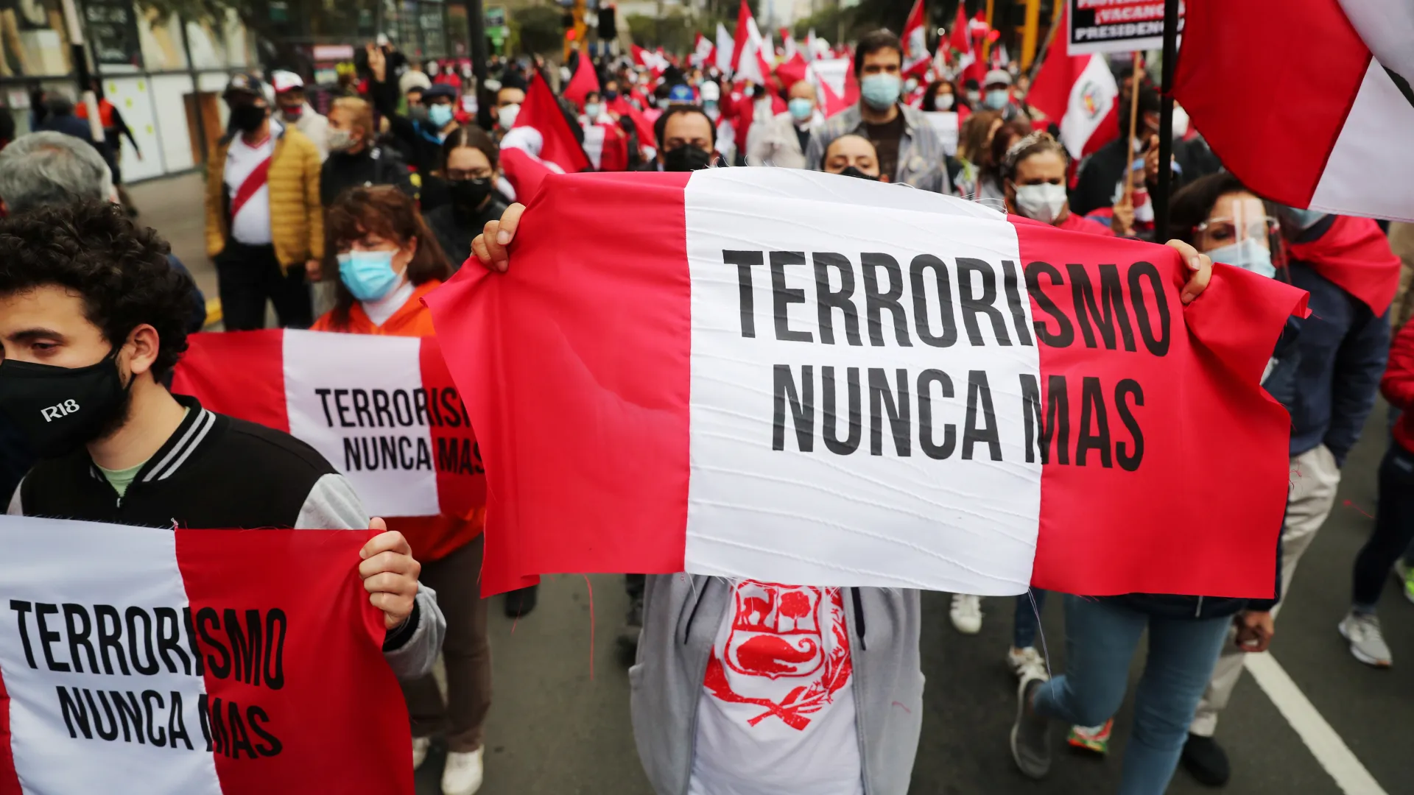
Shining Path in the 21st Century
Effectiveness of Policies
Less active/Less attacks
Underground politics
Resurgence

