Slide 1
Red Brigades
Support and Recruitment

Slide 2
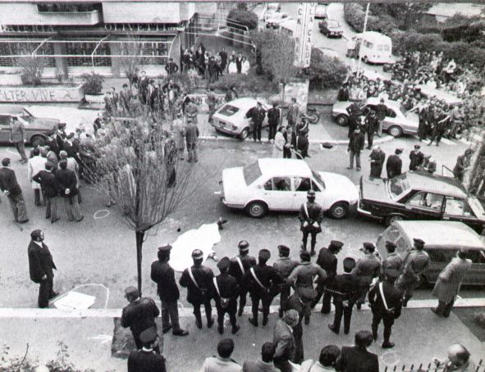
Resources
Robberies
Kidnappings
Camorra

Slide 3
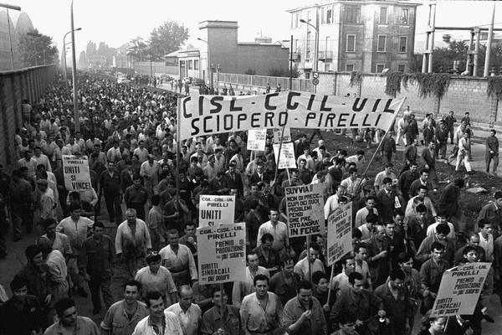
Recruiting
Students and Workers
Strong Italian Heritage
Pre Existing Groups
Feminist Movement
“Hot Autumn” of 1968

Slide 4
Partnerships
Soviet Union
Czechoslovakia
Red Rescue(Soccorso Rosso)
Cuba and Bulgaria

Slide 5
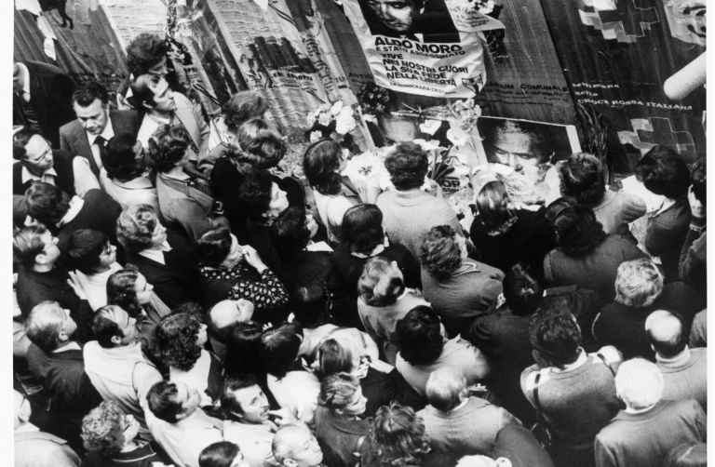
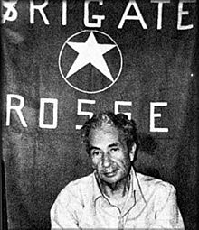
The Fallout
Aldo Moro

