Slide 1
Strategy, Tactics, and Targets of The Red Brigades
Ryan Hur

Slide 2
Strategy
“Dictatorship of the proletariat”
“Armed propaganda”
Violent actions to promote their message
Attack on “the heart of the state”
Capitalist institutions
“Generalized Civil War”
End-result: overthrowing the state
Aimed to appear as a legitimate organization
Careful language
Long-term goals

Slide 3
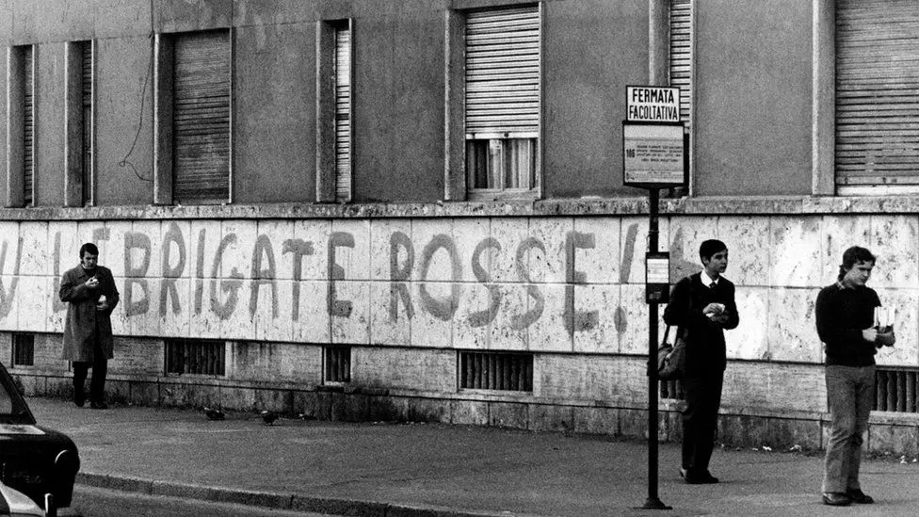
Tactics
Relied on violence
Calculated political terrorism
Politically motivated kidnappings and murders
No mass casualties

Slide 4
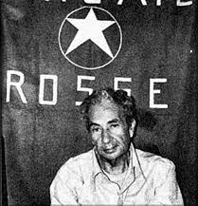
Targets
”Anti-worker”
Early years of operation, less violent
Christian Democrat Party
Aldo Moro

Slide 5
Strategic failure
Moro’s death led to fierce persecution
Never legitimized by the government

