Slide 1


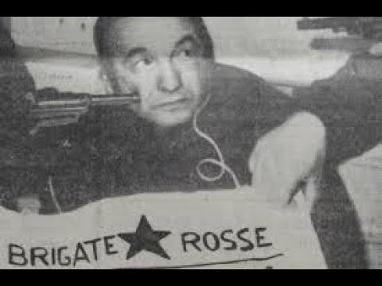
Origins, objectives, Doctrines:​
The Red Brigades
By Braelyn Johnson
Kidnapping of Aldo Moro

Slide 2
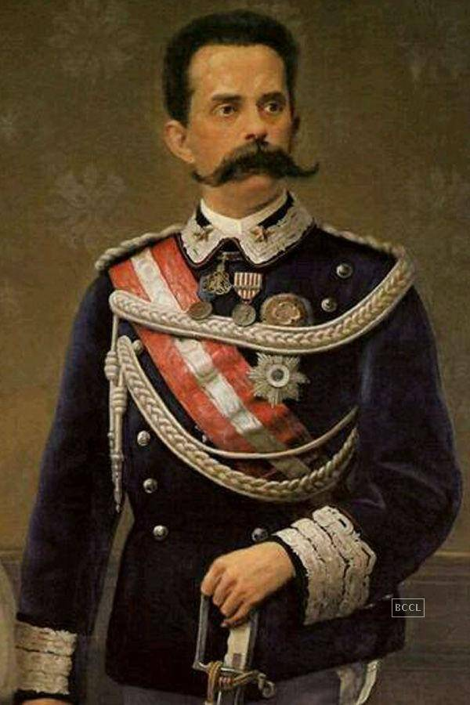
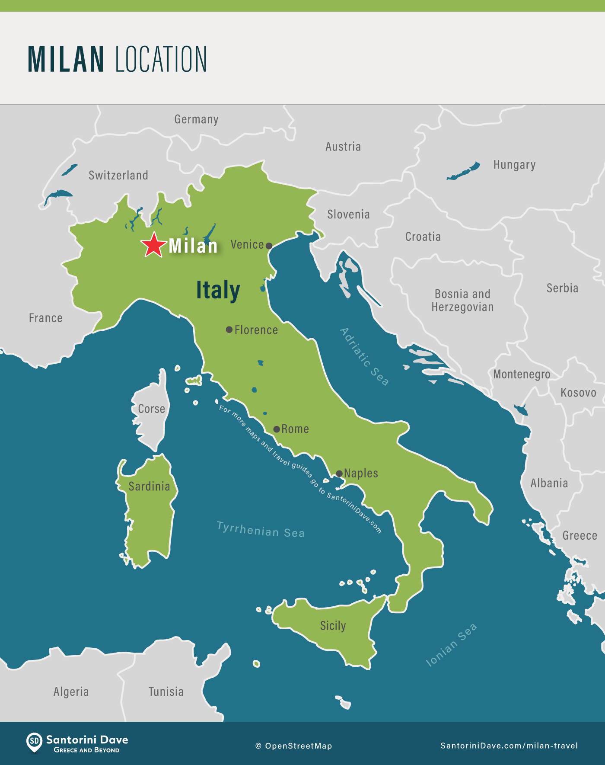
Origins
Milan 1969-1972
Founded by Renato Curcio and Margherita Cagol
Assassination of King Umberto (July 29, 1900)
Included members from Gruppi Di Azione Partigiana (GAP)
Originally focused on kidnappings and destruction of union property

Slide 3
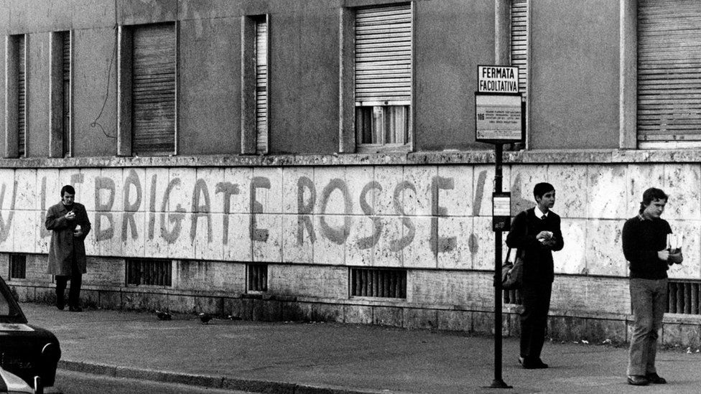
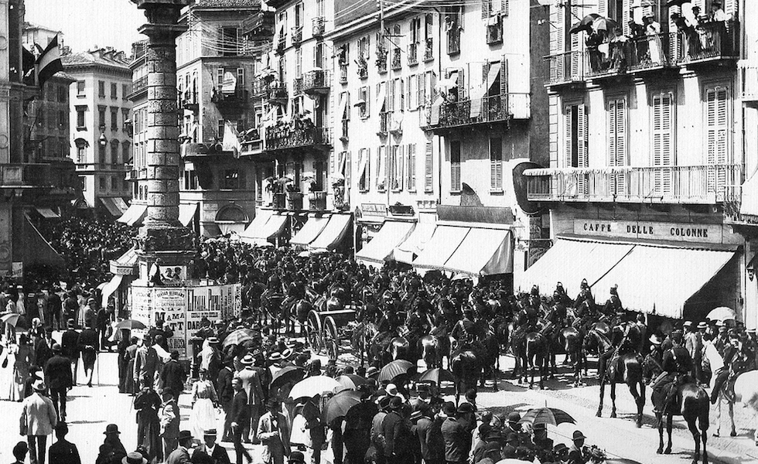
Doctrines
Marxist-Leninist ideology
Main principles from extreme leftist ideology
Aimed for a “dictatorship of the proletariat”
Bava Beccaris Massacre

Slide 4

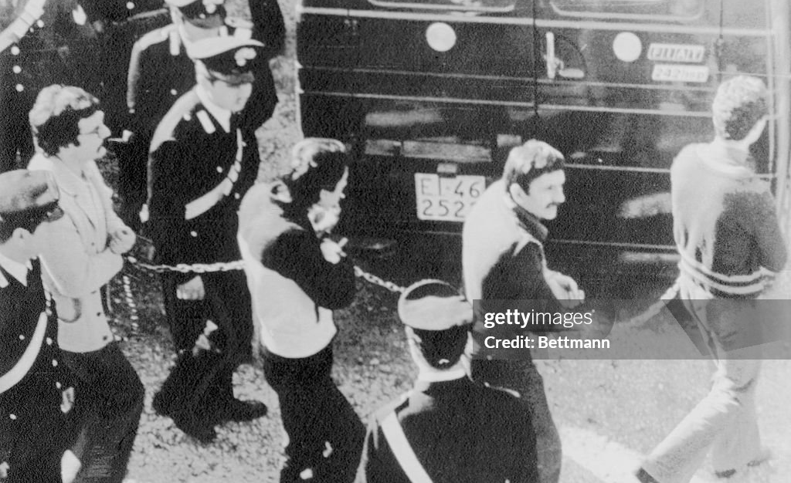
Objectives
Strived to achieve the dictatorship through: Armed propaganda, generalized civil war, and the overthrow of the state.
Creation of revolutionary state
Destruction towards industrial executives, political conservatives, and rightist activists.

Slide 5
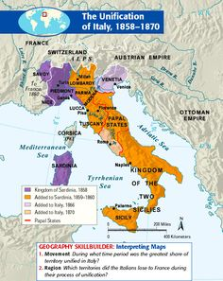
Conclusion
Issue with western democracy
Use of knee-cappings, bombs, and kidnapping to promote ideas
Arrest of members led to the downfall of the organization through the webbed structure.
Unable to create revolutionary state

