Slide 1
Post-War Japanese Government
Surrender, Occupation and Punishment
US-Japan Security Treaty, 1951 (1952)
Japanese Foreign Minister
Shigemitsu Mamoru
Signing the surrender
Agreement, 9/2/45

Slide 2
War Crimes Tribunal International Military Tribunal for the Far East
Justices for IMTFE
Former PM Tojo on trial

Slide 3
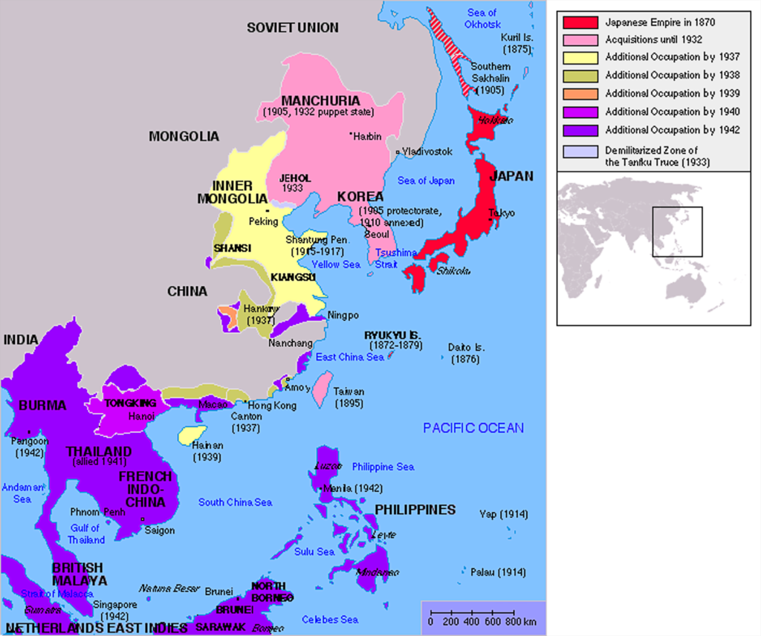
End of the Japanese Empire
From: By Kokiri at English Wikipedia, modifications by Huhsunqu and Markalexander100. - This file was derived from: Japanese Empire.png, CC BY-SA 3.0, https://commons.wikimedia.org/w/index.php?curid=472828

Slide 4
Demilitarization
Article 9. Aspiring sincerely to an international peace based on justice and order, the Japanese people forever renounce war as a sovereign right of the nation and the threat or use of force as means of settling international disputes. In order to accomplish the aim of the preceding paragraph, land, sea, and air forces, as well as other war potential, will never be maintained. The right of belligerency of the state will not be recognized.

Slide 5
Demilitarization?
Japanese Ministry of Defense
Japanese Military Forces 2020
Military Spending
by nation, 2018

Slide 6
1946 Constitution
CHAPTER I
THE EMPEROR
Article 1. The Emperor shall be the symbol of the State and of the unity of the People, deriving his position from the will of the people with whom resides sovereign power.

Slide 7
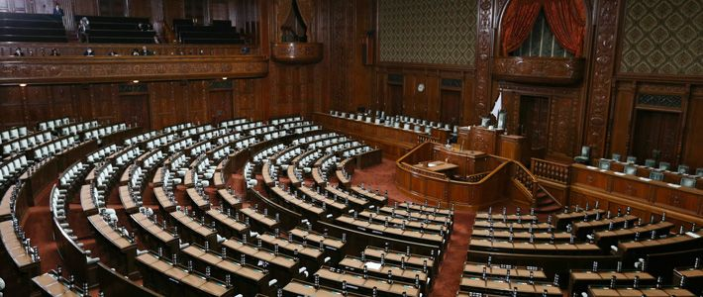
Post-War Governmental Structure
Diet
House of Councillors
House of Representatives

Slide 8
House of Councillors
242 seats
146 by prefectures, based on population
96 selected nationwide (vote for a party and the Party has a list of people who will win the seat based on the nationwide party % of seats)
6 year terms
Half elected every three years
Elections in July

Slide 9
House of Representatives
465 seats
289 from single member districts
176 from proportional representation
11 Blocs each with a number of seats based on population (ranging from 8 to 28 seats)
Magic number 233 (a majority)
4 year terms (maybe…)

Slide 10
Passing Legislation
override Simple majority passage, House of C.
becomes law 2/3 vote
rejected
House of Reps
House of Reps
House of Councillors

Slide 11
2009 Election: House of Reps single-member districts
■ – DPJ ■ – LDP ■ – PNP ■ – SDP ■ – YP
■ – Independent factions

Slide 12
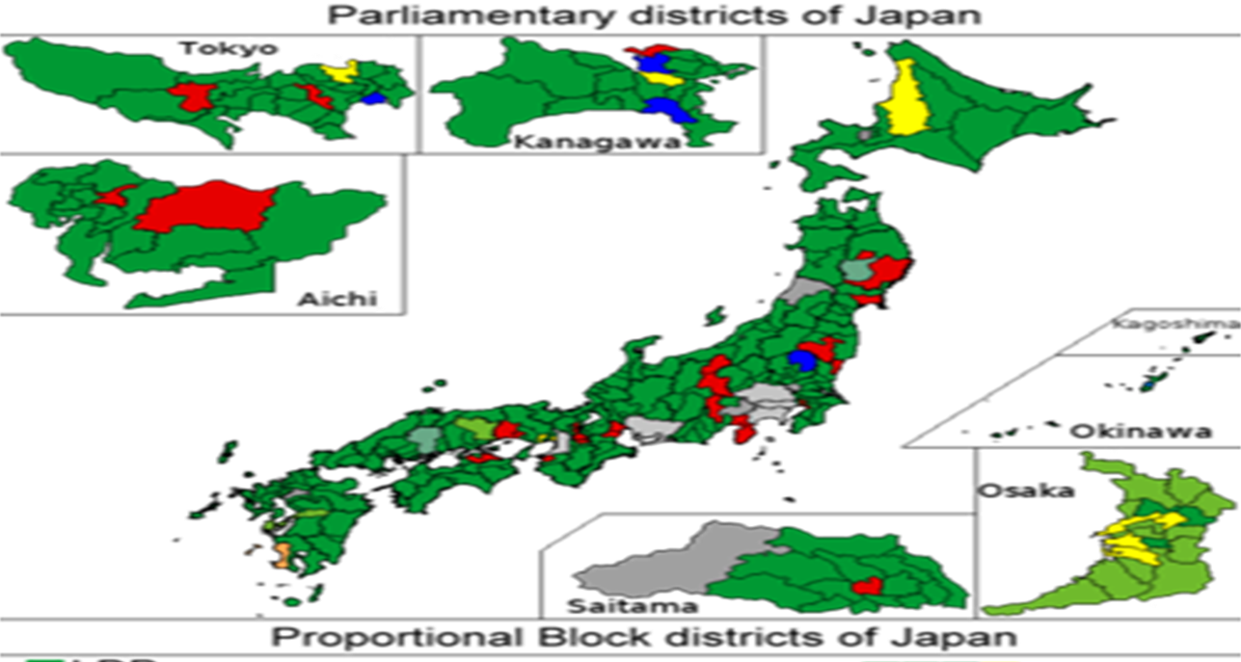
2012 House of Reps Election Results (single-member districts)
LDP DPJ NKP

Slide 13
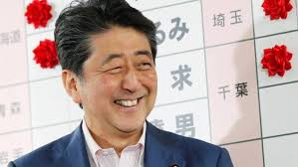
2017 Election Single Member Districts (Happy PM Abe Shinzo)

Slide 14
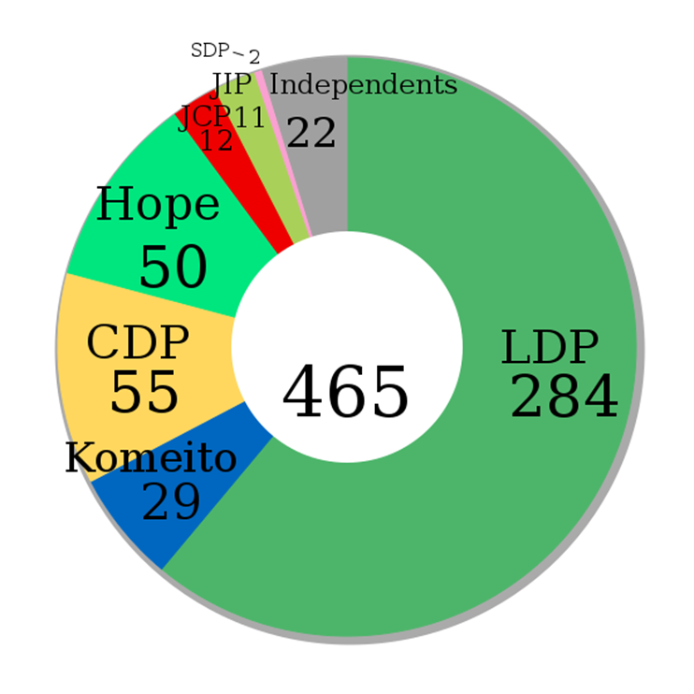
2017 Elections
LDP- Liberal Democratic Party
CDP-Constitutional Democratic Party
Hope- Party of Hope
Komeito (allied with LDP)
JCP-Japan Communist Party
JIP-Japan Innovation Party
SDP-Social Democratic Party

Slide 15
2021 House of Representatives Election

Slide 16
Parliamentary Process for PM
PM and House
serve full term
Party
wins
majority House PM dies or
General elects resigns
election PM
of Lower
House
No party wins No Confidence fails majority motion
passes
Parties negotiate PM dissolves
to form coalition House
(50% of seats, plus one)

Slide 17
The Process (in theory)
PM and House
serve full term
Party
wins
majority House PM dies or
General elects resigns
election PM
of Lower
House

Slide 18
Coalition Formation and Choosing PM
PM and House
serve full term
Party
wins
majority House PM dies or
General elects resigns
election PM
of Lower
House
No party wins majority
Parties negotiate
to form coalition (50% of seats, plus one)

Slide 19
No Confidence Motion
PM and House
serve full term
Party
wins
majority House PM dies or
General elects resigns
election PM
of Lower
House
No party wins No Confidence fails majority motion
passes
Parties negotiate
to form coalition (50% of seats, plus one)

Slide 20
PM Dissolves Lower House
PM and House
serve full term
Party
wins
majority House PM dies or
General elects resigns
election PM
of Lower
House
No party wins No Confidence fails majority motion
passes
Parties negotiate PM dissolves
to form coalition House
(50% of seats, plus one)

Slide 21
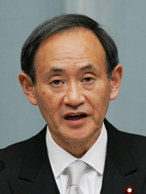
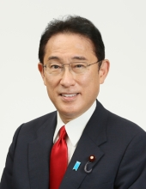
Suga Yoshihide Kishida Fumio
2020-2021 2021--

Slide 22
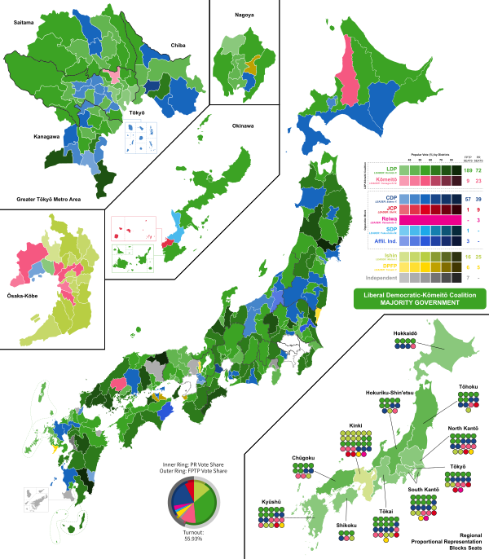
October 2021 Election
LDP: 261(284)
CDP: 96 (New)
JIP: 41 (11)
Komeito: 32 (29)

Slide 23
2021 Lower House Results (reference only)
Party | Single Member District Seats | Proportional Representation Seats | Total
LDP | 189 | 72 | 261
Constitutional Democratic Party (CDP) | 57 | 39 | 96
Japan Innovation Party (JIP) | 16 | 25 | 41
Komeito | 9 | 23 | 32
Democratic Party for the People | 6 | 5 | 11
Japan Communist Party | 1 | 9 | 10
Reiwa Shinsengumi | 0 | 3 | 3
Social Democratic Party | 1 | 0 | 1

Slide 24
Prime Ministers
Office of the PM
Japanese PMs Since 1990s
Yoshida Shigeru Ikeda Hayato Sato Eisuke Nakasone 1946-7, 48-54 1960-64 1964-1972 Yasuhiro 1982-7

Slide 25
Cabinet and Ministries
Cabinet Office
Ministry of Foreign Affairs
Ministry of Economy, Trade, and Industry (formerly MITI)
Ministry of Finance
Ministry of Defense
Ministry of Health, Labour, and Welfare
Power of ministries vs power of politicians
From post-war to 2000s

Slide 26
Business-Government Relations
Economic Philosophy
Nationalism
Protectionism
Partnership
Yoshida Doctrine
“GNPism”
Yoshida Shigeru
PM 1946-7, 1948-54

Slide 27
Administrative Guidance
Ministry of Economy, Trade, and Industry
formerly Ministry of
International Trade
and Industry
(MITI)
The Visible Hand?

Slide 28
Iron Triangle
Liberal
Democratic Party
Business Ministries
Business contributes to campaigns;
LDP passes business-friendly legislation and massive public works projects
Ministries write legislation that helps LDP popularity;
LDP gives jobs to retired bureaucrats
Ministries write legislation that helps business; Business gives high-paying jobs to retiring bureaucrats (amakudari)

Slide 29
1955 System
LDP: Liberal Democratic Party
JSP/SDP: Social Democratic Party
LDP in power from
1955-1993
1994-2009
2012-present
Slide originally recorded in 2015 so ignore me when I talk about how many years the LDP has been in power for the last 60 years; it’s 65 in 2020.

Slide 30
LDP: Liberal Democratic Party
PM Abe Shinzo

Slide 31
Social Democratic Party of Japan
Japan Socialist Party 1955-1991
Social Democratic Party of Japan
1991-present

Slide 32
1 and ½ Party System?
“Consensus Politics”
LDP to lead
JSP/SDPJ to keep it in check, balanced

Slide 33
Party Strength in Lower House

Slide 34
Explaining LDP Domination
Iron Triangle
Factions: Habatsu
Campaign Money
Construction, rice
Opposition Weakness and policies
Marxism, anti-US alliance
Rural Vote

Slide 35
Explaining LDP Domination?
6. Japanese Economic Success
From: http://benmuse.typepad.com/ben_muse/2005/11/changes_in_inco.html

Slide 36
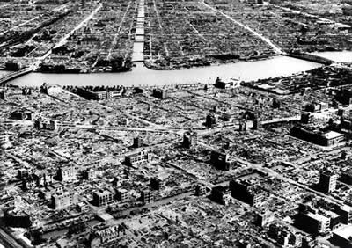
Tokyo 1945

Slide 37
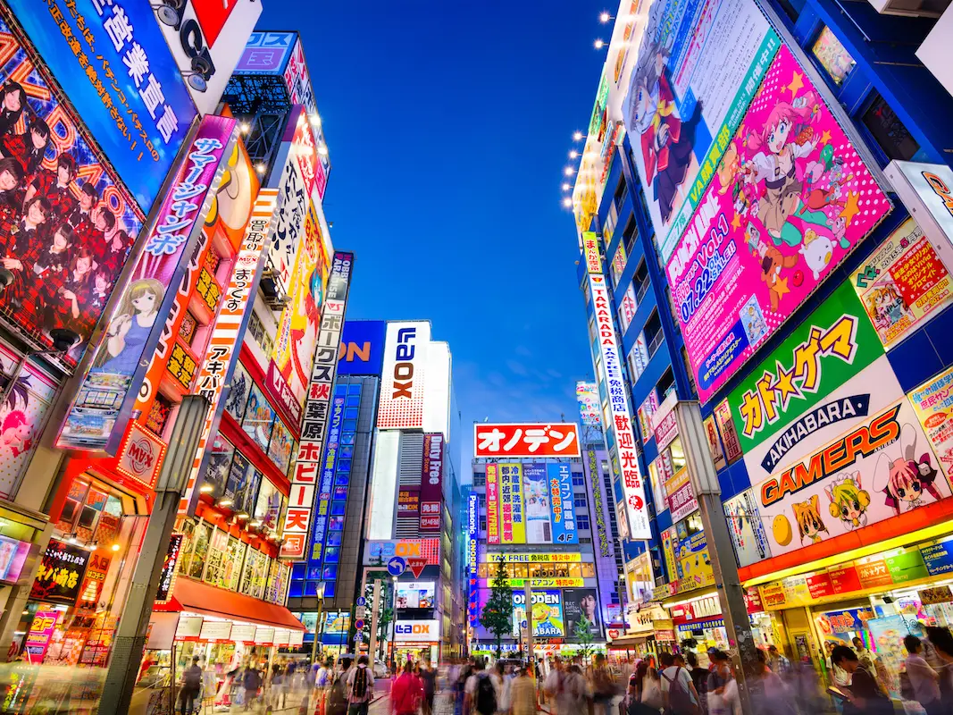
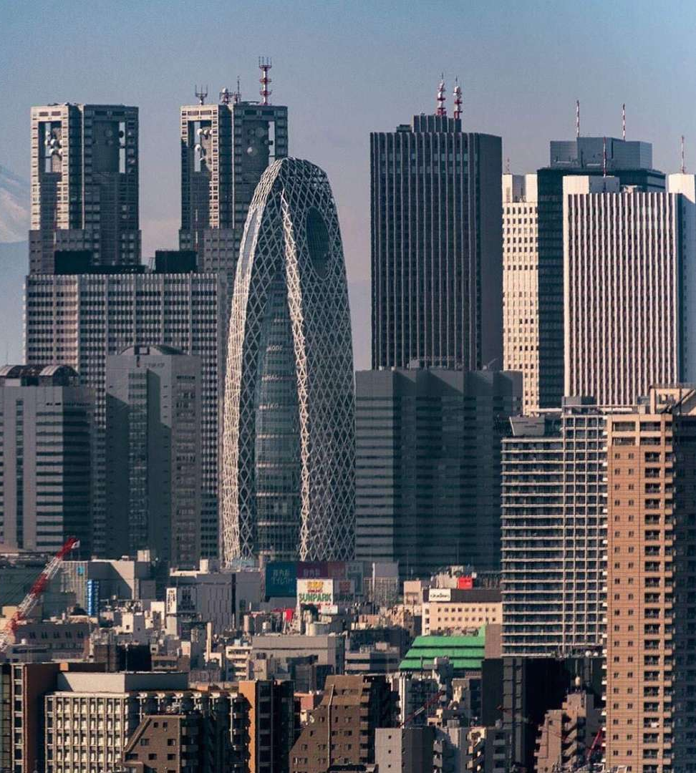
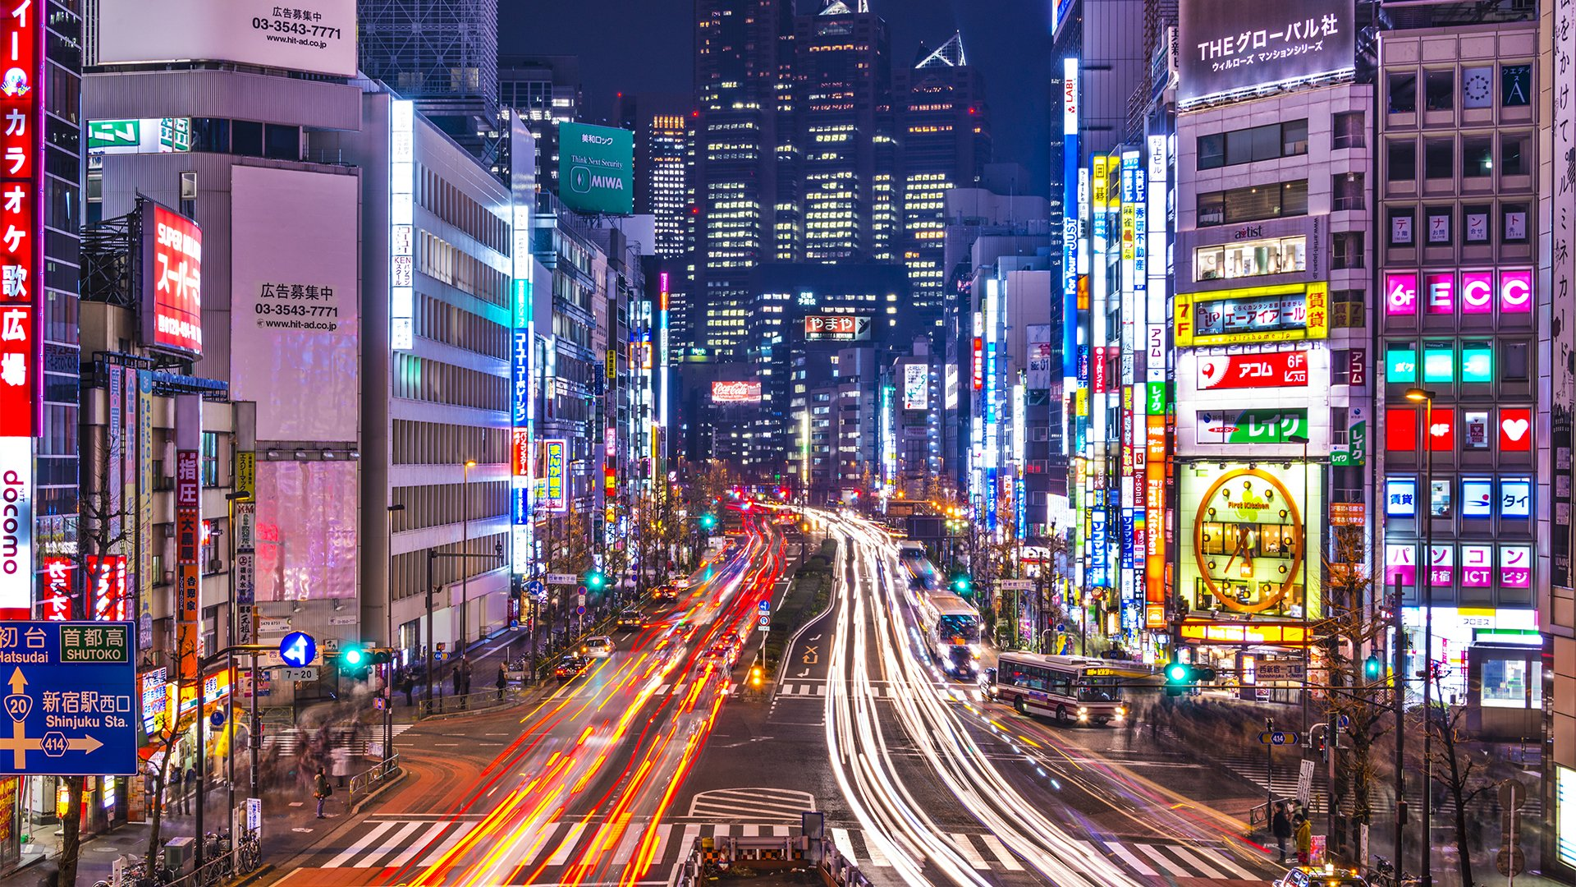
Tokyo 50-60 Years later

Slide 38
Explaining LDP Domination?
7. Consensus Politics
One and ½ Party System

Slide 39
The Questions
Can LDP domination last forever?
Can Japan ever develop a competitive two-party system?

