Slide 1
Oath Keepers
FUNDING
ALLIES
RECRUITMENT

Slide 2
funding
Advertisement
Membership sales
Sponsored events

Slide 3
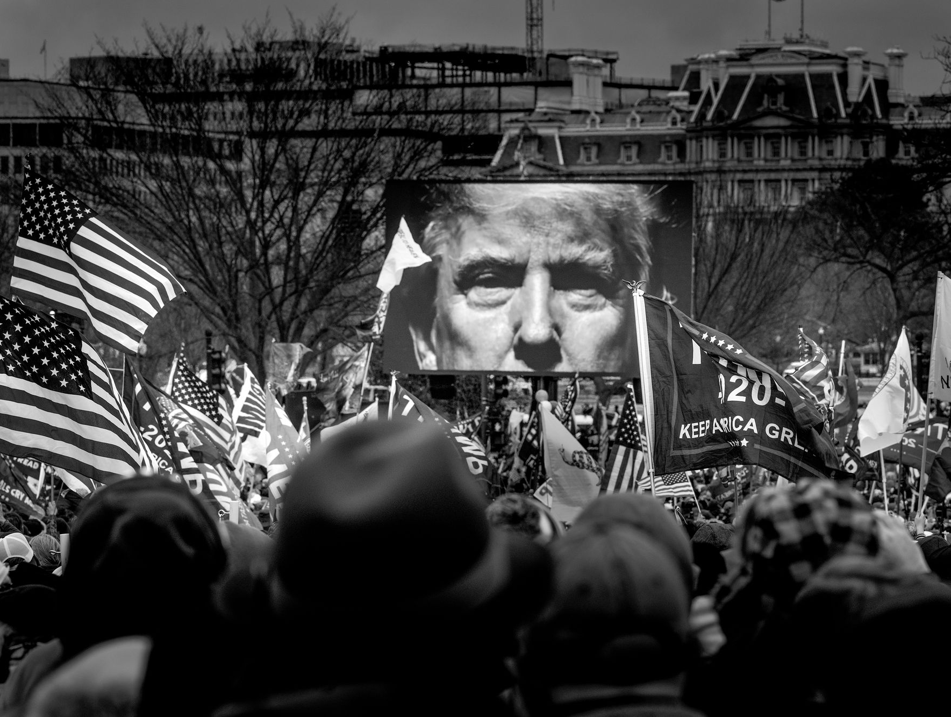
allies
Pre-Trump
Oppose federal power
Post-Trump
Mass federal action
Behind Jan 6 insurrection
Work with Proud Boys
This Photo by Unknown Author is licensed under CC BY-NC-ND

Slide 4
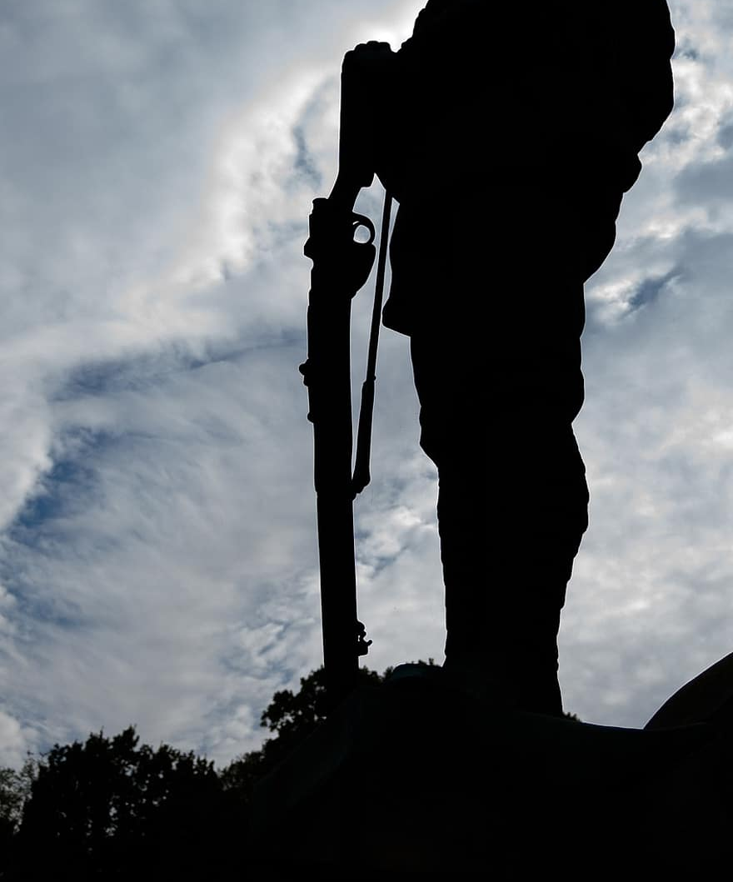
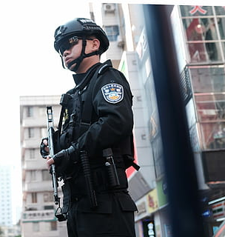
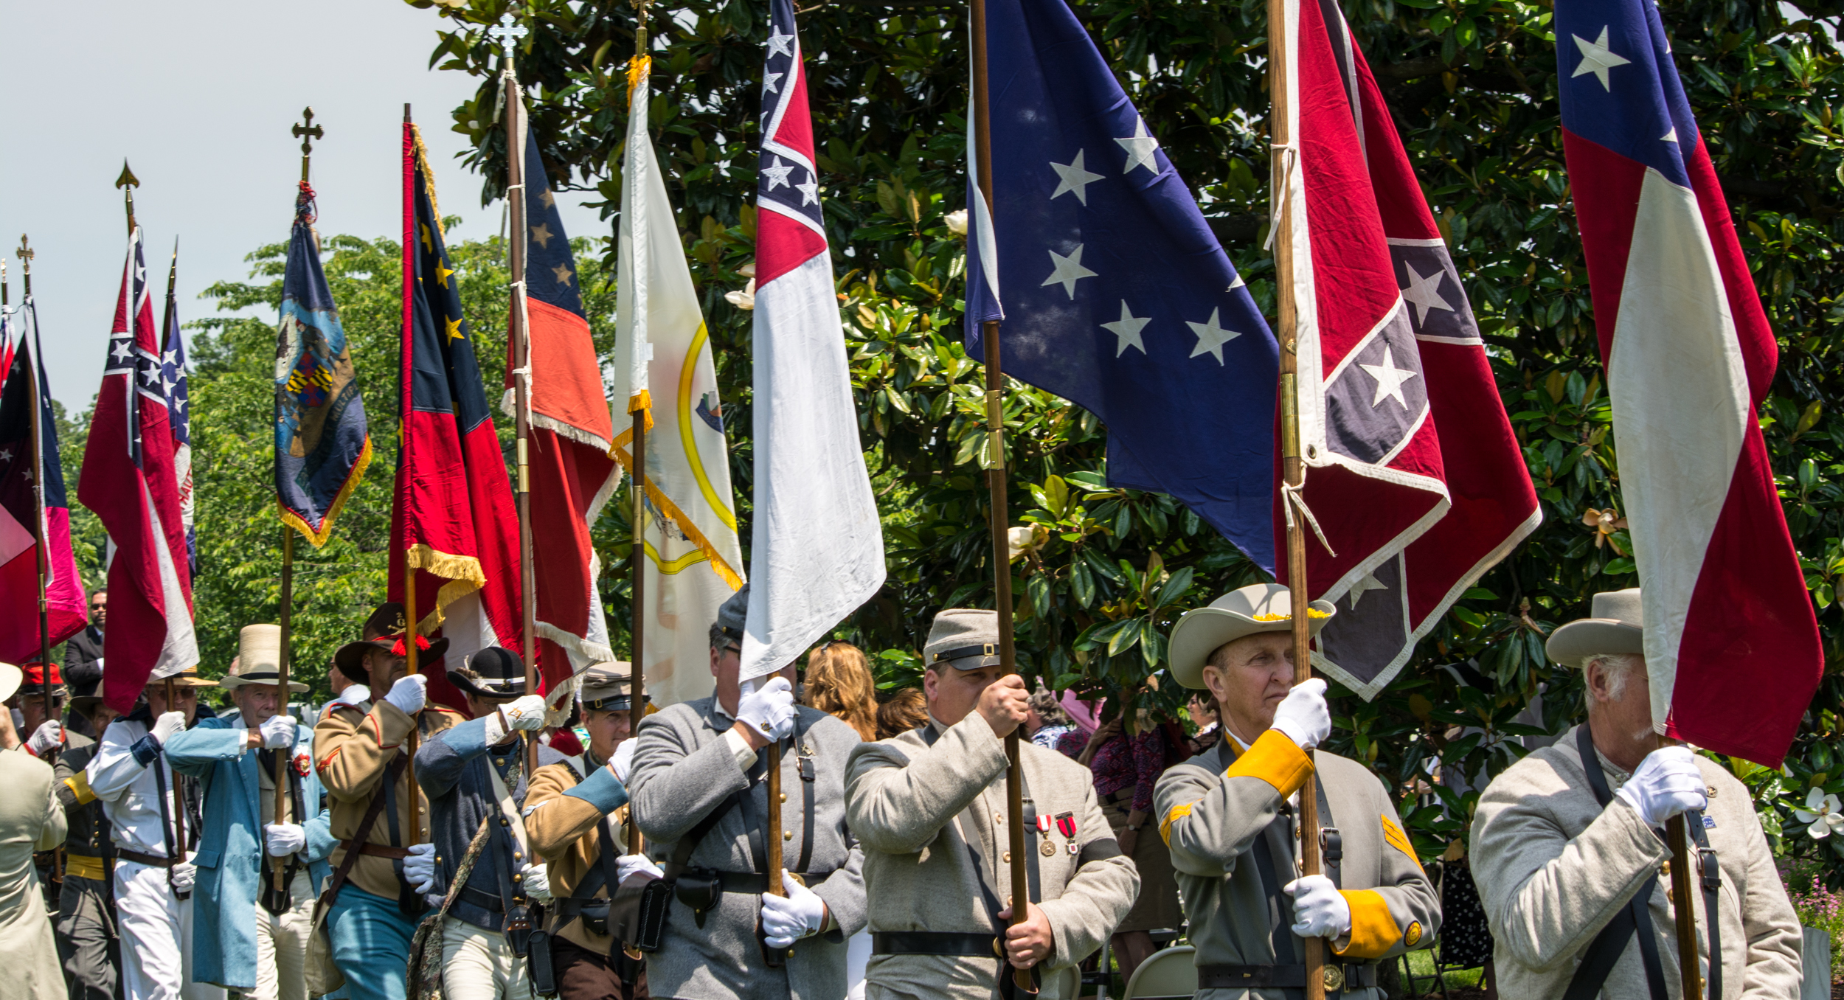
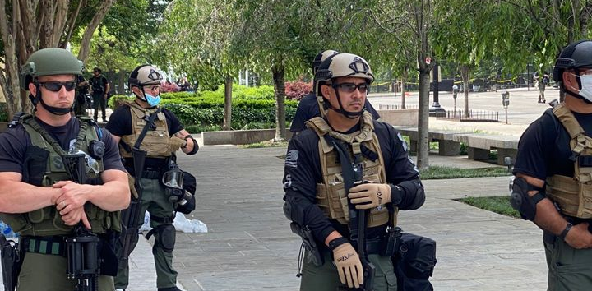
recruitment
Operational enhancements
Conservative ideas
This Photo by Unknown Author is licensed under CC BY-SA
This Photo by Unknown Author is licensed under CC BY-SA

Slide 5
Success?
FUNDING
ALLIES
RECRUITMENT
Members feel like they have been misguided by the US gov

