Slide 1
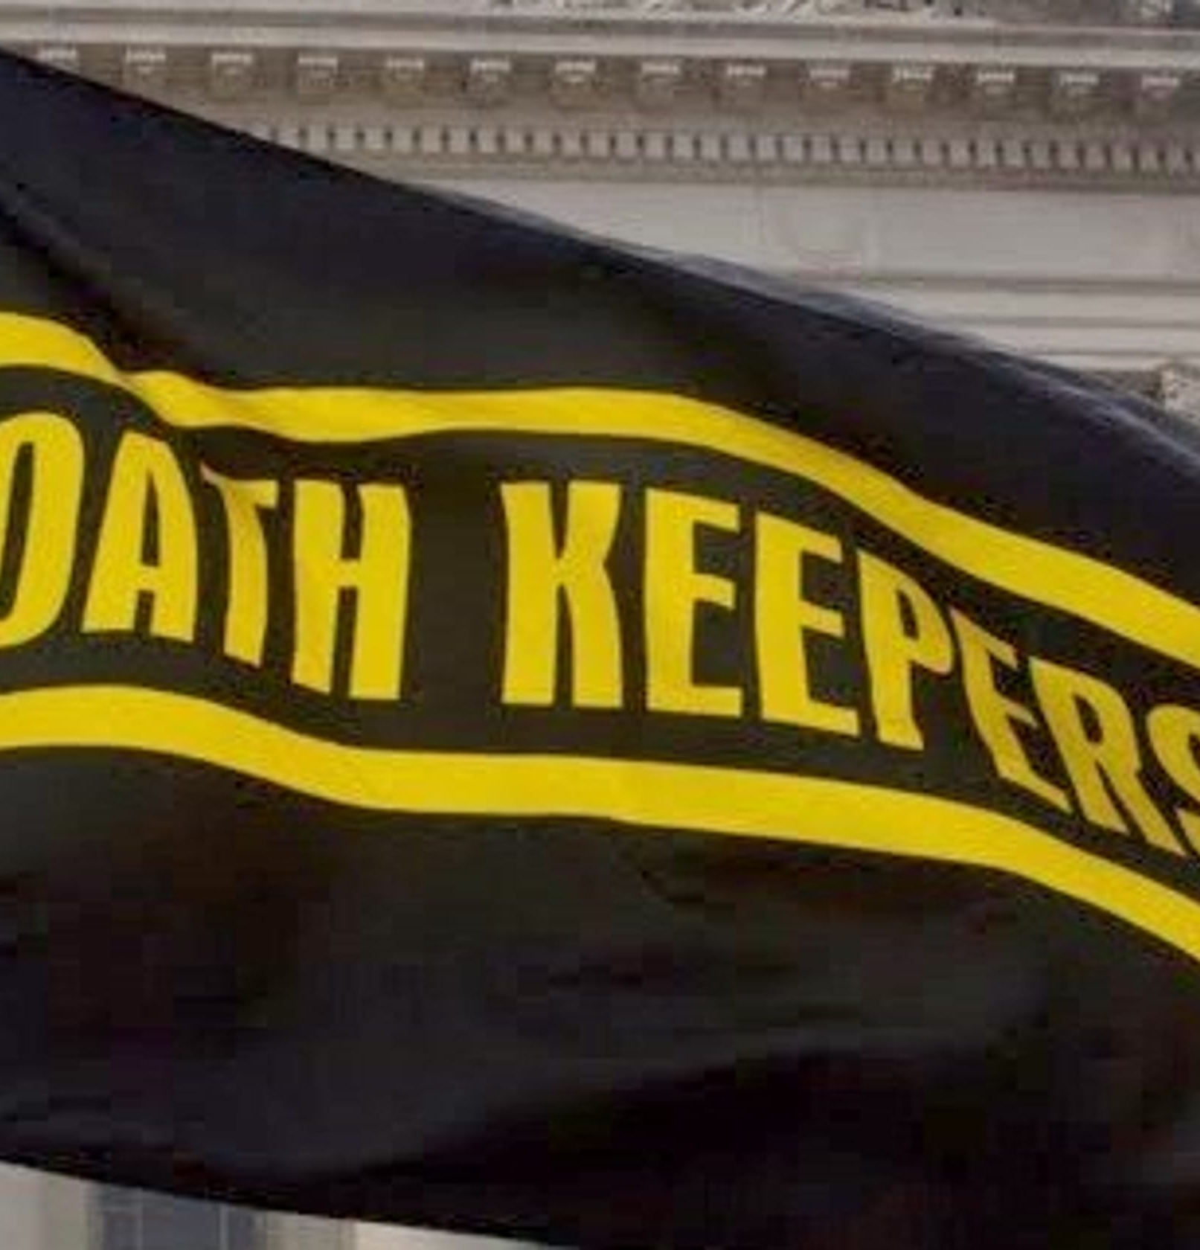
Background Information:
The Oath keepers are an American far right organization, who are antigovernment, and claim to be anti-anything opposing the constitution.
They were founded in March of 2009.
Their founder is Elmer Stewart Rhodes who was a former member of the U.S army.
The organization was founded in order to encourage the current and former military, police, and first responders to uphold their oath to "defend the Constitution against all enemies, foreign and domestic."
The main doctrine of the Oath Keepers is that they follow only the laws of the constitution and nothing else.
Despite how good and reasonable the oath keeper's doctrine may seem, there is a dark, prejudiced side to their beliefs and the way they go about this “protection.”

Slide 2
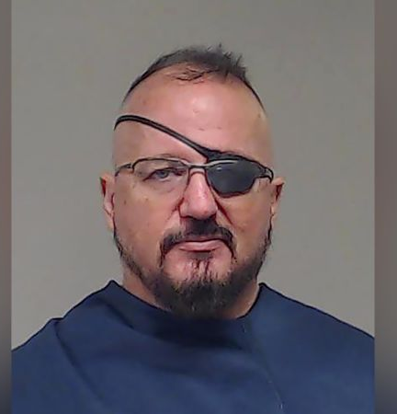
Origins:
Elmer Stewart Rhodes (the founder) is a man who graduated from Yale law school and was also a former Army Paratrooper.
He worked as a staffer for the republican congressman Ron Paul and formed the Oath keepers Organization after Paul’s failed 2008 bid to be the republican presidential Nominee.
President Obama’s election also influenced Rhodes’ decision to form the organization.
In 2013 Rhodes instructed the members of his organization to form Citizen Preservation groups to “protect” Americans from the U.S government’s goal of plunging the country into chaos and scrapping the constitution.
He stated that “They (the government) are preparing to control and contain us, and to shoot us, but not preparing to feed us.”
Rhodes was also a known far right extremist before he founded the Oath keepers.

Slide 3
Doctrine:
Oath keeper doctrine is actually rather simple.
They do not obey the president or any other kind of government official.
They only obey their interpretation of the constitution, and their own declaration of orders that they will not uphold.
They claim that they interpret the U.S. Constitution based on their understanding of its original intent and the principles they believe it embodies.
Their main focus is on encouraging members, specifically those who have military, law enforcement, or first responder backgrounds, to follow their oath to "defend the Constitution against all enemies, foreign and domestic.”
Their key principles include advocating for Limited Government, Individual Rights, Resistance to Unconstitutional Orders, and Defense Against Tyranny.
As an example of the general gist of their rules, the first one is “We will not Obey any order to disarm the American People.

Slide 4
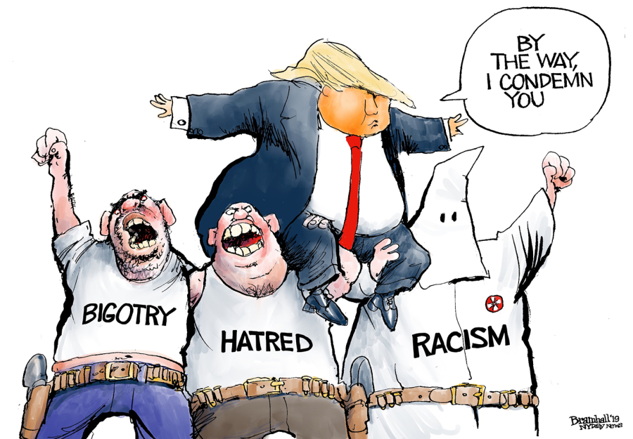
Doctrine Continued:
The Oath Keepers also see Leftist groups, the deep state, and foreign powers, as conspirators and global cabals.
The group also has a streak of Islamophobia and racism.
They However officially reject white supremacy and avoid the word militia when describing themselves so that they seem more appealing to the general public.

Slide 5
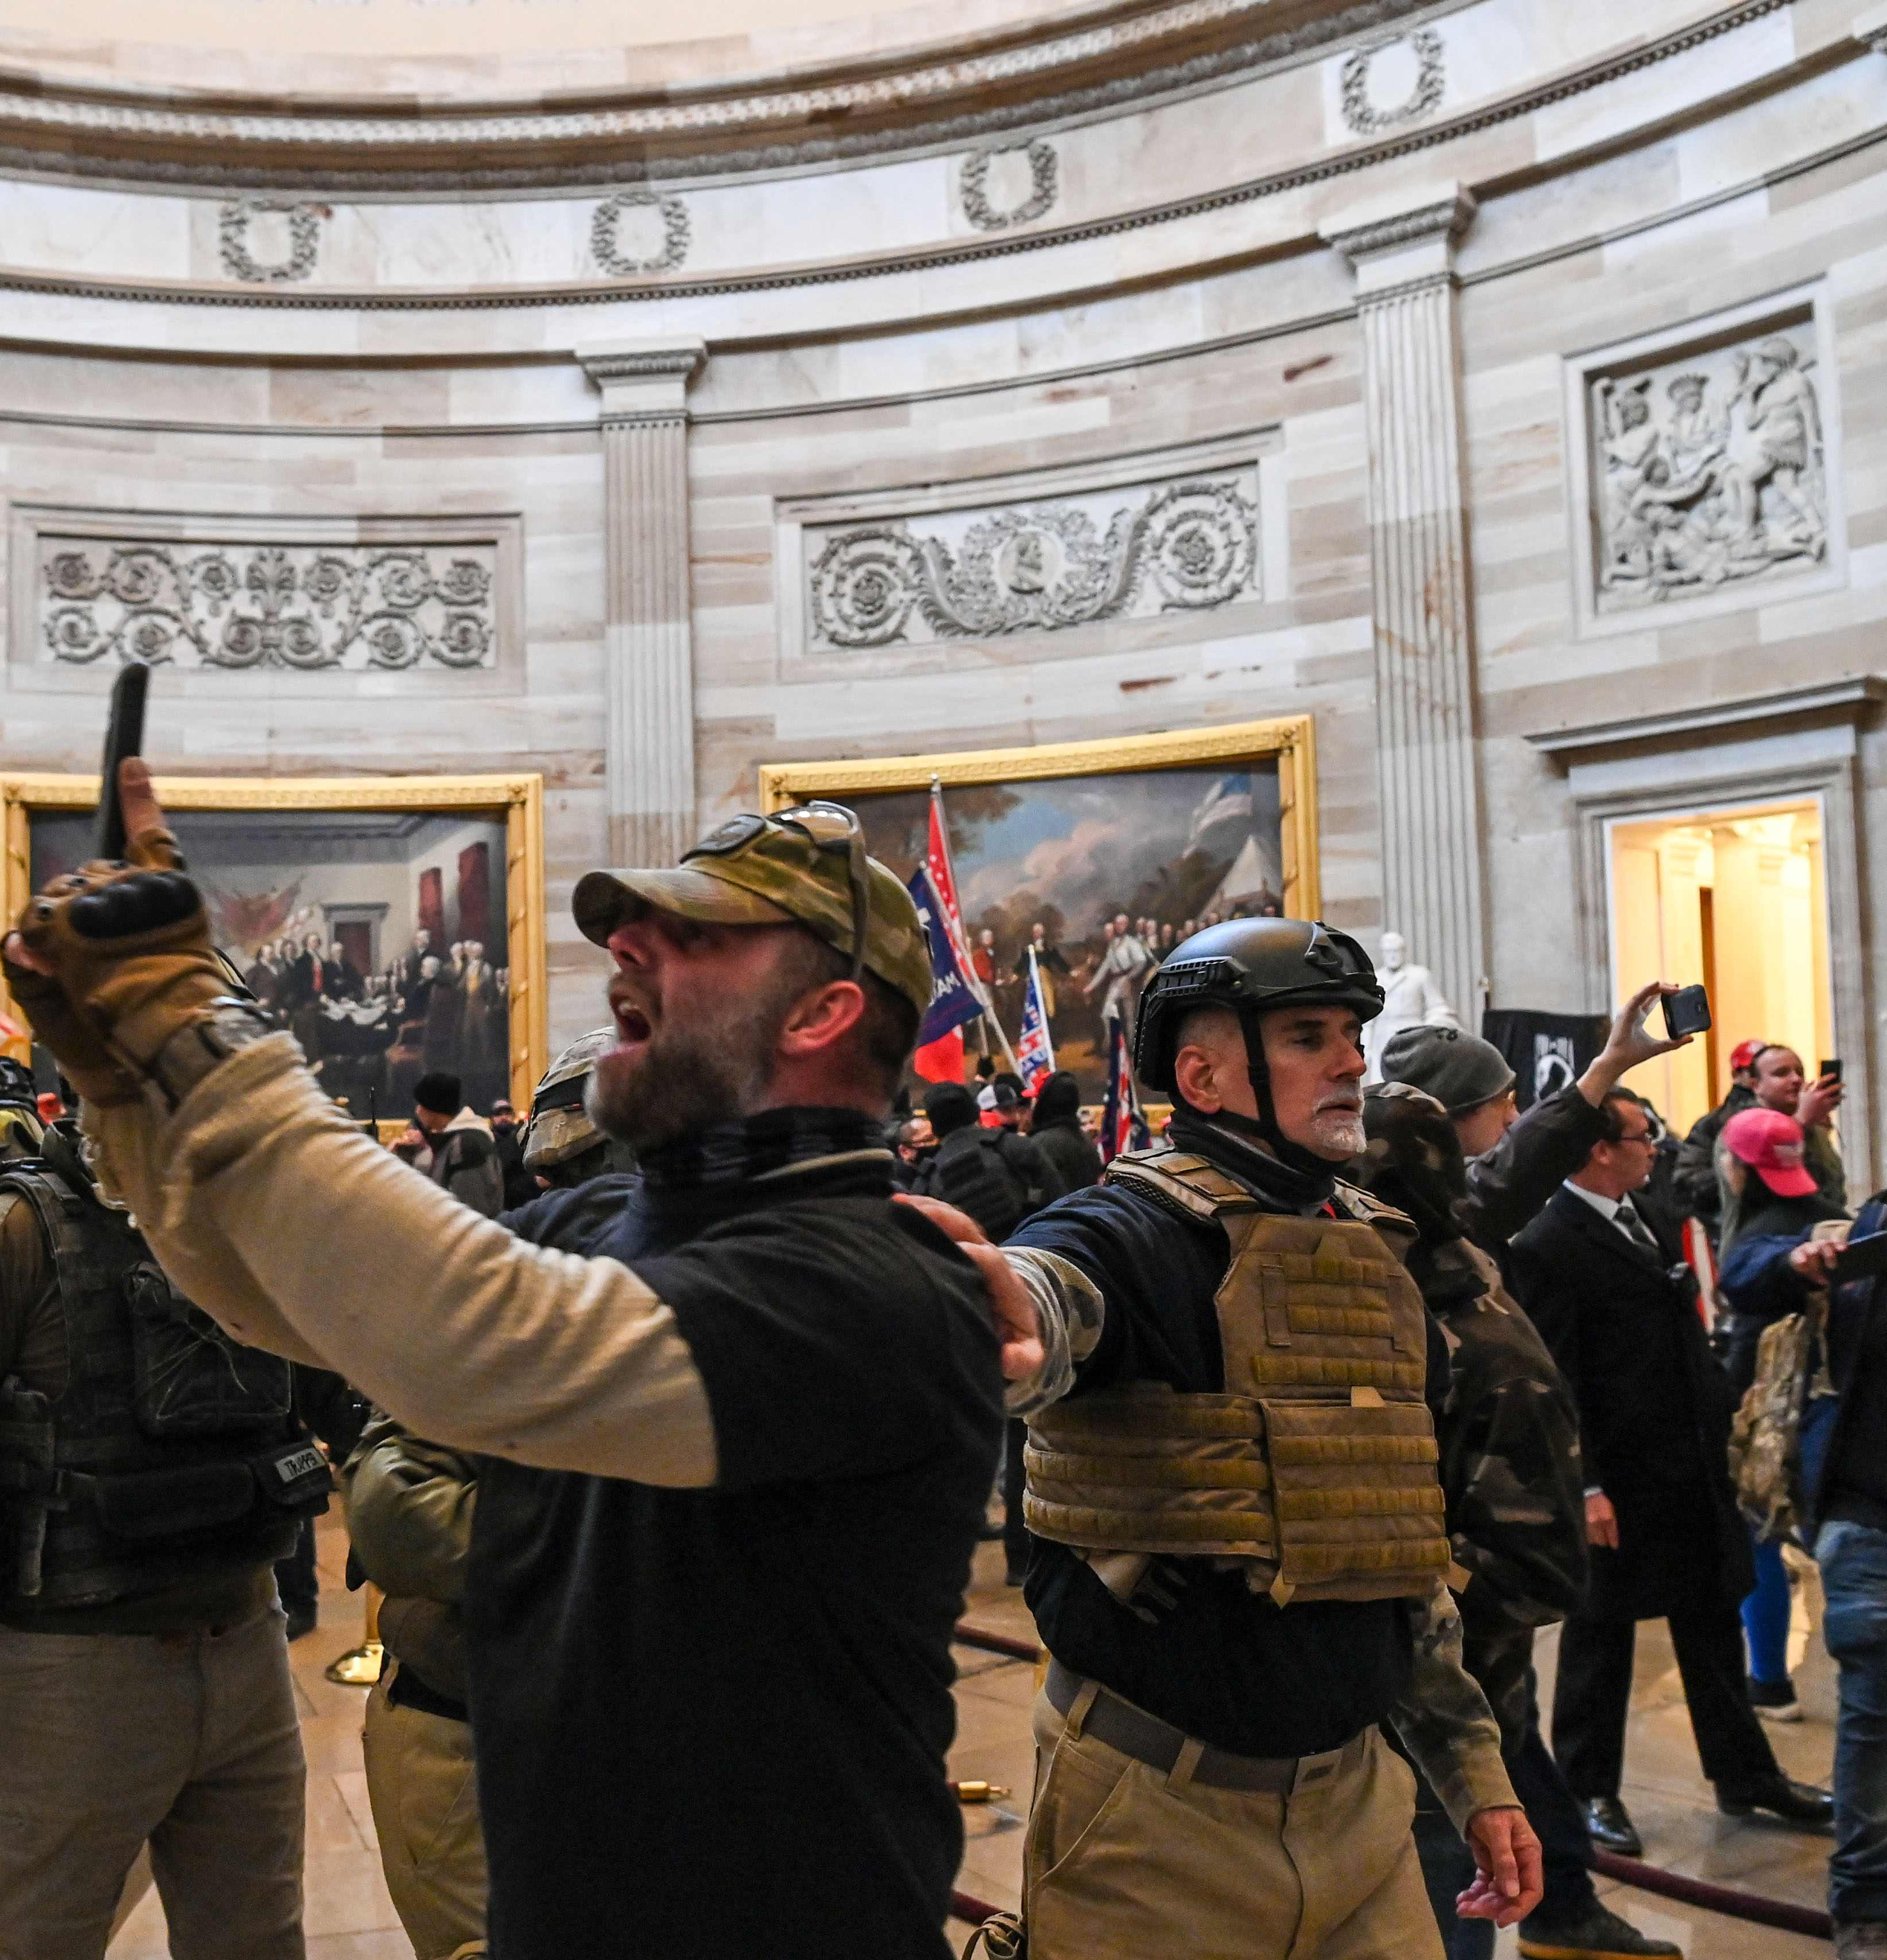
Objectives:
The main objective of the Oath keepers is to protect the rights guaranteed by the constitution, as defined by their own interpretation of it.
In the past, they have responded to calls for aid and support from small communities who feel that their local law enforcement and government have been overstepping (they’ll offer help as long as the communities asking are white).
This support typically includes security, but they have also been called to help with humanitarian disaster relief.
The most significant example of them “defending the constitution,” was their involvement in the January sixth capital attack. The Oath keepers attacked the capital because they believed that the presidential election of 2020 was sabotaged. They were armed and ready to defend the “constitution” with force if necessary.
In the end despite what they claim the oath keepers are a violent radical organization. Their interpretation of the constitution that they so desperately want to protect is completely at odds with the interpretation that the rest of the nation and the judiciary use on a day-to-day basis.

