Slide 1
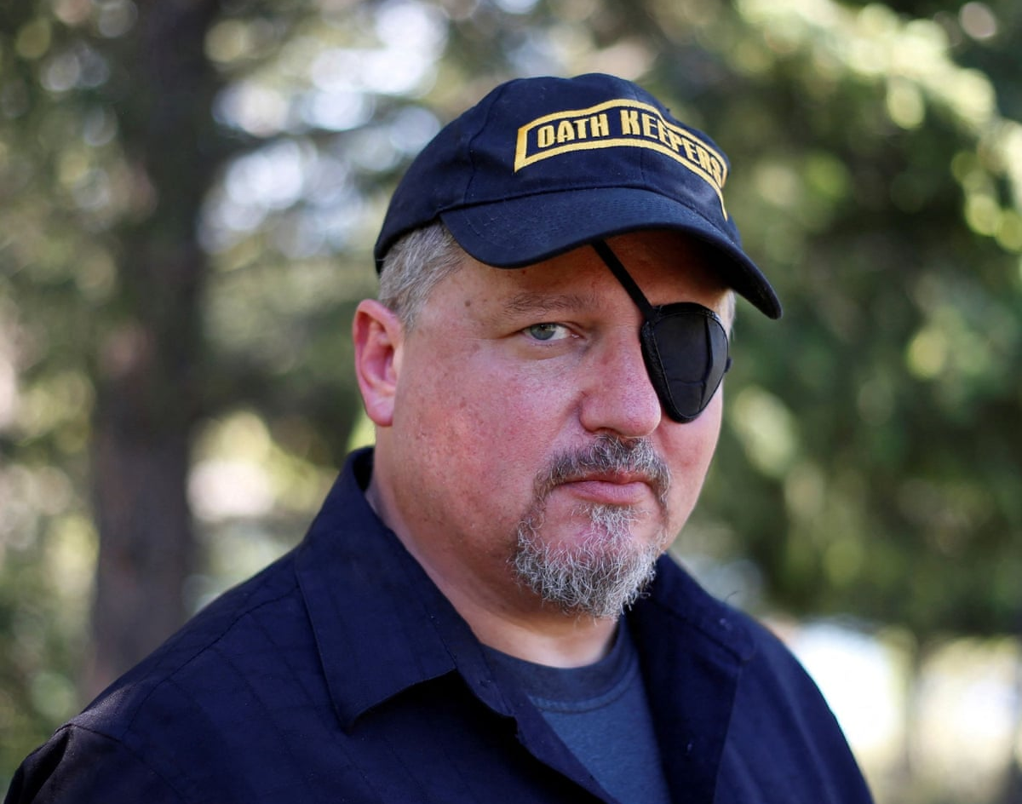
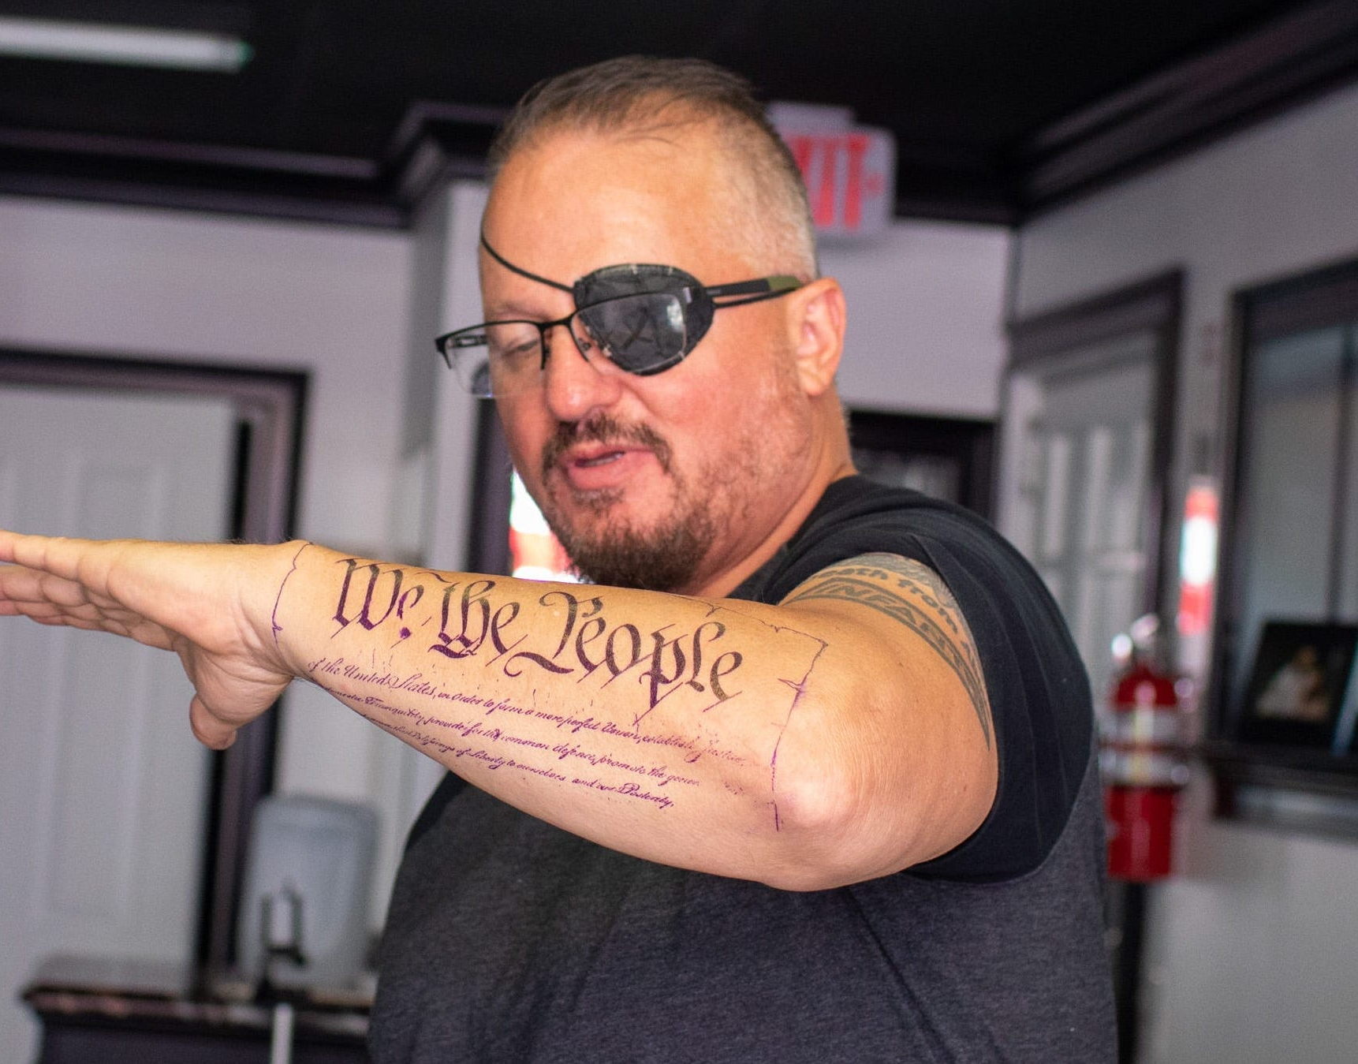
The Oath Keepers Leadership: Stewart Rhodes
“Head of the Dragon”
Disbarred Lawyer, Army Veteran, and Insurrectionist
Sentenced to 18 years for seditious conspiracy

Slide 2
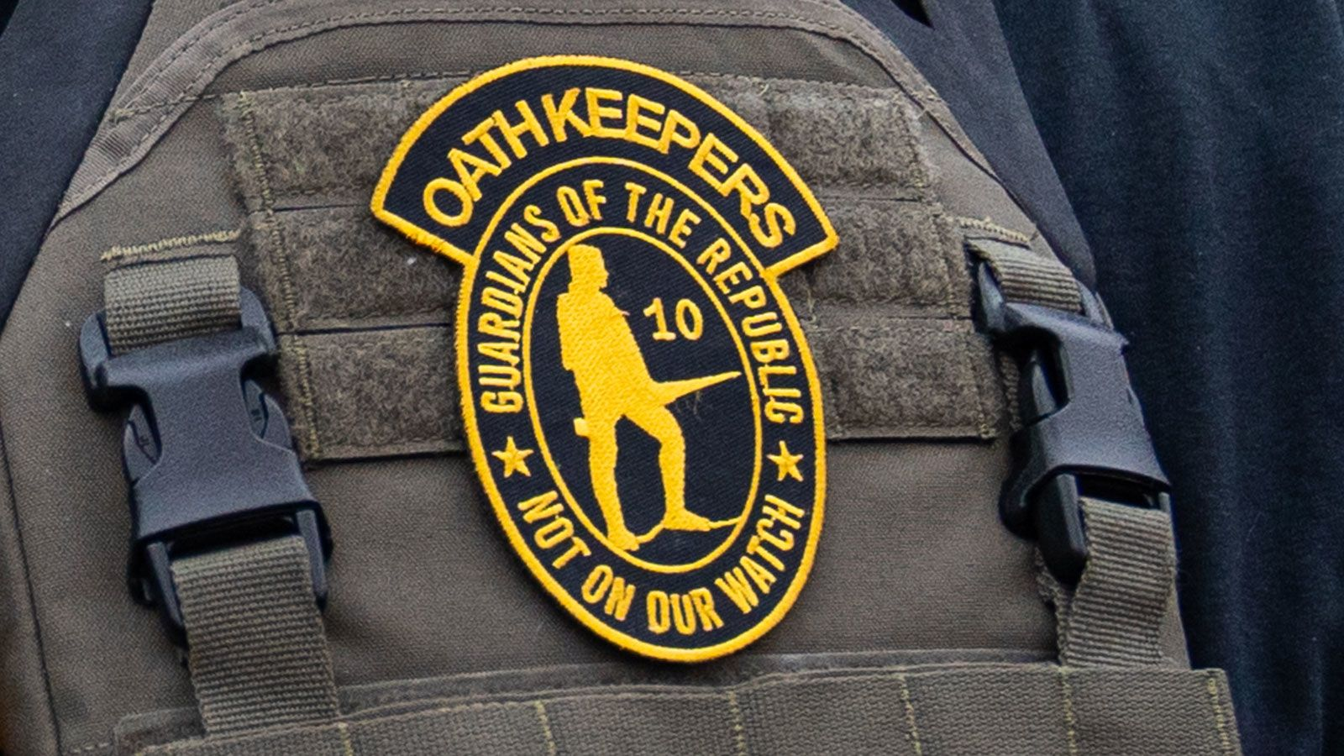
The Oath Keepers Leadership: National Structure
Stewart
Rhodes
Stewart Rhodes’ Role
Board of Directors
Standard Non-Profit hierarchical structure
Chapter
Board Of Directors
Chapter
Chapter
Chapter

Slide 3
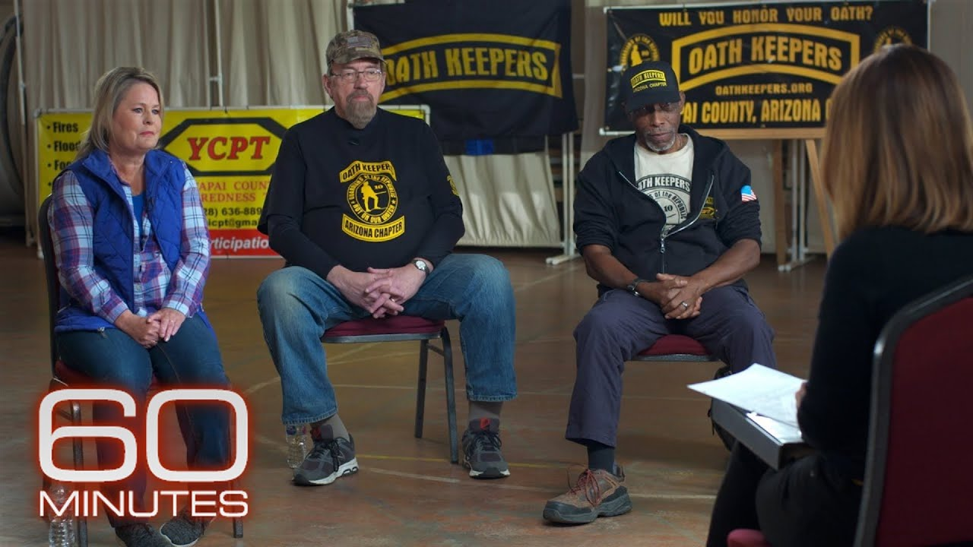
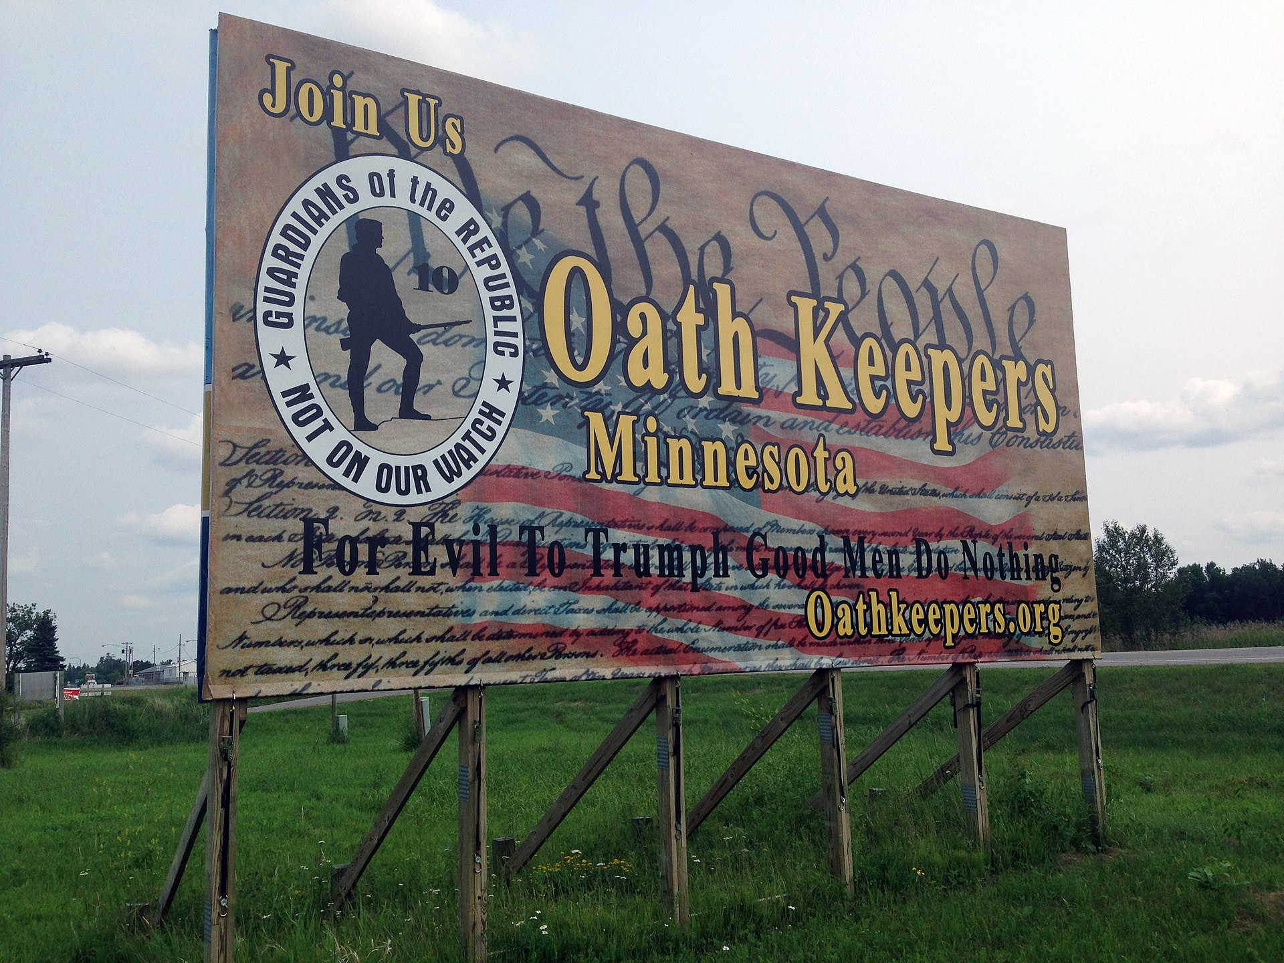
The Oath Keepers Leadership: Chapters
National Level
State/Local Chapters
Independence?
Conflict?

Slide 4
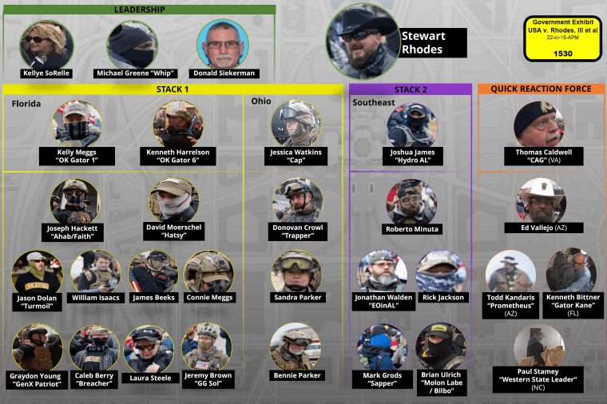
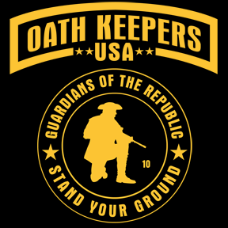
The Oath Keepers Leadership: Stability
Stewart Rhodes Trial
Oath Keepers National?
Local Oath Keepers?
Oath Keepers USA?

Slide 5
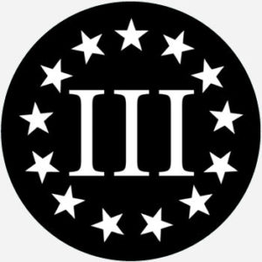
The Oath Keepers Leadership: Conclusions
“Cutting off the head of the Dragon”
Leadership Vacuum
Joining other groups

