Slide 1
The Questions
If the country is really polarized, why?
If the country is not polarized, why does it seem like it is?
Notes:
The following slides are supplementary to the Brownstein book. Since we fell behind the semester I had to skip this lecture (normally two class sessions). The basic thesis about Red and Blue states over the past 15 or so years has been this: Scholars and pundits argue that the US is hopelessly polarized into conservative/Republican vs. liberal/Democratic camps. These camps are represented on an electoral map as Red (Republican) and Blue (Democratic) states. This polarization explains why there is such gridlock, why bipartisanship is a thing of the past, why our political seems broken and unable to solve any problems, and politics in the US has become increasingly bitter.
The questions in the slide are the ones scholars focus on. This PPT slide show provides some answers for each of these questions.

Slide 2
Explaining Polarization
If the US electorate is really polarized, why?
Party Changes
Urban vs. Rural, plus College Towns
Regional
Solid South
4. Culture War: “Guns, God and Gays”
Notes:
This slide is an outline slide. It answers the question: if the country is polarized into red and blue states, why is that true? We’ll talk about four hypotheses to answer the question.

Slide 3
Red States 2016 (180 EV)
Notes:
First, here are the red states. For the past five presidential elections or so, these states have voted for the Republican. Most scholars and election forecasters feel that these states can be chalked up in the Republican column for every presidential election. It doesn’t matter who is running on either side. These are solidly republican states.

Slide 4
Blue States 2016 (215 EV)
Notes:
These are the blue states. For the past five elections or so, these states have gone for the Democrat. Scholars and election forecasters feel that these states will go for the Democrat no matter what. Notice how small the area is and many fewer states there are in this blue bloc of states compared to the red bloc of states. But also notice that the blue bloc is 215 electoral votes and the red bloc is only 180. Population matters. These states have the large urban concentrations and therefore what they lack in area (see the red map), they make up for in people. Remember that the NY metropolitan area has a population of about 20 million people. Montana is about 1 million people. Wyoming is about 600,000 people. North Dakota has about 740,000 million people. You can win a lot of states in the Plains area of the US and not get many electoral votes. The three red states mentioned here give you 9 electoral votes. Blue NY gives you 29.

Slide 5
Swing States (143 EV)
Notes:
These are the swing states. Over the past five or so elections they have gone blue and red or they have been won by the same party, but by a small margin (under 5%). They are swing states, sometimes called purple states. The program I was using for this doesn’t have purple as an option. So they are green here. These are also called battleground states. This is where the action is. If the others are either solid blue or red, the strategy in the election is to win enough of these to get to 270.

Slide 6
The Country by County 2008 Presidential Election
Notes:
This is my favorite map. This shows a county-by-county look at who won the 2008 presidential election. Notice all the red counties and the relatively few blue counties. Again population is what determines electoral votes for each state, so this mostly red map is a victory for blue. Is this polarization? Maybe.

Slide 7
If the nation is polarized, why?

Slide 8
1. Party Changes
Evolution of Parties since 1960s
Homogenization of the parties
Republican Party
Conservatives and Moderates
Democratic Party Conservatives and Liberals
Notes:
The first hypothesis is Brownstein’s thesis illustrated by a chart:
*The Democratic and Republican parties had both been coalitions of conservative and moderate/liberal elements since the end of the civil war.
*In the 1960s this began to change (Civil Rights, Great Society, Vietnam, collapse of the New Deal Coalition, and rise of the Reagan Coalition).
*Conservatives Democrats began to move to the Republican Party (the arrow pointing to the right); Moderate Republicans began to move to the Democratic Party (the arrow pointing to the left).
*This led to a new party system: A more purely conservative party faced off against a more purely liberal party.
*The result is greater polarization. All the conservatives consistently move the Republican party to the right. You win primaries at every level by being more conservative than your opponent. All the liberals and moderates move the Democratic party to the left. You win primaries by being more liberal than your opponent.
But there is a counter argument to this. If you examine recent Democrats and compare them to past Democrats, you’ll notice that Bill Clinton, Barack Obama, and Hillary Clinton are farther toward the center than Lyndon Johnson, for example. The Democratic Party hasn’t shifted to the left as far as the Republican Party has moved to the right. This may be because the American electorate on the whole is slightly right of center (because of the Reagan realignment). So the Democratic Party has to stay somewhat close to the center in order to win. In short, there is a limit to how far left the Party can go. For Republicans there isn’t that limit and it can shift very far to the right.
Then again, the US electorate may be shifting again. The success of Bernie Sanders in 2016 suggests that maybe the Democratic Party can shift further to the left. Even Donald Trump, the Republican nominee (it seems) in 2016, is further to the left than the average Republican on several issues (trade, abortion, and same-sex marriage for example).
Is there a shift to the left on some issues?

Slide 9
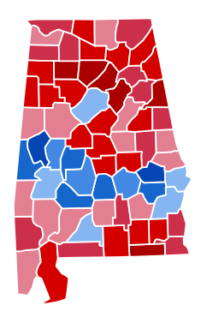
2. Urban vs. Rural, plus College Towns: Population Density Matters
Blue State by County: Illinois
Red State by County: Alabama
Notes:
A second thesis argues that urban areas and college towns are blue. The rest of the nation (more rural areas) are red. The maps above are a red state and a blue state. They don’t really look very different. They are mostly red and have several areas that are blue. The red areas are more rural. The blue areas are more urban or they are college towns that are located in the middle of nowhere. This is the pattern that exists in just about every state in the nation. What decides whether a state is red or blue then? Population is part of it. States that are more urban in general are blue states. States that are more rural in general are red states. The suburbs are up for grabs in many states. For the swing states, whoever can win the suburbs, wins the state. The suburbs are swing counties.

Slide 10
A Purple and Blue State by County
Virginia
Pennsylvania
Notes:
These maps add to the idea. Virginia is a purple state. Pennsylvania is a blue state. I know these two well by their geography. In Virginia, you can see the massive amount of red and the small blue areas. The blue represents Norfolk, Hampton Roads, Richmond, Charlottesville, the suburbs of DC, and that blue county way over in the west is Virginia Tech. For Pennsylvania, the massive amount of red in this blue state is interrupted by Philadelphia, Harrisburg, Scranton-Wilkes-Barre, Pittsburgh, and Erie.

Slide 11
3. Regional: The South Switches
1952
1964
Notes:
A third thesis is that this is all about the South. The South switched from Democrat to Republican and that polarized the electoral map. We talked about the electoral realignment that began in the 1960s and that is seen as the key to the current polarization in this third thesis. It’s related to the first thesis. The South was always the most conservative part of the Democratic Party. When the South switched, the Democratic Party became more liberal on the whole and the Republican Party got a strong dose of southern conservatism. The maps above show the differences we’ve talked about before. In 1952 the South voted against Eisenhower, the war hero, because he was a Democrat. By 1964, the South voted against the Democrat because he had passed the Civil Rights Act. This began the South’s shift and the eventual polarization of the nation.

Slide 12
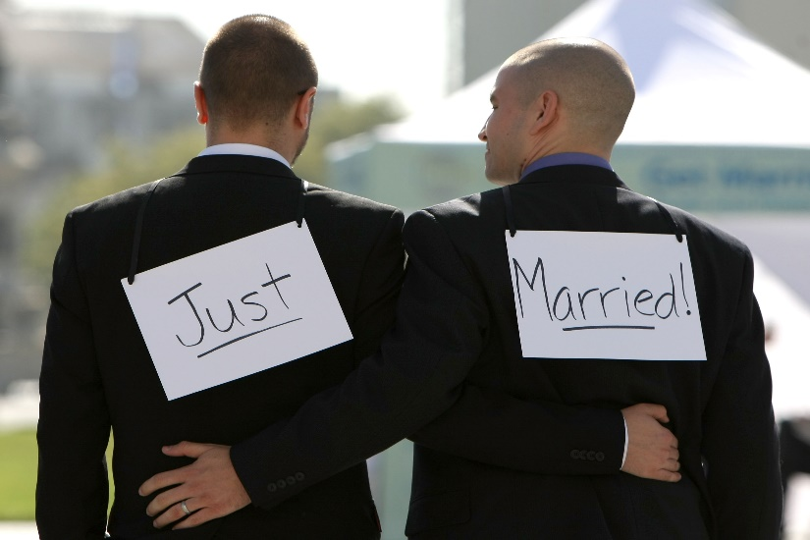
4. Culture War: “Guns, God and Gays”
Which one of these looks like freedom?
Notes:
A fourth thesis, says that this is all about culture. Parts of the nation are becoming more progressive and parts of the nation are holding onto more traditional values (Urban and college towns vs rural areas again?). This slide is intentionally provocative. Which one of these looks like freedom: same sex marriage or the ability to carry your assault rifles into the convenience store when you want lunch? The idea here is that Americans are becoming more and more divided on their basic conception of values and these differences in values are defining the electorate. The biggest cultural divide seems to be over abortion. In poll after poll, a person’s view of abortion seems to be the easiest way to predict whether they are Democrats or Republicans. If you are pro-life, you are likely to be a Republican. If you are pro-choice, you are likely to be a Democrat. Both parties have used these themes in their electoral strategies and often in hyperbole and demagoguery. Then again, it is possible that the pictures above are of the same two men. They got married on Saturday (the picture on the left) and they are on their honeymoon in the mountains (picture on the right). Probably not, but who knows.

Slide 13
Explaining Polarization
If the electorate is not polarized, why does it seem like it is?
Polarization is an election strategy
Polarized elites
The use of fear
Low Turnout
only the most ideological vote
Independents: alienated voters
Result of “winner-take-all” system
Gerrymandering
Notes:
Let’s move to the second question. If the nation is not polarized, why does it look polarized? The argument here is that the electorate is not polarized, but something about the system, or elections, of the way elites behave makes the nation look polarized.

Slide 14
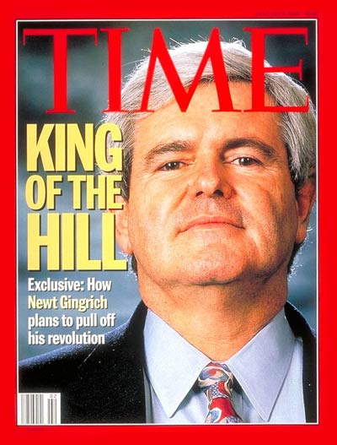
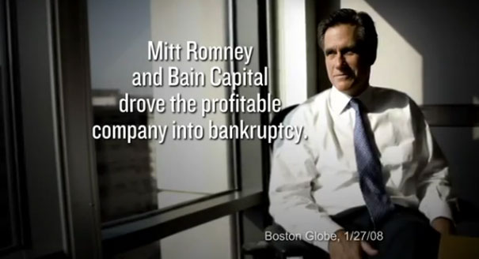
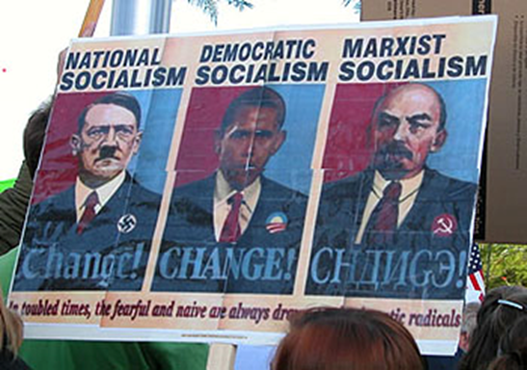
1. Polarization as an Election Strategy
1996 Gopac Memo from Newt Gingrich
Notes:
The first thesis argues that polarization is an election strategy. It assume that elites are polarized. Party officials, pundits and strategists from each party only gain power when their party wins. They aren’t looking for compromise. They aren’t looking necessarily to solve problems. In some ways, it’s better to have problems that you can blame on your opponent, than to solve problems through compromises that give your opponent partial credit. You win when you emphasize the differences in the parties. There are two elements to this. First, you need to mobilize the party faithful. That means throwing out the red meat and becoming as partisan as possible. Democrats will argue that Republicans are waging a war on women. Republicans will argue that the “homosexual agenda” is designed to destroy the family structure of the US. The second part is the use of fear. Pundits and candidates demonize their opponents: It’s not that our party has better policies; it’s that they aren’t real Americans; their not like “us”; they aren’t patriotic; they hate America. The modern pioneer of that is Newt Gingrich, Republican Speaker of the House in the 1990s. Read his GoPac memo from 1996 (the link above). Wow. It suggests words to use to describe Democrats in campaign advertisements and speeches: sick, deranged, perverted… The center picture is a sign that links Obama to Hitler and Lenin. The third is a bit more tame, but it highlights Mitt Romney, suggesting he cause companies to go bankrupt. See the next slide for more.

Slide 15
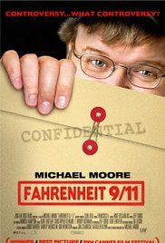
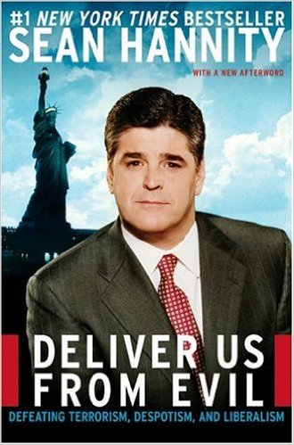
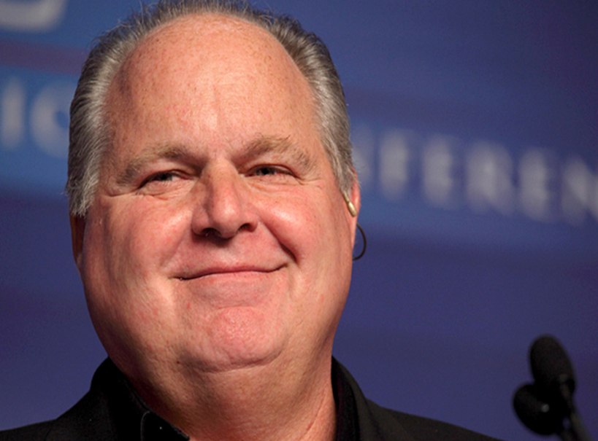
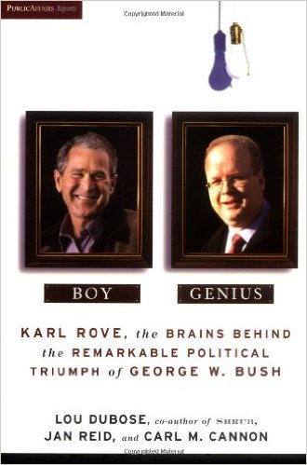
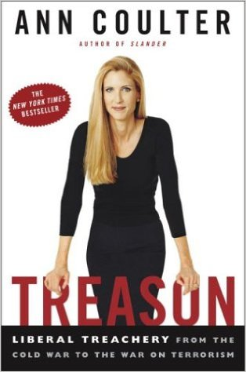
The Pundit World
Rush Limbaugh
Notes:
Speaking of the use of fear and pundits. Books on politics have become more and more shrill, designed primarily to make you afraid of the opposition party. Talk radio is a monument to demagoguery, simplification of complex issues, outright lies, and hyperbole. People have a hard time discussing politics these days because they live in different worlds. For some, it’s not like talking to a fellow American who has different views; it’s confronting the enemy. People who watch Fox News and people who watch CNN have learned different histories of America. And the internet. Wow. You can decide what you believe in and then find a web site that will tell you you’re right, even if you’re hopelessly wrong. There are people who “know” that George Bush was responsible for the attacks on the US on 9/11. He had CIA attack the trade centers so that he could have an excuse to attack Iraq. There are people who “know” that the US Supreme Court and Governor Jeb Bush of Florida stole the 2000 election from Al Gore and gave it to George Bush. These people are living in their own distinct worlds and get their news from web sites that support those views.
The illustrations above are of Rush Limbaugh who has spent the last 20 years or so hammering away at the Democratic Party, with hyper-conservative ideas, wild accusations, and often flat out lies (I’m somewhat conservative on a lot of issues and often agree with some of Limbaugh’s ideas, but while you are entitled to your own opinions, you are not entitled to your own facts, a paraphrase of Senator Daniel Patrick Moynihan. Limbaugh is the Godfather of the Trump movement in some ways. He has been rabidly anti-Trump, but his style and success foreshadows the Trump style and success (he tells you that he is always right and that he’s smarter than everyone else; he belittles his opponents; and he sells his ideas with a stream of consciousness style). The other illustrations are of books by Ann Coulter (Treason: Liberal Treachery from the Cold War to the War on Terrorism), Sean Hannity (Deliver Us from Evil: Defeating Terrorism, Despotism, and Liberalism), Lou Dubose and Carl Cannon (Boy Genius – a book that portrays GW Bush as essentially an idiot and adviser Karl Rove as the puppet master), and the final is of a movie by Michael Moore (Fahrenheit 9/11, which hammers Bush on the post 9/11 policies in ways that are filled with conspiracy theories and falsehoods, all the while trying to be funny). That’s two from the right (which equate the Democratic Party with treason and terrorism) and two from the left (that mock the Republican Party as a bunch of ideological fools and morons).
The point is that media has become a political battleground and the purpose is to make you fear the political opposition. The Republican Party is much more organized in these efforts and more successful. The number of books and radio programs on the right dwarfs that of the Democratic side. The reason why leads to an interesting debate. Most of the explanations are partisan. Are Americans more conservative on the whole as the Republican Party argues? If so that explains why Limbaugh and Glenn Beck and Bill O’Reilly, and Sean Hannity and Ann Coulter are celebrities and millionaires. There is nothing equivalent on the liberal side. MSNBC tries to be like Fox in the evening, but the audience is not nearly close to the size of the Fox audience. Liberals or Progressives argue that it’s not because there are more conservatives in the US, it’s because liberals and progressives don’t want propaganda and half-truths and demagoguery in their news shows; they want news.

Slide 16
2. Voter Turnout only the most ideological vote
Presidential Midterm Primaries
1992 55% 1994 41%
1996 49% 1998 38%
2000 51% 2002 39%
2004 57% 2006 40%
2008 58% 2010 41% 2010 18%
2012 55% 2014 36% 2014 14%
Notes:
A second thesis is a kind of a simple, but powerful one. Only the most ideological people actually vote. People in the center don’t vote enough. The chart above shows the voting percentage for the past few elections. For presidential elections, the low since 1992 was 49%; the high was 58%. Let’s call is roughly 55%. That means for a presidential election 45% of the voting age population sits out the election. It’s unclear why and it’s unclear who they are. We can’t find out through exit polls because they aren’t voting. But we do know that the people who do vote are more committed to a party and more ideological than the average American. It’s even worse for midterm elections. The turnout is even lower and the actual voters are even more ideological. For primaries, it’s even, even worse and that’s a problem. People who choose the Republican and Democratic party candidates for the House, Senate, and the Presidency are more ideological than everyone else. The Democratic primary voters are much more to the left than the average Democrat and much further to the left than the electorate. The Republican primary voters are much more to the right than the average Republican and much further to the right than the electorate. And if the parties keep nominating people who are too far to the left or too far to the right for the average American in the center, that creates even more reasons for the people in the center to decide not to vote. The bottom line is that the center doesn’t vote as much as the right and left do. That creates polarization. So get out and vote!

Slide 17
Voter Turnout
Notes:
Here’s another chart of voter turnout.

Slide 18
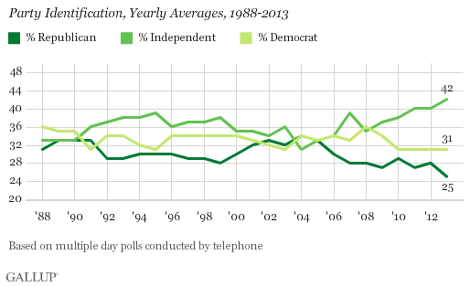
Independents: alienated voters
The center doesn’t vote?
But the left and right do?
Notes:
This adds to the idea. Take a look at the chart and you’ll see that more and more Americans identify as Independents. They don’t feel that either party serves their interest. They generally react to this by not voting. In some states, you are not allowed to vote in a primary unless you register with the party. That means that these Independents may not have any role in choosing the candidates they will have to choose from in the election. This further alienates them. If these people are in the center and most of them seem to be, their refusal to vote or inability to vote in the case of primaries, means that their centrist views are pushed out of the actual electorate, leaving more ideological people in the driver’s seat. The result is polarization.

Slide 19
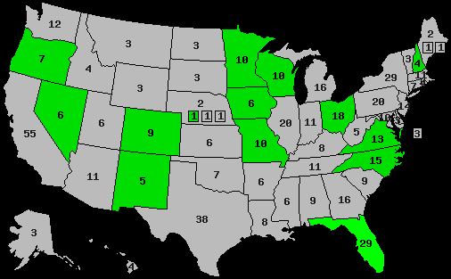
Swing voters (143 EV) or Not Swing Voters?
If independent voters don’t vote, how do you win? Get out your base: Be more partisan and ideological in the swing states!
Notes:
And, if you’re a Republican or Democratic party strategist and you believe that the center doesn’t vote, how do you design a strategy to win? You try to get the base out as much as possible, appeal to the most partisan voters, demonize the opponent, use polarization as strategy, and hope you get the ideological voters to come out and vote.
Then again, typically after the conventions, presidential candidates do move to the center, an acknowledgement that you need to get the center on your side to win the swing states. That’s less necessary for a Senate race and almost not important for most House races.

Slide 20
3. Result of “winner-take-all” system
Florida 2000: Red State?
 | Presidential Candidate | Vice Presidential Candidate | Political Party | Popular Vote |  | Electoral Vote
 | George W. Bush | Richard Cheney | Republican | 2,912,790 | 48.85% | 25
 | Albert Gore Jr. | Joseph Lieberman | Democratic | 2,912,253 | 48.84% | 0
 | Ralph Nader | Winona LaDuke | Green | 97,488 | 1.63% | 0
 | Patrick Buchanan | Ezola Foster | Reform | 17,484 | 0.29% | 0
 | Harry Browne | Art Olivier | Libertarian | 16,415 | 0.28% | 0
 | Other (+) | - | - | 6,680 | 0.11% | 0
Notes:
A third thesis, suggest that the polarization argument is great for television and all our new graphics capabilities, but it’s almost silly. What looks like polarization is a result of our system, a system that needs some adjustments. Above are the results of the Florida presidential election in 2000. Bush won by 537 votes. But he received all 25 of Florida’s electoral votes, and Florida was marked as red on the electoral map. Many simply said: that’s it; Florida is red. You might also wonder how we can be so polarized when the popular vote total was so close and Gore won that popular vote. There were many states that were won by Bush or Gore by under 5%. The entire election was close, not just Florida. Also that 2000 election, won by a Republican followed two elections won by Democrats and was followed by a 2004 Republican victory and two straight Democratic victories. It looks like the US people slide back and forth between the parties and see eight years as about enough time for one party to enjoy power. That’s not very polarized. It seems like the American voter is pretty discerning and likes to mix it up a little between the parties.
Why does it look like polarization? If you win a state by one vote, you get all the electoral votes of that state. If you win a Senate race by one vote, you get the seat and the loser goes home. If you win a House district by one vote, you are a member of the House of Representatives and the loser is nothing. If you only see the winners and losers and not the vote total, you might see this as polarization. Many nations have proportional representation seats, based on party, so that the “losers” still get some representation. Imagine if state had 20 seats in the House. In a winner-take-all system, a party could win each seat by one vote and win al twenty seats (with a state-wide margin of ten votes). Now imagine a system with some proportional representation. Take the twenty seats and imagine that ten of them were based on winner-take-all districts and ten of them were selected based on the state-wide vote for the party (proportional representation based on the state-wide vote). If a Party got 50% of the vote, it gets 5 of the seats. If another party gets 30%, it gets 3 seats. If two small parties get 10%, they each get one seat. That means that the minority of voters (the losers in the winner-take-all system) still get some representation.
Now imagine that you gave electoral votes out that way. For the 538 votes, you get the electoral vote in the state based on the % you receive of the state vote. That would change everything. For example, in the 2000 Florida election, Bush wouldn’t get all 25 votes. He’d get 13; Gore would get 12. That’s very different.
There are lots of ways you can play around with this. Nebraska and Maine already have different methods of assigning electoral votes (two EV for winning the state and one EV for winning a House District within the state).

Slide 21
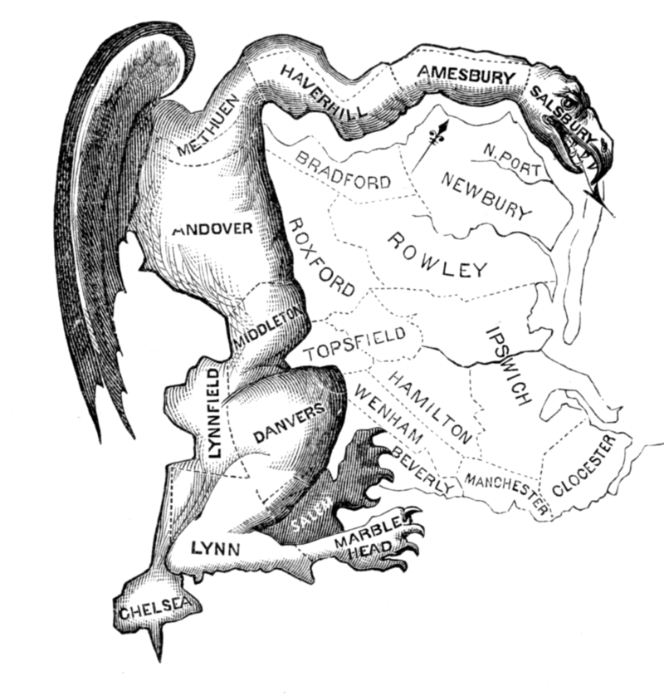
4. Gerrymandering: Ugly, Uglier
Governor Elbridge Gerry (MA)
From Boston Gazette, March 1812
Notes:
The fourth thesis brings us to my least favorite thing in the world: Gerrymandering. This is named after Elbridge Gerry, one of the founding fathers and a Governor of Massachusetts (before becoming Madison’s VP). Gerry designed the district you see above; people said it was shaped like a salamander (and thus the name). Here’s what it is. Every state has a certain number of House districts based on its population at the last census. The number of seats is a federal-level decision. The shape of those districts is drawn up by the state legislature (unless there are law suits filed that the district maps violate some aspect of the constitution or laws that enforce it, like the Voting Rights Act). State legislatures draw up districts to maximize their party’s ability to win that House seat. What does that mean? Let’s say a state has eight House districts. The last election four went to Democrats and four went to Republicans. Then Democrats win the next local elections and control the state legislature. It just happens to be after the census and the state has to reapportion the districts. Democrats then can shift the districts a little bit. They can take four districts that were mixed Republican and Democrat voters and were split 2 and 2 and change them. You shift the map so that a large % of the Republicans in those four districts are put into one of the districts. Then you may go from four districts that were roughly 50/50 Republicans and Democrats to three districts that are 70/30 for Democrats and one that is 90/10 for Republicans. So then Democrats win three of the four districts; Republicans get just one. In this sense, the candidates choose the voters. Think about it.
Both parties do it. One of the most recent ones was in Ohio. The Ohio state legislature redistricted the area around Cleveland. There were two long time Democrats who had represented different parts of the Cleveland area for decades. The state legislature changed the map and combined the two districts into one, essentially eliminating an incumbent Democrat. It forced the two Ohio Representatives who were fixtures of Democratic politics to run against each other. Just by shifting the map, the Republicans removed a Democratic incumbent.
As I said, everyone does it, unless courts step in and say NO. That happened recently in Arizona.

Slide 22
Maryland’s Districts
Notes:
Here’s what the Democratic legislature in Maryland designed. Look at the 2nd and 4th and 8th. Does that make sense? You can see the state legislature drawing a map to include and exclude certain kinds of voters.

Slide 23
North Carolina’s Districts
Notes:
Here’s what the Republican state legislature did in North Carolina. Look at the 4th, 12th, and 13th.

Slide 24
What is the result? Is there polarization?
Notes:
The big question!!!

Slide 25
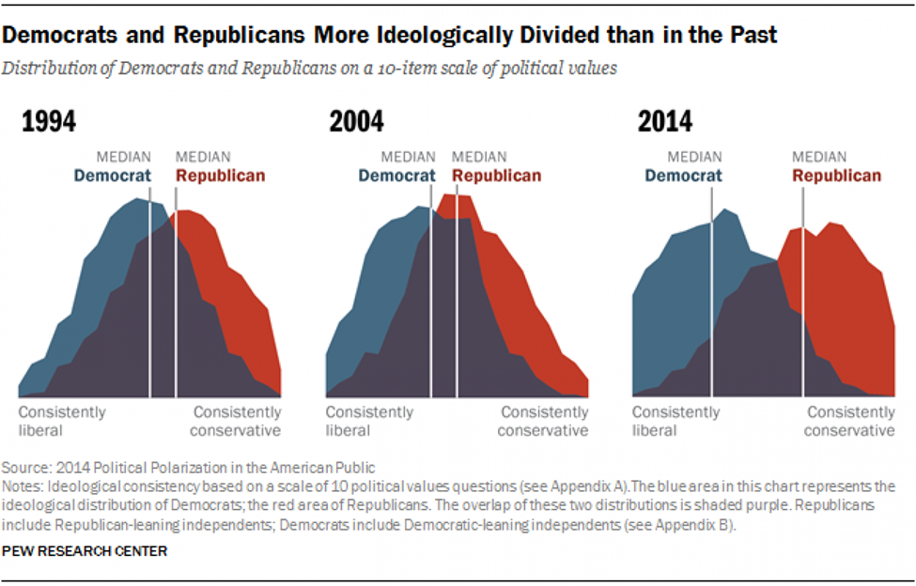
Polarizing the Nation: The Result in Public Opinion
Pew research center. POLITICAL POLARIZATION IN THE AMERICAN PUBLIC JUNE 12, 2014;
http://www.people-press.org/2014/06/12/section-1-growing-ideological-consistency/#interactive
Notes:
This chart shows public opinion. The Pew Research Foundation looked at whether the public was more or less ideological. They created a spectrum from right to left based on a set of questions related to key issues. I’m not sure which methodology they used for this, but one method is asking people questions like: do you think there should be less or more gun control? Do you think that abortion should easier or harder to get? Then you give people scales of 1-10 to see how strongly they feel about it. Then you can chart their answers. Pew did surveys every ten years starting in 1994. Compare 1994 to 2014. You can imagine the center on this chart and see that in 1994 the majority of both Democrats and Republicans are near the middle. You can see in 2014 that both parties have moved away from the center. Republicans are more to the right. Democrats are more to the left.

Slide 26
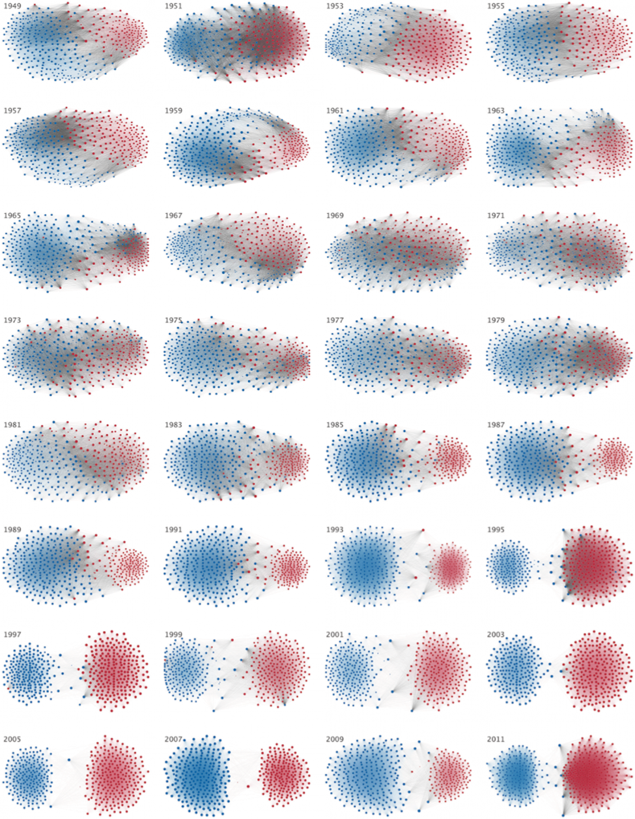
Polarizing the Nation: Voting in the House
Andris C, Lee D, Hamilton MJ, Martino M, Gunning CE, Selden JA (2015) The Rise of Partisanship and Super-Cooperators in the U.S. House of Representatives. PLoS ONE 10(4): e0123507. doi:10.1371/journal.pone.0123507
Notes:
This shows what has happened in the House of Representatives. The chart tracks votes and how often members vote across party lines. The upper left corner is 1949. Moving to the right then down on the chart you move forward in time (by two years for every blot of red and blue dots) until you get to 2011 on the bottom right. The more the red and blue dots are in the center, the more members of the House are cooperating and working together and voting across party lines. Notice the closeness to the center in the top rows. Then look at the bottom three rows which represent the 1990s to today. Something happened in the 1990s! Since then there has been very little crossing of party lines. The House of Representatives is more polarized.

