Slide 1
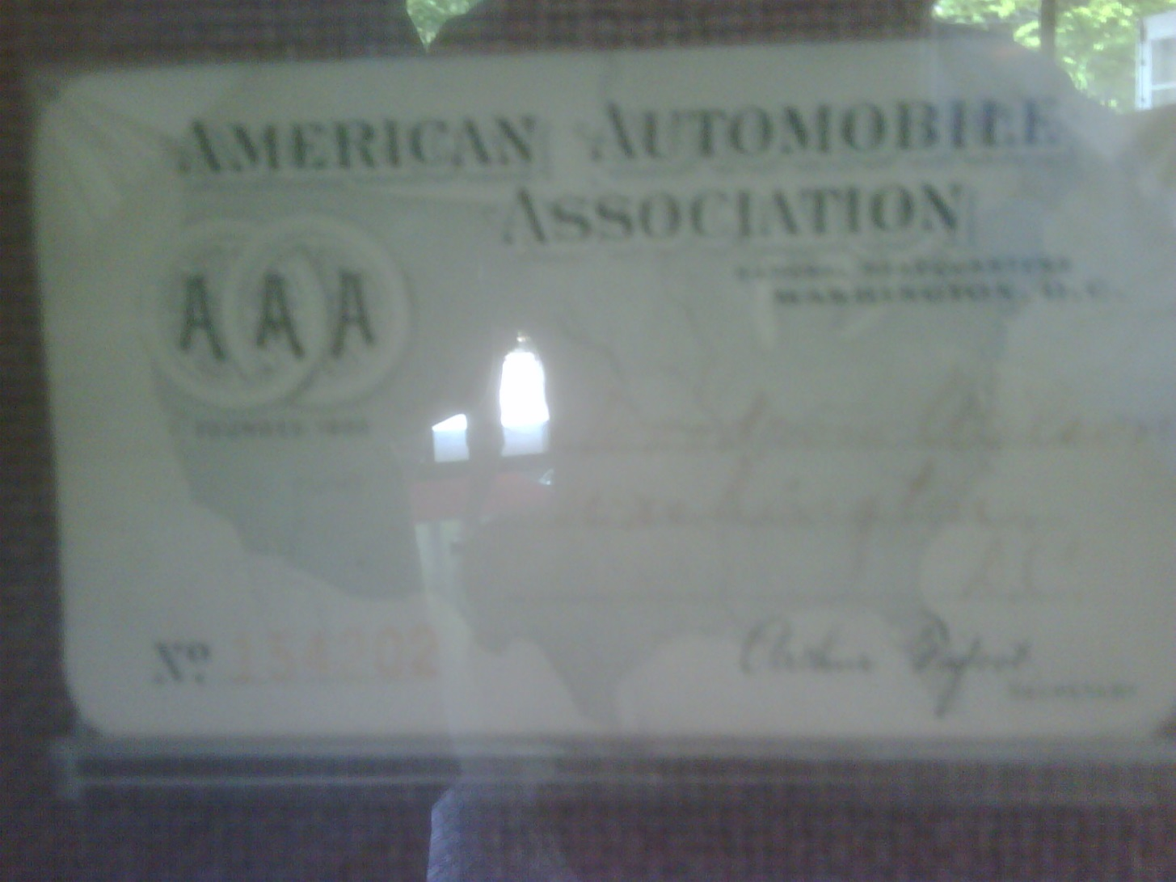
Wilson’s AAA Card

Slide 2
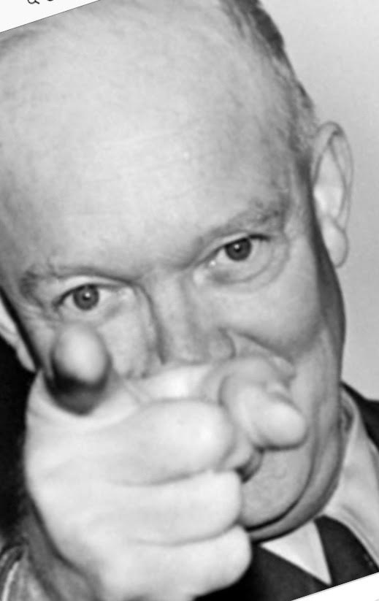
Ike Wants You!

Slide 3
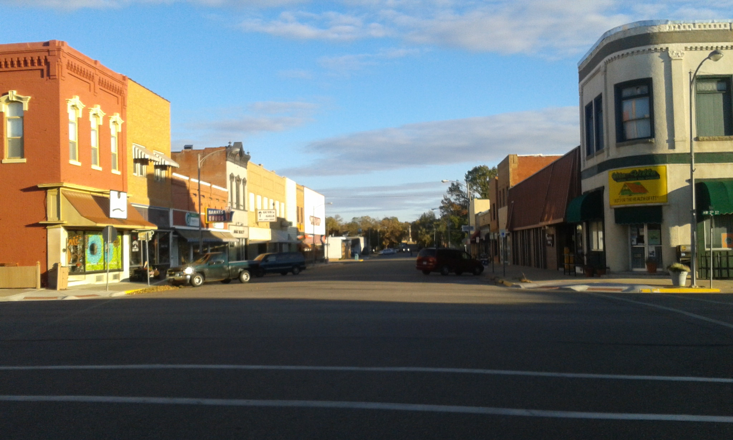
Abilene, Kansas

Slide 4
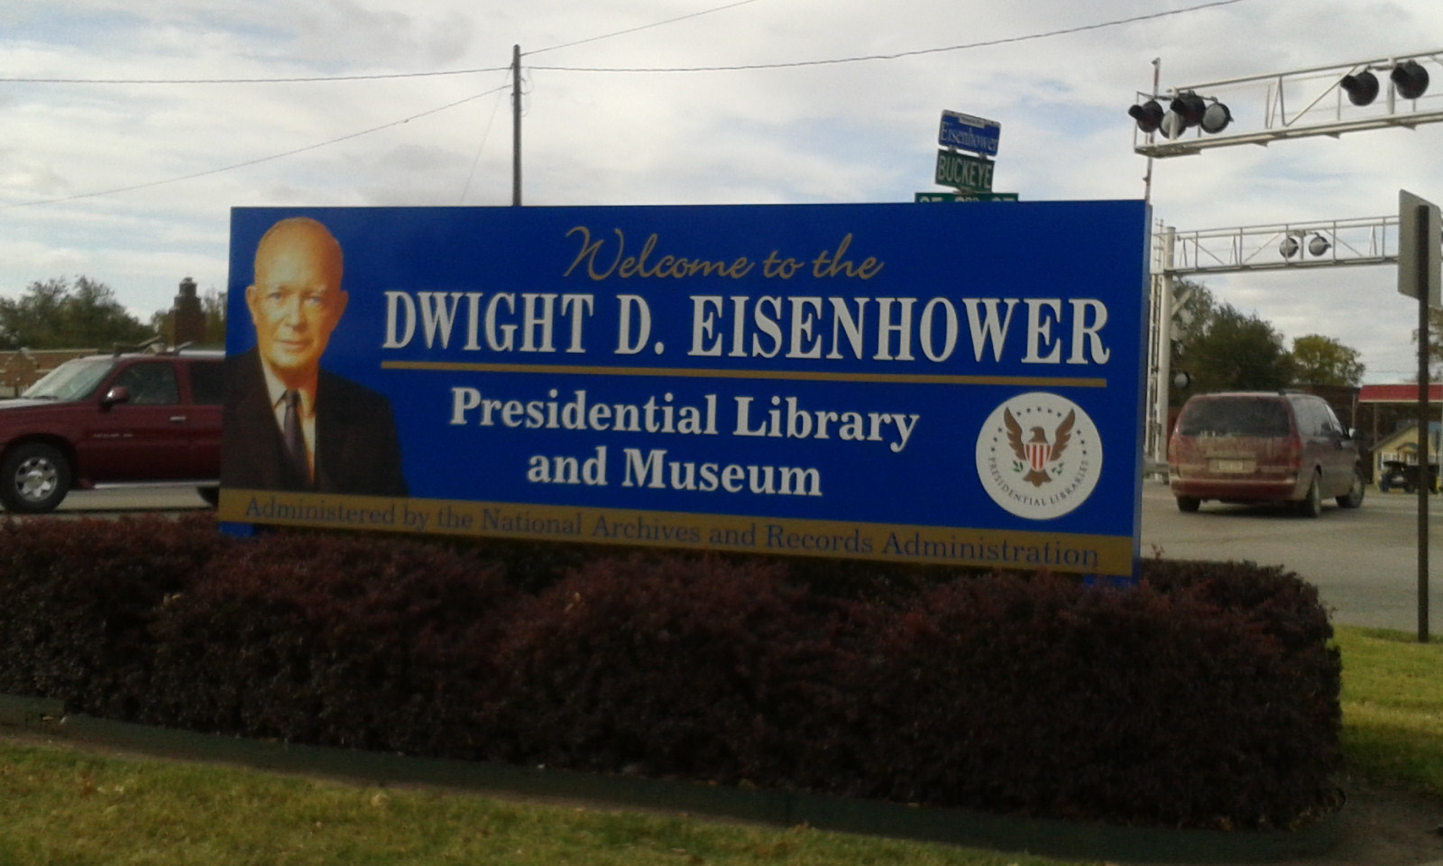
Entrance to Ike Library

Slide 5
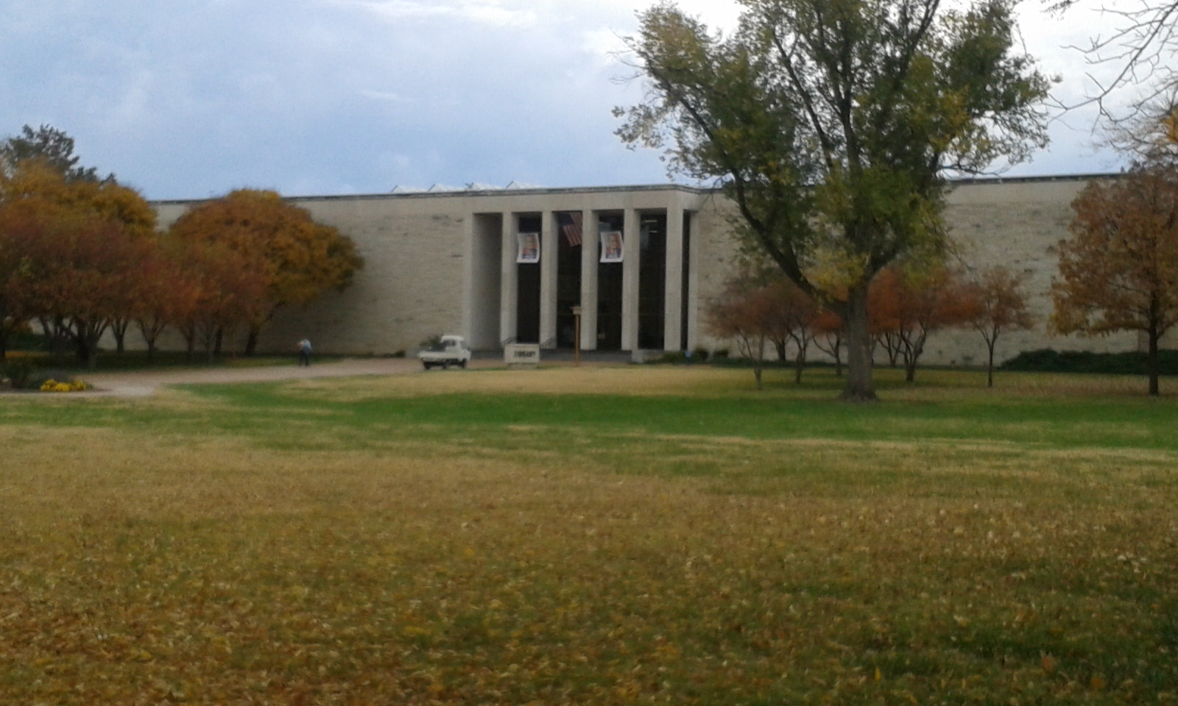
Ike Library

Slide 6
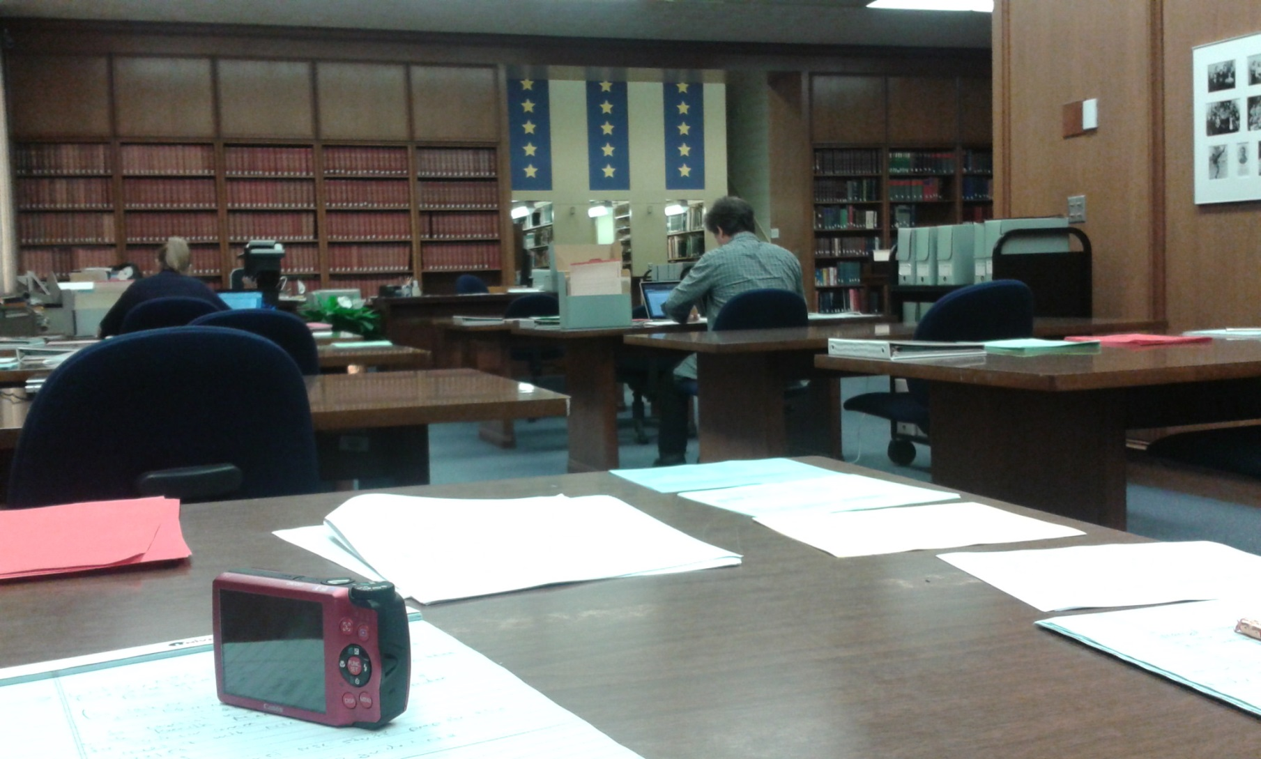
Ike Reading Room

Slide 7
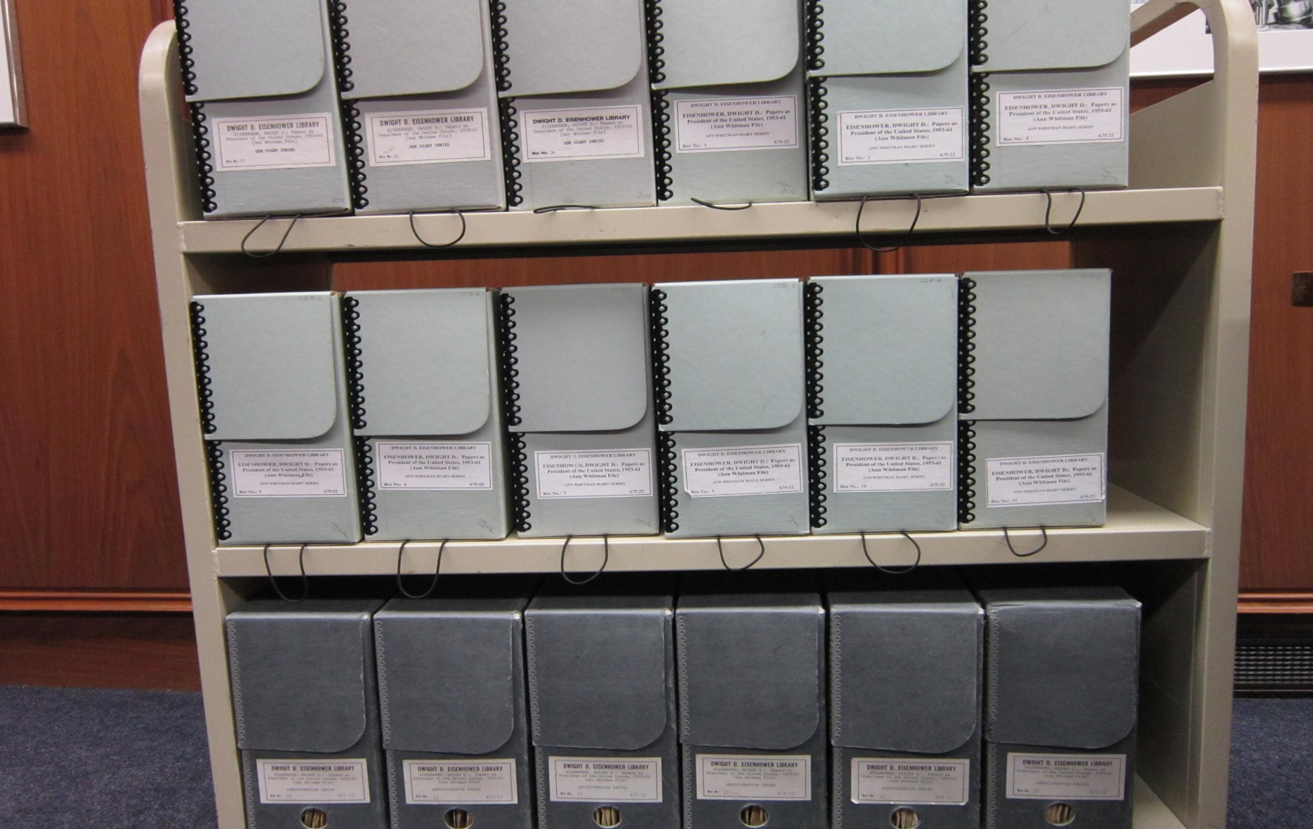
Ike Cart with Boxes

Slide 8
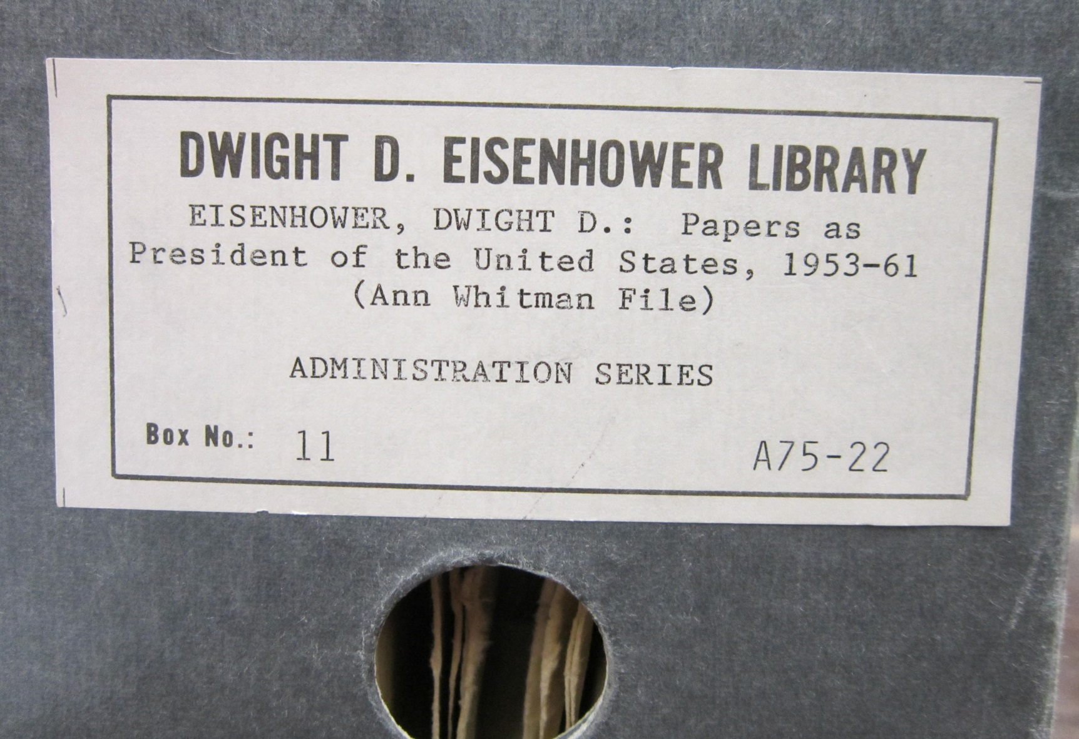
Ike Box

Slide 9
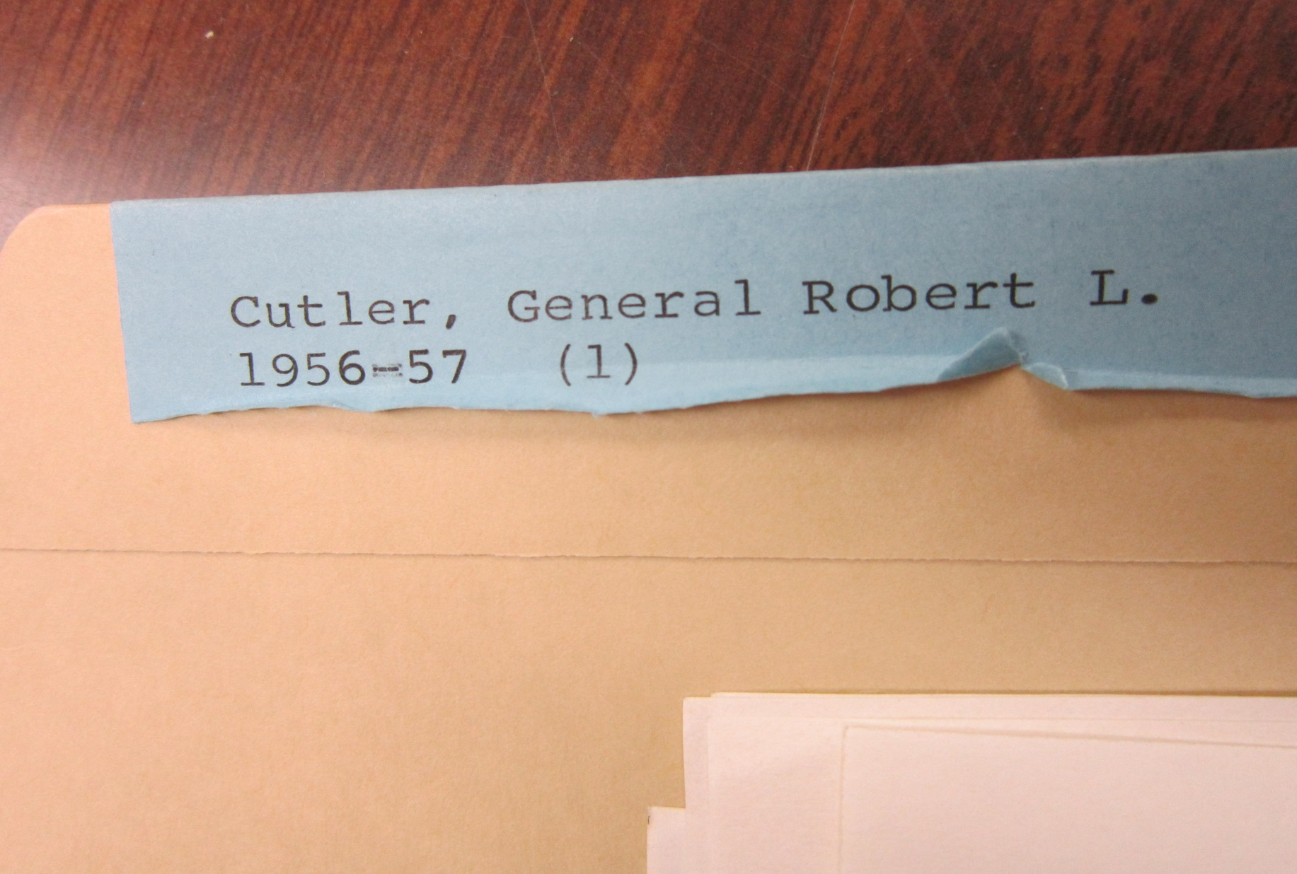
Ike Folder

Slide 10
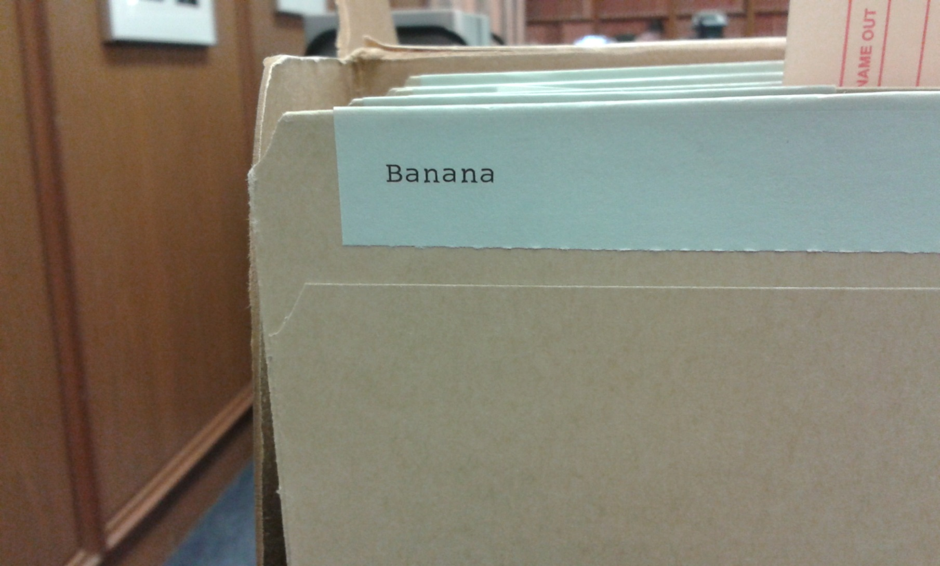
Interesting Ike Folder (Empty)

Slide 11
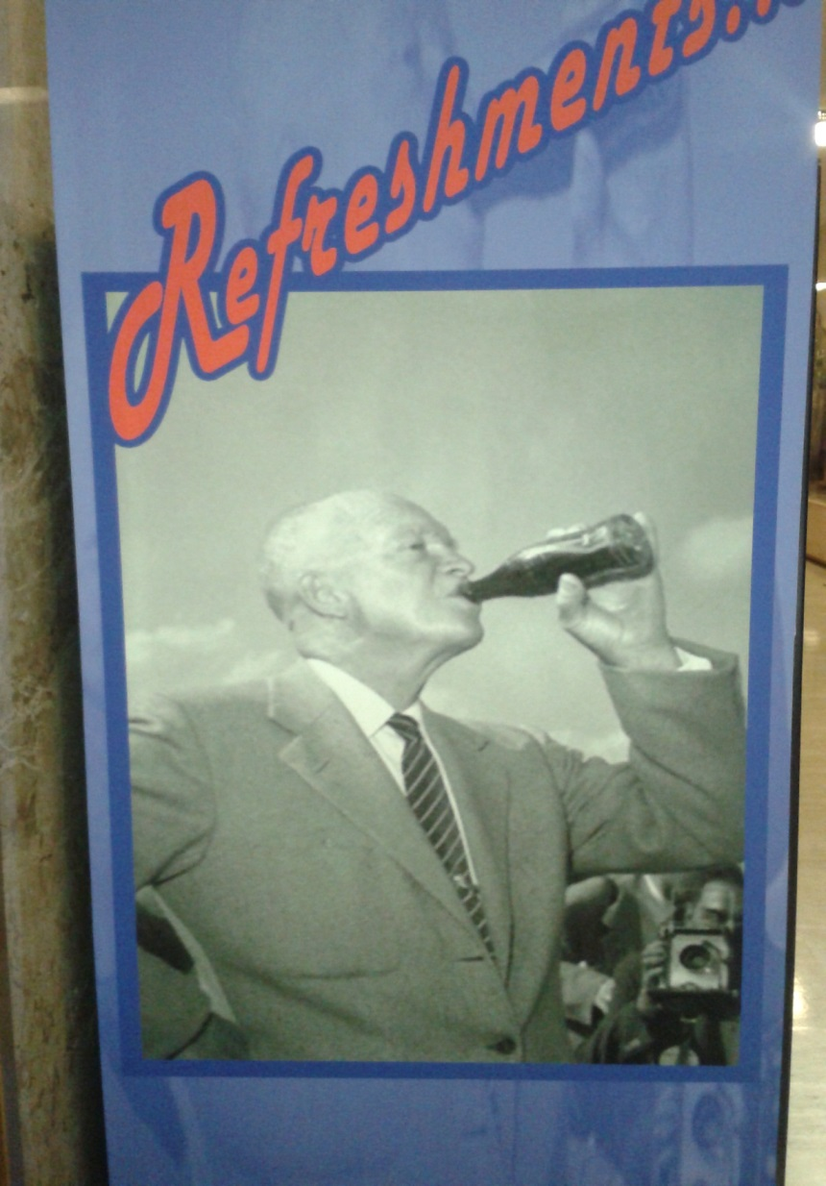
Vending Machine at Ike Library

Slide 12
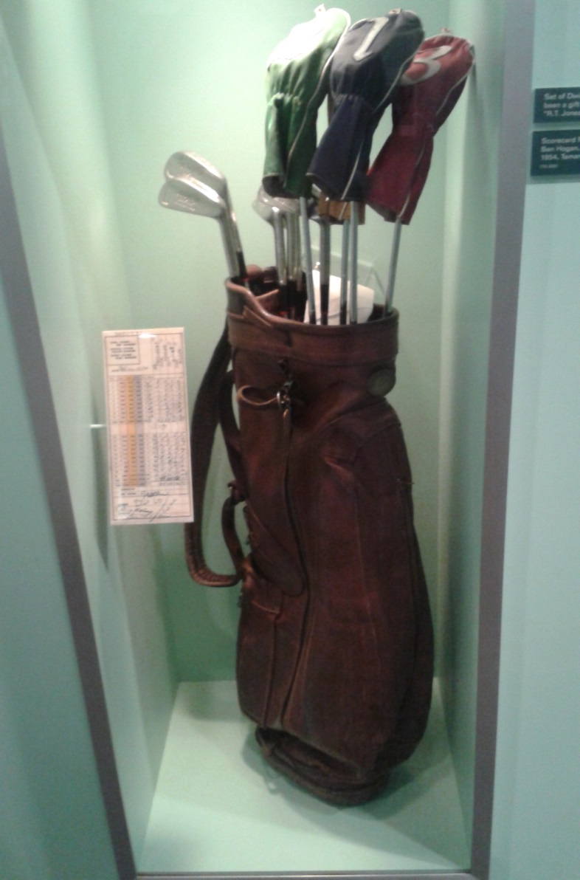
Ike’s Golf Clubs

Slide 13
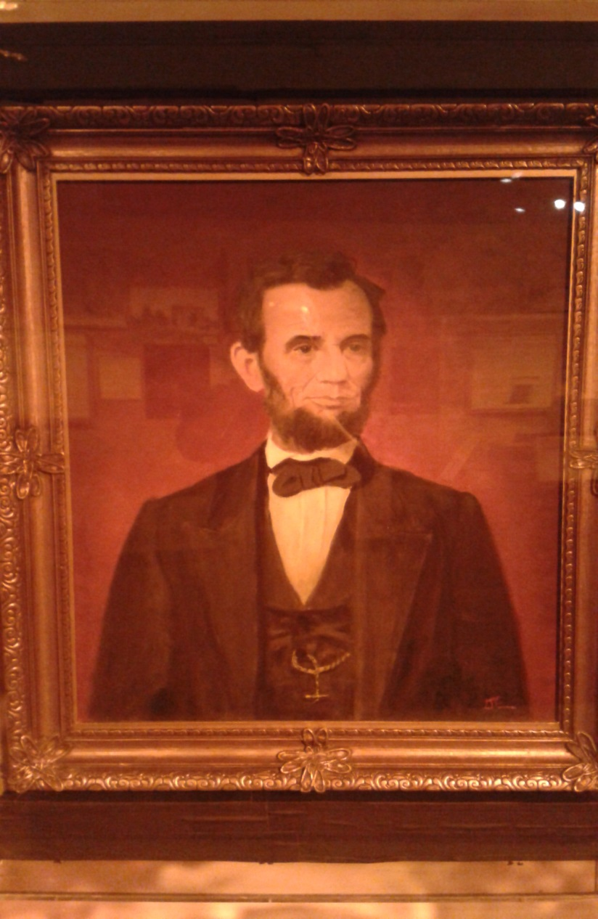
Ike’s Painting of Lincoln

Slide 14
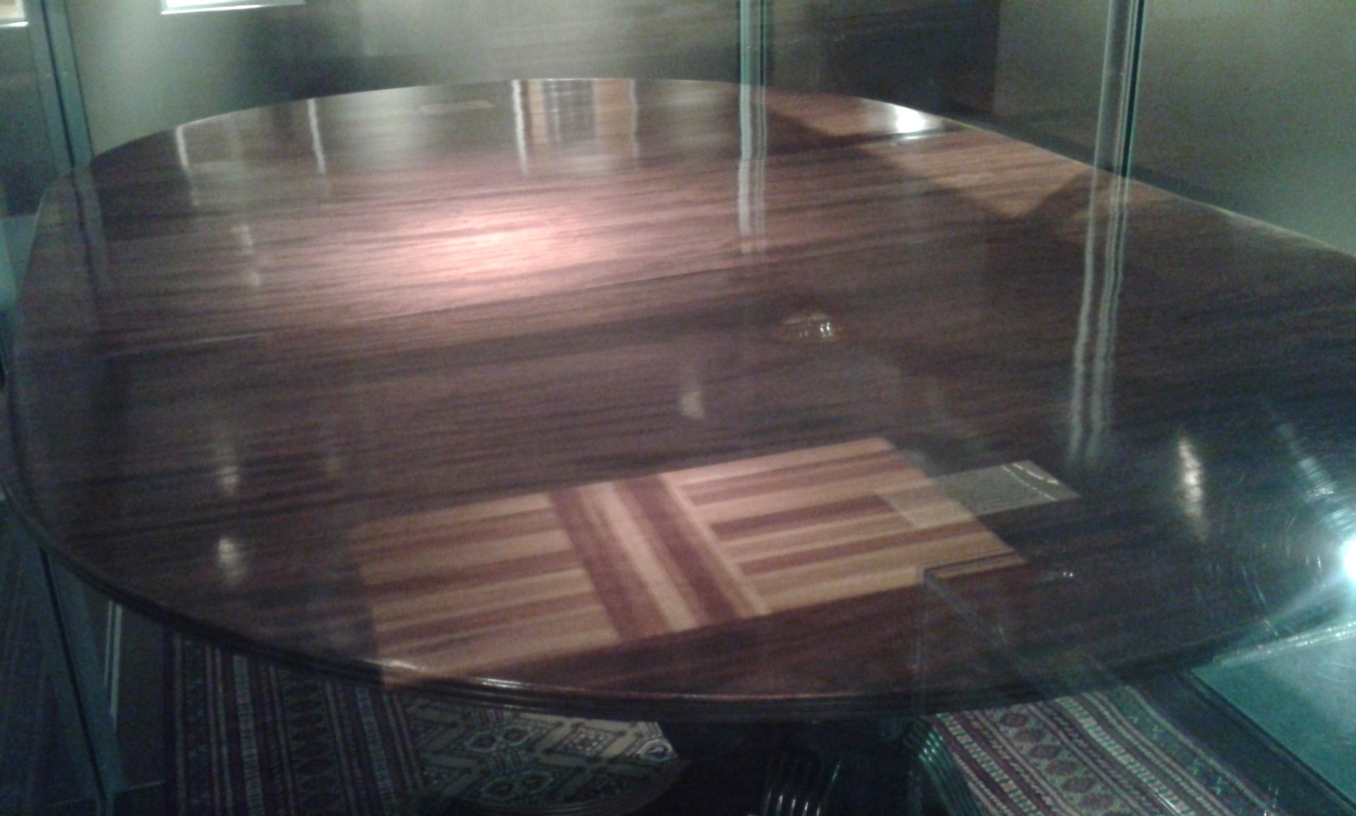
Table where D-Day was Planned
(Ike Museum)

Slide 15
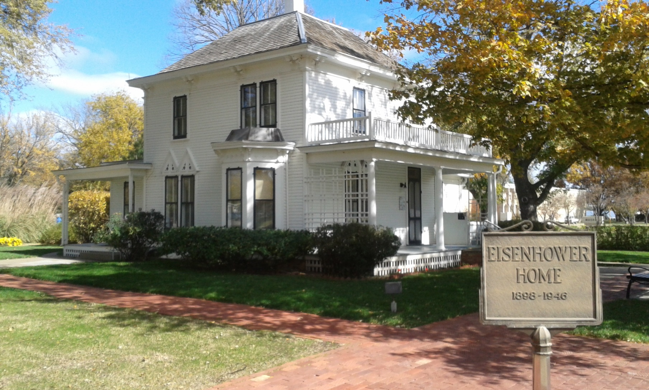
Ike’s Home

Slide 16
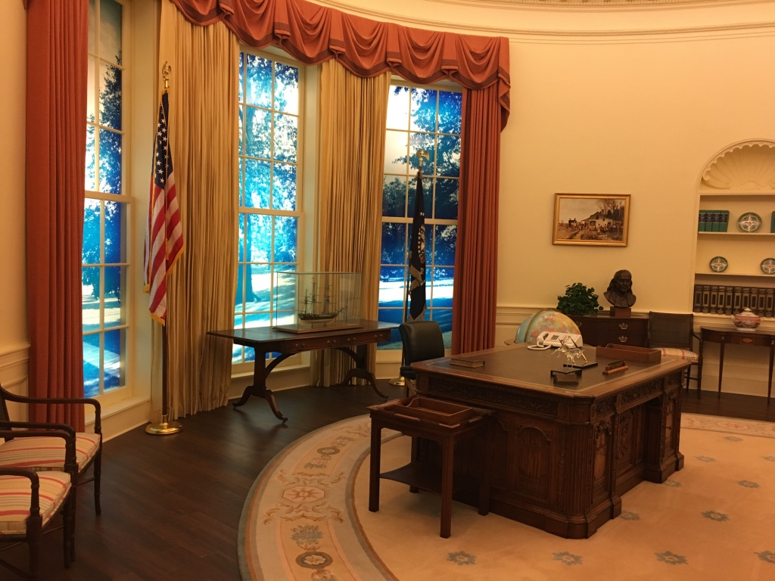
Replica of Carter’s Oval Office

