Slide 1
Flying to California To Yorba Linda

Slide 2
Almost There

Slide 3
RN Library Yorba Linda, CA

Slide 4
RN Home

Slide 5
RN Library Courtyard

Slide 6
Nixon Library Entrance

Slide 7
RN Reading Room

Slide 8
Pull Slip

Slide 9
RN Boxes

Slide 10
RN Box

Slide 11
RN Folder

Slide 12
RN Memo Style

Slide 13
Nixon in College

Slide 14
Nixon and Checkers

Slide 15
Nixon and James Brown

Slide 16
Nixon and Congressional Investigators during Watergate

Slide 17
Kissinger initialing that he has officially received Nixon’s Resignation

Slide 18
Nixon Notes for Speech Made in Beijing 1972 at Dinner with Mao

Slide 19
Menu at State Dinner in China, February 1972

Slide 20
Walkie-Talkie Used by Watergate Burglars

Slide 21
Actual Lockpicks Used by Watergate Burglars

Slide 22
Nixon Pizza

Slide 23
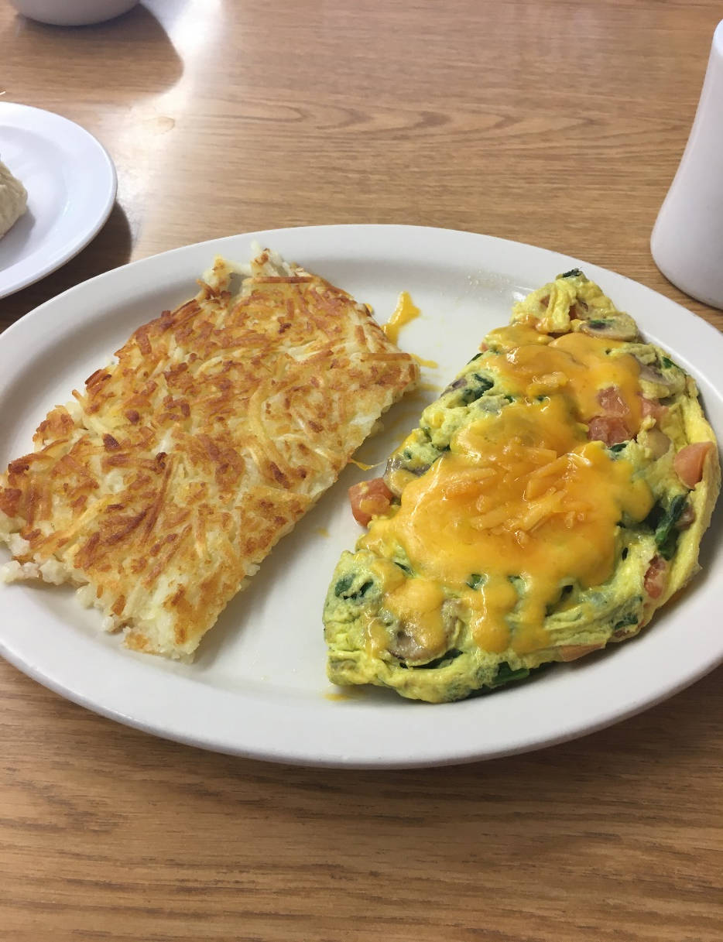
Nixon Breakfasts

Slide 24
Autograph Picture of Dodger Great Maury Wills at Mini Gourmet Diner in Yorba Linda

Slide 25
Nixon Shirt

Slide 26
Another Nixon Shirt

Slide 27
Ford Library Ann Arbor, MI

Slide 28
Ford Reading Room

Slide 29
Ford Box

Slide 30
Ford Folder

Slide 31
President Leslie Lynch King

Slide 32
All-American Center Gerald Ford University of Michigan

Slide 33
Ford Campaigning

Slide 34
Ford’s Contact Offer from Green Bay Packers

Slide 35
Betty Ford Dancing in the Cabinet Room

