Slide 1
JFK Library Boston, MA

Slide 2
Entrance to JFK Library

Slide 3
Scary building I had to walk past on my way to the JFK Library

Slide 4
JFK Library Shelf

Slide 5
LBJ Library, Austin TX

Slide 6
Lady Bird and LBJ at the Library

Slide 7
LBJ with his students at Welhausen School in Cotulla, TX, late 1920s

Slide 8
Vote Johnson

Slide 9
Vote Johnson Again

Slide 10
Letter from Senator LBJ to President Truman offering legislative assistance for US Policy in Korea, June 1950

Slide 11
Crib Notes for Oath of Office Used on Air Force One to Swear in LBJ, 11/22/63

Slide 12
Talking Points for LBJ First Meeting with his new Cabinet, 11/23/63

Slide 13
Vote LBJ for President 1964

Slide 14
LBJ’s Oval Office (notice the portrait of Jackson on the wall)

Slide 15
LBJ and the News

Slide 16
MLK and LBJ

Slide 17
In a Nutshell….

Slide 18
LBJ and Vietnam

Slide 19
The End

Slide 20
Stacks of File Boxes Viewed from the Museum Hall

Slide 21
LBJ Reading Room

Slide 22
LBJ Box

Slide 23
LBJ Folder (File Series Name)

Slide 24
LBJ Folder (Folder name)

Slide 25
LBJ’s Desk

Slide 26
LBJ and His Best Friend

Slide 27
FDR and LBJ

Slide 28
White House Pool

Slide 29
The President Relaxes

Slide 30
Thurgood Marshall and LBJ

Slide 31
LBJ and Ike

Slide 32
Temperature in Austin

Slide 33
Now, this is a real waffle, son…

Slide 34
Driving to Texas

Slide 35
Still Driving to Texas

Slide 36
Driving to Texas Passing Clinton’s Home Town

Slide 37
Clinton Birthplace Marker (Didn’t See Museum, still driving to Texas)

Slide 38
In Texas, But Still Driving to Austin

Slide 39
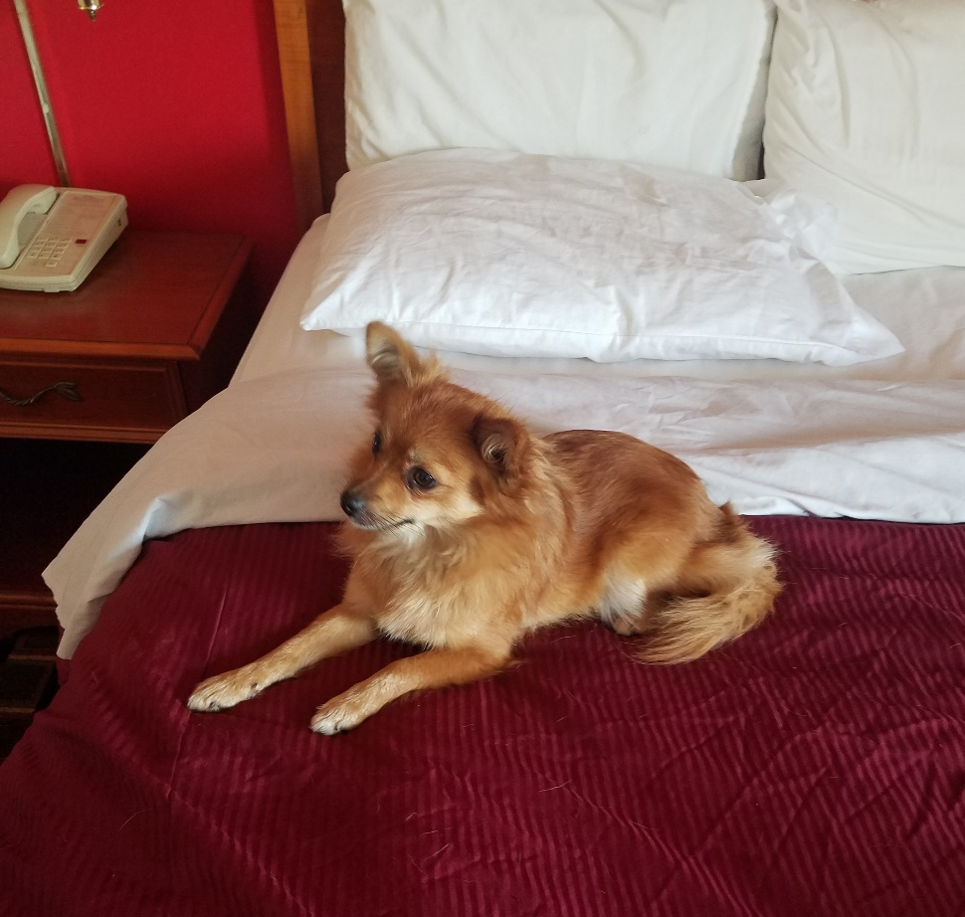
Driving Back from Texas, in Tennessee
Rescued this little dog on Route 40

Slide 40
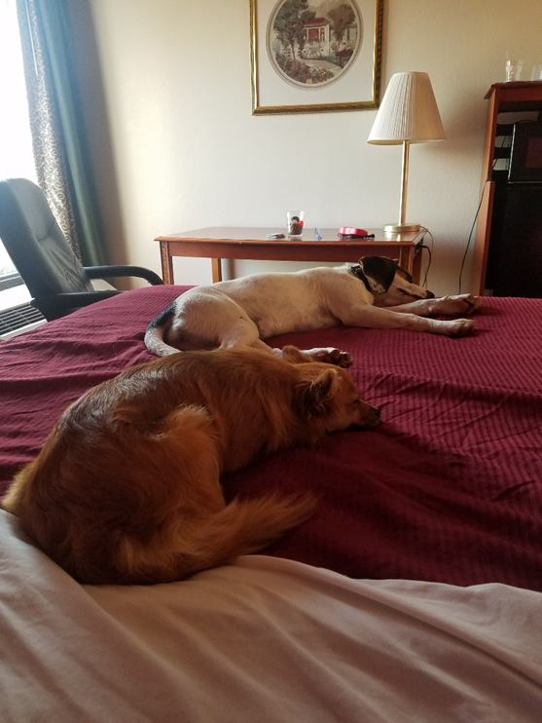
And her big friend
Crushed two discs in my neck rescuing them, but found them good homes

