Slide 1
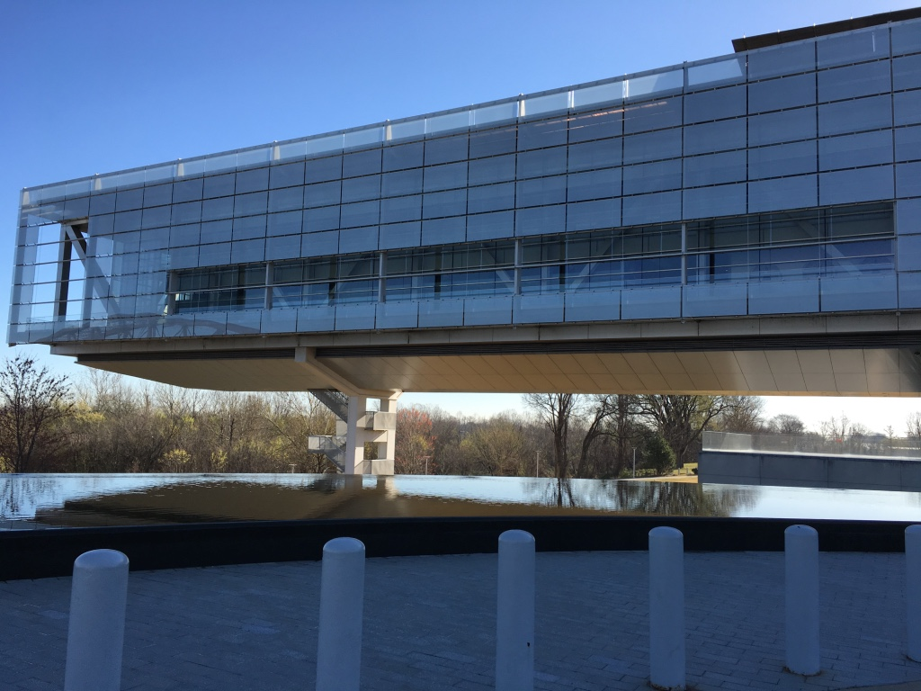
Clinton Library

Slide 2
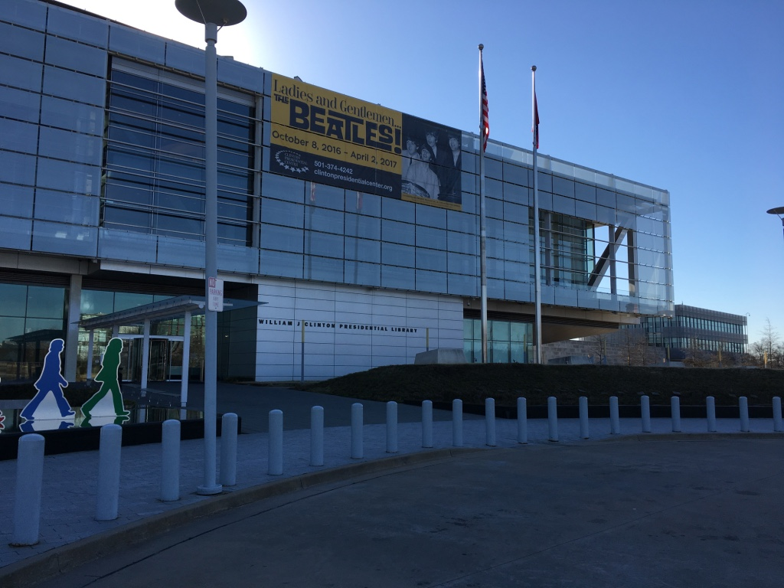
Clinton Library

Slide 3
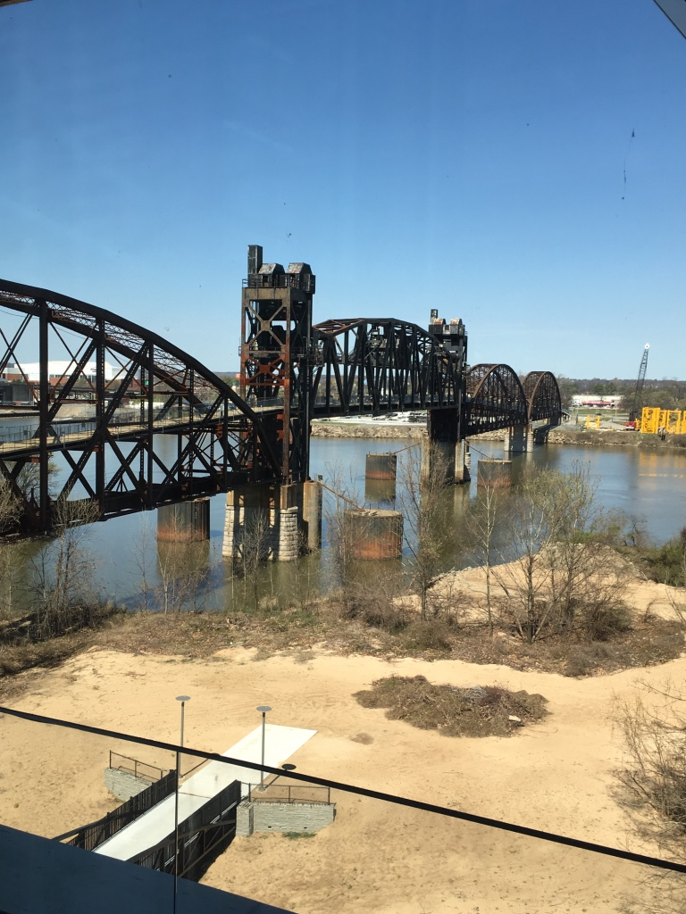
Arkansas River View from the Library

Slide 4
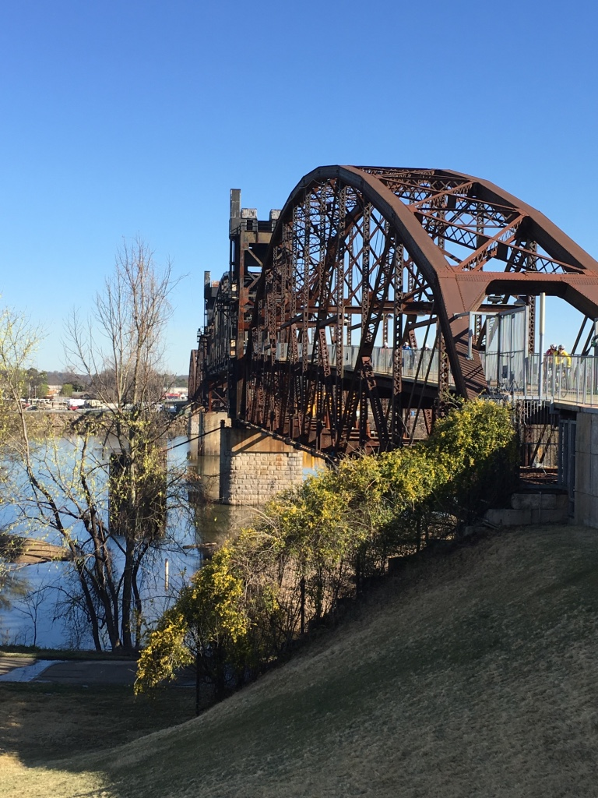
The Bridge is Scary

Slide 5
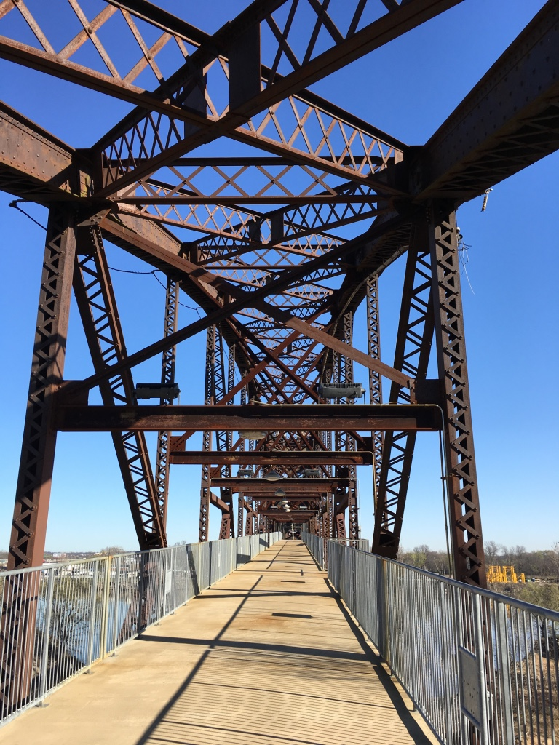
I Walked Across…

Slide 6
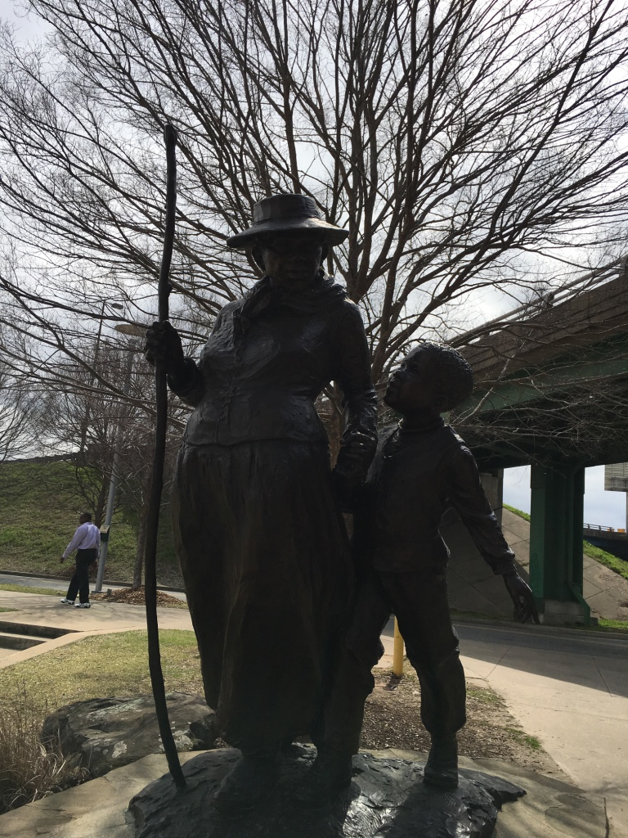
Harriet Tubman Stature Where the Underground Railroad Crossed the Arkansas River, a few blocks from the library

Slide 7
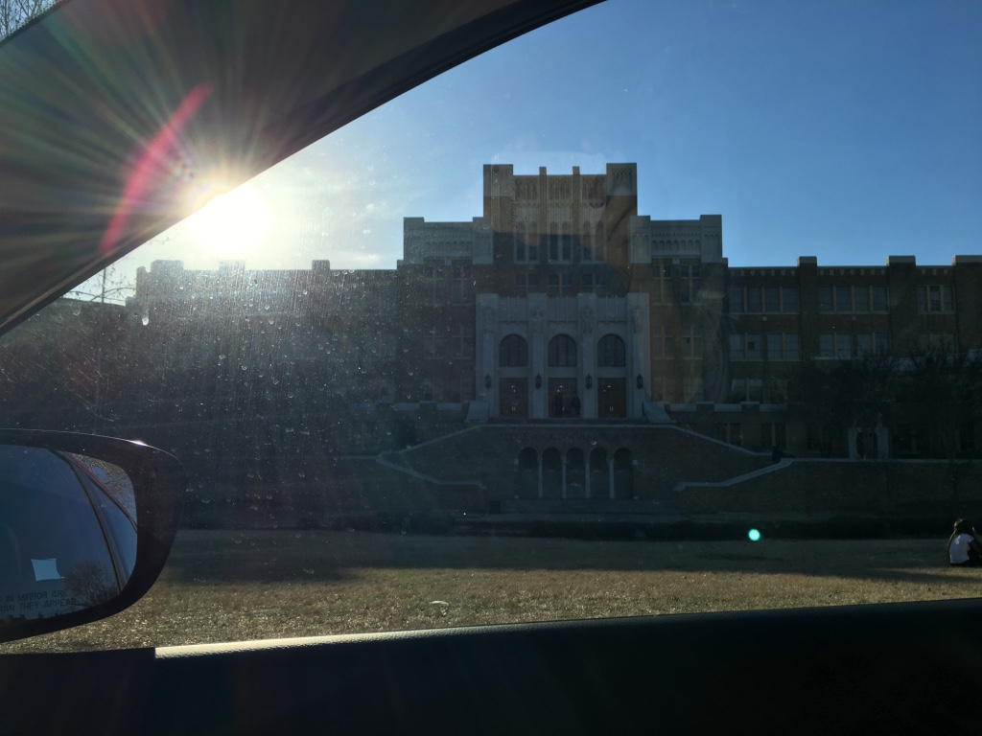
Central High, Little Rock

Slide 8
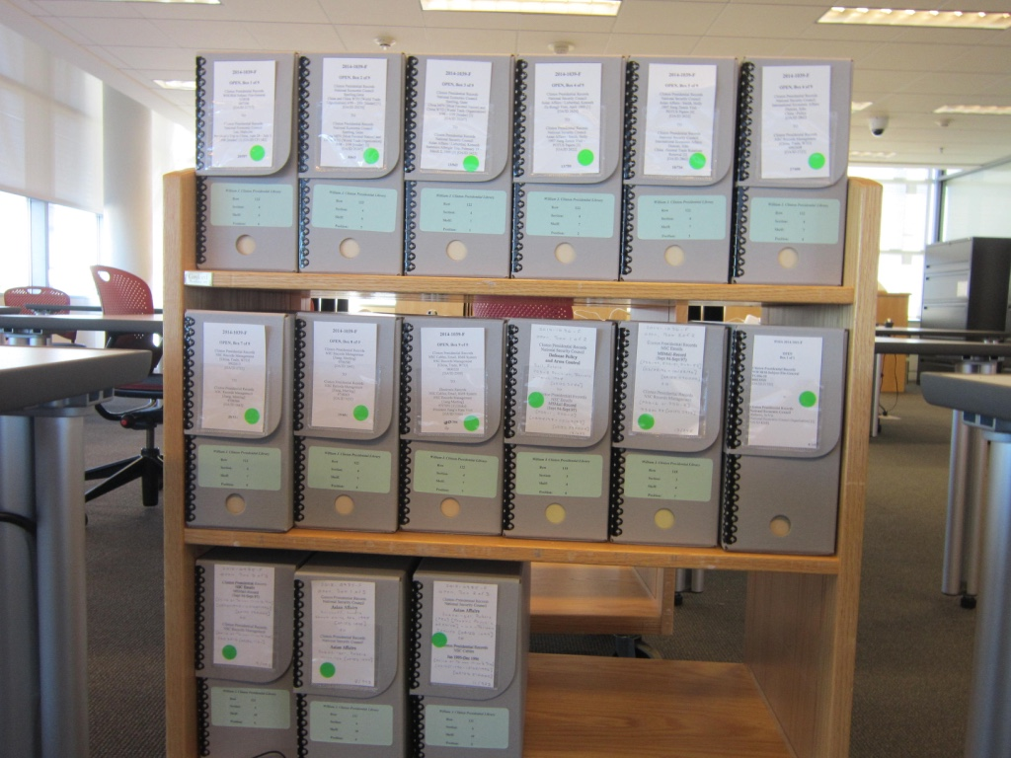
Clinton Cart

Slide 9
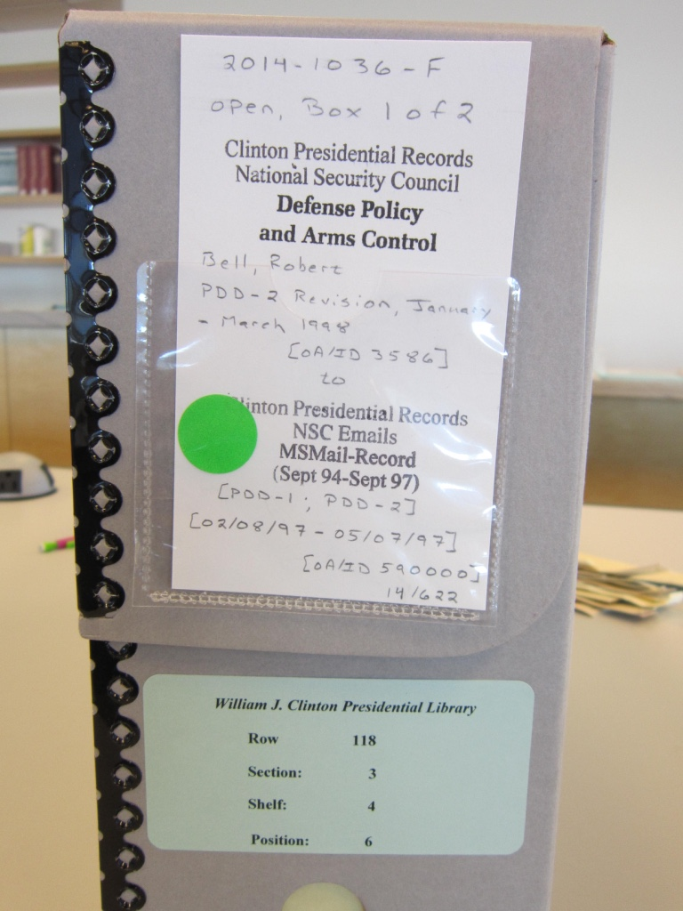
Clinton Box

Slide 10
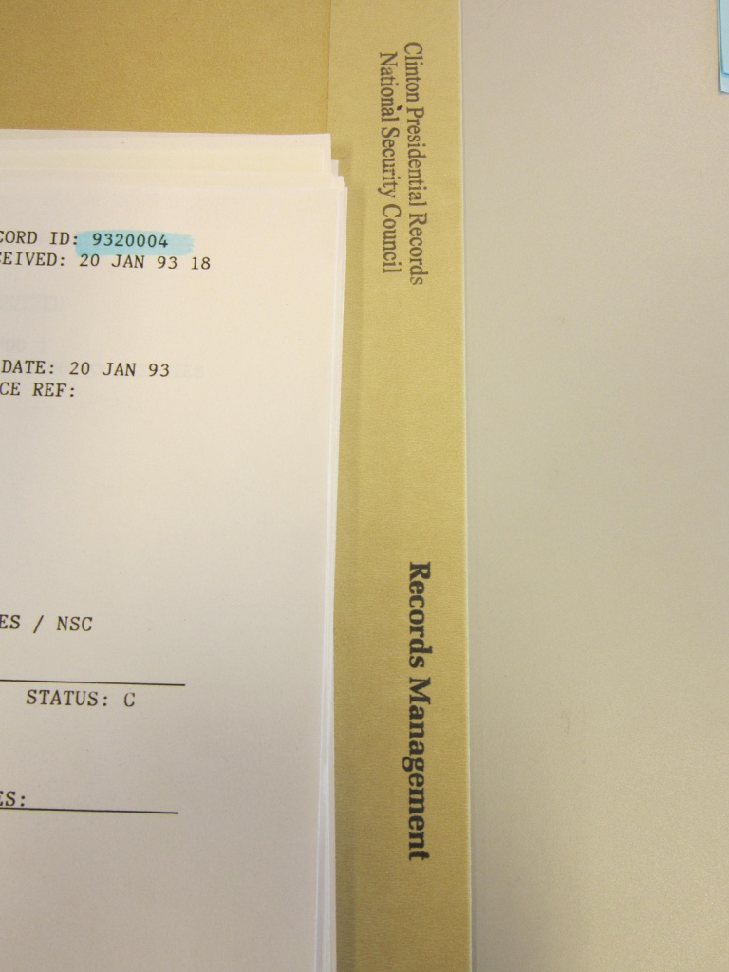
Clinton Folder

Slide 11
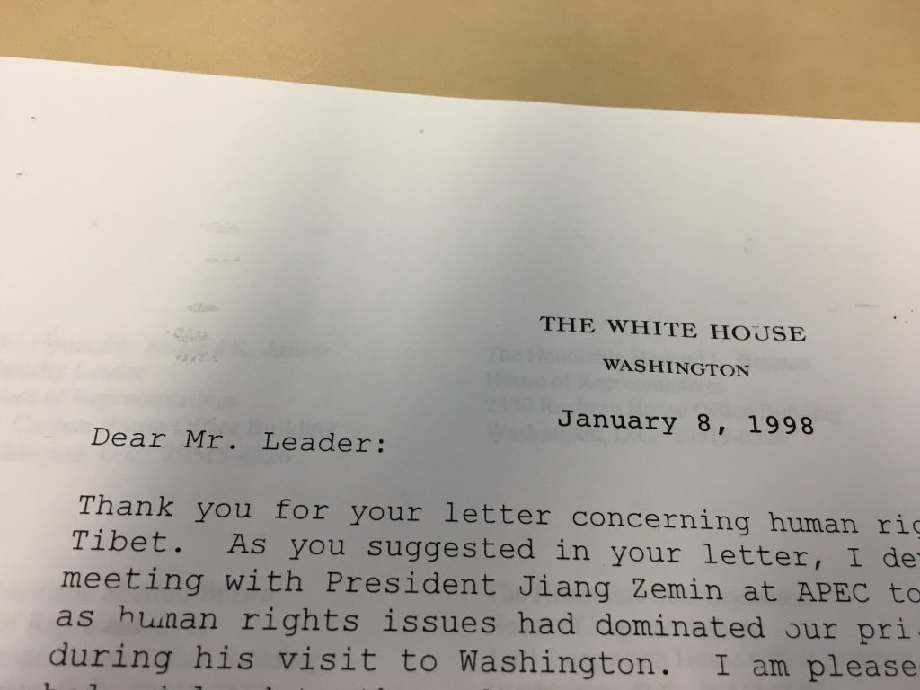
Diplomatic Form Letter

Slide 12
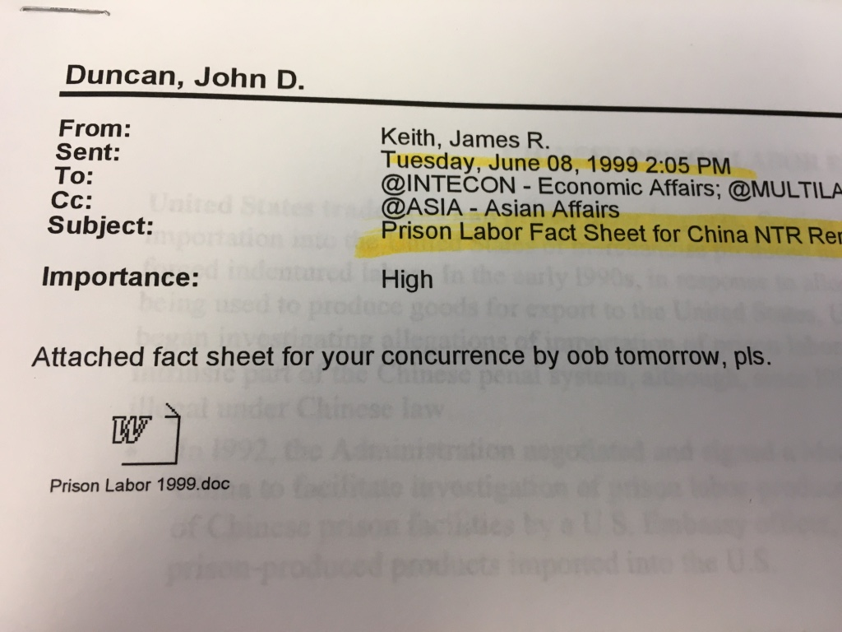
Read Closely: What time tomorrow?

Slide 13
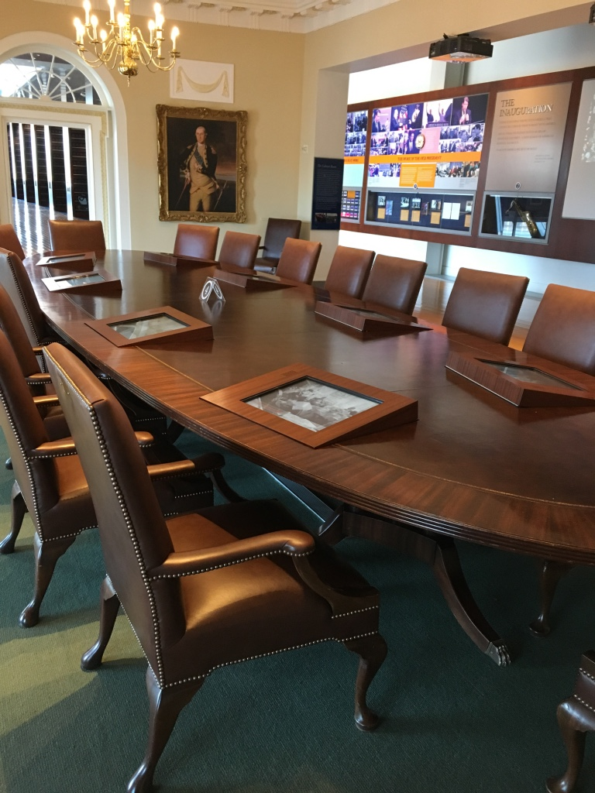
Cabinet Room Replica

Slide 14
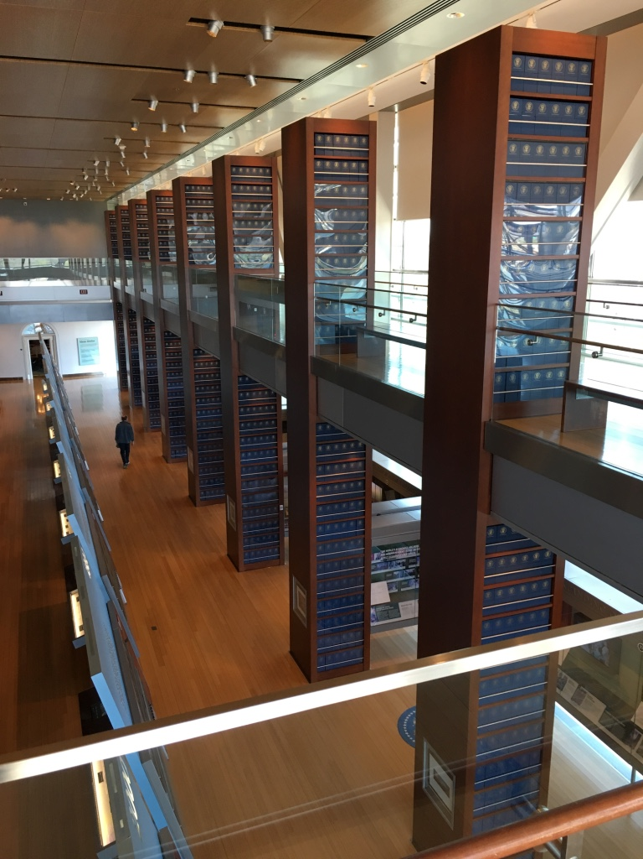
Inside the Museum

Slide 15
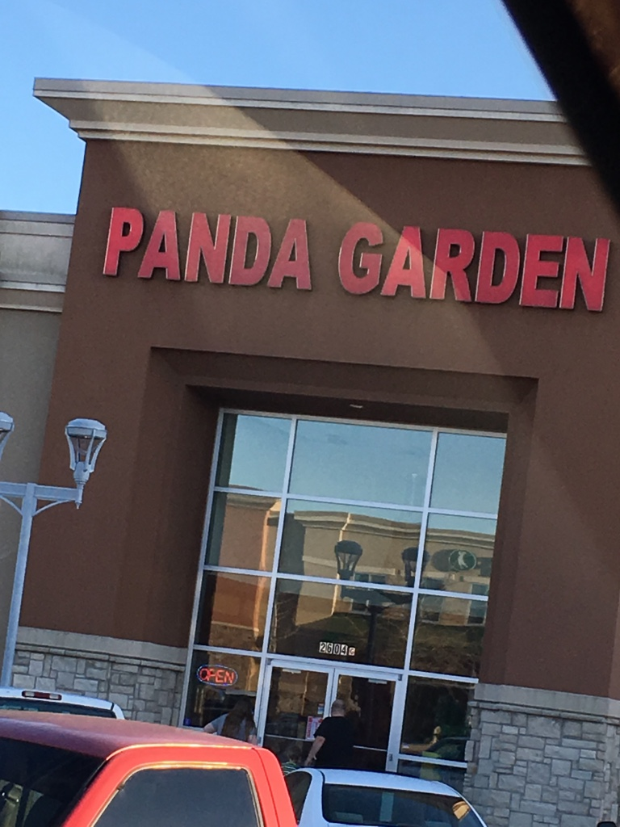
Dinner

