Slide 1
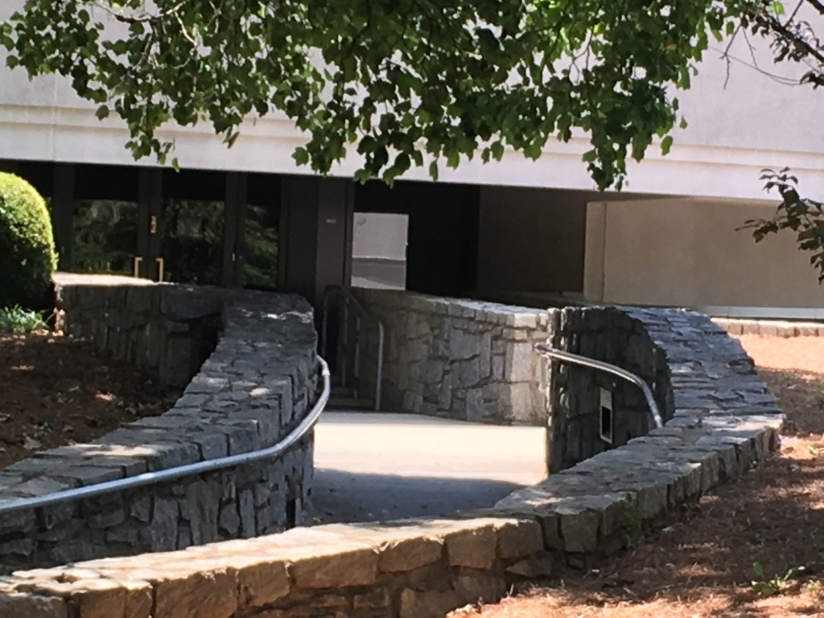
Carter Library Entrance

Slide 2
Carter Reading Room

Slide 3
My Day

Slide 4
Carter Box

Slide 5
Carter Folder

Slide 6
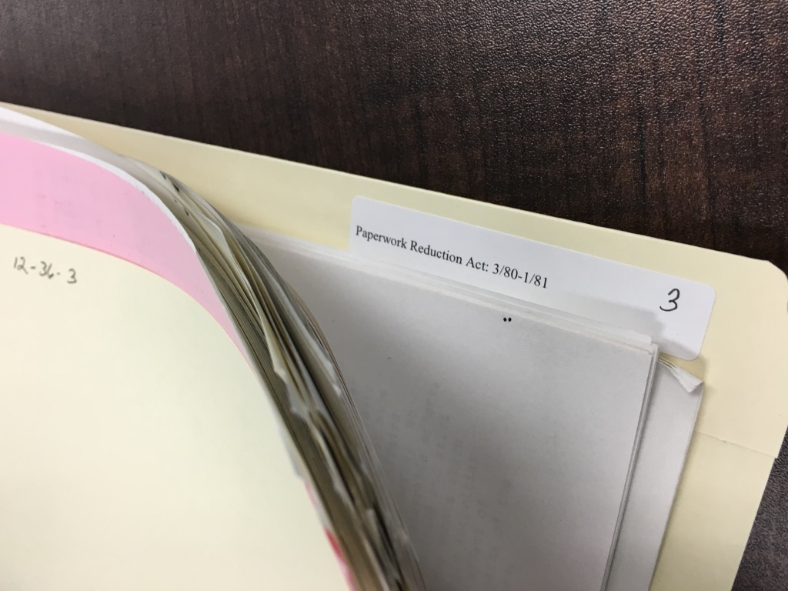
File that reads: “Paperwork Reduction Act 3/80-1/81”

Slide 7
The Boxes of Material

Slide 8
Camp David Sadat and Begin Meeting

Slide 9
Carter, Nixon, and Deng Xiaoping

Slide 10
The First Family and Captain America

Slide 11
Lillian Carter and her son

Slide 12
Replica of Carter’s Oval Office

Slide 13
Atlanta!

Slide 14
Walt Frazier was born in Atlanta

Slide 15
Carter Pizza

Slide 16
Carter Omelet Atlanta Airport IHOP

Slide 17
Bob Ryan on Around the Horn from TV in Atlanta Airport IHOP

