Slide 1
Japan since 1990
Recession since 1990
Challenges to 1955 System
Heisei revolution
A new center-right 1 and ½ party system
Koizumi Era
Internal challenges to LDP (Koizumi)
The new powerful Prime Minister
The DPJ Challenge and Failure of a Two Party System
2012: Return to LDP Rule

Slide 2
“Japan Inc.”
A Miracle
A Model: The East Asian Strategy
From: http://benmuse.typepad.com/ben_muse/2005/11/changes_in_inco.html

Slide 3
The 1990s
The Miracle Ends
Bubble Economy collapses
And the political fallout begins

Slide 4
“Bubble Economy”
Pay back loans
Build factories
Loans Hire people Buy land
Build offices
Pay back Loans
Banks
Companies
Government

Slide 5
Bubble Economy Collapses, 1990
Pay back loans
Build factories
Loans Hire people Buy land
Build offices
Pay back Loans
Banks
Companies
Government

Slide 6
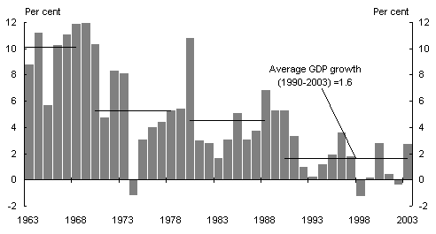
Japanese GDP
From Sian Fenner, The Japanese economy and future growth prospects, Department of the Treasury, Australia, http://www.treasury.gov.au/documents/817/HTML/docshell.asp?URL=05_article_4.asp

Slide 7
GDP Growth 1980-2013

Slide 8
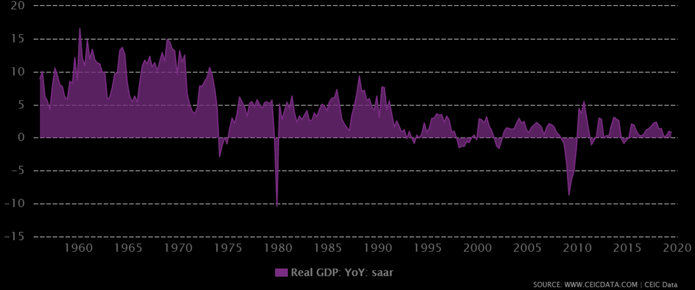
GDP Growth 1956-2020
CEIC data (CEIC is an economic forecasting organization)
https://www.ceicdata.com/en/indicator/japan/real-gdp-growth

Slide 9
1. Heisei Revolution

Slide 10
Evolution of Japanese Parties (1990-2009) (Reference Only)
Liberal
Democratic LDP LDP LDP LDP LDP LDP LDP
Party (LDP) (1994) (Spring 1998;
Breakaway LDP alone)
Factions (1992-93)
Sakigake
Japan New Party
Shinseito Sakigake Sakigake Sakigake
(dissolved 2004)
Social
Democratic
Party of Japan SDPJ SDPJ SDPJ SDP SDP
(SDPJ)
Democratic Party
Komeito of Japan (DPJ) DPJ DPJ
(Clean Government (4/98) (2009)
Party)
"NOT-LDP" New Frontier coalition Party (NFP) Peace and Reform
Democratic Network
Socialist
Party (DSP) Komeito New Komeito NKP NKP
New Peace Party
United Social Liberal League
Democratic Party (LDP ally 99-00; merges with DPJ)
(USDP) New Conservative (LDP ally) (merges with LDP 2003)
Japan
Communist Party JCP JCP JCP JCP JCP
(JCP)
1990 7/18/93 June 1994 Dec. 1994 Fall 1996 1997-1998 1999-2009 2009
*Ruling party or coalition at the time in RED

Slide 11
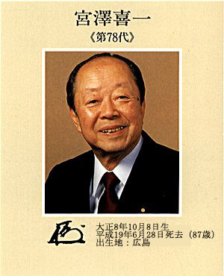
LDP Scandals
PMs in the 1990s
Takeshita Noboru Uno Sosuke Kaifu Toshiki Miyazawa Kiichi
Nov. 1987–June 1989 June–Aug. 1989 8/89–11/91 11/91–8/93

Slide 12
No Confidence Motion
PM and House
serve full term
Party
wins
majority House PM dies or
General elects resigns
election PM
of Lower
House
No party wins No Confidence fails majority motion
passes
Parties negotiate
to form coalition (50% of seats, plus one)

Slide 13
End of 1955 System? Heisei Revolution of Summer 1993
July 18, 1993 Election
 | 1990 Election | 1993 Election
LDP | 275 | 223
SDPJ | 136 | 70
Komeito | 45 | 51
Shinseito (Renewal Party) | --- | 55 (ex-LDP)
Shinshinto (Japan New Party) | ---- | 35 (ex-LDP)
Sakigake (New Pioneer Party) | --- | 13 (ex-LDP)
Democratic Socialist Party | 13 | 15
Independents | 26 | 34

Slide 14
What we Know Summer 1993?
Not-LDP coalition in power (July 1993)
SDPJ
Renewal Party (ex-LDP)
Japan New Party (ex-LDP)
Sakigake (ex-LDP)
United Social Democratic Party
Democratic-Socialist Party
Komeito
Old parties lose
Left loses
LDP factional split

Slide 15
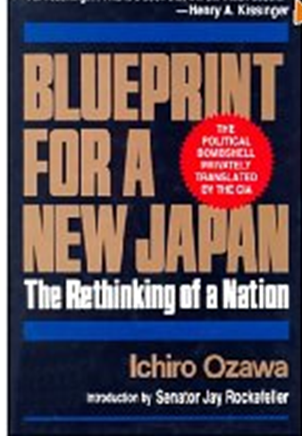
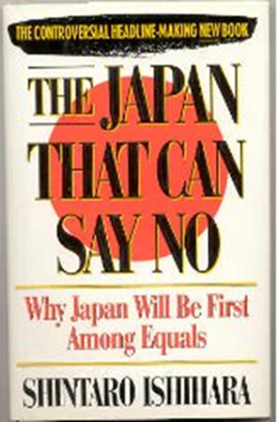
Not-LDP Policies
Electoral reform (to current system)
Open up the economy (maybe)
Catch-up, Now What?
No more little brother
Say “No” to US
UNSC seat
Apologizes for WW II

Slide 16
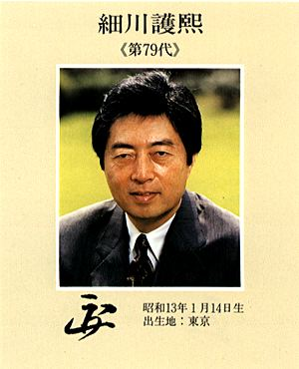
But…
PMs in the 1990s
Hosokawa Morihiro Hata Tsutomu Murayama Tomiichi Hashimoto Ryutaro
New Party New Party SDPJ (LDP coalition) LDP
8/1993 – 4/1994 4/1994 – 6/1994 6/1994 – 1/1996 1/96-7/98

Slide 17
Results of Heisei Revolution?
Not-LDP Coalition Collapses
LDP Back in power
Electoral Reform in Lower House 1996
300 Single-member Districts (now 289)
180 Proportional representation (now 176)
You vote for a person in SMD
And a Party
New System Develops by mid-1990s

Slide 18
2. New 1 and ½ Party System? Center-Right, not Center-Left
(seats in Lower House) 1996 2000 2003
New Frontier Party 156 0 0
Democratic Party of Japan 52 127 178
LDP 239 233 242
Kan Naoto DPJ Hatoyama Yukio DPJ

Slide 19
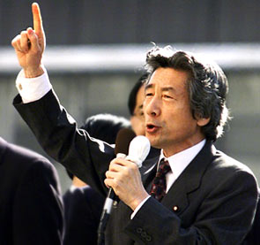
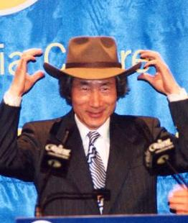
3A. Internal Challenges to LDP
1998: LDP Party Rules Changes
First test of New Rules 2001
Koizumi Junichiro (PM 2001-2006)

Slide 20
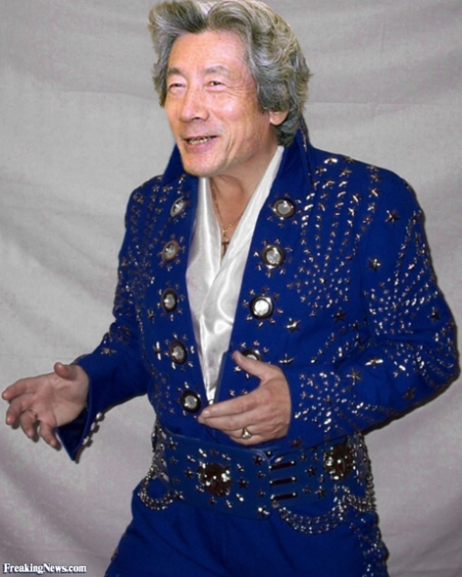
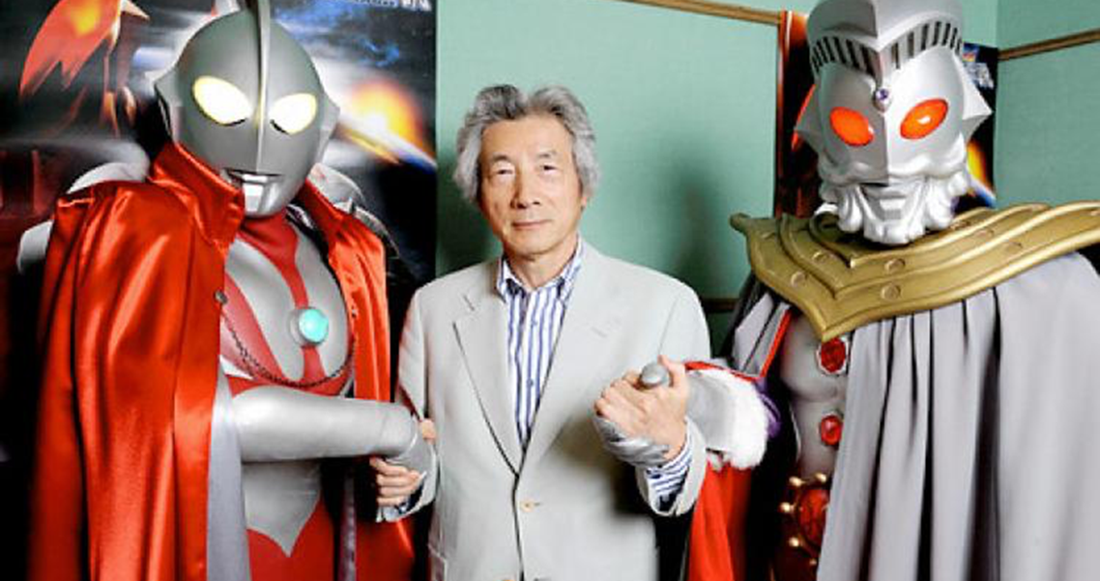
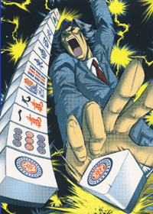
More Koizumi
Legend of Koizumi manga is now, well, legend
Search the internet or YouTube for
“The Legend of Koizumi” videos.
See “Koizumi’s Final Rising Sun vs. Mao”;
A mahjong game for the future of the world!

Slide 21
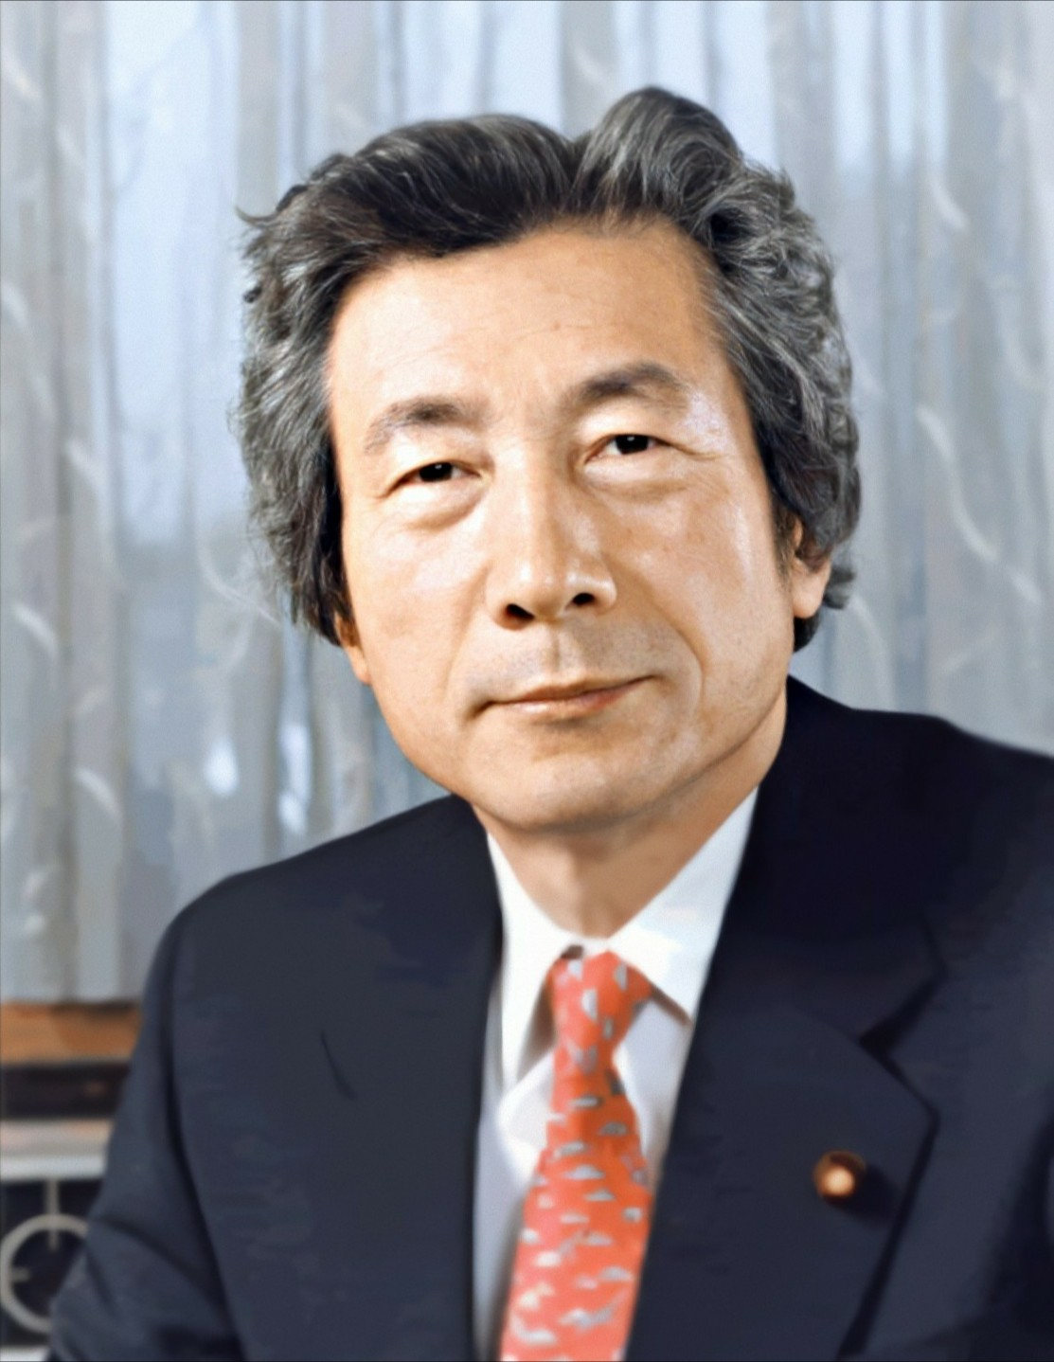
3B. New Powerful Prime Minister
1998 (2001)
PM now rules cabinet Secretariat
Secretariat Staff
Cabinet Office Councils
Important Councils
1)Council on Economy and Fiscal Policy 2)Council for Science and Technology Policy 3)Central Disaster Management Council 4)Council for Gender Equality
2013: Four Ministers Meeting: Abe

Slide 22
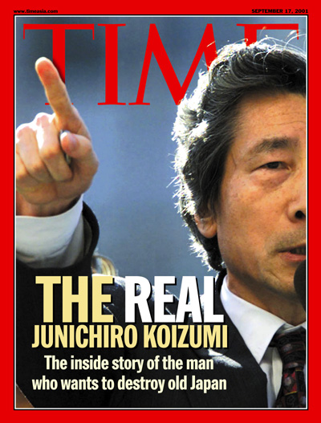
Koizumi vs. The Iron Triangle
Reforms
Open up economy
Banking Industry
Budget Cuts
Less Public Works Spending
Campaign finance
Postal reform

Slide 23
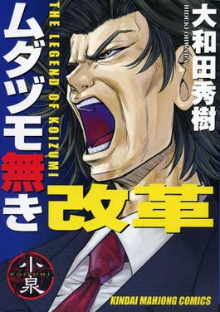
September 2005 Election: Koizumi Wins
Iron Triangle/LDP Anti-Reform factions (“Rebels”)
vs.
Koizumi ‘s candidates (“Assassins”)
LDP 212 to 296 seats
DPJ 177-113 seats
Postal reform bill
passes October 2005

Slide 24
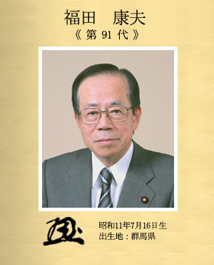
But…
Koizumi retires, September 2006
PMs since the 1990s
Abe Shinzo Fukuda Yasuo Aso Taro
9/06-9/07 9/07-9/08 9/08-9/09

Slide 25
Japan and 2008 Recession

Slide 26
4. Two Party System? 2009 Election
2005 2009
LDP 296 119
DPJ 113 308
New PM
Hatoyama Yukio
(DPJ)

Slide 27
Party Strength in Lower House

Slide 28
DPJ Victory
Why did DPJ win?
LDP weakness
Recession
“Flexicons”

Slide 29
DPJ in Power?
Rolling back market reforms?
Alliance with the US?
Worries about Japanese Identity?
Breaking the Iron Triangle?

Slide 30
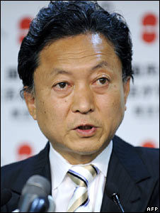
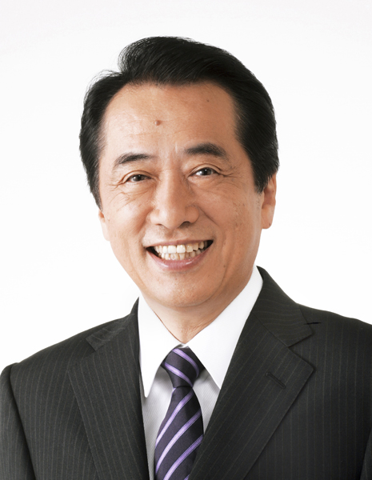
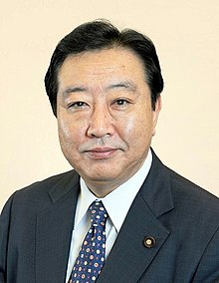
DPJ Troubles
Hatoyama Yukio Kan Naoto Noda Yoshihiko
9/16/09—6/8/10 6/8/10—9/2/11 9/2/11—12/26/12

Slide 31
Great East Japan Earthquake March 11, 2011

Slide 32
The Damage (from Japan Science and Technology Agency)

Slide 33
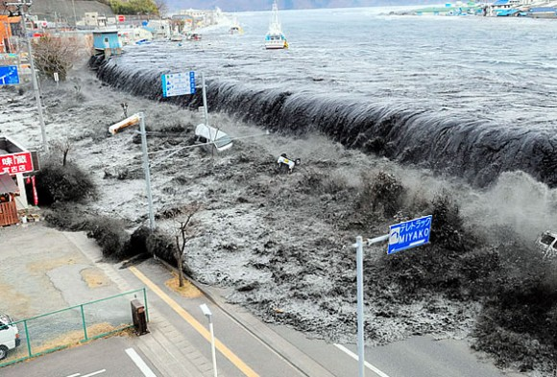
Before and After

Slide 34
Fukushima Nuclear Reactor

Slide 35
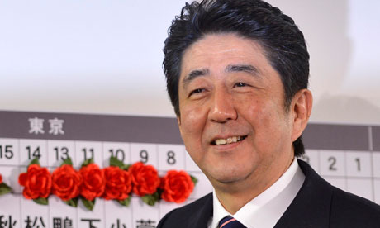
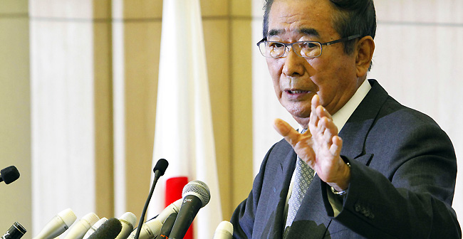
5. Return to LDP Rule December 2012 Election
LDP DPJ Restoration
Pre-2009 303 110 0
2009 Election 119 308 0
Dec. 2012 294 56 54
New PM Restoration Party Leader
Abe Shinzo (LDP) Ishihara Shintaro

Slide 36
2012 Election

Slide 37
December 2014 Election*
LDP DPJ*** JIP**
2009 119 308 0
Dec. 2012 294 56 54
December 2014 290 73 42 *Now 475 seats; 238 for majority
**Restoration party became Japan Innovation Party (JIP) in 2014 **Then Merged with DPJ in 2015
***DPJ is now just Democratic Party: the new DP has 96 seats
PM Abe

Slide 38
December 2014 Election

Slide 39
December 2017 Election*
LDP DPJ JIP** Hope*** CDP****
Dec. 2014 290 73 42 0 0
Dec. 2017 284 1 11 50 55
*Now 465 seats; 233 for majority
**Japan Innovation Party
***Party of Hope: Koike Yuriko’s Party (ex-LDP)
**** Constitutional Democratic Party; formed from ex-DPJ members

Slide 40
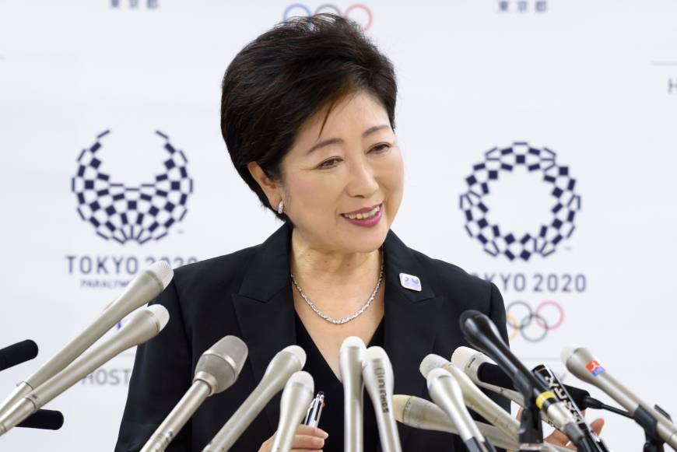
Questions/Lessons
Is the 1955 System dead?
Does Japan have a Two-Party System?
When in doubt, back to the LDP?
Koike Yuriko Future? Governor of Tokyo
Party: Tomin First no Kai (Tokyoites First)

Slide 41
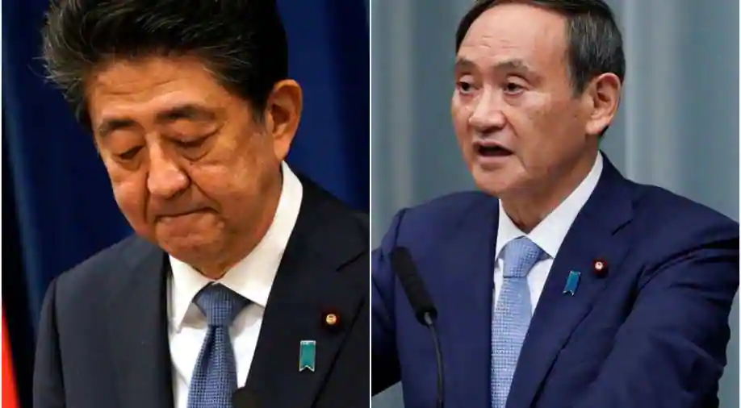
August-September 2020
Abe retires as longest serving PM in Japanese history
Suga Yoshihide replaces him

Slide 42
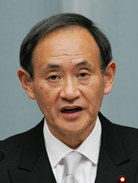
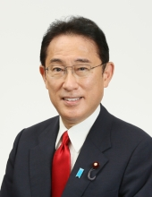
Suga Yoshihide Kishida Fumio
2020-2021 2021--

Slide 43
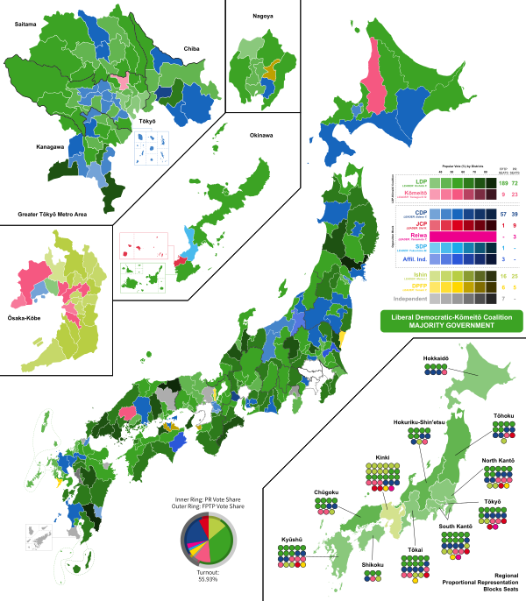
October 2021 Election
LDP: 261(284)
CDP: 96 (New)
JIP: 41 (11)
Komeito: 32 (29)

Slide 44
2021 Lower House Results (reference only)
Party | Single Member District Seats | Proportional Representation Seats | Total
LDP | 189 | 72 | 261
Constitutional Democratic Party (CDP) | 57 | 39 | 96
Japan Innovation Party (JIP) | 16 | 25 | 41
Komeito | 9 | 23 | 32
Democratic Party for the People | 6 | 5 | 11
Japan Communist Party | 1 | 9 | 10
Reiwa Shinsengumi | 0 | 3 | 3
Social Democratic Party | 1 | 0 | 1

Slide 45
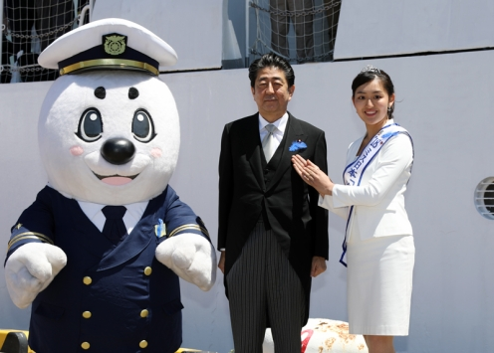
Umimaru, Mascot of the Japanese Coast Guard and Friends…
Abe attends 70th Anniversary of Japanese Coast Guard, May 2018

Slide 46
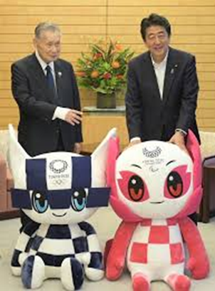
2020 Olympics Postponed; Mascots Live On
Abe with Olympics and Paralympics mascots

Slide 47
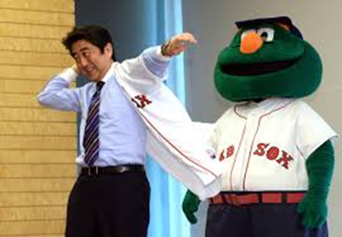
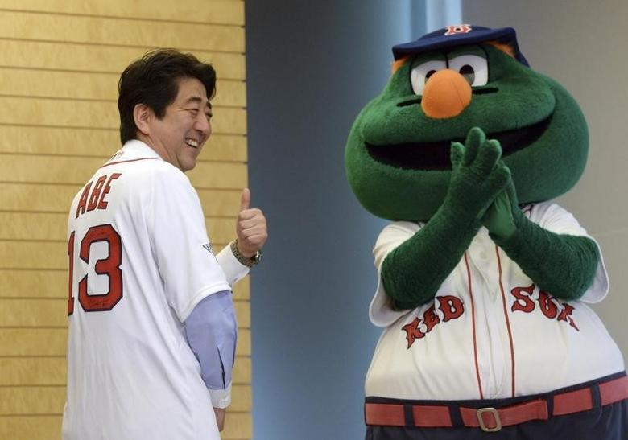
Abe likes American Mascots too…
Abe with Boston Red Sox Mascot Wally the Green Monster, 2014

Slide 48
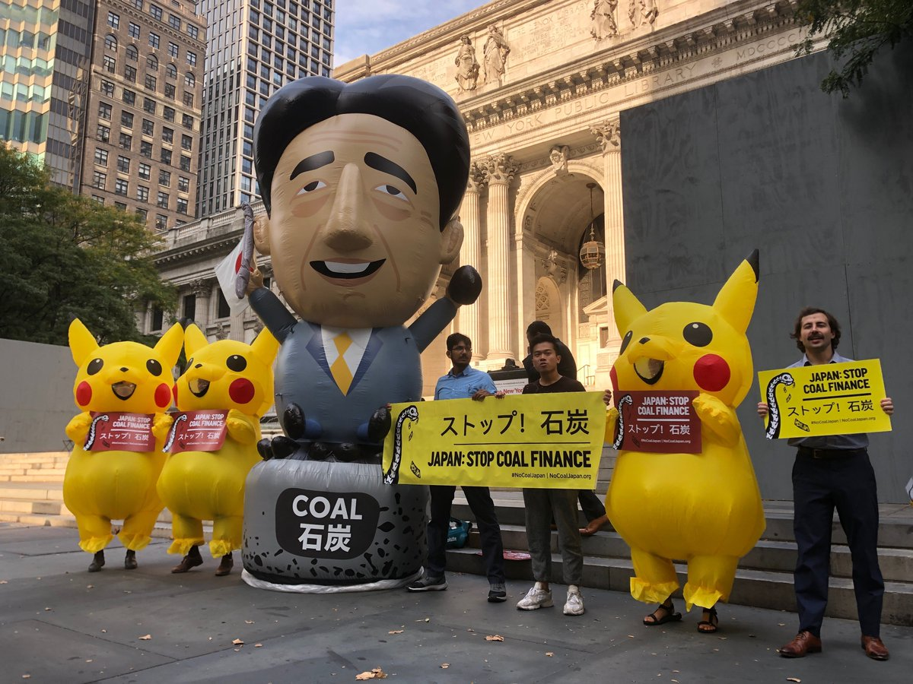
Protesting Pikachus Outside UN Climate Summit, 2019
Pikachus with Abe Mascot, NY, September 2019

