Slide 1
Iran and the JCPOA

Slide 2
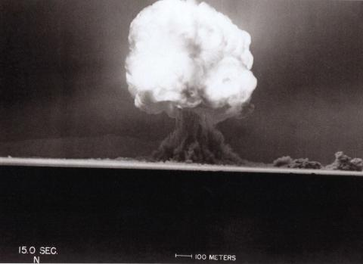
US: Manhattan Project (Begins 1942)
July 16, 1945
“Trinity”

Slide 3
US Use of Atomic Bombs in WW II (for reference)
Hiroshima
Nagasaki
August 6, 1945
“Gun-Type” device
“Little Boy”
Plane: Enola Gay
August 9, 1945
Implosion device
“Fat Man”
Plane: Bock’s Car

Slide 4
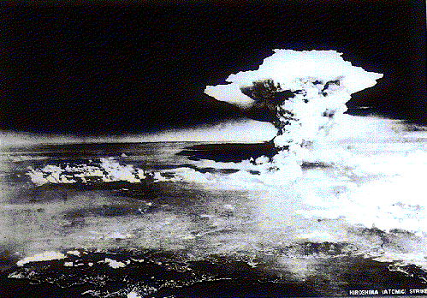
Hiroshima August 6, 1945

Slide 5
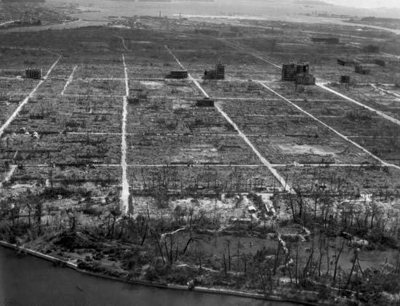
Hiroshima After the bomb

Slide 6
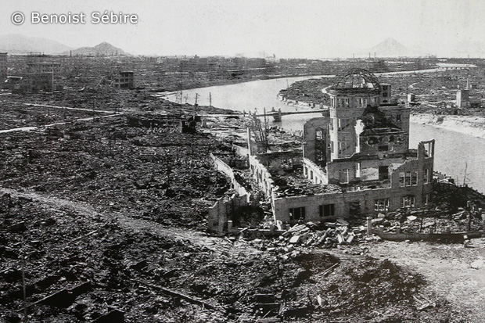
Hiroshima

Slide 7
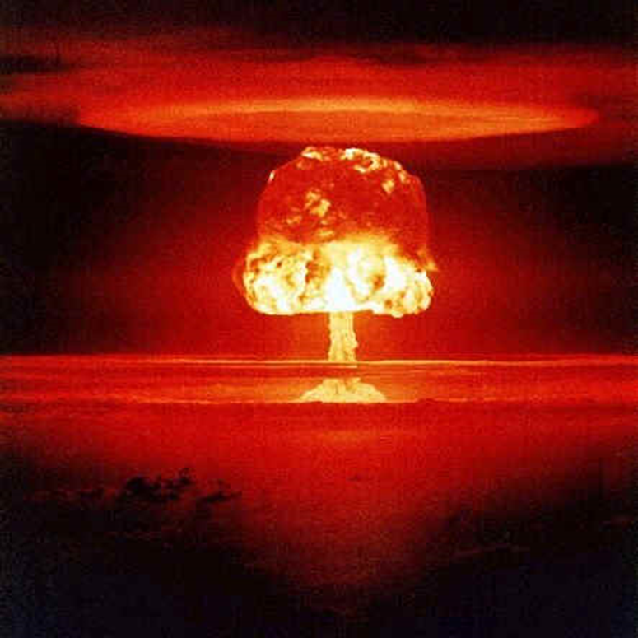
Who Has Nuclear Weapons?
By the end of the Cold War:
US 1945
USSR/Russia 1949
UK 1952
France 1960
China 1964
Israel (19??)

Slide 8
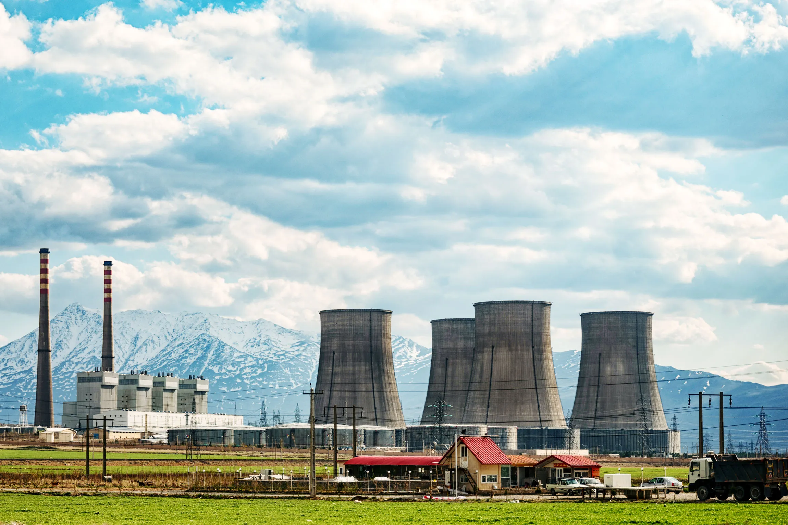
Nuclear Energy: The Pathway to a Bomb?
Arak, Iran

Slide 9
The Proliferation Problem
“Nth Country Problem”

Slide 10
Very Simple Version
Waste
U U and Pu (storage
(or Pu) or recycle)
Weapon
U = Uranium
Pu = Plutonium
See: https://whatisnuclear.com/recycling.html
Reactor

Slide 11
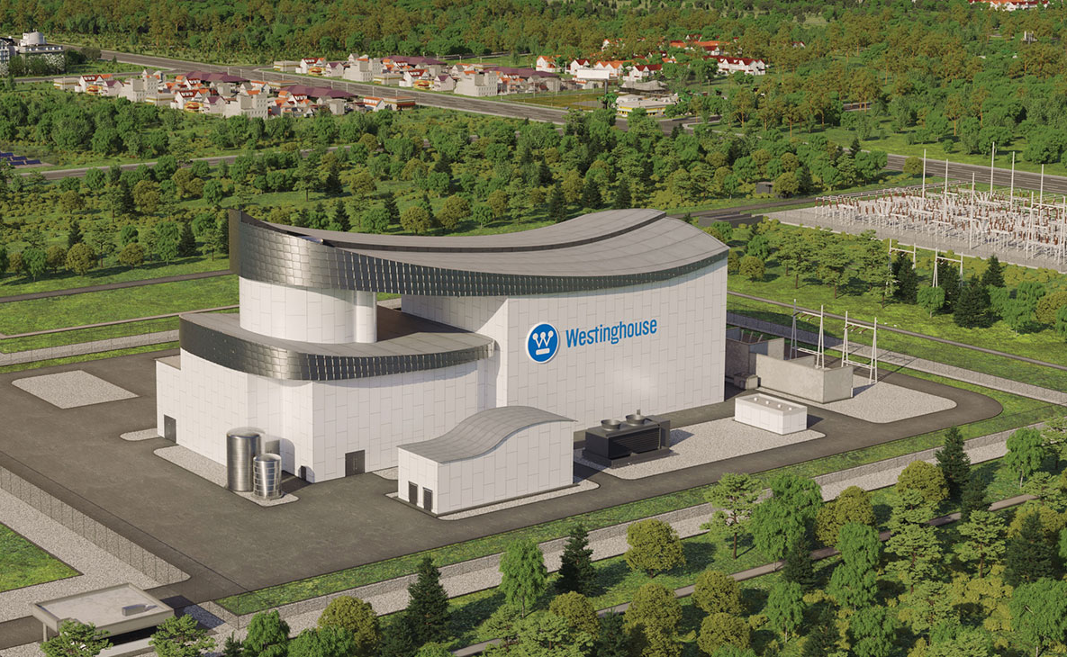
What to do?
Nuclear powers want an exclusive club
Other nations want nuclear energy
Nuclear energy is a profitable business
Westinghouse

Slide 12
Reducing the Spread of Nuclear Weapons
Eighteen-Nation Committee on Disarmament
Nuclear Non-Proliferation Treaty 1968 (1970)
Two Types of States
Nuclear Weapon States
Non-Nuclear Weapons States

Slide 13
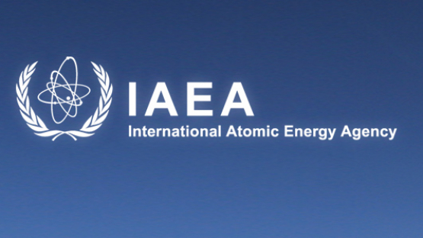
Verification of Treaty Obligations
IAEA Safeguard Basics
Inspections
Surveillance cameras
Seals
Accounting

Slide 14
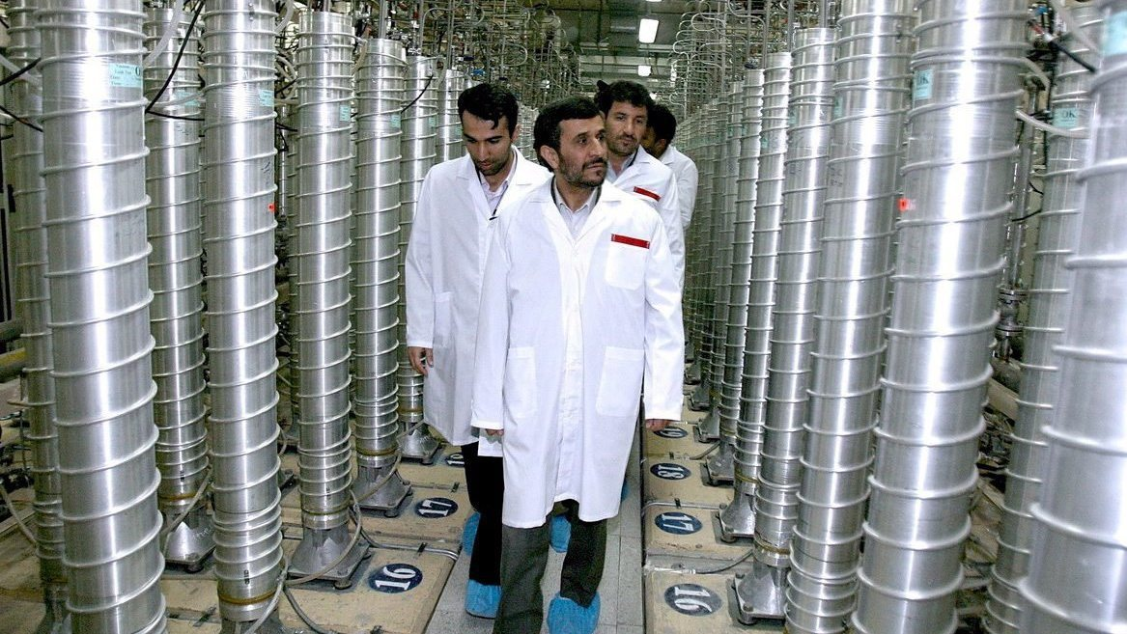
Uranium Enrichment
U²³⁵
Natural Uranium: .7% U²³⁵
Enriched Uranium for energy: 3-5%
Highly Enriched Uranium: 20%
Weapon-grade Uranium: 80%
https://phys.org/news/2019-06-nuclear-weapons-iran-uranium-enrichment.html

Slide 15
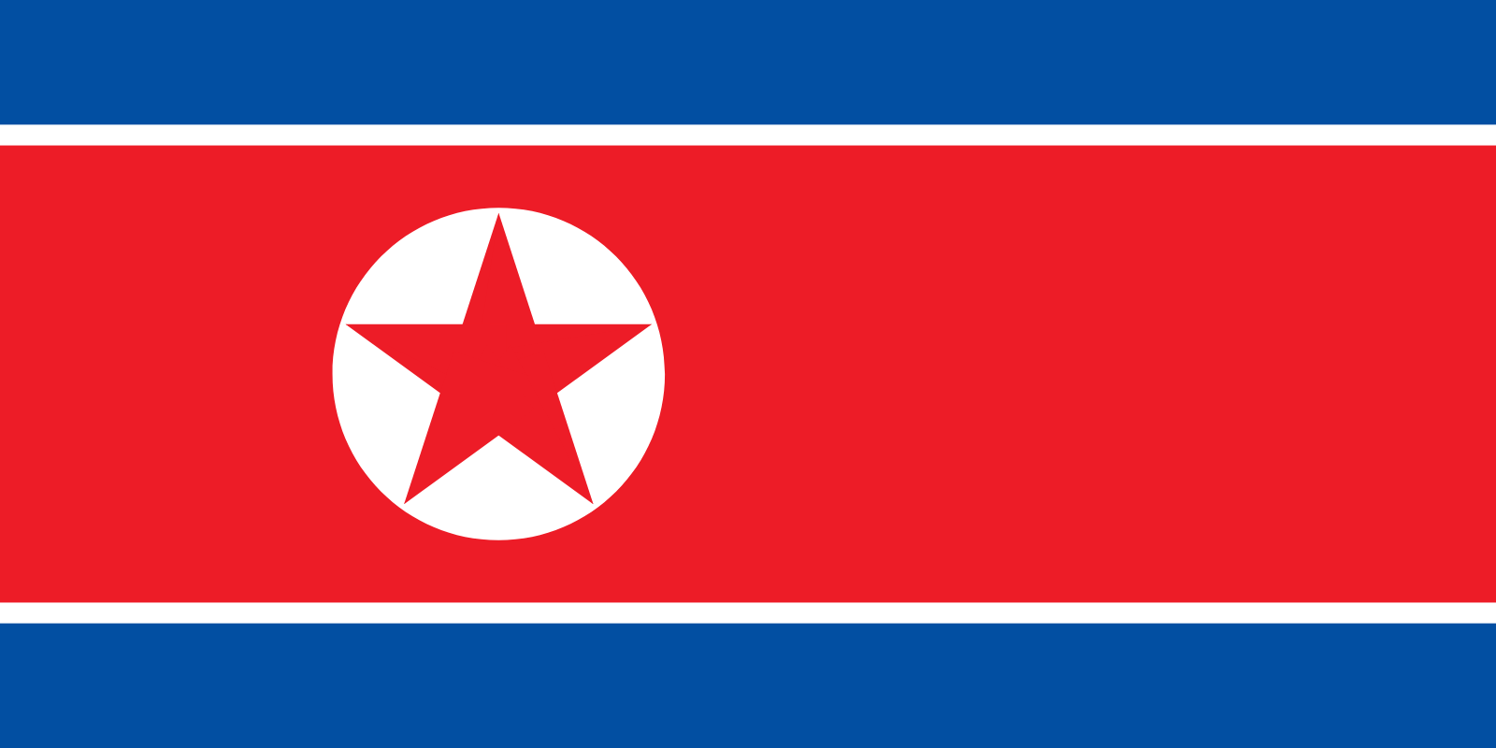
Problems?
Never Signed NPT
Israel
India
Pakistan
Violated Treaty Provisions
Iraq
Iran
North Korea

Slide 16
The Questions
Why does a nation decide it wants nuclear weapons?
What can the world do about it?
Does it really matter when a nation goes nuclear?

Slide 17
Why does a nation decide it wants nuclear weapons?
Deterrence
To demonstrate power
To Bargain
Asymmetric Escalation
Catalytic
Notes:
Deterrence: assured retaliation against a rival
To demonstrate power: Realism (Swaggering)
To Bargain: achieving political goals (compellence)
Asymmetric Escalation: to compensate for a disadvantage
Catalytic: to bring a third party into the situation

Slide 18
What to do with non-signatory nations or violators?
Options
Ignore the NPT issues (it’s an ally)
Sanctions
Negotiations
Destruction of nuclear facilities
Regime Change
A combination of these

Slide 19
Does it really matter when a nation goes nuclear?
If deterrence is strong, does it matter?
Instability?
Arms races?
Is it all really political?
My allies can have nuclear weapons; my rivals can’t
It’s all just a calculation of the balance of power:
Global
Regional

Slide 20
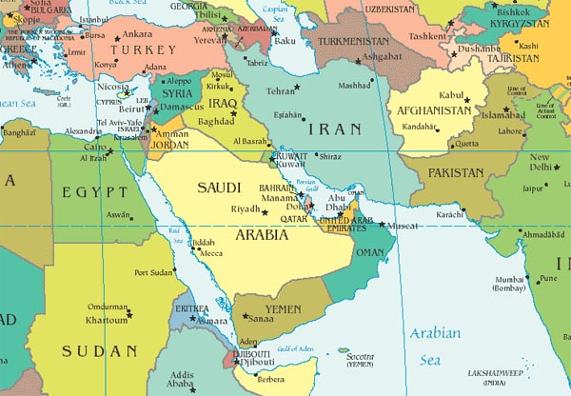
Iran and its Neighbors

Slide 21
The Neighborhood?
Iran vs. Iraq
Persian vs. Arab
Shi’ite vs. Sunni
Radical Theocracy vs. Military Dictatorship
Iran vs. Israel
Iran vs. Saudi Arabia
Iran vs. the US
Israel and Palestine
OIL

Slide 22
Iranian Strategy
Deterrence of neighbors
Asymmetric Escalation
(against Israel and US)
Regional Power
Arms Race
Israel
Iraq
Saudi Arabia

Slide 23
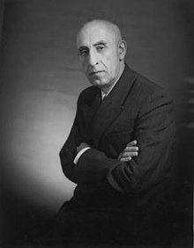
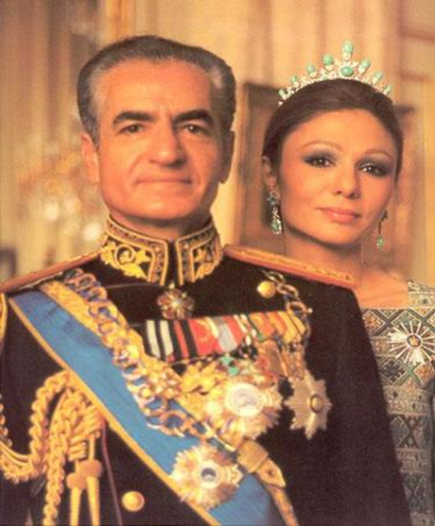
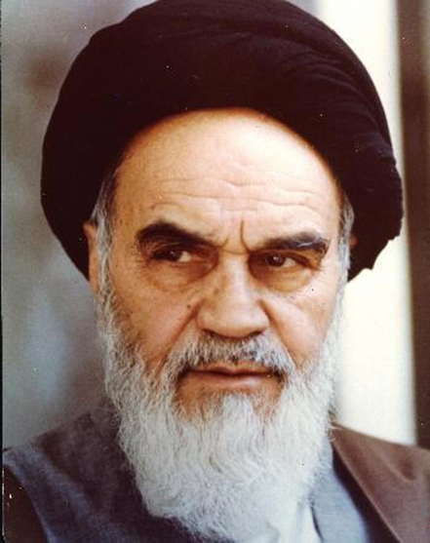
Modern Iran and the Outside World
PM Mohammad Shah of Iran Ayatollah
Mossadegh Mohammed Ruhollah
1951-53 Reza Pahlevi Khomeini

Slide 24
November 4, 1979
Notes:
24

Slide 25
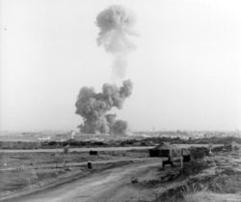
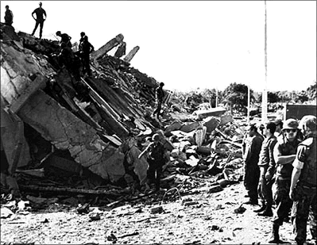
Beirut 1983: Hezbollah

Slide 26
The Program and Response
Signed NPT 1968
Began nuclear energy program 1970
Decision for bomb: 1982-1984
Detection: 1990s
Highly Enriched Uranium (HEU)
E3 Negotiations 2003-2005

Slide 27
Sanctions and Negotiations
UN Security Council Resolutions
June 2006: P5+1
US Sanctions
The Deal:
End suspicious activities
or
Tightening economic sanctions

Slide 28
P5 +1 Negotiations

Slide 29
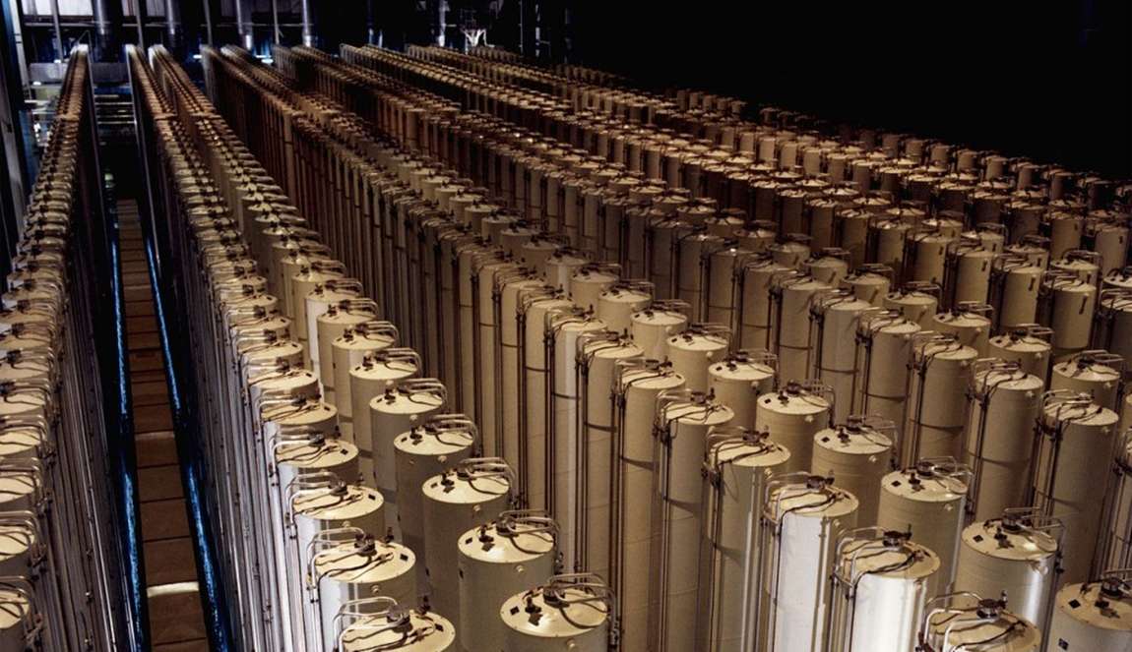
More Pressure: 2010
June 2010: UNSCR 1929
Stuxnet/Olympic Games
Cyberattack by the US and Israel

Slide 30
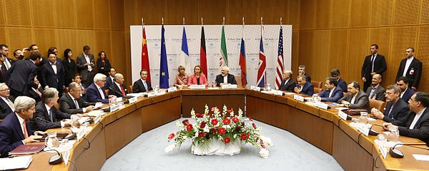
Deal: JCPOA Joint Comprehensive Plan of Action
July 14, 2015
UNSCR 2231 July 20, 2015
Summary

Slide 31
JCPOA Details
Arms Control Today Summary
Arms Control Today Analysis
Sunset Clauses (US Institute for Peace)
Sunset Clauses (Foreign Affairs)

Slide 32
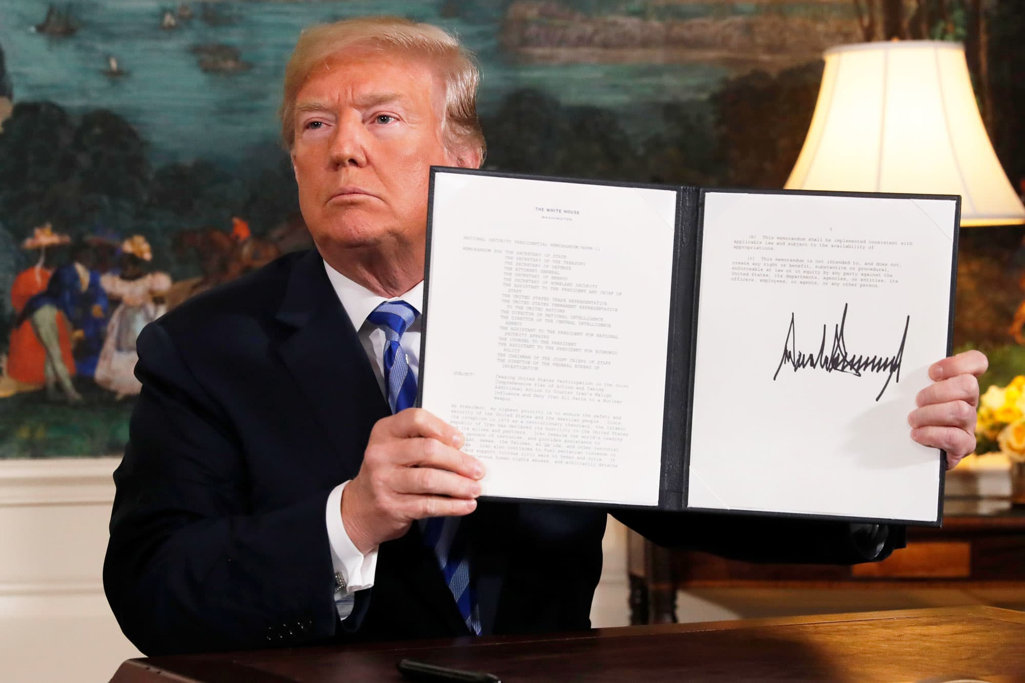
But…
May 8, 2018
US withdraws: “Maximum Pressure”
Reimposes sanctions
12 Demands

Slide 33
Iranian Response
2018-2019 “Strategic Patience”
May 2019: selected non-compliance
60 day intervals
Pressure on EU to change US mind

Slide 34
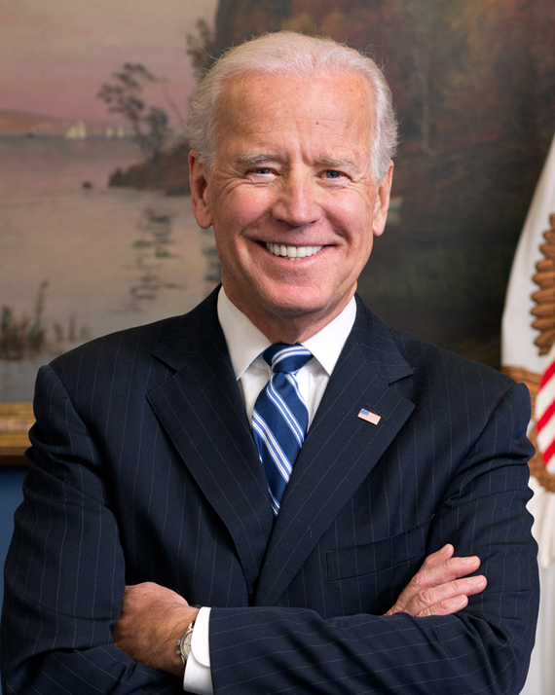
Back to JCPOA?
January 2021: Biden Administration

Slide 35
Two Choices
Nuclear deal delinked from other issues
vs
Comprehensive change in Iranian foreign policy

