Slide 1
2019 Indian Elections
Phases | Polling dates
I | April 11
II | April 18
III | April 23
IV | April 29
V | May 6
VI | May 12
VII | May 19

Slide 2
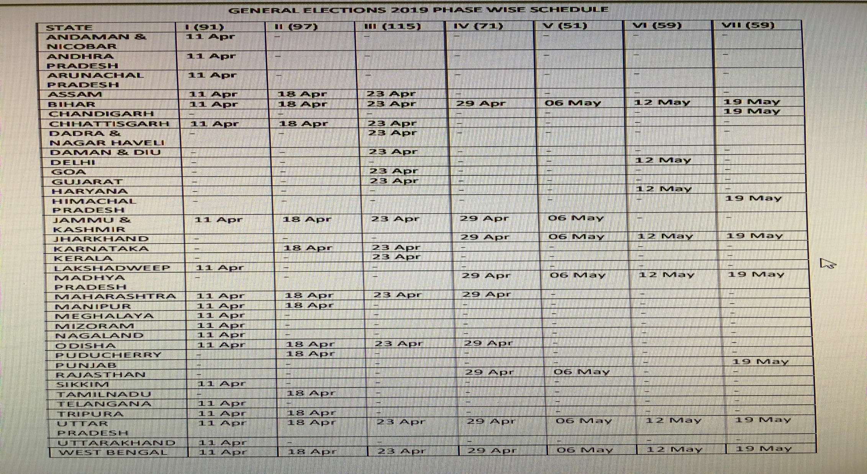
By State

Slide 3
States and Union Territories

Slide 4
The Map

Slide 5
2010 Census State Population (estimates)
State | Population (millions)
Uttar Pradesh | 199.9
Maharashtra | 112.4
Bihar | 104.1
West Bengal | 91.3
Madhya Pradesh | 72.6
Tamil Nadu | 72.1
Rajasthan | 68.5
Karnataka | 61.1
Gujarat | 60.4
Andhra Pradesh | 49.6
Odisha | 41.9
Telangana | 35.0

Slide 6
Compared to Countries

Slide 7
Indian Election 2009

Slide 8
Indian Election 2014

Slide 9
December 2018: A Sign?

Slide 10
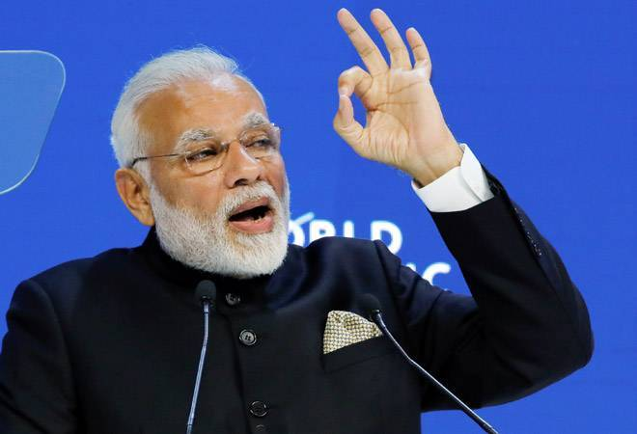
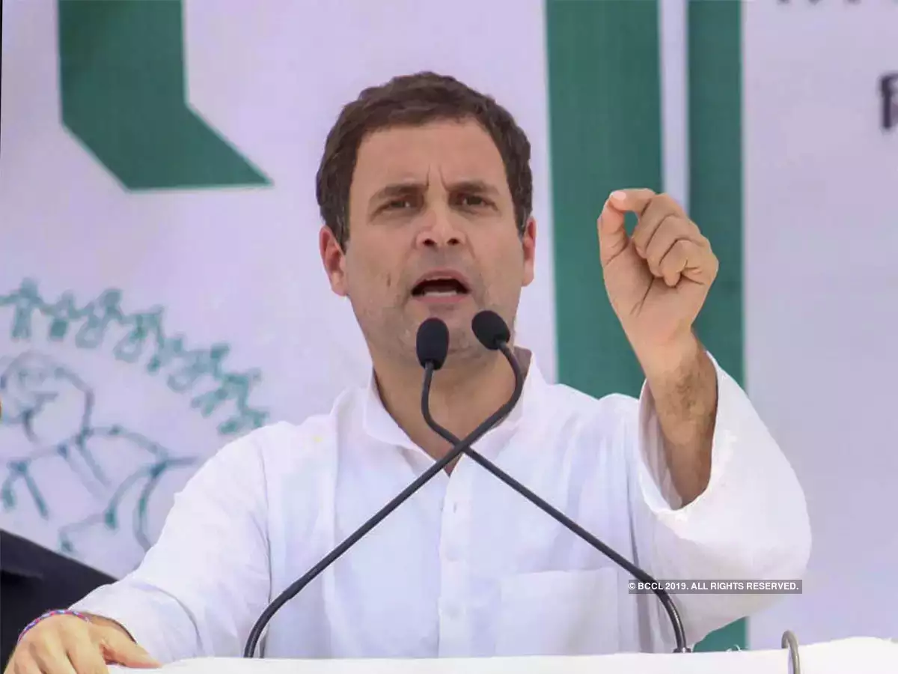
The Candidates for PM
Current PM Narendra Modi Rahul Gandhi, INC
BJP

Slide 11
Congress Dominates until late 1980s
Election Year | Seats for Congress | Seats for Second Largest Party
1952 | 364** | 16
1957 | 371** | 27
1962 | 361** | 29
1967 | 283** | 44
1971 | 352** | 44
1977 (lost power) | 154 | 298 (Janata Party alliance)**
1980 | 353** | 35
1984 | 415** | 30
1989 (lost power) | 197 | 143 (Coalition)**
1991 (formed coalition) | 226** | 120

Slide 12
Competition
Election Year | Seats for Congress (INC) | Seats for BJP
1996 | 136 | 160
1998 | 140 | 176**
1999 | 112 | 182**
2004 | 145** | 138
2009 | 206** | 116
2014 | 44 | 276**

