Slide 1
India Two
History to Independence

Slide 2
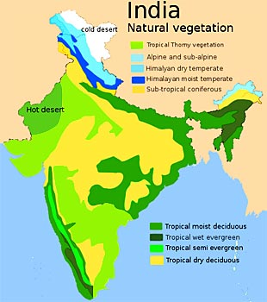
Factors in Political Culture
Geography
Agrarian economy
Population
Religion
  Hindu: 80%
  Muslim: 14.2%
  Christian 2.3%
  Sikh: 1.7%

Slide 3
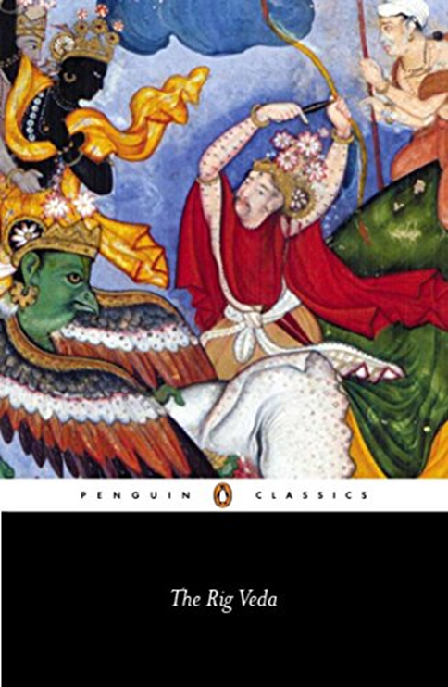
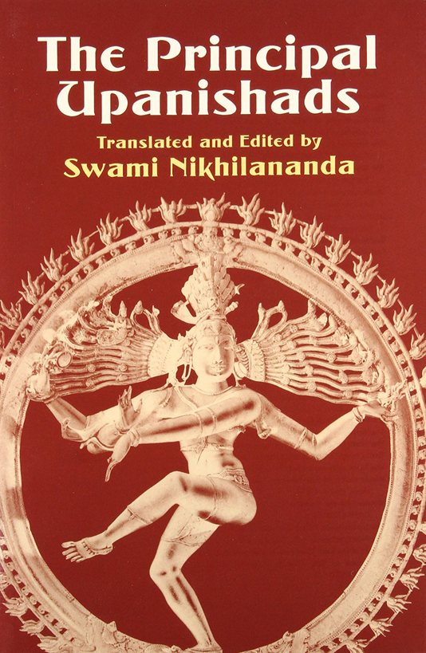
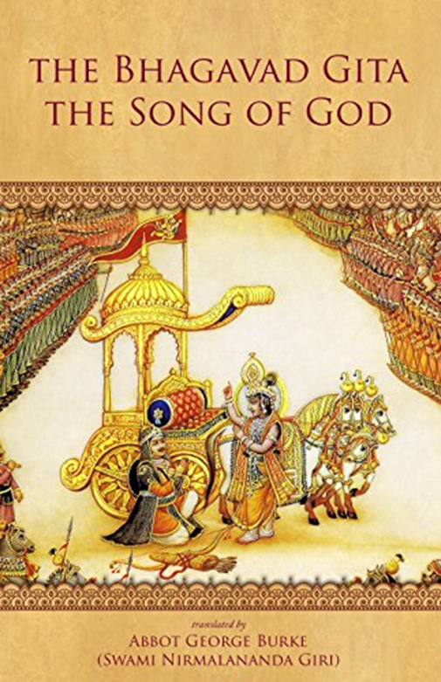
Hinduism
Rig Veda Upanishads Bhagavad Gita
1,500-800 BCE 800-500 BCE 400-200 CE

Slide 4
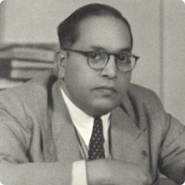
Hindu Caste System
Thousands of castes
Priests – Brahmins
Warriors – Kahtriyas
Landowners/merchants – Vaishyas
Small Farmers – Sudras
Outcastes, sub-castes, backward tribes, and “Untouchables” or Dalits or Harijans
Bhimrao Ambedkar

Slide 5
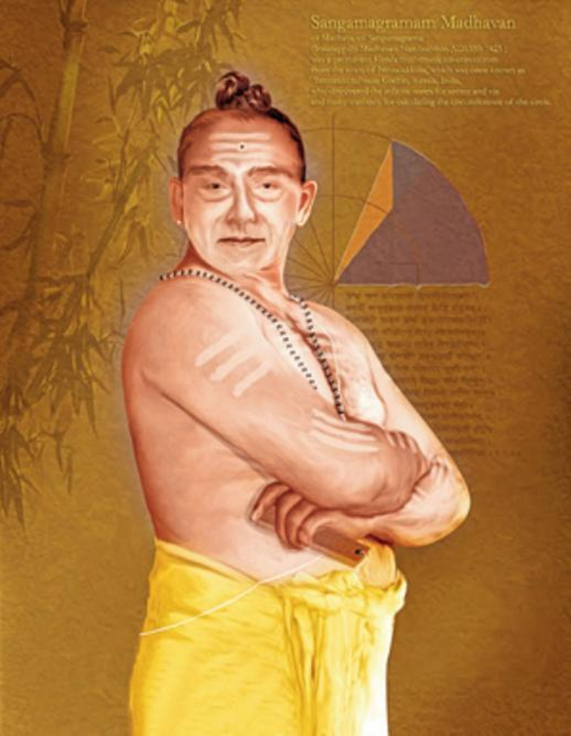
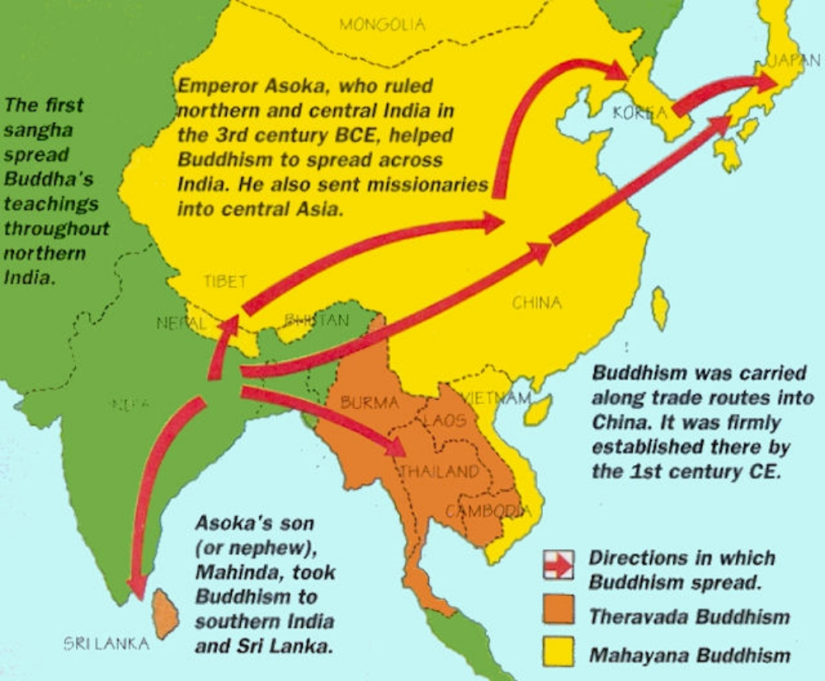
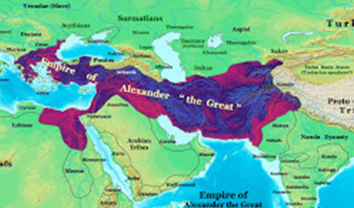
Some History
Buddhism Madhava
1340-1425
Calculus
Limits to
Alexander’s
Empire

Slide 6
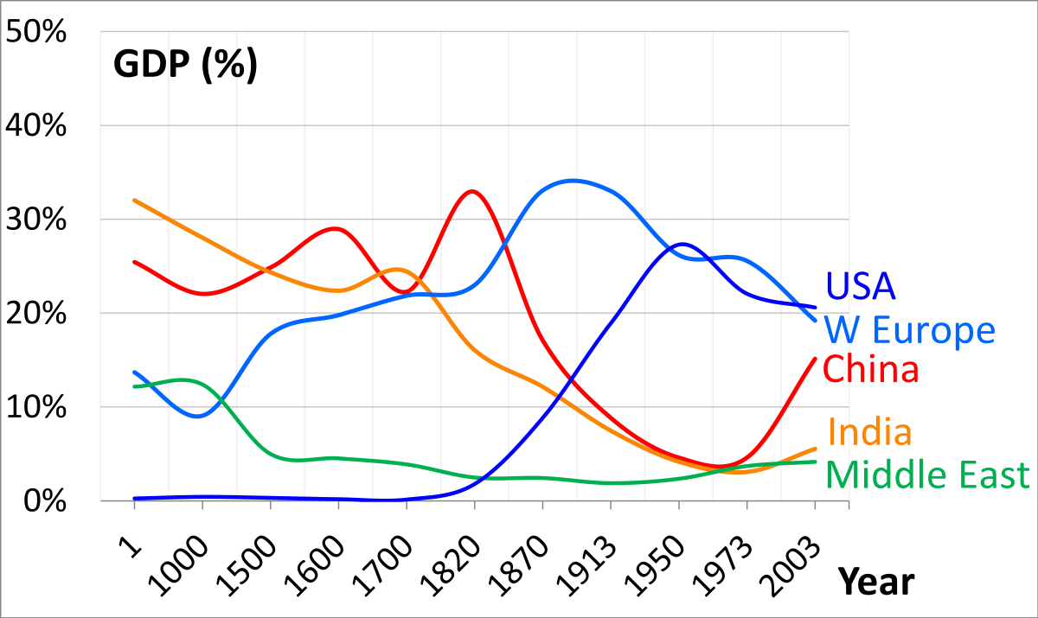
Indian Power and Wealth

Slide 7
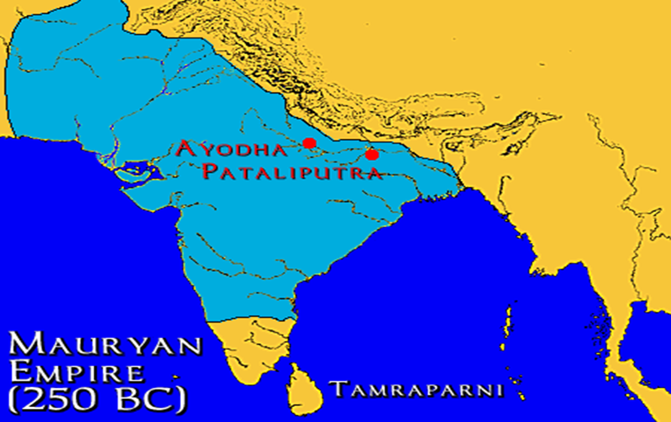
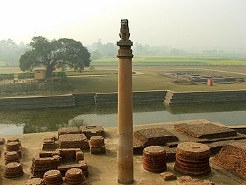
Mauryan Dynasty, 321-185 BC
Pillars of Ashoka Emperor of India
268-232 BCE (born 304 BCE)

Slide 8
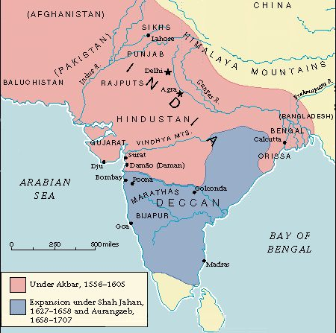
Mughal Dynasty, 1529-1707

Slide 9
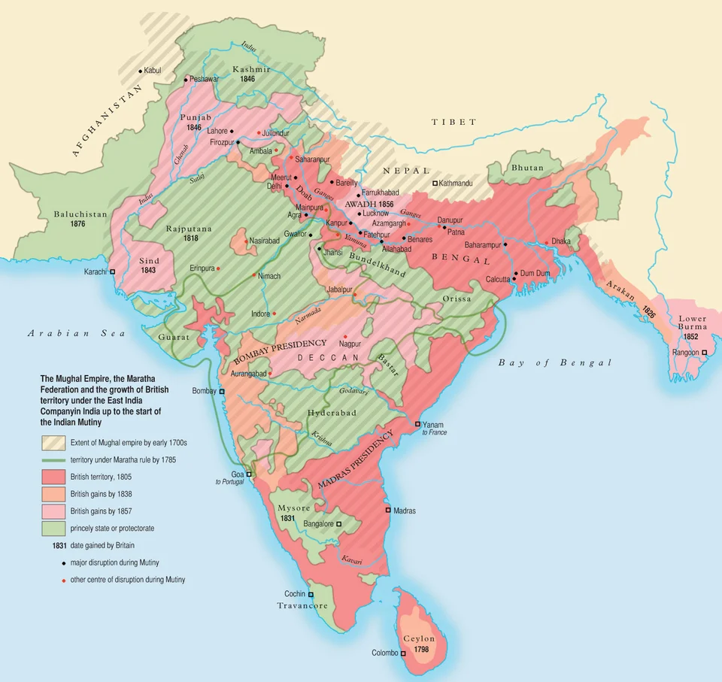
British East India Company
Relevant by 1639; the Real Power by 1757

Slide 10
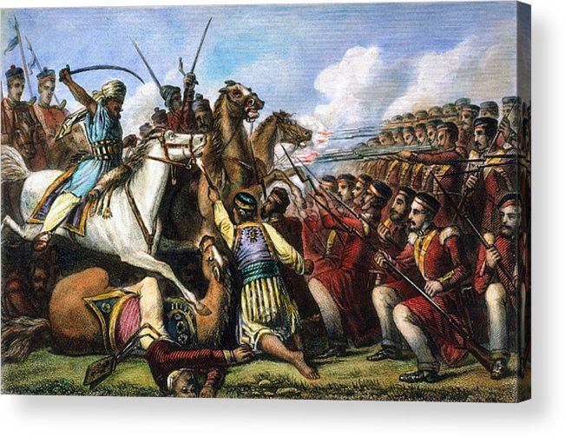
Indian Mutiny, Sepoy Mutiny
1857-1858

Slide 11
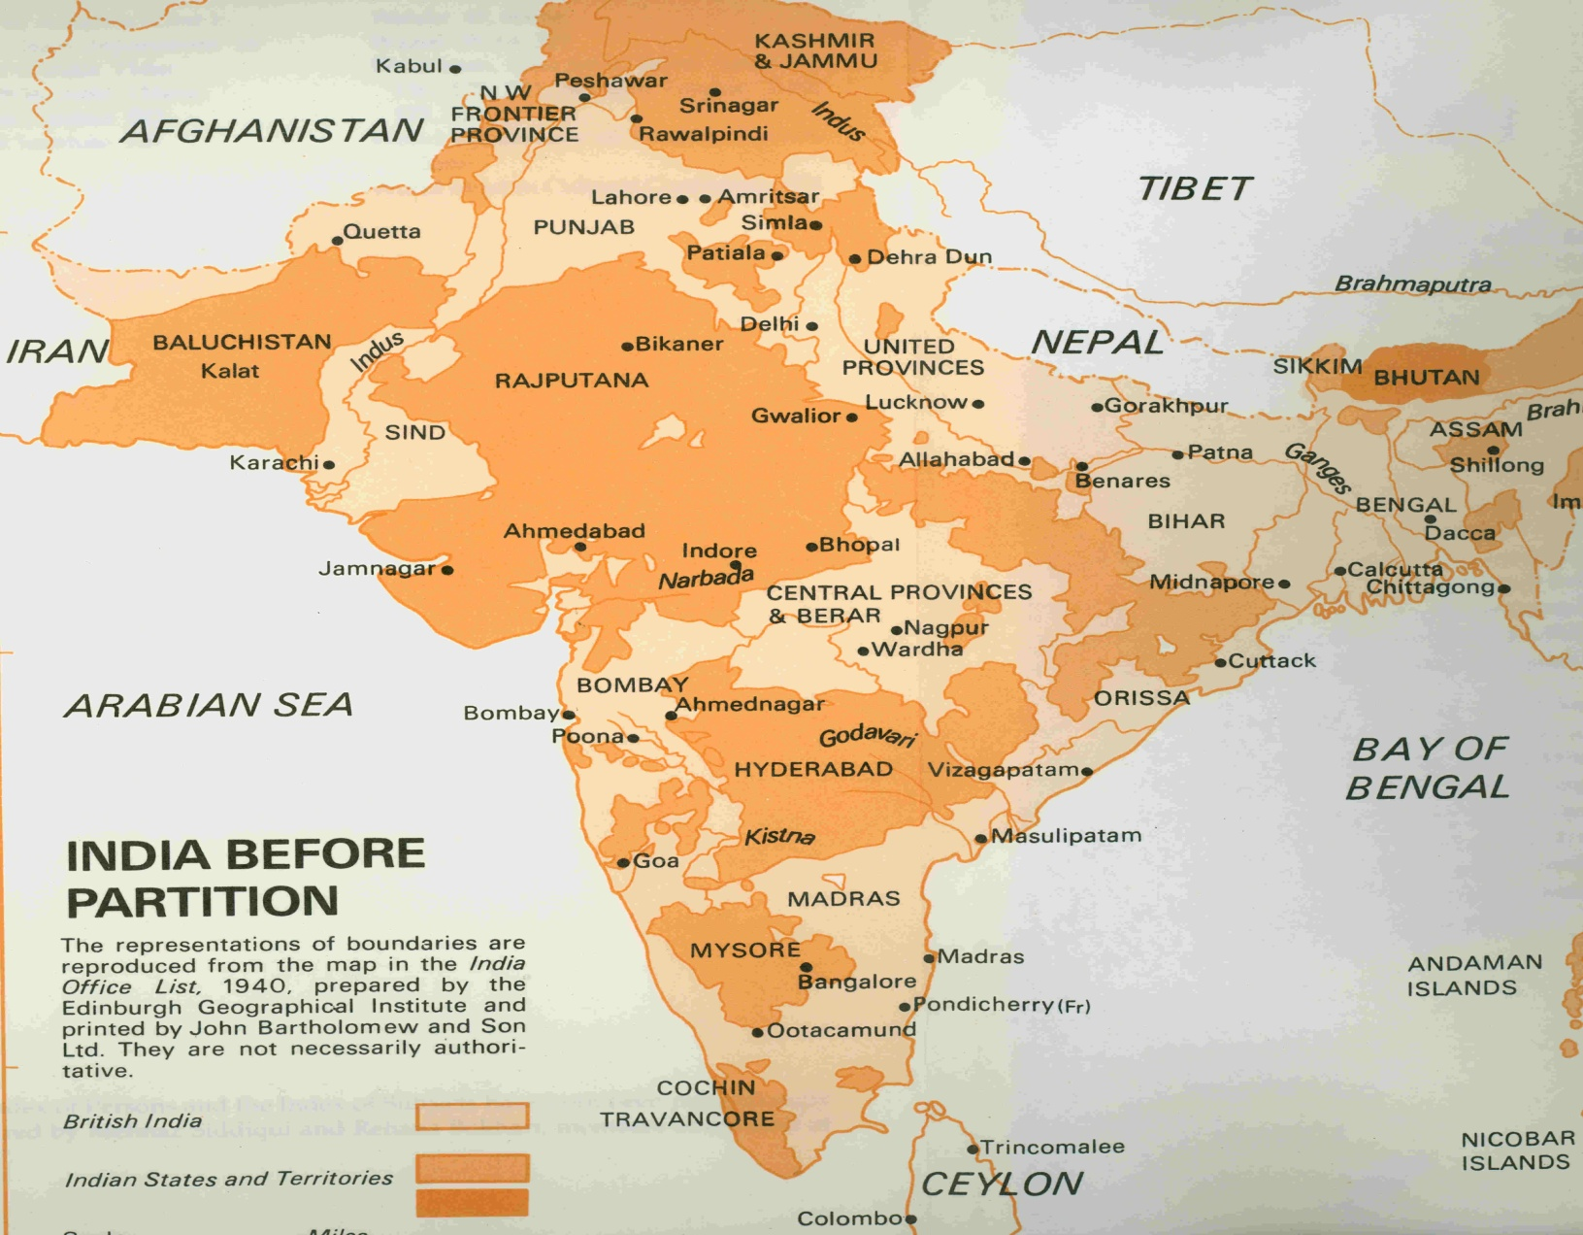
British Colonialism

Slide 12

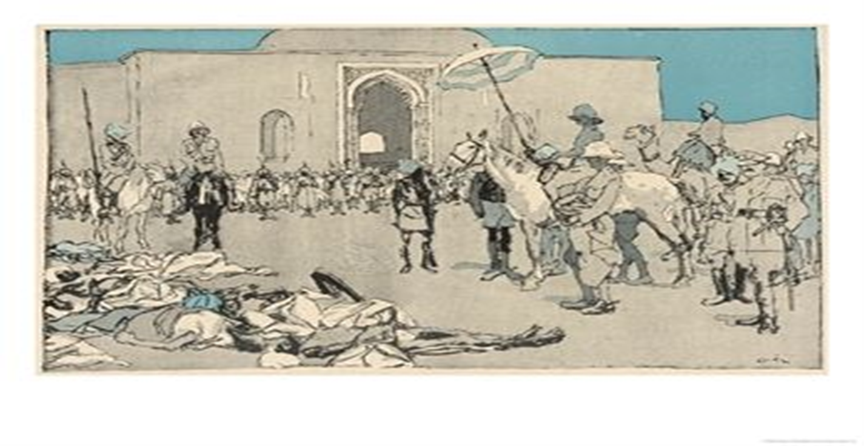
The Path to Independence
Viceroy rules
Indian National Congress (1885)
Amritsar Massacre
  April 1919
  Eduard Thony painting

Slide 13
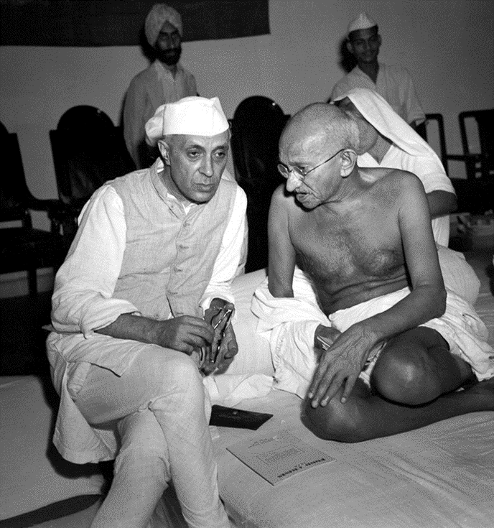
Gandhi’s Impact on the INC
Extremists vs. moderates
Ending factional struggle
Mass movement
Non-violence
  Gandhi’s writings
Independence Now
Jawaharlal Nehru and Mohandas Gandhi (1940s)

Slide 14
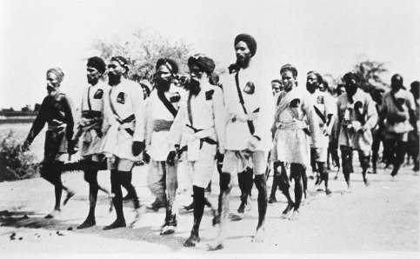
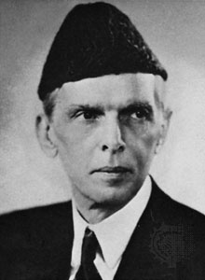
Independence Movements
Muslim League Shiromani Akali Dal
Mohammed Ali Jinnah

Slide 15

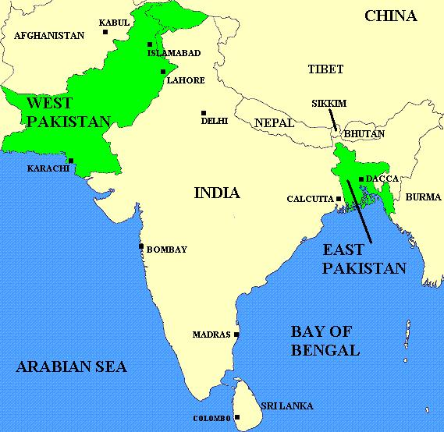
Independence and partition

Slide 16
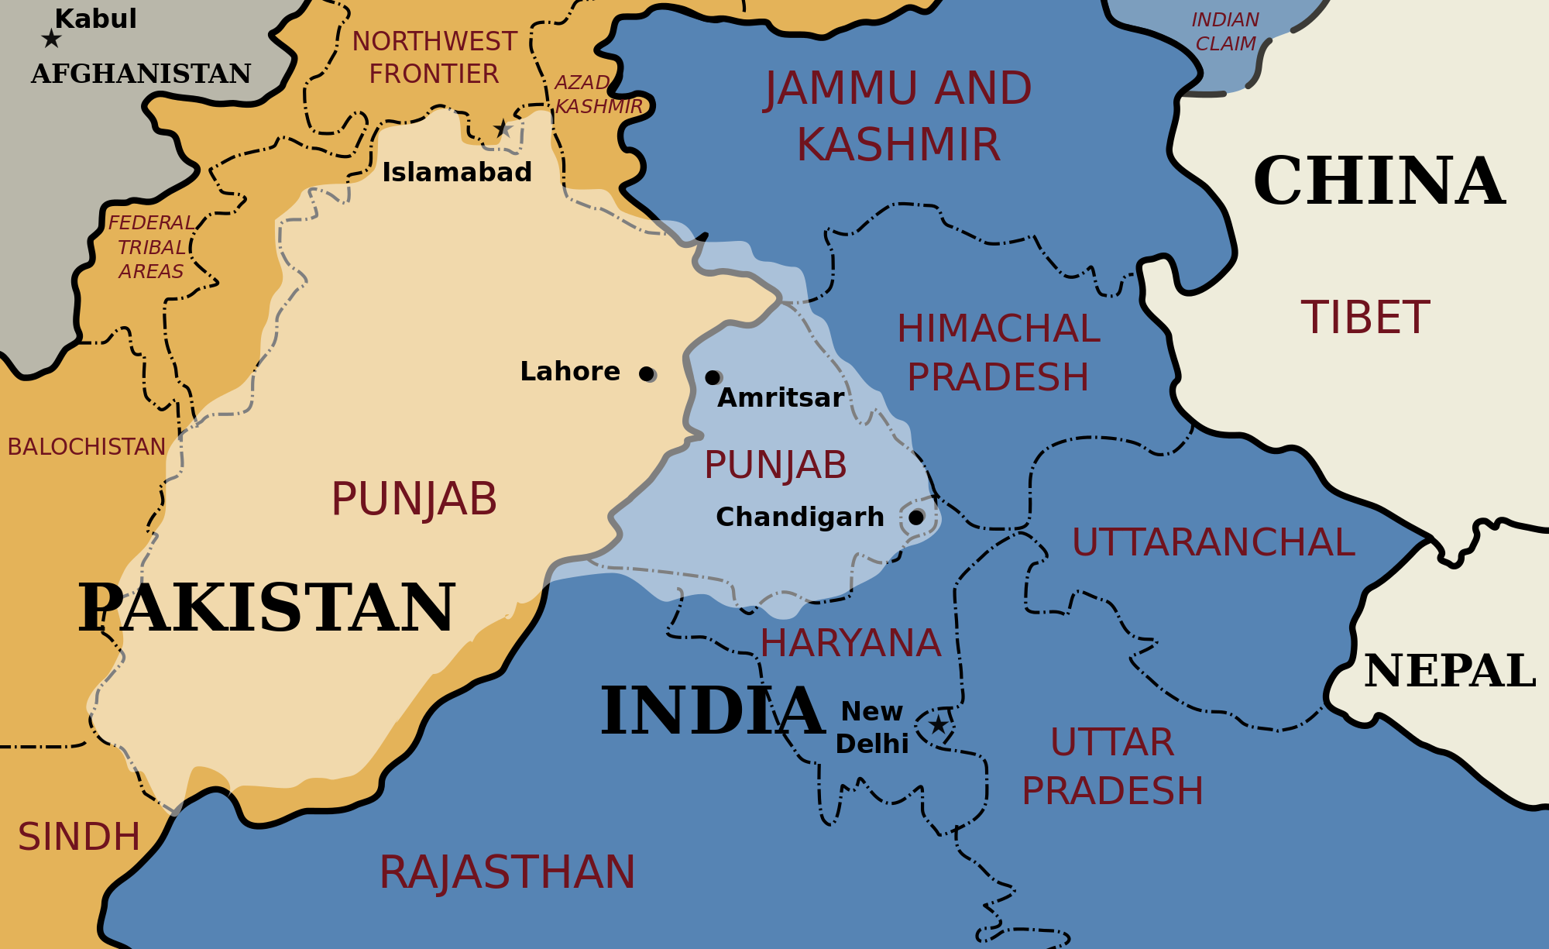
Punjab Divided

Slide 17
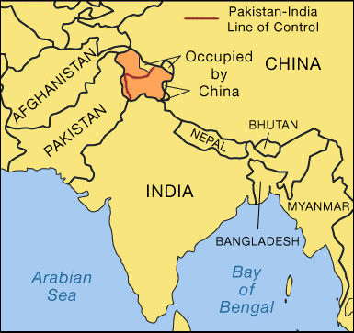
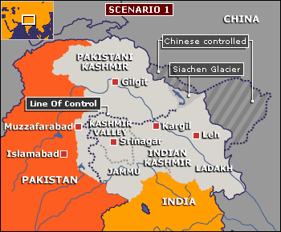
Kashmir Divided
UNMOGIP

