Slide 1
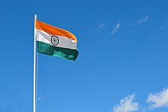
Independent India

Slide 2
Character of New State
Parliamentary Democracy
Federalism
States (also parliamentary systems)
Chief Ministers
Neutrality in Cold War
Experience with Administration
Constitution 1950
395 articles

Slide 3
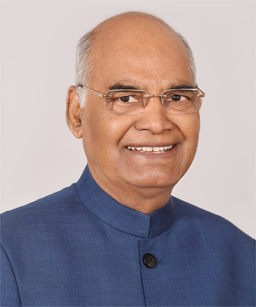
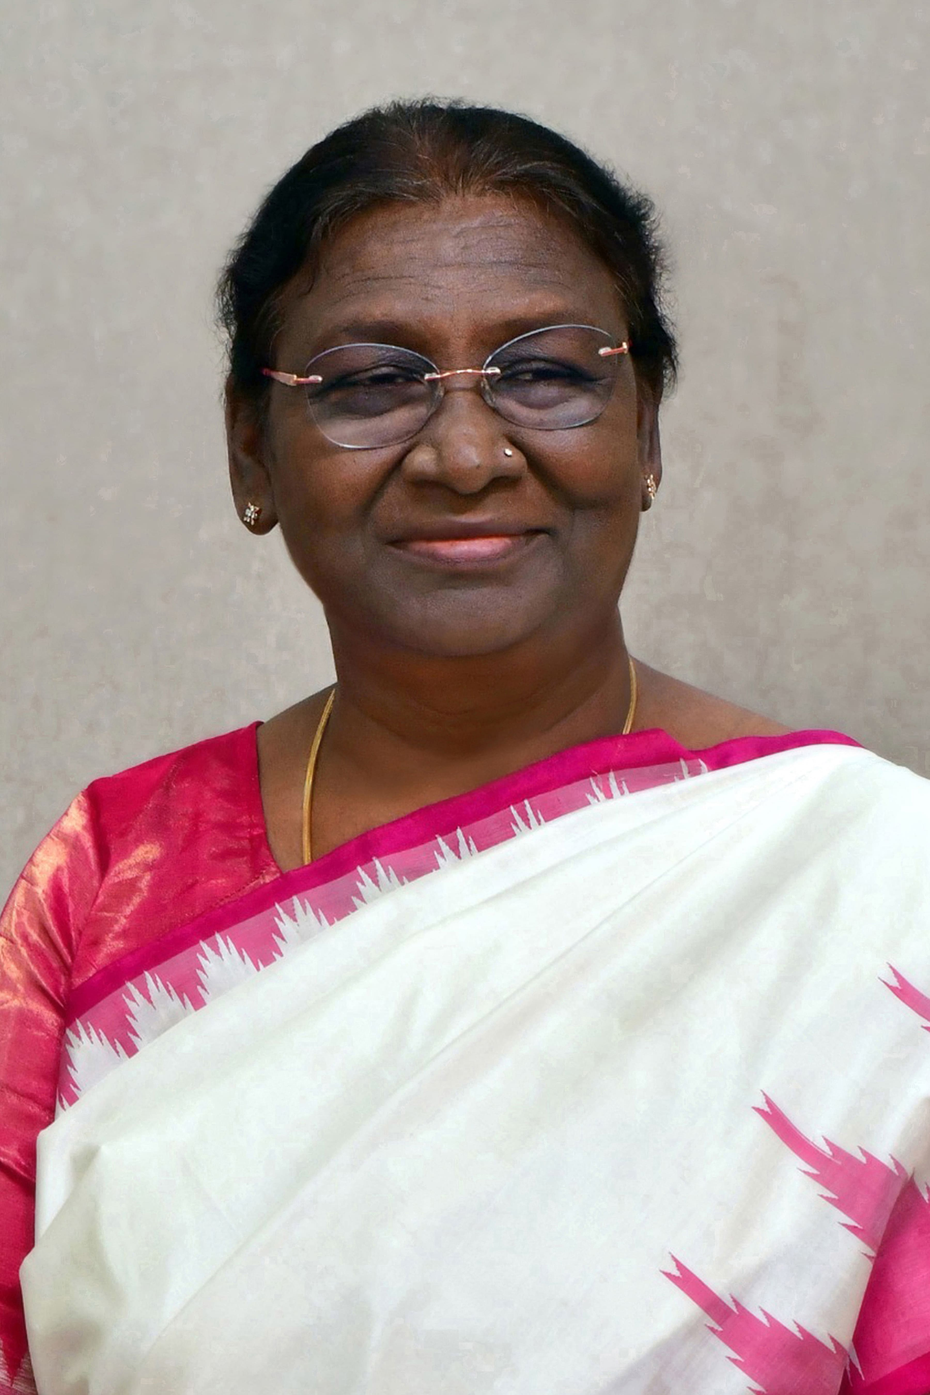
Government Structure
Indian Constitution
President
Shri Ram Nath Kovind Smt. Droupadi Murmu
(2017-2022) (2022--)
Lawyer and MP Teacher/Politician

Slide 4
Bicameral Parliament
Rajya Sabha
Lok Sabha
245 members
233 elected by state parliaments/union territories
12 appointed by President
545 members (originally)
543 elected in SMD
2 appointed (until 2020)
84 seats reserved for scheduled castes
47 reserved for scheduled tribes
Magic number 272

Slide 6
Parliamentary Process for PM
PM and House
serve full term
Party
wins
majority House PM dies or
General elects resigns
election PM
of Lower
House
No party wins No Confidence fails majority motion
passes
Parties negotiate PM dissolves
to form coalition House
(50% of seats, plus one)

Slide 7
The Process (in theory)
PM and House
serve full term
Party
wins
majority House PM dies or
General elects resigns
election PM
of Lower
House

Slide 8
Coalition Formation and Choosing PM
PM and House
serve full term
Party
wins
majority House PM dies or
General elects resigns
election PM
of Lower
House
No party wins majority
Parties negotiate
to form coalition (50% of seats, plus one)

Slide 9
No Confidence Motion
PM and House
serve full term
Party
wins
majority House PM dies or
General elects resigns
election PM
of Lower
House
No party wins No Confidence fails majority motion
passes
Parties negotiate
to form coalition (50% of seats, plus one)

Slide 10
PM Dissolves Lower House
PM and House
serve full term
Party
wins
majority House PM dies or
General elects resigns
election PM
of Lower
House
No party wins No Confidence fails majority motion
passes
Parties negotiate PM dissolves
to form coalition House
(50% of seats, plus one)

Slide 11
1996 Election
Bharatiya Janata Party (BJP) 160
Congress Party 136
National Front 110
National Front forms government

Slide 12
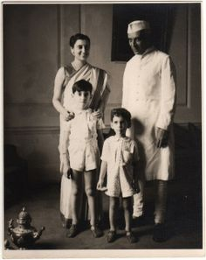
Prime Minister
Narendra Modi
2014—
Left to right: Indira Gandhi (PM 1966-1977, 1980-1984; Jawaharlal Nehru (PM 1947-1964); Rajiv Gandhi (PM 1984-1989); Sanjay Gandhi (MP 1980)

Slide 13
Council of Ministers (Cabinet)

Slide 14
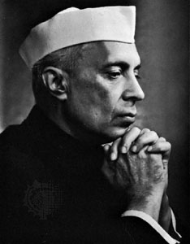
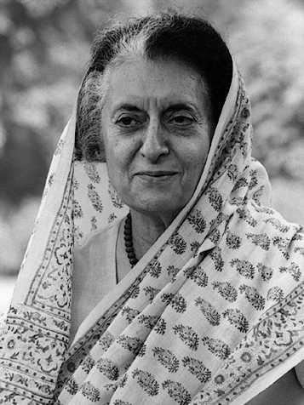
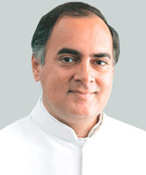
Nehru Dynasty
Jawaharlal Nehru Indira Gandhi Rajiv Gandhi
1947-1964 1966-1977 1984-1989
1980-1984

Slide 15
Congress Party INC

Slide 16
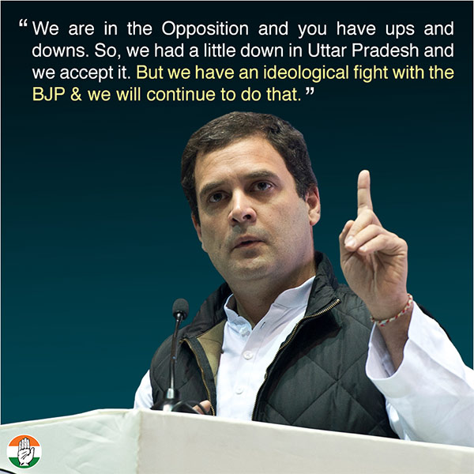
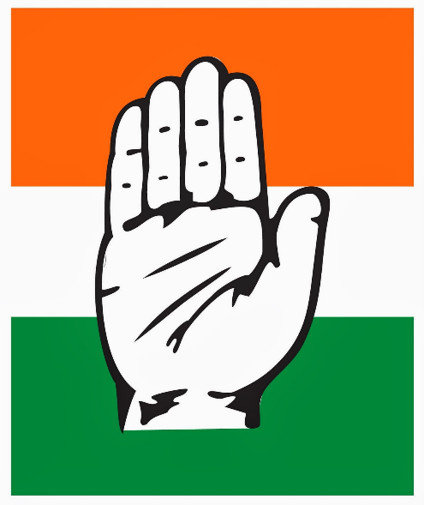
Congress’ Ideology
Secularism
Socialist economics 1947-1991
Economic Reform
1991-present

Slide 17
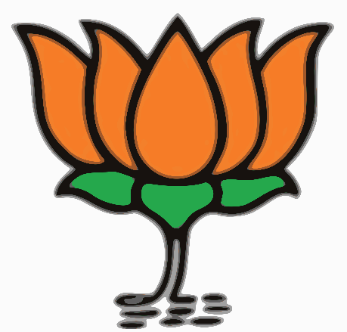
Bharatiya Janata Party (BJP)
1984 | 2
1989 | 88
1991 | 120
1996 | 160
1998 | 176
1999 | 182

Slide 18
BJP Ideology
Hindutva (Hindu Nationalism)
RSS (Rashtriya Swayamsevak Sangh; National Volunteer Organization)
Sangh Parivar (umbrella organization for RSS and allies)
Vishwa Hindu Parishad (VHP)

Slide 19
Others
Leftist parties
AITC (All India Trinamool Congress (West Bengal, Manipur, Tripura and Arunachal Pradesh)
Communist Party of India (Marxist)
Regional parties
AIADMK (All India Anna Dravida Munnetra Kazhigam) Tamil Nadu state
Telugu Desam Party (Andrha Pradesh)
Samajwadi Party (Uttar Pradesh)
Caste-based Parties
Bahujan Samaj Party

