Slide 1
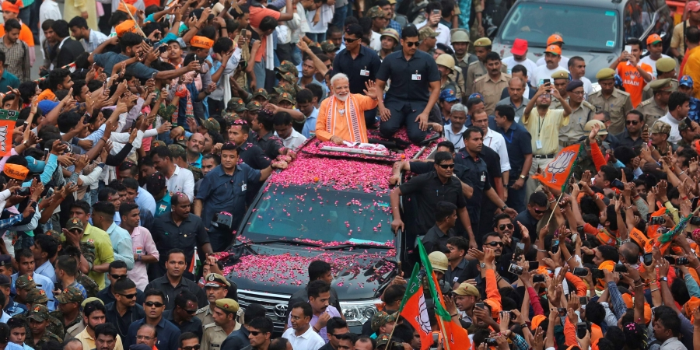
3. BJP Dominance 2014 to Present

Slide 2
Indian Election Data (Lok Sabha)
Election Year | Seats for Congress | Seats for Second Largest Party
1952 | 364 (45%) | 16
1957 | 371 (47.8%) | 27
1962 | 361 (44.7%) | 29
1967 | 283 (40.8%) | 44
1971 | 352 (43.7%) | 44
1977 (lost power) | 154 (34.5% | 295 (Bharatiya Lok Dal alliance)
1980 | 353 (42.7%) | 41
1984 | 415 (48.1%) | 30

Slide 3
Indian Election Data (Lok Sabha)
Election Year | Seats for Congress | Seats for BJP
1984 | 415 (48.1%) | 2 (7.4%)
1989 (lost power) | 197 (39.5% | 89 (11.4%)
1991 (formed coalition) | 226 (36.4%) | 120 (20.1%)
1996 | 136 (28.8%) | 161 (20.3%)
1998 | 141 (25.8%) | 176 (25.6%)
1999 | 112 (28.3%) | 182 (23.8%)
2004 | 145 (26.5%) | 138 (22.2%)
2009 | 206 (28.6%) | 116 (18.8%)
2014 | 44 (19.5%) | 276 (31.3%)
2019 | 52 (19.7%) | 303 (37.7%)

Slide 4
2014 Election
Party | Seats
BJP | 276
Congress | 44
AIADMK (Tamil Nadu) | 37
AITC (West Bengal) | 34
BJD (Odisha) | 20
SHS (Maharashtra) | 16
TDP (Andhra Pradesh, Telangana)) | 16
TRS (Telangana) | 11
CPM | 9
YRSP (Andhra Pradesh, Telangana) | 9

Slide 5
LS Elections 1952-2019

Slide 6
BJP Changes I
BJP moves to Populist Nationalism
Us vs. Them
Elites (Congress Party)
Muslims (Terrorists/Pakistan)
Non-Hindus who would attack “our” culture
Treasonous Hindus who would help “them”
The history of “victimization”
That centuries-old assault on Hinduism ends now
BJP represents “real Indians”

Slide 7
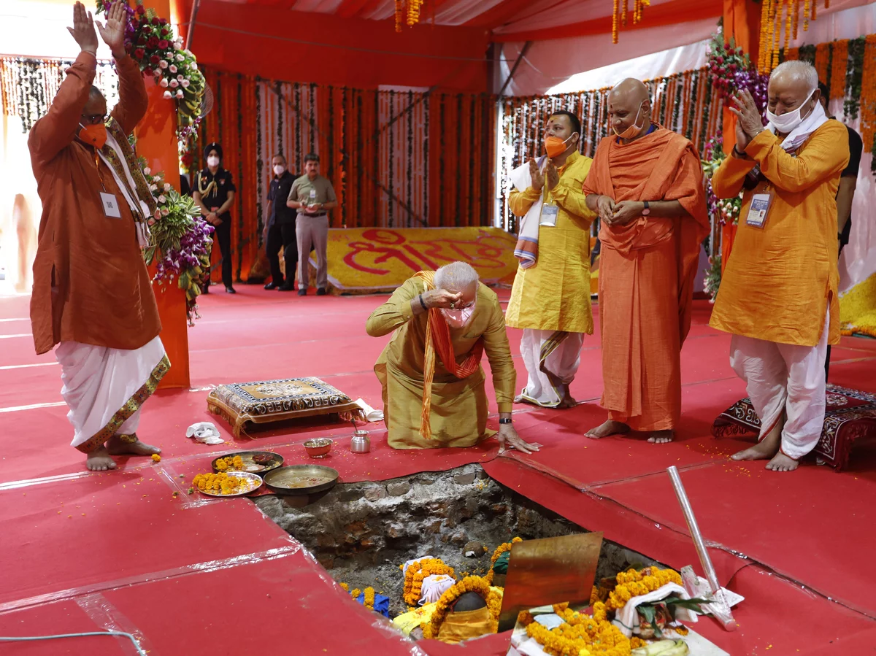
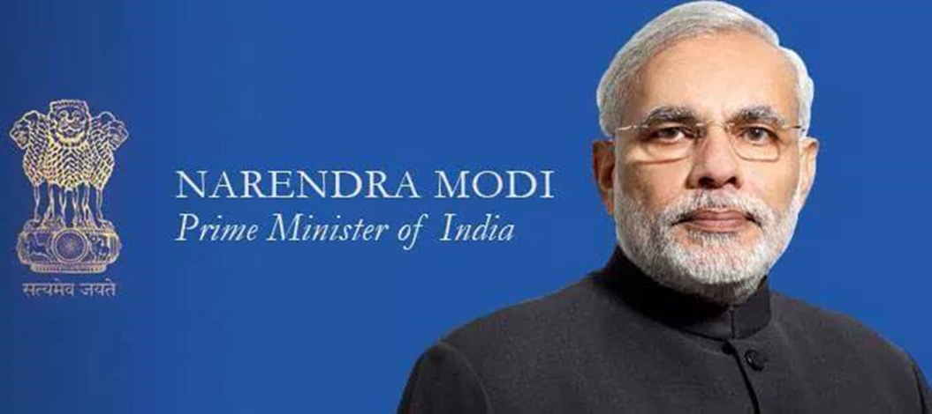
BJP Changes II
Narendra Modi
Cult of personality
“Moditva”
August 2020
Foundation of Ayodhya temple

Slide 8
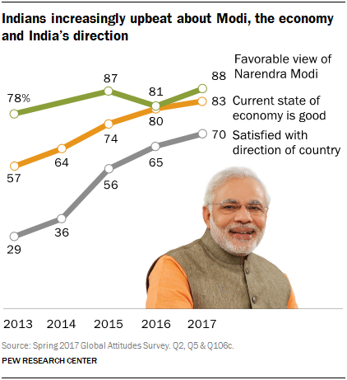
SUCCESS 2014 and 2019
BJP doubles support among poor
BJP doubles support among lower castes
State-level dominance too

Slide 9
Policies
Modi is the kindly Uncle or Grandfather
Critics:
State-level politicians implementing Hindutva
Rewriting school textbooks, inserting Hindu culture into curriculum
Pressuring universities to promote Hinduism and the “correct” version of social science and natural science
Ignoring (encouraging) vigilante violence against the “enemies of Hinduism”

Slide 10
2019 Election
Party | Seats
BJP | 303
Congress | 52
DMK (Tamil Nadu) | 23
AITC (West Bengal) | 22
YSR Congress (Andhra Pradesh) | 22
Shiv Sena (Maharashtra) | 18
Janata Dal (U) (Left-wing) | 16
BJD (Odisha) | 12
BSP (Uttar Pradesh) | 10

Slide 11
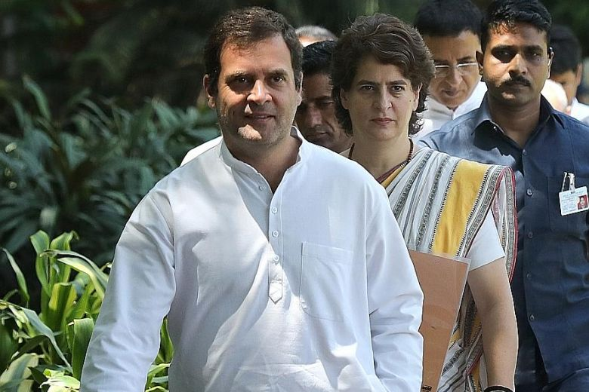
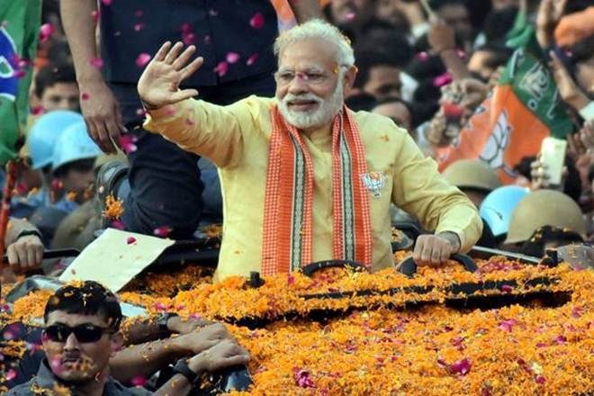
2019 Election
BJP’s Modi Victorious
Congress
INC Rahul Gandhi Resigns (July 2019) (refused by Party)

Slide 12
More Assertive BJP (and response)
Jammu and Kashmir Status August 2019
Citizenship Amendment Act December 2019
National Registry of Citizens November 2019

Slide 13
1. Jammu and Kashmir Status

Slide 14
2. Citizenship Amendment Act December 2019
Must live or work for federal government for 11 years before application for citizenship
Exception:
Refugees from Pakistan, Bangladesh, Afghanistan can apply after 6 years if…
Hindu, Sikh, Buddhist, Jain, Parsi or Christian

Slide 15
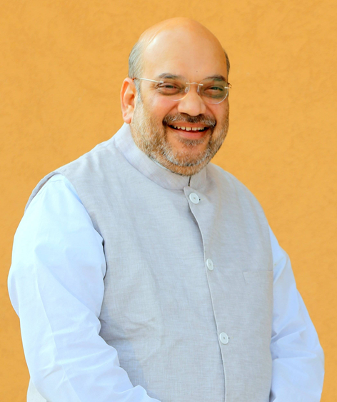
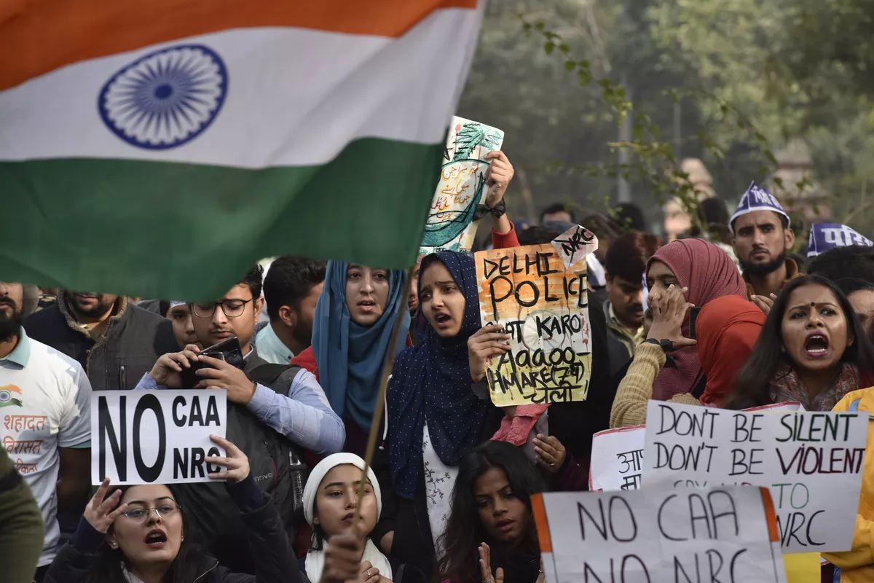
3. National Registry of Citizens November 2019
Home Minister Amit Shah

Slide 16
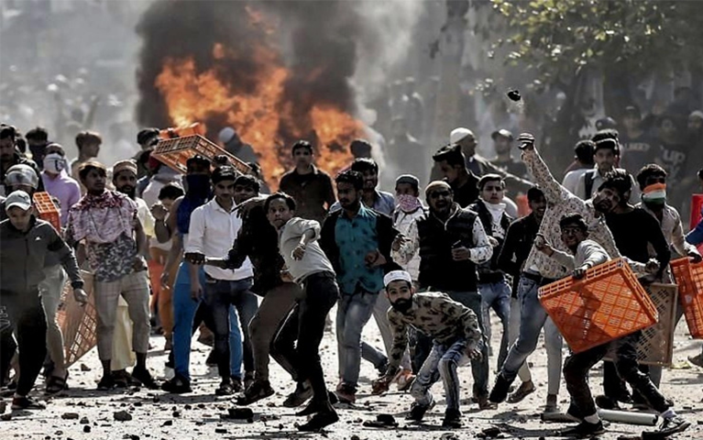
Protests and Violence

Slide 17
Delhi Violence 2020

Slide 18
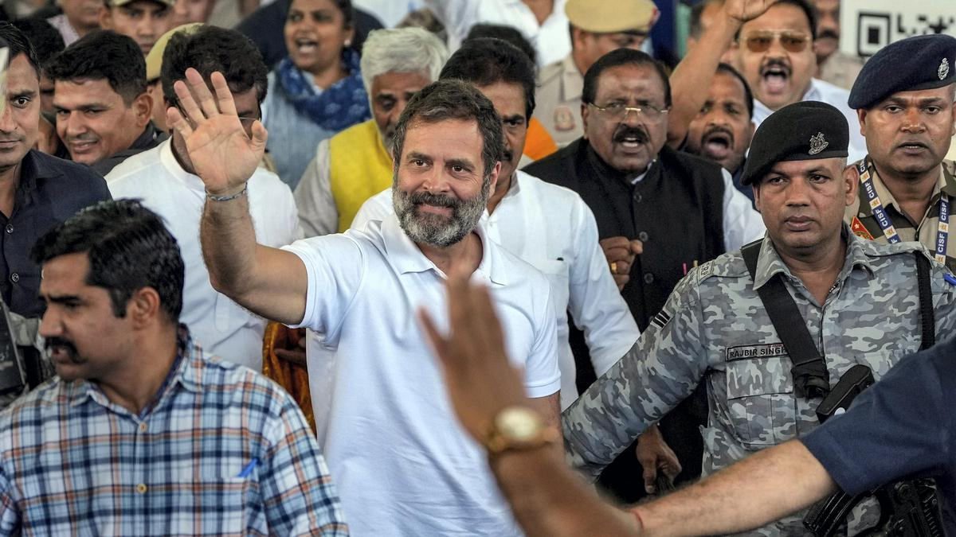
March 23, 2023
Gandhi given two sentence for criminal defamation in Surat, Gujarat

Slide 19
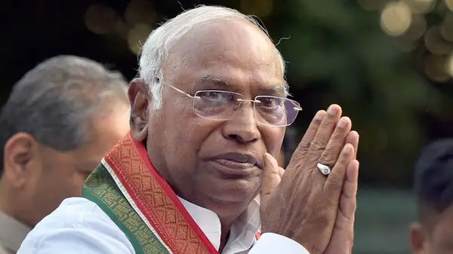
The Challenges
Hindu Nationalism vs. Secular India
Is “Ethnic Democracy” Democracy?
Congress Party Leadership?
New INC leader
Mallikarjun Kharge
(2022)

