Slide 1
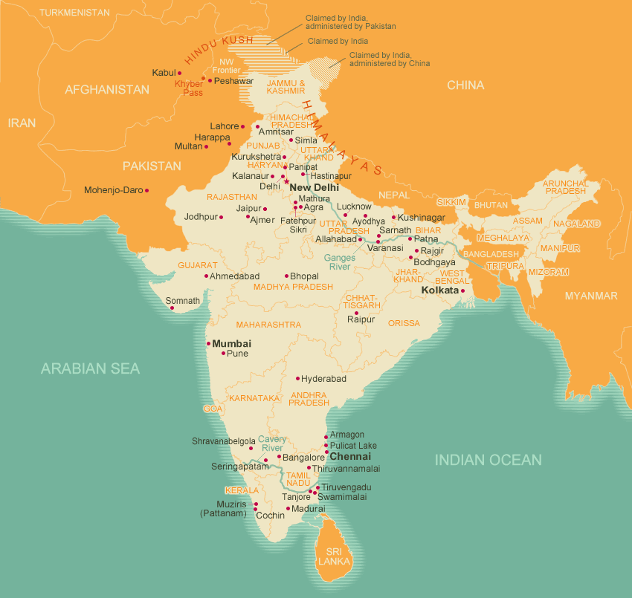
India

Slide 2
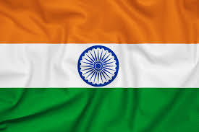

Slide 3
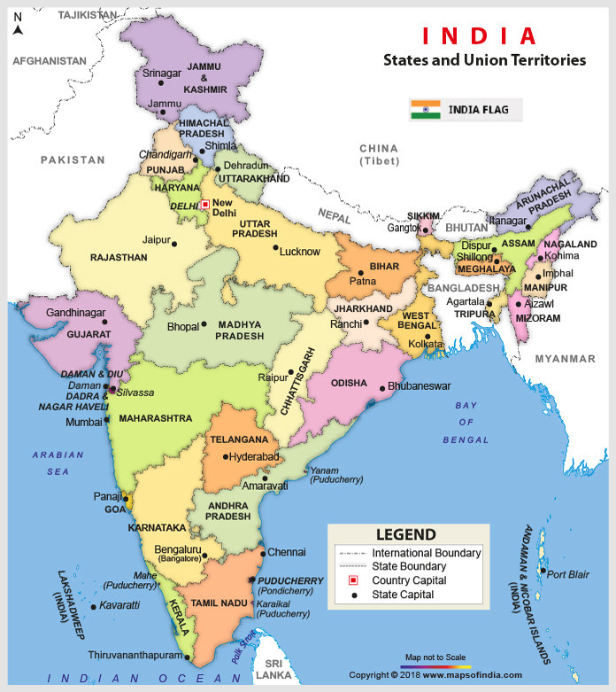

Slide 4
Basics
Over 1.32 Billion people (2020)
Opening to the world economically since 1991
Importance of the US-Indian-Chinese relationship in the future

Slide 5
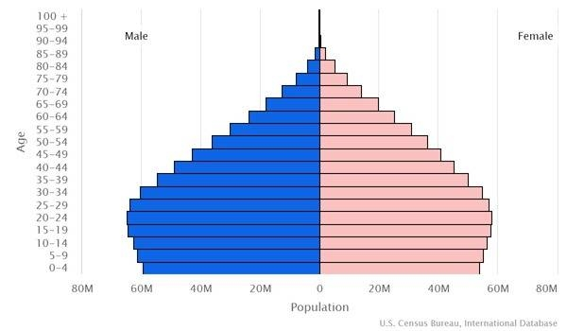
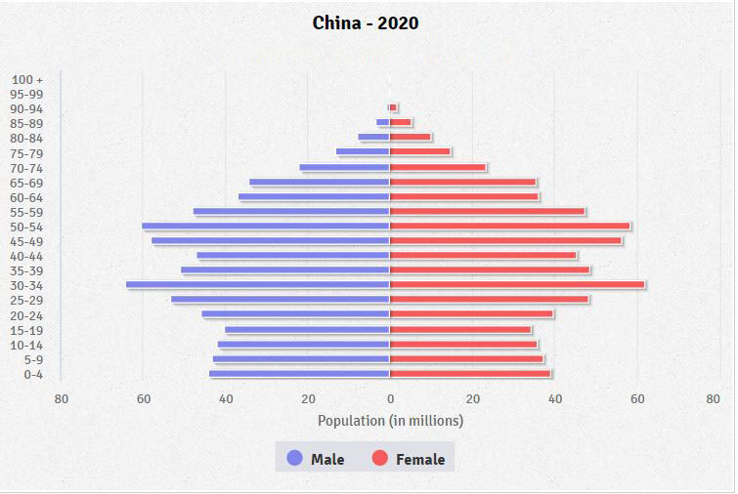
Young Nation Data from 2020 (CIA World Factbook)
India China

Slide 6
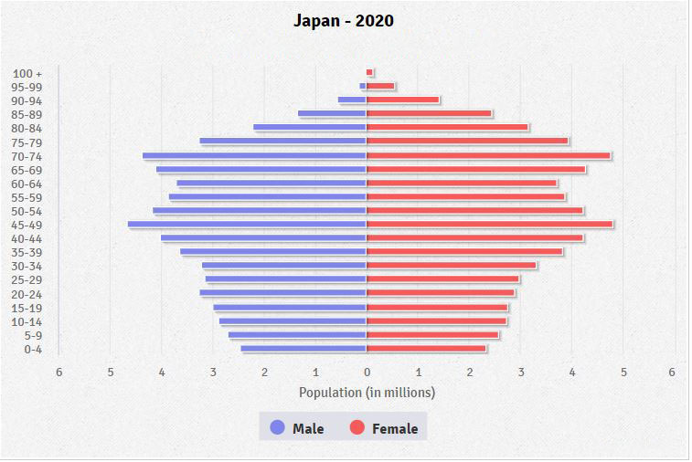
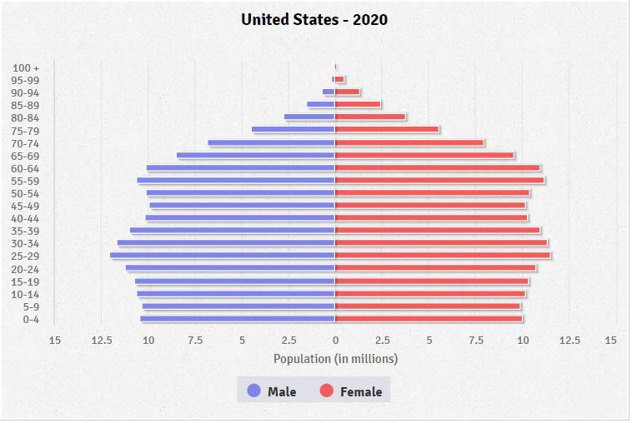
Compared to…
Japan US

Slide 7
Paradoxes
Democracy and Inequality
Indian Economic Model
Wealth and Poverty
Diversity
National vs Regional
Religion, Democracy, Ideology
Separation of Church and State

Slide 8
Paradox One: Democracy and Inequality
Largest democracy in the World
2004: 675 million eligible voters
2019: 910 million eligible voters
But…
Economic inequality
Social inequality (due to lingering Hindu caste system)

Slide 9
Paradox Two: Indian Economic Model
East Asian Model: Authoritarian and capitalist
India: Democratic with a socialist economy (until 1991 when economic reforms began)

Slide 10
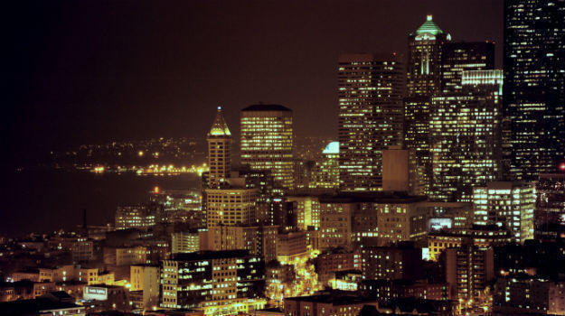
Paradox Three: Wealth and Poverty
Bangaluru (was Bangalore)
India’s Silicon Valley Slums of any city

Slide 11
Mumbai

Slide 12
Paradox Four: Diversity
80% Hindu, but…
Over 180 million Muslims
third largest Muslim population in the world
Ethnicity
Indo-Aryan: 72%
Dravidian 25%
23 Official languages now

Slide 13
Paradox Five: National vs. Regional?
Two major national parties:
Congress Party
BJP
2019 election (17th Lok Sabha)
34 regional parties in Parliament
Lok Sabha Party-wise

Slide 14
Paradox Six: Religion, Democracy, Ideology
Religion: 80% Hindu
But… a national ideology of separation of church and state…
But “Hindu Nationalism”
Hindutva

Slide 15
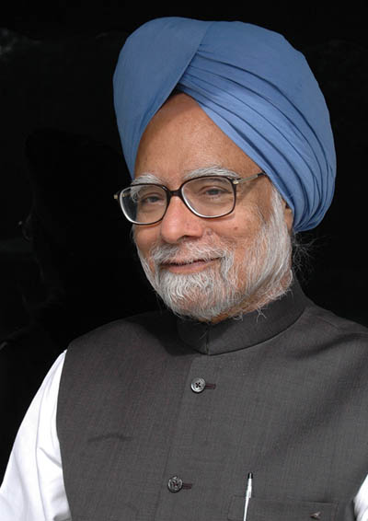
Prime Minister 2004-2014
Manmohan Singh
The first Sikh PM
From Congress Party

Slide 16
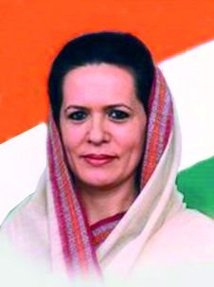
Leader of Congress Party Late 1990s-Early 2000s
Sonja Gandhi
Roman Catholic
Born in Lusiana, Italy
Before marriage
Sonia Maino

Slide 17
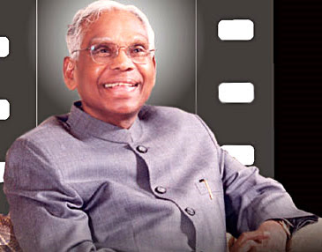
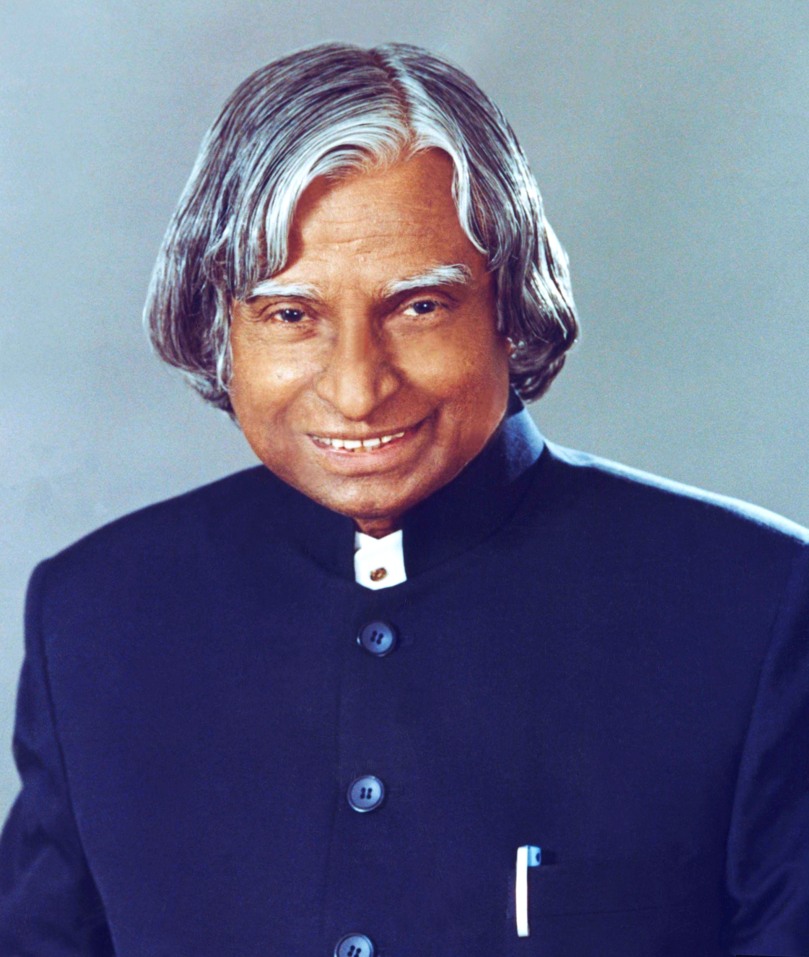
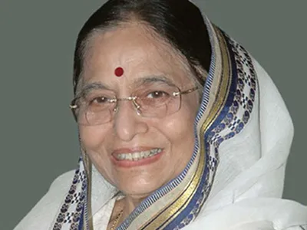
Three Presidents of India
K. R. Narayanan A. P. J. Abdul Kalam Pratibha Devisingh Patil
First Dalit Pres. First Muslim Pres. First Woman Pres.
1997-2002 2002-2007 2007-2012
Diplomat Scientist/Defense MP

Slide 18
Citizenship Amendment Act December 2019
Must live or work federal government for 11 years before application for citizenship
Exception:
Refugees from Pakistan, Bangladesh, Afghanistan can apply after 6 years if…
Hindu, Sikh, Buddhist, Jain, Parsi or Christian

Slide 19
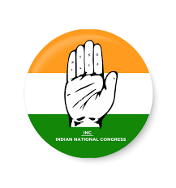
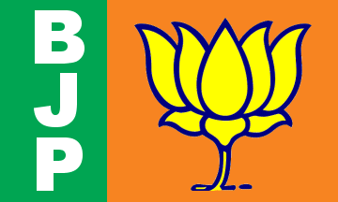
Secular India vs. Hindu India?
Congress vs. BJP

