Slide 1
Public Policy
Federalism
Social Policy
Economic Policy

Slide 2
Federalism
State Government
State Legislature
Legislative Assembly
Legislative Council
Governor
Chief Minister
Village Panchayats (Part IX of Constitution)

Slide 3
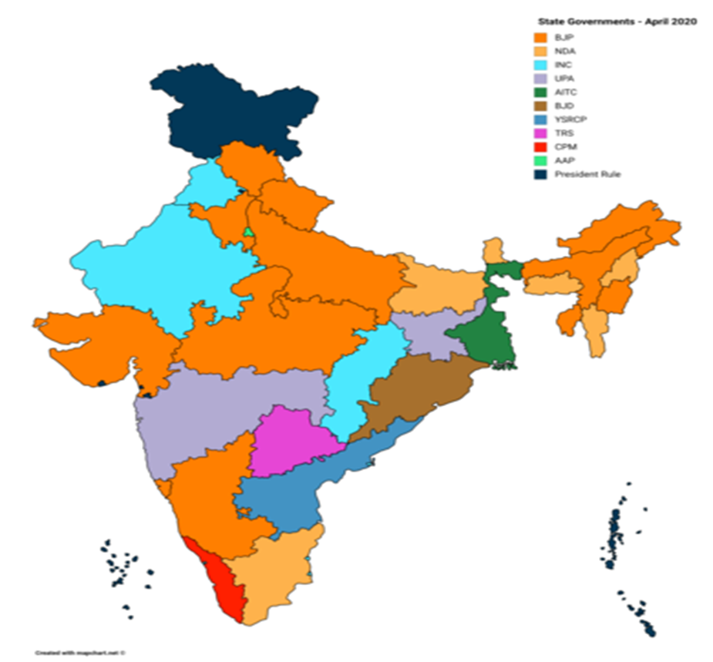
State Legislature Control 2020
BJP – 12
BJP/NDA – 6
INC – 4
INC/UPA 2
AAP, AITC, BJD,
CPI(M), TRS,
YSRCP – 1 each
President rule -- 1

Slide 4
Social Policy
Affirmative Action
Reserved seats in elected parliaments
National Commission for Scheduled Castes
National Commission for Scheduled Tribes
Government Positions

Slide 5
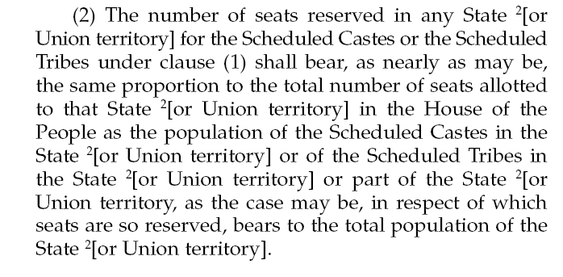
Reserved Seats in Parliament (Art. 330)

Slide 6
Socialist Economic Policy
Nationalization
National Planning Commission – 1950
Five Year Plans
“Hindu Rate of Growth” -- 3.2%
“License Raj”
Raj means “rule”, initially a term for British Colonial rule

Slide 7
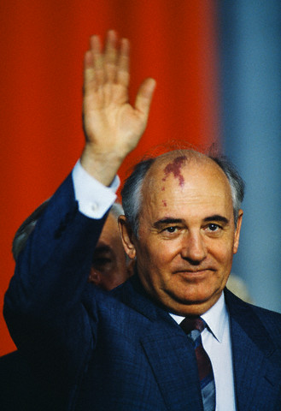
1990s Economic Crisis

Slide 8
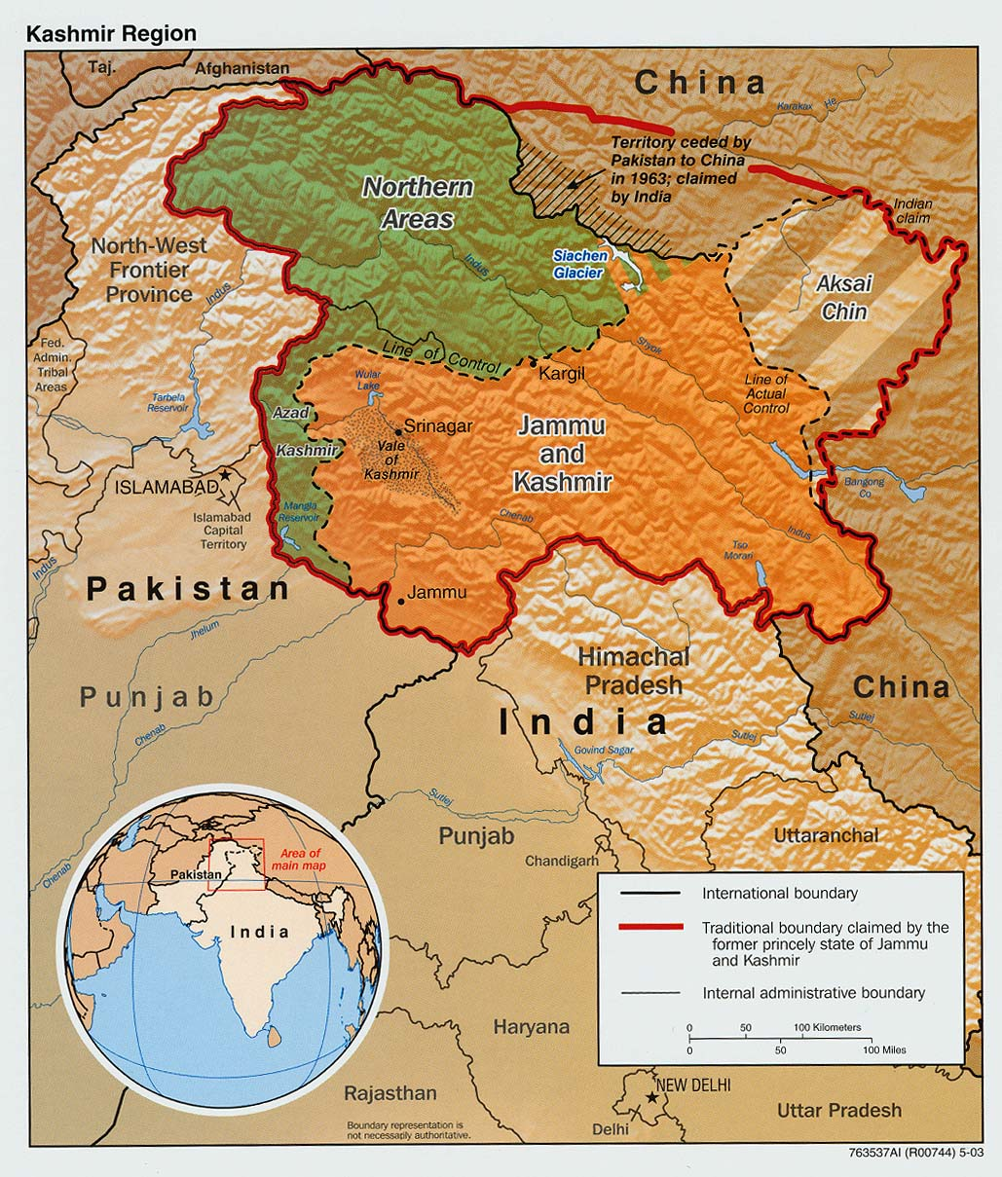
Political-Military Crisis

Slide 9
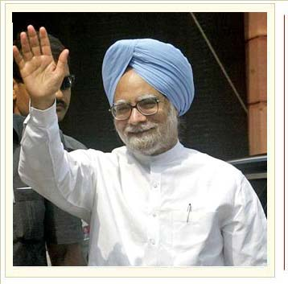
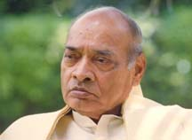
Reforms Begin: Congress Party
Nehru Dynasty over
1991 Reforms
PM P.V. Narasimha Rao, 1991-96
Finance Minister Manmohan Singh

Slide 10
The Reforms
Open up economy to foreign investment
Privatization
Ending government control of economy
Reduce government regulation
Export Processing Zones

Slide 11
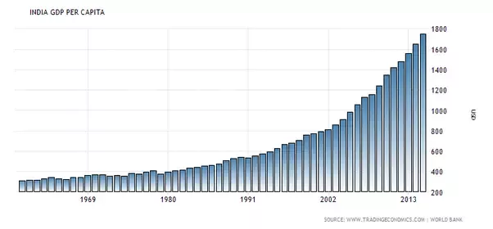
Economic Results

Slide 12
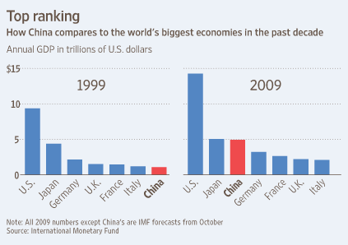
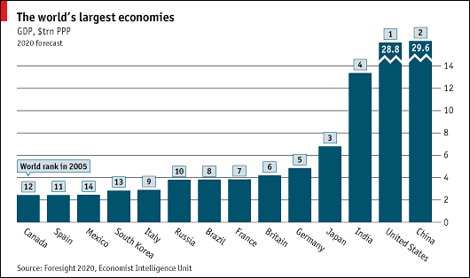

Slide 13
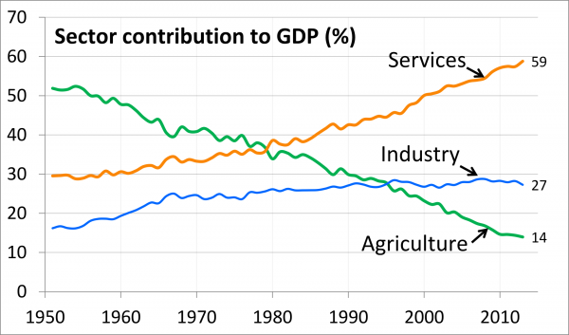
Indian Growth by Sector

Slide 14
Political Results
1996 Election
Party | 1991 Seats | 1996 Seats
Congress | 225 | 136
BJP | 119 | 160

Slide 15
BJP Constituency
Elites who benefit from government policy
Government employees
Business protected by the government
Poor who live off government assistance
Anti-affirmative action groups
Hindu nationalists

Slide 16
Economic Reform
BJP vs. Congress
Pace
Depth
Openness

