Slide 1
Current Politics
Congress years 1947-1996
Years of Competition 1996-2014
Two Party System?
Two Half Parties?
Regional parties, Religious Parties, Caste Parties
3. BJP Dominance 2014-Present

Slide 2
1. Congress Years 1947-1996 Nehru Dynasty
Jawaharlal Nehru Indira Gandhi
PM 1947-64 PM 1966-77, 80-84

Slide 3
Congress Dominates
Election Year | Seats for Congress | Seats for Second Largest Party
1952 | 364 | 16
1957 | 371 | 27
1962 | 361 | 29
1967 | 283 | 44
1971 | 352 | 44
1977 (lost power) | 154 | 298 (Janata Party alliance)
1980 | 353 | 41
1984 | 415 | 30

Slide 4
LS Results 1952-1984

Slide 5
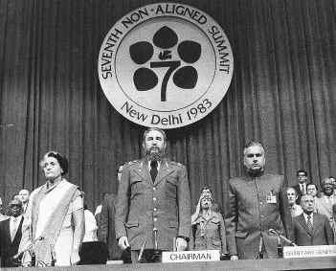
Indira Gandhi PM 1966-1977, 1980-84

Slide 6
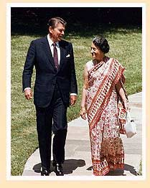
Congress (I)

Slide 7
June 26, 1975—1/18, 1977

Slide 8
Congress After the Emergency
Election Year | Seats for Congress | Seats for Second Largest Party
1952 | 364 | 16
1957 | 371 | 27
1962 | 361 | 29
1967 | 283 | 44
1971 | 352 | 44
1977 (lost power) | 154 | 298 (Janata Party alliance)
1980 | 353 | 41
1984 | 415 | 30

Slide 9
Divided Punjab

Slide 10
1984 Golden Temple of Amritsar

Slide 11
October 31, 1984

Slide 12
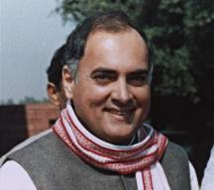
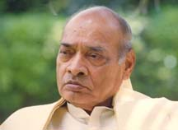
Congress after Indira Gandhi
1984-1989 1991-1996
Rajiv Gandhi P. V. N. Rao

Slide 13
2. Years of Competition 1996-2014
Factors
End of Nehru Dynasty
Economic reform
Corruption in Congress
Rise of regional, religious, caste-based parties
Hindu Nationalism

Slide 14
BJP Constituency
Elites who benefit from government policy
Government employees
Business protected by the government
Poor who live off government assistance
Anti-affirmative action groups
Hindu nationalists

Slide 15
BJP Results
Election | BJP | Congress
1971 | 0 | 372
1977 | 0 | 164
1980 | 13 | 377
1984 | 2 | 426
1989 | 89 | 195
1991 | 120 | 252
1996 | 160 | 136
1998 | 176 | 140
1999 | 182 | 112

Slide 16
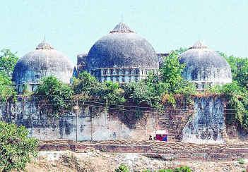
Rise of Hindu Nationalism
Ayodhya, Uttar Pradesh
Babri Mosque 16th Century
Ayodhya Temple

Slide 17
Babri Mosque, December 6, 1992

Slide 18
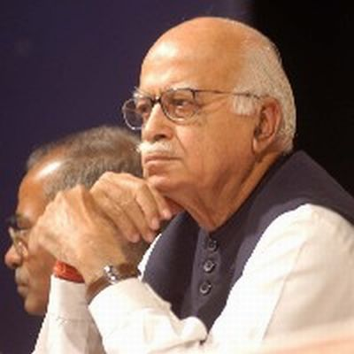
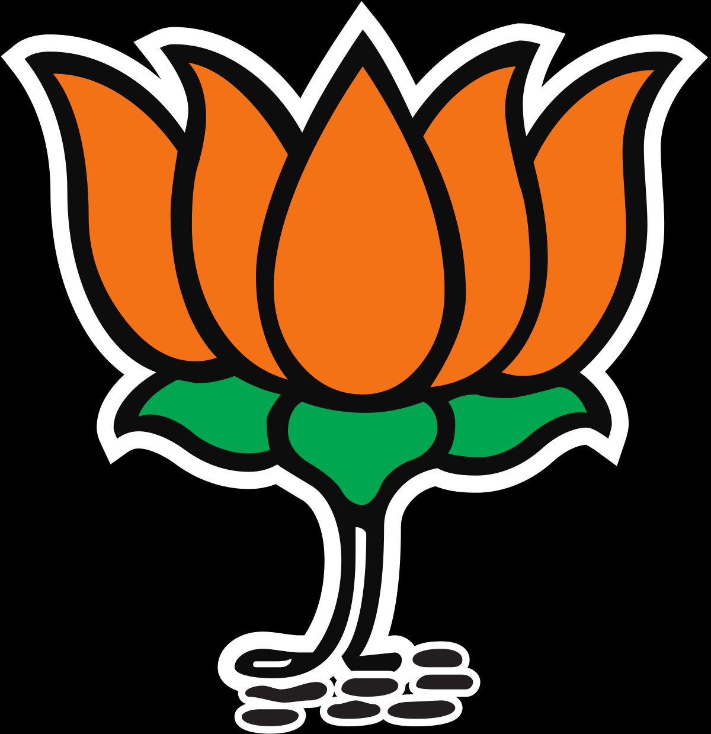
Fallout of Destruction of Babri Mosque
1992-1993 Riots
Liberhan Commission Report
L. K. Advani
President BJP

Slide 19
Beginning of Competition
Election Year | Seats for Congress | Seats for Second Largest Party or Largest after 1996
1984 | 415 | 30
1989 (lost power) | 197 | 143
1991 (formed coalition) | 226 | 120
1996 | 136 | 160
1998 | 140 | 176
1999 | 112 | 182
2004 | 145 | 138
2009 | 206 | 116

Slide 20
LS 1952-2009

Slide 21
1996 Election
Bharatiya Janata Party (BJP) 160
Congress Party 136
National Front 110
National Front forms government

Slide 22
1998 Election
BJP 176
Congress Party 140
United Front 97

Slide 23
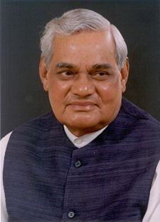
1998
BJP forms government
National Democratic Alliance (15 parties)
PM A. B. Vajpayee 1998-2004
Indian nuclear tests
May 1998

Slide 24
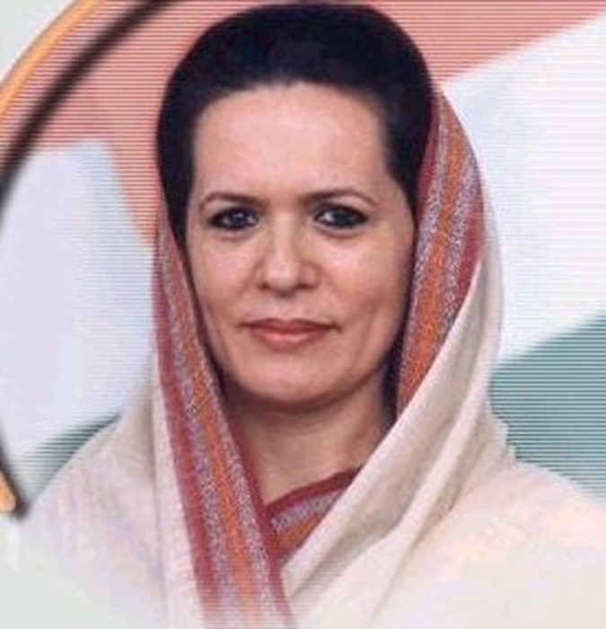
1999 Election
BJP 182
Congress Party 112
BJP keeps power
1999-2004
Sonia Gandhi agrees to
lead Congress in opposition

Slide 25
The New Era?
Two Party System?
Two Half Party System
Importance of Regional, Religious, Cast, Leftist Parties
National Democratic Alliance (BJP)
Vs
United Progressive Alliance (Congress)

Slide 26
2004 and 2009 Election
BJP/National Demoratic Alliance (NDA)
vs.
Congress/United Progressive Alliance (UPA)
Congress: “It is a contest between the Congress…and the BJP that is systematically undermining the very essence of Indian civilization and destroying the very idea of India.”

Slide 27
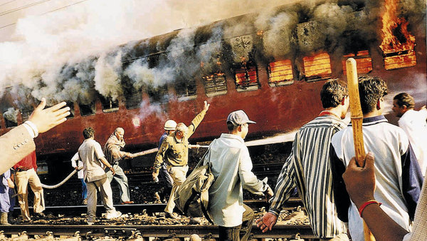
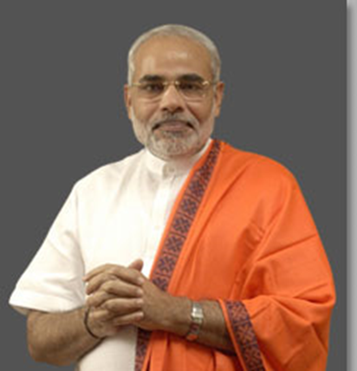
Narendra Modi Chief Minister of Gujarat (2001-2014)
Gujarat 2002
Article on Communal Violence
Human Rights Watch Report on Gujarat Riots

Slide 28
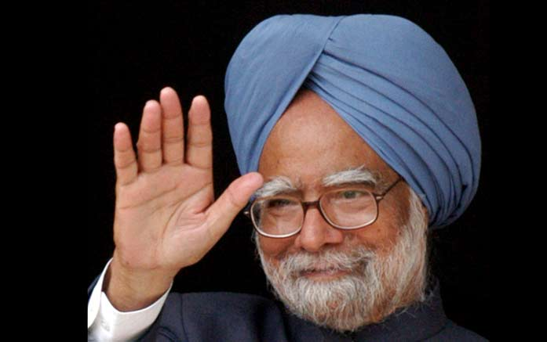
2004 and 2009 Elections
2004 2009
BJP 138 114
Congress Party 145 206
UPA forms coalition
PM Manmohan Singh
2004-2014

