Slide 1
Hezbollah: Support for the Organization, Finances, and Recruiting Methods
Haley Kosztolnik

Slide 2
Funding
- Iran
- Taxing Shi’ite communities
- Charities and Religious Donations

Slide 3
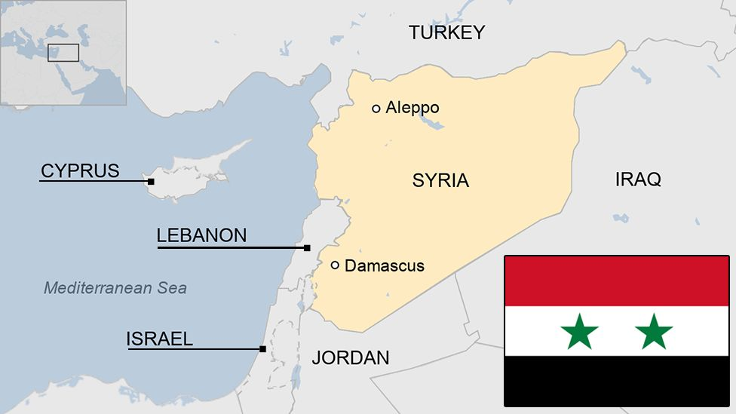
Allies
Iran
Syria

Slide 4
Recruitment
Propaganda
Schools and education efforts
Citizen who feel indebted to the organization

Slide 5
Conclusions
Sustainable and successful
Oversight, funding, and support of Iranian government
Religious funding from Europe
Globalized funding scheme

