Slide 1
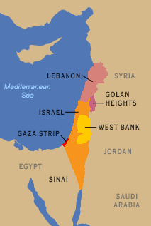
Strategy, Targets, and Method of Operation of Hezbollah

Slide 2
Strategy: Nonviolent
Medical care
Financial aid
Education
Media indoctrination
Notes:
Also: Pictured here is Hassan Nasrallah, Secretary-general of Hezbollah

Slide 3
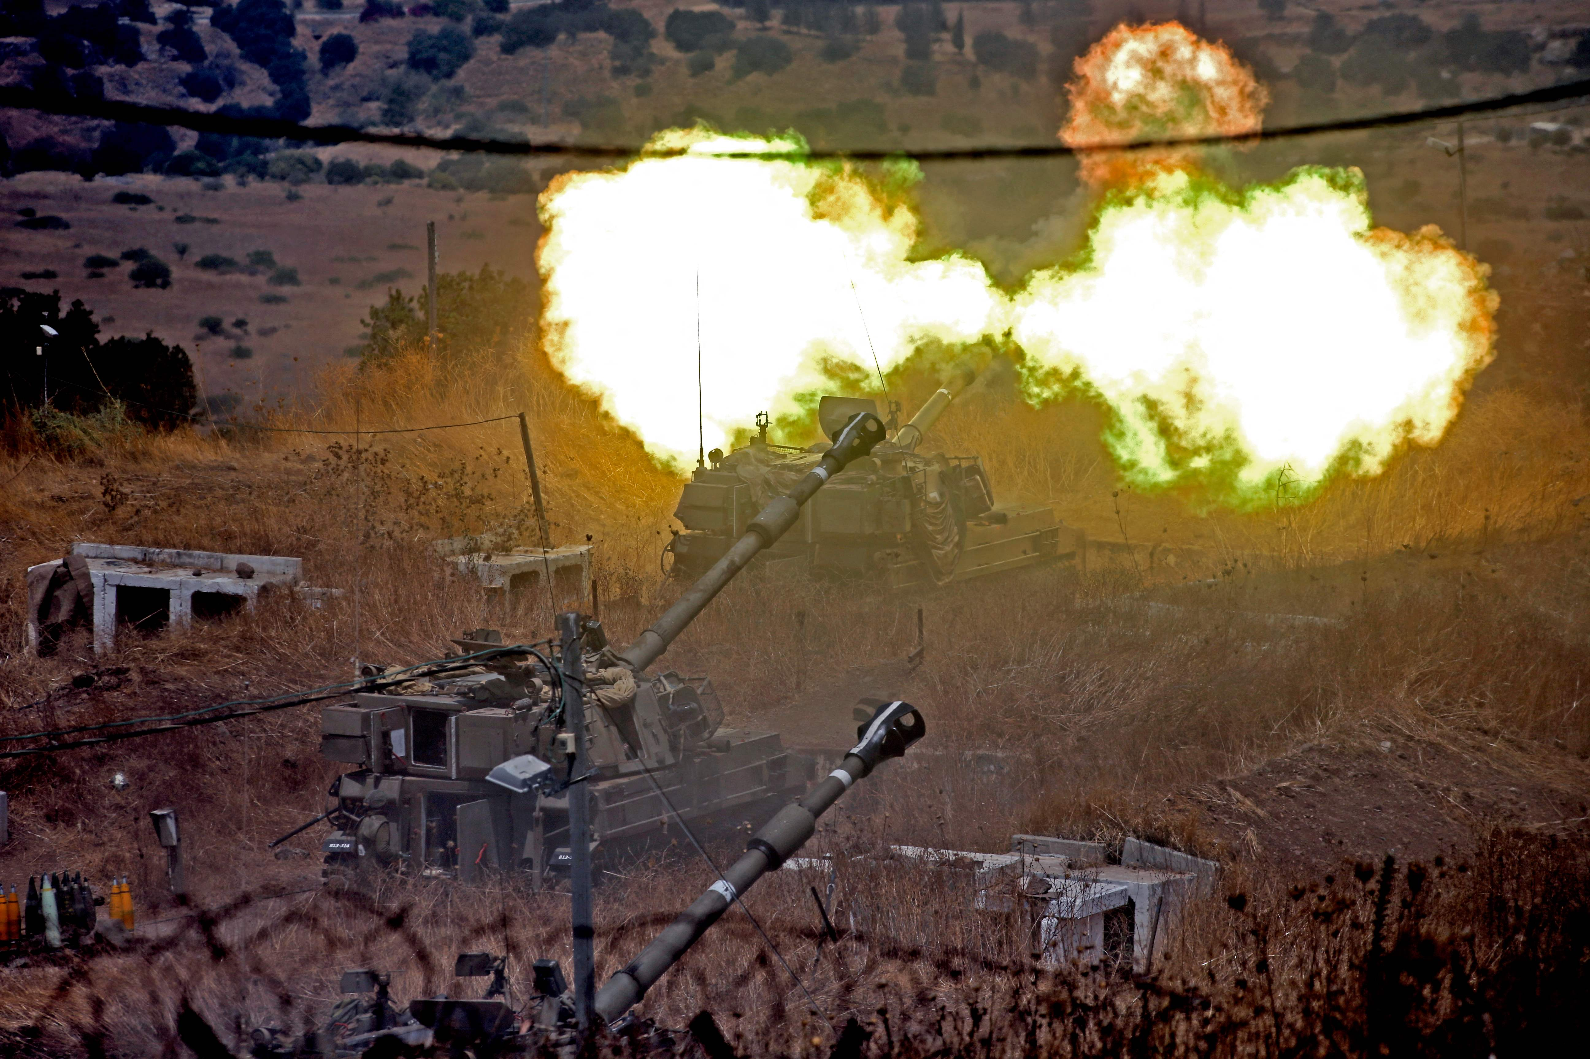
Strategy: Violent
Kidnapping
Bombing
Hijacking
Assassination

Slide 4
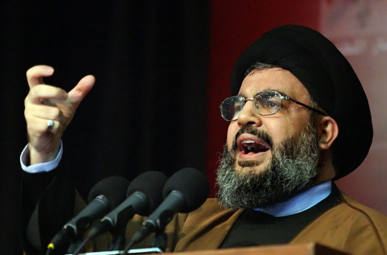
Tactics/Goals
Nonviolent
Violent
New manifesto
Notes:
Again pictured is Hassan Nasrallah, Secretary-general of Hezbollah

Slide 5
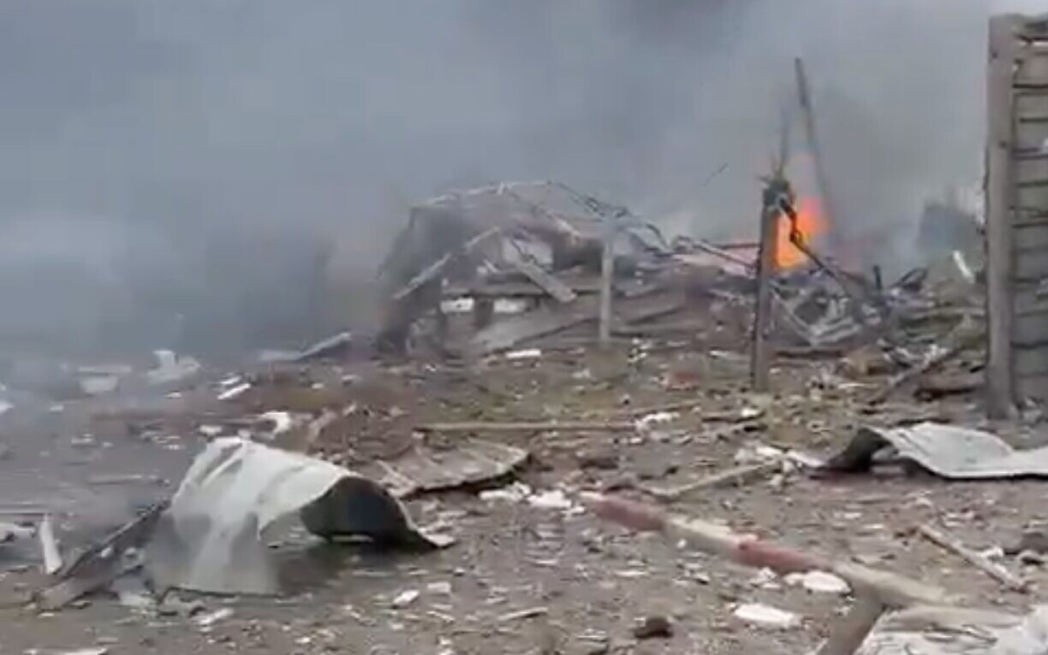
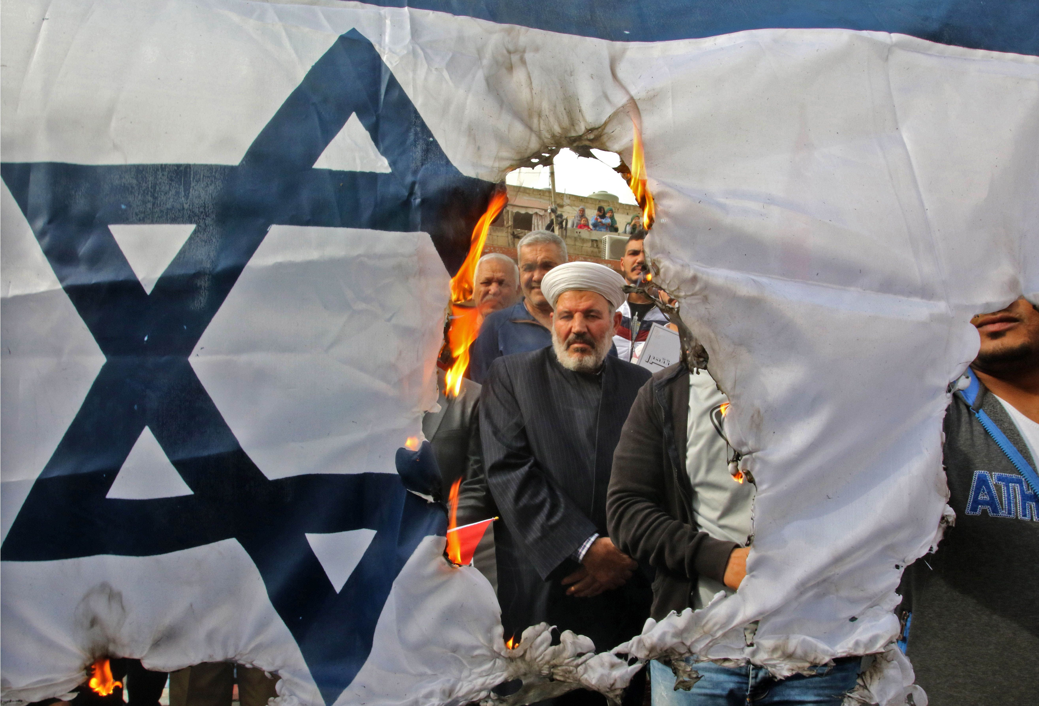
Targets
Israel
International Israeli interests
U.S.
Domestic Lebanon
Notes:
Pictured- protestors burning an Israeli flag, IDF base hit by Hezbollah rocket

