Slide 1


Hezbollah: Non-Violent Political Activities
By: Jake Waldman

Slide 2
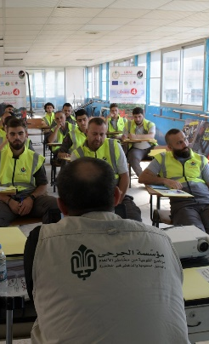
The Hezbollah Social Service Section
The Jihad al-Binna Development Group (JBDG)
The Martyrs Foundation
The Woman’s Association
The Islamic Health Organization (IHO)
The Educational division
Imam al-Mahdi Scouts

Slide 3
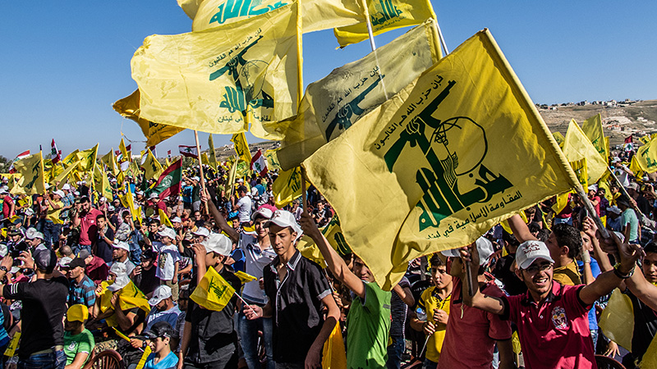
Hezbollah as a Political Party
Participated in lections since 1992
Has increased its parliamentary bloc from 12 to 57 seats from 2000 to 2009.
Corruption among Hezbollah party officials is widespread

Slide 4
Benefits to Hezbollah?
Many of these institutions were created to enable Hezbollah to prosper as an organization and political party
The Imam al-Mahdi Scouts are a tool for indoctrination.
Through these services, Hezbollah has built and maintained its basis for ideological support, expanded its voting bloc, and boosted its influence within the Lebanese government.

